Slide 1

CAP202 OBJECT ORIENTED PROGRAMMING
Unit3

Slide 2


Slide 3


Slide 4

Class
Class is a collection of similar types of objects.
For example: Fruits is class of mango, apple , orange etc.
Fruits

Slide 5
Class
Class is a collection of data members and member functions.
Example:
class Employee{
//data members
// member functions
};
Employee
employeeId employeeName
getDetails() setDetails()

Slide 6
Object
Object is an instance of a Class.
class Employee
{
int employeeId;
char employeeName[20];
public:
void getDetails(){}
void setDetails(){}
};
int main()
{
Employee e1; // e1 is a object
return 0;
}

Slide 7
In this code which option is correct?
class student
{
public:
int regno;
void getStudentDetails();
}
A: regno is data member
B. getStudentDetails() is member function
C. above both options are correct

Slide 8
access specifier
private
public
protected
By default, all members of a class are private if you don't specify an access specifier.

Slide 9
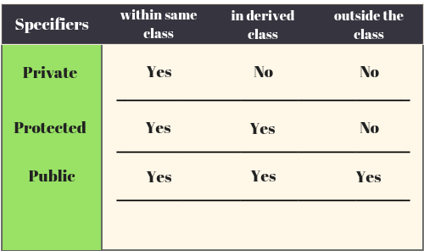

Slide 10
Select correct option
class Employee
{
int employeeId;
char employeeName[20];
public:
void getDetails(){}
void setDetails(){}
};
int main()
{
Employee e1;
e1. employeeId=1234
cout<< e1. employeeId;
return 0;
}
1234
0
Compilation error
Run time error

Slide 11
How to achieve encapsulation features in C++?
Define private data members in a class and
Define public set and get accessors functions which can be used to access these private data members.
Why Encapsulation?
Increased security of data

Slide 12
Select correct option
class Employee
{
private: int employeeId;
char employeeName[20];
public:
void getDetails(){
employeeId=1234
cout<< employeeId;
}
};
int main()
{
Employee e1;
e1. getDetails();
return 0;
}
1234
0
Compilation error
Run time error

Slide 13
Any Query?
Unit-1 End

