Slide 1

CAP202 OBJECT ORIENTED PROGRAMMING
Unit3

Slide 2
Nesting of member functions
A member function can call another member function of the same class directly without using the dot operator. This is called as nesting of member functions.

Slide 3
A program for find out employee name who is getting highest salary in organization.

Slide 4
How to achieve encapsulation features in C++?
Define private data members in a class and
Define public set and get accessors functions which can be used to access these private data members.
Why Encapsulation?
Increased security of data

Slide 5
By using make data member as a private and get and set accessor function as a public.
For example:
student is class
registrationNumber is private data member of this class and
getRegNo() and setRegNo() is accessor function for this class

Slide 6
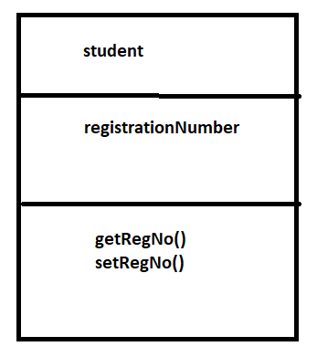
Class Diagram:-

Slide 7
class student
{
private:
int registrationNumber;
public:
void setRegNo(int regno)
{
registrationNumber=regno;
}
int getRegNo()
{
return registrationNumber;
}
};

Slide 9
Select correct option
class Employee
{
private: int employeeId;
char employeeName[20];
public:
void getDetails(){
employeeId=1234
cout<< employeeId;
}
};
int main()
{
Employee e1;
e1. getDetails();
return 0;
}
1234
0
Compilation error
Run time error

Slide 10
Any Query?
Unit-1 End

