Slide 1
HANDLING EXCEPTIONS & MULTITHREADING
Unit-5

Slide 2
Syllabus-unit-5
Handling Exceptions: An overview,
catching and throwing exceptions,
propagation of exceptions,
handling multiple exceptions and errors
Multithreading,
thread communication, suspending, resuming,
deadlock and stopping threads

Slide 3
Exception Handling in Java
Exception
Exception is an abnormal condition.
In java, exception is an event that disrupts the normal flow of the program. It is an object which is thrown at runtime.
Suppose there is 10 statements in your program and there occurs an exception at statement 5, rest of the code will not be executed i.e. statement 6 to 10 will not run. If we perform exception handling, rest of the exception will be executed. That is why we use exception handling.

Slide 4
Exception Handling
Exception Handling is a mechanism to handle runtime errors.
Types of Exception:
There are mainly two types of exceptions: checked and unchecked where error is considered as unchecked exception.
Checked Exception
Unchecked Exception
Error

Slide 5
1)Checked Exception:
.Checked exceptions are checked at compile-time.
e.g. IOException, SQLException, ClassNotFoundException etc
2)Unchecked Exception: Unchecked exceptions are not checked at compile-time rather they are checked at runtime.
e.g. ArithmeticException, NullPointerException, ArrayIndexOutOfBoundsException, NumberFormatException etc.
3)Error
e.g. OutOfMemoryError, VirtualMachineError, AssertionError etc.

Slide 6
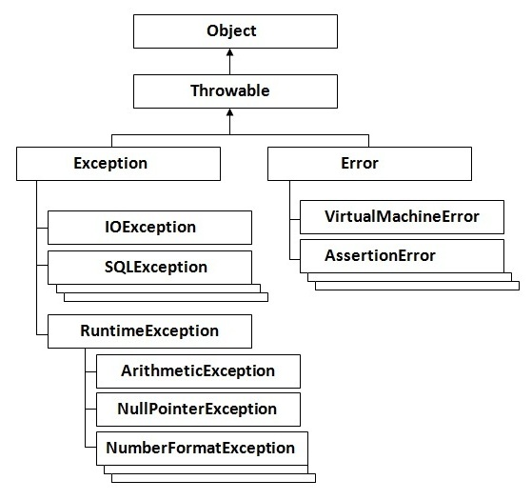
Hierarchy of Exception classes
The Object class is the parent class of all the classes in java by default. In other words, it is the topmost class of java.
Throwable class is the root class of
Java Exception hierarchy

Slide 7
Exception Handling where exceptions may occur
int a=50/0;//ArithmeticException
String s=null; System.out.println(s.length());//NullPointerException
String s="abc";
int i=Integer.parseInt(s);//NumberFormatException
int a[]=new int[5]; a[10]=50; //ArrayIndexOutOfBoundsException

Slide 8
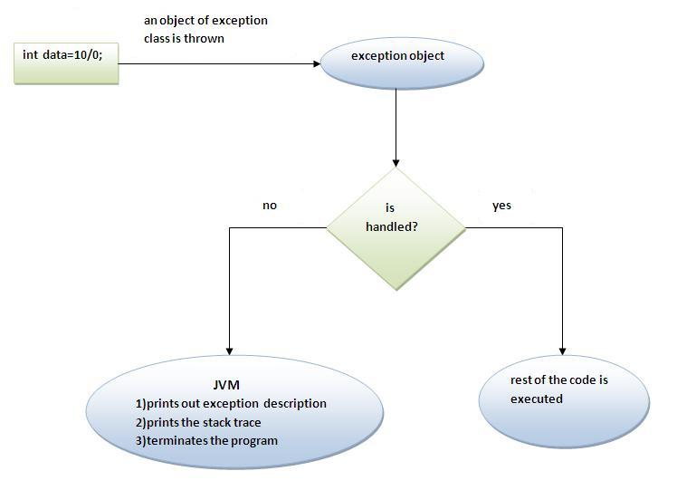
What happens behind the code int a=50/0;

Slide 9
Five keywords used in Exception handling:
try
catch
finally
throw
throws

Slide 10
Multiple catch block:
Rule: At a time only one Exception is occured and at a time only one catch block is executed.
Rule: All catch blocks must be ordered from most specific to most general i.e. catch for ArithmeticException must come before catch for Exception .
Example: tryMultiCatchEx

Slide 11
Nested try syntax:
try {
statement 1;
statement 2;
try {
statement 1;
statement 2;
}
catch(Exception e)
{
}
}
catch(Exception e)
{
} ....
Example: tryNestedTryEx

Slide 12
finally block
The finally block is a block that is always executed. It is mainly used to perform some important tasks such as closing connection, stream etc.
Rule: For each try block there can be zero or more catch blocks, but only one finally block.
Example: finallyBlockEx

Slide 13
Throw/throws keyword
If a method does not handle a checked exception, the method must declare it using the throws keyword. The throws keyword appears at the end of a method's signature.
The throw keyword is used to explictily throw an exception. We can throw either checked or uncheked exception. The throw keyword is mainly used to throw custom exception.
Throw –Example(throwExceptionEx.java)
Throws-Example(throwsExceptionEx.java)

Slide 14
import java.io.*;
public class className
{
public void deposit(double amount) throws IOException
{
// Method implementation
throw new MyException();
}
}

Slide 15
differences
throws Used with method signature while throw used inside method
1) You can declare multiple exception thrown by method in throws keyword by separating them in common e.g. throws IOException, ArrayIndexBoundException etc, while you can only throw one instance of exception using throw keyword e.g. throw new IOException("not able to open connection").
throw keyword can also be used to break a switch statement without using break

Slide 16
int number = 5;
switch(number){
case 1:
throw new RuntimeException("Exception number 1");
case 2:
throw new RuntimeException("Exception number 2");
}

Slide 17
Custom exception
class MyException extends Exception
{
}
Example:-CustomException(invalidInputException.java) and (invalidInputExceptionEx.java)
Exception methods:
printStackTrace():for displaying exception message with details
getMessage(): Only display exception name

Slide 18
Exception Propagation
An exception is first thrown from the top of the stack and if it is not handled, it drops down the call stack to the previous method,If not handled there, the exception again drops down to the previous method, and so on until they are handled or until they reach the very bottom of the call stack.This is called exception propagation.
Example: (exceptionPropagation.java)

