Slide 1
Java
Preparatory Session
Date:17th April 2019

Slide 2
Download:
https://www.oracle.com/technetwork/java/javase/downloads/jdk12-downloads-5295953.html

Slide 3
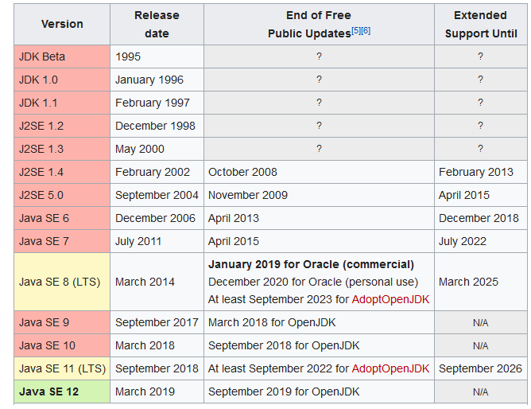

Slide 4
What`s the difference between JSE, JME and JEE? Or,
What`s the difference between J2SE, J2ME and J2EE?

Slide 5
Java Technology Overview
Java is divided into 4 categories:
Core Java or Java SE (J2SE)
Advance Java or Java EE (or J2EE)
Java ME (or J2ME)
Java FX

Slide 6
Java SE or Java Standard Edition
Java SE (core java) is for developing stand alone applications. It is basic. Provides basic java libraries and concepts like OOPS, exception handling, threading mechanism, collections etc. These things will be used even when you are writing a web-application (J2EE)
Java EE or Java Enterprise Edition
Java EE is for developing web based application (client-server). It includes technologies like Servlets, JSP, EJB, JDBC etc.
Java ME or Java Micro Edition
Java ME is used for micro devices and embedded development like mobile phone, sensors, micro-controller, TV set-top boxes etc.
Java FX
Java FX is for developing rich UI applications. It is supposed to be a replacement of Java Swing/AWT in long run.

Slide 7
Java Frameworks
Spring MVC (Model View Controller)
Struts
Java server faces
Hibernate
Gluon

Slide 8
Interview Questions:---
What is the difference between JDK,JRE and JVM?
Is it necessary to java file name as class name?
  If not then how to compile??
Can we run java file with two main methods?
Can we use final keyword with main method?
In System.out.println() what is System here?
Which package is default package in Java?

Slide 9
System is class from java.lang package
Out is object
Println is method

Slide 10
Java Documentation:
Javadoc filename.java

Slide 11
Variables in java:
Local
Instance
Static or class (It cannot be local)

Slide 12
class Student{
int marks=50;//instance variable
static int total=100;//static variable
void result()
{
int CA=90;//local variable
}
}//end of class

Slide 13
The static variable can be used to refer to the common property of all objects for example, the company name of employees, college name of students, etc.
The static variable gets memory only once when the object is created.
But in normal instance variable it create memory each time when the object is created.

Slide 14
Q: Count number of a class objects created in Java?
Ans:Counter.java

