Slide 1
Collection in java

Slide 2
Problem with array/limitations
Fixed size
Contain homogeneous elements
Not contain Predefine data structure like: stack,linked list,queue etc.
To overcome this problem go for collections→

Slide 3
Collection
group of individual objects.
Student S1=new
Student()
S1
S2
S3
S4
S5
S6

Slide 4
Collection framework
Several classes and interfaces which can be used
a group of objects.
Package: util
import java.util.*;

Slide 5
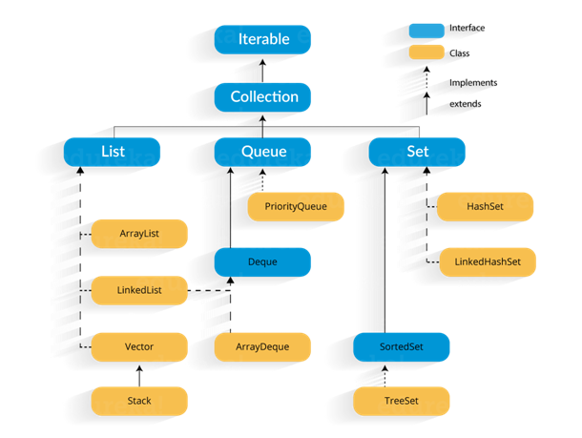

Slide 6
Keyword: extends and implements
Used in case of inheritance:
Class to class-extends
(class classA extends classB)
Interface to interface: extends
Class to interfcae: implements
(class classA implements interfaceA)

Slide 7
Iterator interface
Iterator is an interface that iterates the elements.
Iterator can traverse elements in a collection only in forward direction.
It is used to traverse the list and modify the elements. Iterator interface has three methods:
public boolean hasNext() – This method returns true if the iterator has more elements.
public object next() – It returns the element and moves the cursor pointer to the next element.
public void remove() – This method removes the last elements returned by the iterator.

Slide 8
ListIterator
ListIterator is an interface in a Collection framework, and it extends the Iterator interface.
Using ListIterator, you can traverse the elements of the collection in both forward and backwards directions.

Slide 9
Methods in ListIterator
void add(Object object): It inserts object immediately before the element that is returned by the next( ) function.
boolean hasNext( ): It returns true if the list has a next element.
boolean hasPrevious( ): It returns true if the list has a previous element.
Object next( ): It returns the next element of the list. It throws ‘NoSuchElementException’ if there is no next element in the list.
Object previous( ): It returns the previous element of the list. It throws ‘NoSuchElementException’ if there is no previous element.
void remove( ): It removes the current element from the list. It throws ‘IllegalStateException’ if this function is called before next( ) or previous( ) is invoked.

Slide 10
Collection interface
Methods:
Method | Description
public boolean add(E e) | It is used to insert an element in this collection.
public boolean remove(Object element) | It is used to delete an element from the collection.
public int size() | It returns the total number of elements in the collection.
public void clear() | It removes the total number of elements from the collection.
public boolean contains(Object element) | It is used to search an element.
public boolean isEmpty() | It checks if collection is empty.

Slide 11
List interface
It is an interface that extends the Collection interface.
List interface is implemented by the classes ArrayList, LinkedList, Vector, and Stack.
Lists are further classified into the following:
ArrayList
LinkedList
Vectors

Slide 12
ArrayList al=new ArrayList();
//creating old non-generic arraylist
ArrayList<String> al=new ArrayList<String>();
//creating new generic arraylist
Java new generic collection allows you to have only one type of object in a collection. Now it is type safe so typecasting is not required at runtime.

Slide 13
Methods in ArrayList:
Add():
Add new elements to an ArrayList using the add() method.
Syntax:
arrayListObj.add(arrayListElement)
Ex:
List.add(“java”)
2. Adding an element at a particular index in an ArrayList.
Syntax:
arrayListObj.add(arrayListIndex, arrayListElement)
Ex:
List.add(2, “java”)

Slide 14
3. size():
to find the size of an ArrayList using the size() method.
Syntax:
arrayListObj.size()
Ex:
List.size()
4. get():
access the element at a particular index in an ArrayList using the get() method.
Syntax:
arrayListObj.get(0)
Ex:
List.get(0)

Slide 15
5. Set():
to modify the element at a particular index in an ArrayList using the set() method.
Syntax:
arrayListObj.set(index,element)
Ex:
List.set(4, “java”)
6. isEmpty():
To check if an ArrayList is empty using the isEmpty() method.
It will return true or false
List.isEmpty()

Slide 16
7. contains():
This method returns true if this list contains the specified element.
Ex:
boolean retval = arrlist.contains(10);
8. remove():
to remove the element at a given index in an ArrayList
Syntax:
arrayListObj.remove(int index)
9. removeAll():
to remove all the elements from an ArrayList.

Slide 17
10. indexOf():
The indexOf() method of ArrayList returns the index of the first occurrence of the specified element in this list, or -1 if this list does not contain the element.

Slide 18
Methods in Stack class
Object push(Object element) : Pushes an element on the top of the stack.
Object pop() : Removes and returns the top element of the stack. An ‘EmptyStackException’ exception is thrown if we call pop() when the invoking stack is empty.
Object peek() : Returns the element on the top of the stack, but does not remove it.
boolean empty() : It returns true if nothing is on the top of the stack. Else, returns false.
int search(Object element) : It determines whether an object exists in the stack. If the element is found, it returns the position of the element from the top of the stack. Else, it returns -1.

