Slide 1



PROGRAMMING IN JAVA

Slide 2
ARRAY
Array is a collection of similar type of elements that have contiguous memory location.
In java, array is an object the contains elements of similar data type.
It is a data structure where we store similar elements. We can store only fixed elements in an array.
Array is index based, first element of the array is stored at 0 index.

Slide 3
Advantage of Array
Code Optimization: It makes the code optimized, we can retrieve or sort the data easily.
Random access: We can get any data located at any index position.
Disadvantage of Array
Size Limit: We can store only fixed size of elements in the array. It doesn't grow its size at runtime. To solve this problem, collection framework is used in java.

Slide 4
Types of Array: There are two types of array.
Single Dimensional Array
Multidimensional Array-
    2D array
    3D array
    Jagged array

Slide 5
SINGLE DIMENSIONAL ARRAY
The syntax for declaring and instantiating an array:
There are two ways to declare an array,
type[] arrayName;
type arrayName[];

Slide 6
How to instantiate an array
arrayName = new type[length];
How to declare and instantiate an array in one statement
type[] arrayName = new type[length];

Slide 7
EXAMPLES
Array of integers
int[] num = new int[5];
Array of Strings
String[] nameList = new String[5];
nameList[0] = "Amanda Green";
nameList[1] = "Vijay Arora";
nameList[2] = "Sheila Mann";
nameList[3] = "Rohit Sharma";
nameList[4] = "Mandy Johnson";

Slide 8
ARRAY LENGTH
The syntax for getting the length of an array
arrayName.length
e.g-
int[] values = new int[10];
for (int i = 0; i < values.length; i++)
{
values[i] = i;
}

Slide 9
THE ARRAYS CLASS
Arrays.sort
e.g-
int[] numbers = {2,6,4,1,8,5,9,3,7,0}; Arrays.sort(numbers);
for (int num : numbers)
{
System.out.print(num + " ");
}

Slide 10
SOME OTHER METHODS:
equals( arrayName1, arrayName2 )
copyOf( arrayName, length )
binarySearch( arrayName, value )

Slide 11
TWO-DIMENSIONAL ARRAYS
The syntax for creating a rectangular array-
type[][] arrayName = new type[rowCount][columnCount];
A statement that creates a 3x2 array
int[][] numbers = new int[3][2];
3x2 array and initializes it in one statement
int[][] numbers = { { 1, 2 }, { 3, 4 }, { 5, 6 } };

Slide 12
JAGGED ARRAY
type[][] arrayName = new type[rowCount][];
e.g:-int num[][]=new int[4][];
num[0]=new int[1];
num[1]=new int[2];
num[2]=new int[3];
num[3]=new int[4];

Slide 13
ENHANCED FOR LOOP FOR 2D ARRAY
for (int[] num: arr)
{
for(int data: num)
{
System.out.println(data);
}
}

Slide 14
ANONYMOUS ARRAY:
An array without any name is called anonymous array.
Anonymous array is passed as an argument of method
Syntax: new arrayType[]{ array elements};
// anonymous int array
new int[] { 1, 2, 3, 4};
// anonymous char array
new char[] {'x', 'y', 'z‘};
// anonymous String array
new String[] {“hello", “hi", “bye"};
// anonymous multidimensional array
new int[][] { {10, 20}, {30, 40, 50} };

Slide 15
3 D ARRAY:
Syntax:
array_type[][][] array_name = new array_type[x][y][z];
Ex:
int[][][] num=new int[2][3][4];
Here, num[i][j][k] where ‘i’ is the array number, ‘j’ is the row number and ‘k’ is the column number.

Slide 16
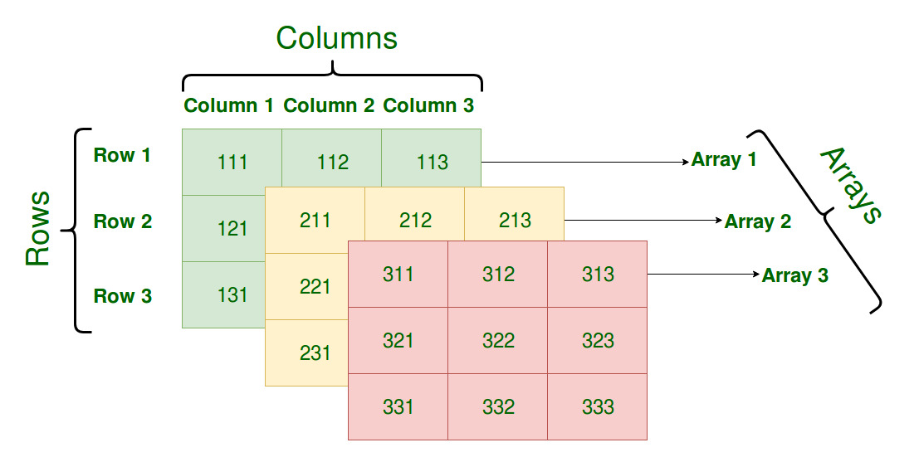

Slide 17
4 D ARRAY
Array of 3 D Array
int [][][][] num=new int[2][2][2][2];
Multi dimensional array means arrya of arrays.

