Slide 1

CAP950 OPEN SOURCE TECHNOLIGIES (PHP)

Slide 2
An array is a special variable, which can hold more than one value at a time.
An array stores multiple values in one single variable:
<?php $cars = array("Volvo", "BMW", "Toyota"); echo "I like " . $cars[0] . ", " . $cars[1] . " and " . $cars[2] . "."; ?>
Creation of Arrays in PHP
The array() function is used to create an array
array();

Slide 3
In PHP, there are three types of arrays:
Indexed arrays - Arrays with a numeric index
Associative arrays - Arrays with named keys
Multidimensional arrays - Arrays containing one or more arrays

Slide 4
PHP Indexed Arrays

Slide 5
PHP Indexed Arrays
There are two ways to create indexed arrays
The index can be assigned automatically (index always starts at 0), like this:
$cars = array("Volvo", "BMW", "Toyota");
or
$cars[0] = "Volvo"; $cars[1] = "BMW"; $cars[2] = "Toyota";
the index can be assigned manually
<?php $cars = array("Volvo", "BMW", "Toyota"); echo "I like " . $cars[0] . ", " . $cars[1] . " and " . $cars[2] . "."; ?>

Slide 6
PHP Array Functions
PHP array() function
PHP array() function creates and returns an array. It allows you to create indexed, associative and multidimensional arrays.
PHP array_change_key_case() function
PHP array_change_key_case() function changes the case of all key of an array.
<?php
$salary=array(“Rahul"=>"550000","Vijay"=>"250000",“Mandeep"=>"200000");
print_r(array_change_key_case($salary,CASE_UPPER));
?>

Slide 7
PHP array_reverse() function
PHP array_reverse() function returns an array containing elements in reversed order.
<?php
$month=array(“jan",“feb",“march","april");
$reversemonth=array_reverse($month);
foreach( $reversemonth as $s )
{
echo "$s<br />";
}
?>

Slide 8
PHP array_search() function
PHP array_search() function searches the specified value in an array. It returns key if search is successful.
<?php
$month=array(“jan",“feb",“march","april");
$key=array_search(“feb",$month);
echo $key;
Note: if key is greater then 0 it means item found

Slide 9
in_array() Function
The PHP in_array() function is also an inbuilt function that is used to find whether the specified element is present in the given array or not. This function returns a Boolean value TRUE if the given value exists in an array, else it returns FALSE if the value is not found.

Slide 10
array_diff() function
It Compare the values of two arrays, and return the differences:
<?php
$a1=array(1,2,-1);
$a2=array(1,-1);
$result=array_diff($a2,$a1);
print_r($result);
?>

Slide 11
PHP array_intersect() function
PHP array_intersect() function returns the intersection of two array. In other words, it returns the matching elements of two array.
<?php
$month1=array(“jan",“feb",“march","april");
$month2=array(“may",“june",“march","april");
$res=array_intersect($month1,$month2);
foreach( $res as $n )
{
echo "$n<br />";
}
?>

Slide 12
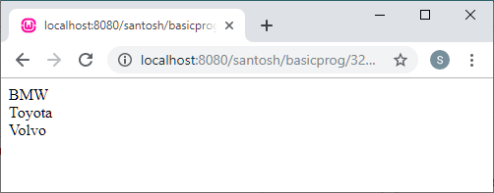
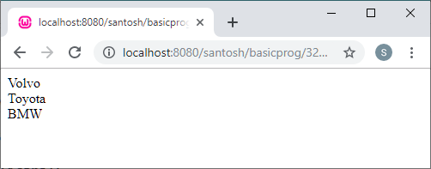
Sorting in Indexed Arrays
sort()
rsort()
<?php
$cars=array("Volvo","BMW","Toyota");
sort($cars);
$clength=count($cars);
for($x=0;$x<$clength;$x++)
{
echo $cars[$x];
echo "<br>";
}
?>
<?php
$cars=array("Volvo","BMW","Toyota");
rsort($cars);
$clength=count($cars);
for($x=0;$x<$clength;$x++)
{
echo $cars[$x];
echo "<br>";
}
?>

Slide 13
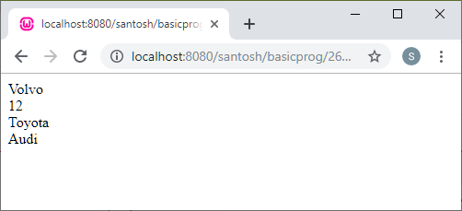
The count() Function : To get the Length of an Array
<?php
$n=3;
$cars = array($n);
$cars[0] = "Volvo";
$cars[1] = 12;
$cars[2] = "Toyota";
$cars[3] = "Audi";
echo $cars[0];
echo"<br>";
echo $cars[1];
echo"<br>";
echo $cars[2];
echo"<br>";
echo $cars[3];
?>
The count() function is used to return the length (the number of elements) of an array
<?php $cars = array("Volvo", "BMW", "Toyota"); echo count($cars); ?>
Loop Through an Indexed Array
<?php
$cars=array("Volvo","BMW","Toyota");
$clength=count($cars);
for($x=0;$x<$clength;$x++)
{
echo $cars[$x];
echo "<br>";
}
?>

Slide 14
PHP Associative Arrays

Slide 15
PHP Associative Arrays
Associative arrays are arrays that use named keys that you assign to them.
There are two ways to create an associative array:
$age = array("Peter"=>"35", "Ben"=>"37", "Joe"=>"43");
OR
$age['Peter'] = "35"; $age['Ben'] = "37"; $age['Joe'] = "43";
The named keys can then be used in a script:
<?php $age = array("Peter"=>"35", "Ben"=>"37", "Joe"=>"43"); echo "Peter is " . $age['Peter'] . " years old."; ?>

Slide 16
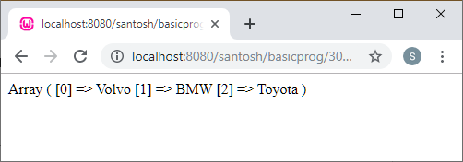
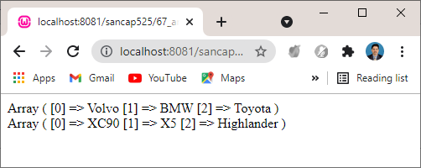
<!DOCTYPE html>
<html>
<body>
<?php
$a=array("Volvo"=>"XC90","BMW"=>"X5","Toyota"=>"Highlander");
print_r(array_keys($a));
?>
</body>
</html>
<?php
$a=array("Volvo"=>"XC90","BMW"=>"X5","Toyota"=>"Highlander");
print_r(array_keys($a));
echo "<br>";
print_r(array_values($a));
?>

Slide 17
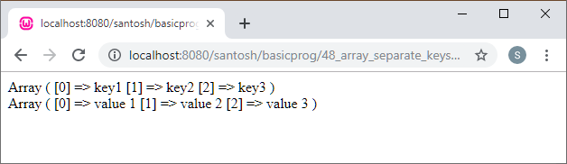
Getting Keys/Values Separately From Associative Array
<?php
$a=array("key1"=>"value 1","key2"=>"value 2","key3"=>"value 3");
print_r(array_keys($a));
echo "<br>";
print_r(array_values($a));
?>

Slide 18
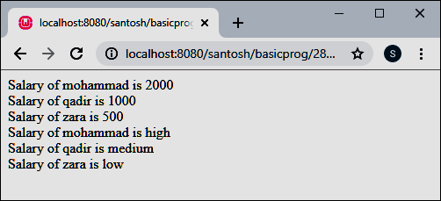
<html>
<body>
<?php
/* First method to associate create array. */
$salaries = array("mohammad" => 2000, "qadir" => 1000, "zara" => 500);
echo "Salary of mohammad is ". $salaries['mohammad'] . "<br />";
echo "Salary of qadir is ". $salaries['qadir']. "<br />";
echo "Salary of zara is ". $salaries['zara']. "<br />";
/* Second method to create array. */
$salaries['mohammad'] = "high";
$salaries['qadir'] = "medium";
$salaries['zara'] = "low";
$mohammad_sal=$salaries['mohammad’];
//echo "Salary of mohammad is ".$mohammad_sal."<br>";
echo "Salary of mohammad is ". $salaries['mohammad'] . "<br />";
echo "Salary of qadir is ". $salaries['qadir']. "<br />";
echo "Salary of zara is ". $salaries['zara']. "<br />";
?>
</body>
</html>

Slide 19
Loop Through an Associative Array
To loop through and print all the values of an associative array
The foreach loop can be used for this
<?php $age = array("Peter"=>“73", "Ben"=>“29", "Joe"=>“46"); foreach($age as $x => $x_value)
{ echo "Key=" . $x . ", Value=" . $x_value; echo "<br>"; } ?>

Slide 20
Sort Functions For Arrays
sort() - sort arrays in ascending order
rsort() - sort arrays in descending order
asort() - sort associative arrays in ascending order, according to the value
ksort() - sort associative arrays in ascending order, according to the key
arsort() - sort associative arrays in descending order, according to the value
krsort() - sort associative arrays in descending order, according to the key

Slide 21
Insert new array:
array_push() :
$skillset= array('JavaScript','Python','C++');
$new_array = array_push($skillset, 'PHP', 'HTML', 'CSS');

Slide 22
array_splice() Function
The array_splice() function removes selected elements from an array and replaces it with new elements.
Syntax
array_splice(array, start, length, array)
If the function does not remove any elements (length=0), the replaced array will be inserted from the position of the start parameter

Slide 23
$original_array = array( '1', '2', '3', '4', '5' );
$position = 2;
$inserted_value=11;
array_splice( $original_array, $position, 0, $inserted_value );
output:
1 2 11 3 4 5

Slide 24
Converting Between Arrays and Variables
Converting Between Arrays and Variables PHP provides two functions, extract() and compact(), that convert between arrays and variables.

Slide 25
Creating an Array from Variables : use compact()
<?php
$BR = “BIHAR";
$PU = “PUNJAB";
$KR = "KERELA";
$states = compact(“BR", “PU", "KR");
print_r($states);
//The print_r() function is a built-in function in PHP and is used to print //or display information stored in a variable.
?>

Slide 26
compact() function
The compact() function is used to create an array from variables and their values.
Or,
The compact() array function in PHP will create an array from a list of variables.

Slide 27
A function when an array is passed as a parameter
<?php
$username = "kumar";
$password = "kumar123";
$age = "45";
$NAME = array("username", "password");
$result = compact($NAME, "age");
print_r($result);
?>

Slide 29
Creating Variables from an Array: use: extract()
The extract() function automatically creates local variables from an array.
$person = array('name' => 'kumar', 'age' => 45, 'designation' => 'Assistant Professor');
extract($person);
echo $name.”<br/>”;
echo $age.”<br/>”;
echo $designation;

Slide 30
Multidimensional Arrays
A multidimensional array is an array containing one or more arrays.
PHP understands multidimensional arrays that are two, three, four, five, or more levels deep.
The dimension of an array indicates the number of indices you need to select an element.
For a two-dimensional array we need two indices to select an element
For a three-dimensional array we need three indices to select an element

Slide 31
PHP - Two-dimensional Arrays
A two-dimensional array is an array of arrays (a three-dimensional array is an array of arrays of arrays).
Name | Stock | Sold
Volvo | 22 | 18
BMW | 15 | 13
Saab | 5 | 2
Land Rover | 17 | 15
$cars = array ( array("Volvo",22,18), array("BMW",15,13), array("Saab",5,2), array("Land Rover",17,15) );

Slide 32
The two-dimensional $cars array contains four arrays, and it has two indices: row and column.
To get access to the elements of the $cars array we must point to the two indices (row and column):
<?php echo $cars[0][0].": In stock: ".$cars[0][1].", sold: ".$cars[0][2].".<br>"; echo $cars[1][0].": In stock: ".$cars[1][1].", sold: ".$cars[1][2].".<br>"; echo $cars[2][0].": In stock: ".$cars[2][1].", sold: ".$cars[2][2].".<br>"; echo $cars[3][0].": In stock: ".$cars[3][1].", sold: ".$cars[3][2].".<br>"; ?>

Slide 33
We can also put a for loop inside another for loop to get the elements of the $cars array
<?php for ($row = 0; $row < 4; $row++)
{ echo "<p><b>Row number $row</b></p>"; echo "<ul>"; for ($col = 0; $col < 3; $col++)
{ echo "<li>".$cars[$row][$col]."</li>"; } echo "</ul>"; } ?>

Slide 34
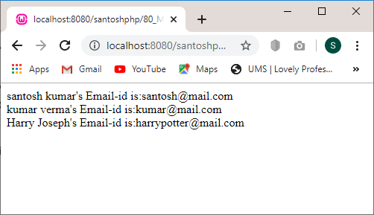
 | name | emai
 | santosh kumar | santosh@mail.com
<?php
$address = array(
array(
"name" => "santosh kumar",
"email" => "santosh@mail.com",
),
array(
"name" => "kumar verma",
"email" => "kumar@mail.com",
),
array(
"name" => "Harry Joseph",
"email" => "harrypotter@mail.com",
)
);
echo "santosh kumar's Email-id is:".$address[0]["email"]."<br>";
echo "kumar verma's Email-id is:".$address[1]["email"]."<br>";
echo "Harry Joseph's Email-id is:".$address[2]["email"]."<br>";
?>

Slide 35
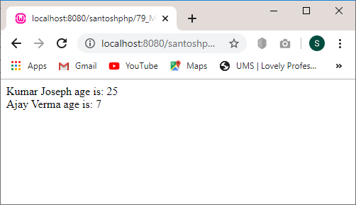
firstname | lastname | age
Kumar | Joseph | 25
<?php
$details = array(
array("firstname" => "Kumar", "lastname" => "Joseph", "age" => 25),
array("firstname" => "Amanda", "lastname" => "Miller", "age" => 18),
array("firstname" => "James", "lastname" => "Brown", "age" => 31),
array("firstname" => "Ajay", "lastname" => "Verma", "age" => 7),
array("firstname" => "Michael", "lastname" => "Davis", "age" => 43),
array("firstname" => "Sarah", "lastname" => "Miller", "age" => 24),
array("firstname" => "Patrick", "lastname" => "Miller", "age" => 27) );
echo "Kumar Joseph age is: " . $details[0]["age"]."<br>";
echo "Ajay Verma age is: " . $details[3]["age"];
?>

Slide 39
Any Query?

