Slide 1

CAP950 OPEN SOURCE TECHNOLIGIES (PHP)

Slide 2
Topics will be covered……
Introduction with language basics: -
brief introduction to PHP,
lexical structures in PHP,
data types and variables in PHP,
control flow and loops in PHP,
embedding PHP in web pages

Slide 3
Print any message on screen using echo
PHP echo statement can be used to print the string, multi-line strings, escaping characters, variable, array, etc.
<?php
echo "Hello World";
?>

Slide 4
Print any message on screen using print()
print always returns an integer value, which is 1.
Using print, we cannot pass multiple arguments.

Slide 5
Difference between echo and print
echo
echo is a statement, which is used to display the output.
echo can be used with or without parentheses.
echo does not return any value.
We can pass multiple strings separated by comma (,) in echo.
echo is faster than print statement.
print
print is also a statement, used as an alternative to echo at many times to display the output.
print can be used with or without parentheses.
print always returns an integer value, which is 1.
Using print, we cannot pass multiple arguments.
print is slower than echo statement.

Slide 6
What will be output for the following code?
<?php
$firstname="kumar";
$lastname="vishal";
print "My name is:",$firstname,$lastname;
?>
My name is:kumarvishal
kumarvishal
Nothing
Error

Slide 7
Check the difference
<?php
$firstname="kumar";
$lastname="vishal";
echo "My name is:",$firstname,$lastname;
?>
<?php
$firstname="kumar";
$lastname="vishal";
print "My name is:",$firstname,$lastname;
?>

Slide 8
Variable in PHP
In PHP, a variable is declared using a $ sign followed by the variable name.
$variableName=value;
PHP variables are case-sensitive, so $name and $NAME both are treated as different variable.

Slide 9
<?php
$str="hello string";
$x=200;
$y=44.6;
echo "string is: $str <br/>";
echo "integer is: $x <br/>";
echo "float is: $y <br/>";
?>

Slide 10
PHP $ and $$ Variables
The $var (single dollar) is a normal variable with the name var that stores any value like string, integer, float, etc.
The $$var (double dollar) is a reference variable that stores the value of the $variable inside it.

Slide 11
What will be output?
A.
abc
200
200
B.
abc
200
abc
C.
abc
abc
200
D. None
<?php
$x = "abc";
$$x = 200;
echo $x."<br/>";
echo $$x."<br/>";
echo $abc;
?>

Slide 12
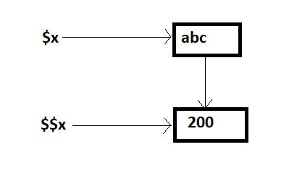

Slide 13
PHP has three types of variable scopes:
Local variable
Global variable
Static variable

Slide 14
<?php
$x = 5; //global
function mytest()
{
$x = 7; //local
echo "Local x: " .$x."<br>";
echo "Global x: " .$GLOBALS['x'];
}
mytest();
?>

Slide 15
Static variable
We use the static keyword before the variable to define a variable, and this variable is called as static variable.
Static variables exist only in a local function, but it does not free its memory after the program execution leaves the scope.
Syntax:
static $var_name;

Slide 16
What will be output?
<?php
function static_var()
{
static $num1 = 3; //static variable
$num2 = 6; //local variable
$num1++;
$num2++;
echo "Static: " .$num1 ."</br>";
echo "Non-static: " .$num2 ."</br>";
}
static_var();
static_var();
?>
A.
Static: 4 Non-static: 7 Static: 5 Non-static: 8
B.
Static: 4 Non-static: 7 Static: 5 Non-static: 7
C.
Static: 4 Non-static: 7 Static: 4 Non-static: 7
D.
None

Slide 17
PHP Data Types
boolean
integer
float
string

Slide 18
PHP Operators
Arithmetic Operators
Assignment Operators
Bitwise Operators
Comparison Operators
Incrementing/Decrementing Operators
Logical Operators
String Operators
Array Operators
Type Operators
Execution Operators
Error Control Operators

Slide 19
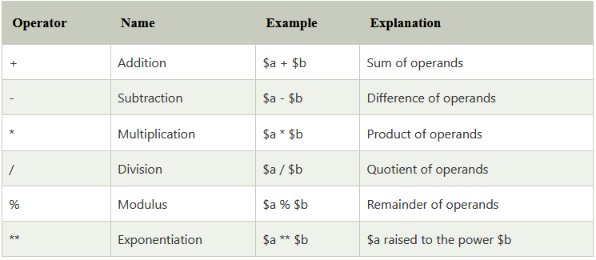
Arithmetic Operators

Slide 20
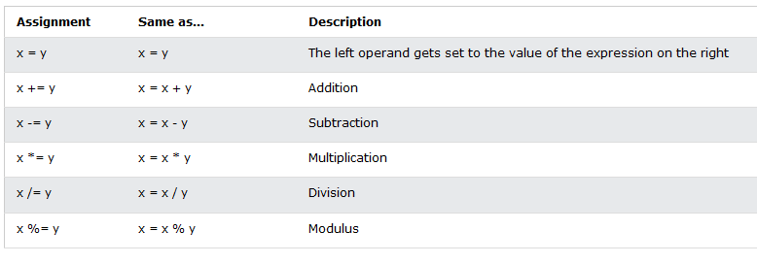
Assignment Operators

Slide 21
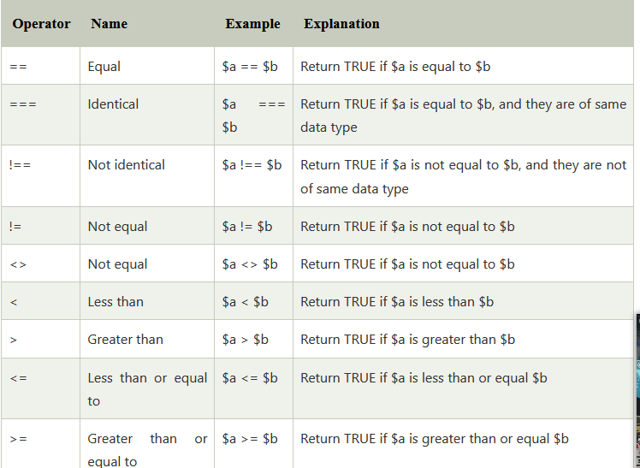
Comparison Operators

Slide 22
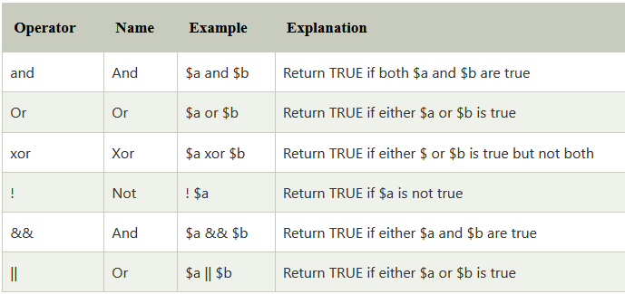
Logical Operators

Slide 23
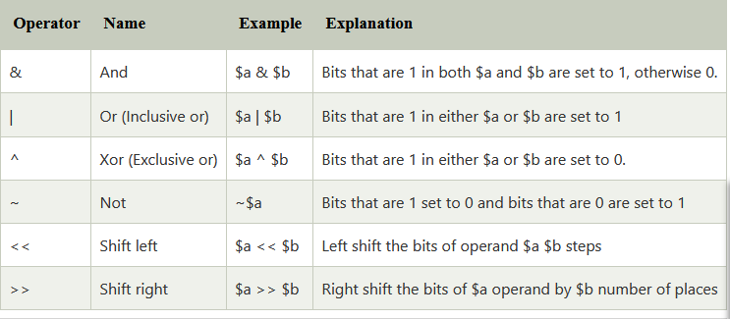
Bitwise Operators

Slide 24
Read Value from HTML input box using GET
<form method=“get">
<input type="text" name=“myname" class="button"/>
<input type="submit" name=“btnsubmit" value=“SUBMIT"/>
</form>
// php
<?php
$name = $_GET[' myname'];
echo $name;
?>

Slide 25
Read Value from HTML input box using GET
<html>
<head>
<title>Take input from user</title>
</head>
<body>
<form method="get">
<input type="text" name="name" />
<input type="submit" name="btnsubmit" value="SUBMIT"/>
</form>
<?php
if(empty($_GET["name"]))
{
echo "Enter your name please";
}
else{
$name=$_GET["name"];//receiving name field value in $name variable
echo "Welcome, $name";
}
?>
</body>
</html>

Slide 26
Read Value from HTML input box using POST
<form method=“post">
<input type="text" name=“myname" class="button"/>
<input type="submit" name=“btnsubmit" value=“SUBMIT"/>
</form>
// php
<?php
$name = $_POST[' myname'];
echo $name;
?>

Slide 27
if (condition1){
//code to be executed if condition1 is true
} elseif (condition2){
//code to be executed if condition2 is true
} elseif (condition3){
//code to be executed if condition3 is true
....
} else{
//code to be executed if all given conditions are false
}

Slide 29
Any Query?

