Slide 1

CAP950 OPEN SOURCE TECHNOLIGIES (PHP)

Slide 2
PHP Operators
Arithmetic Operators
Assignment Operators
Bitwise Operators
Comparison Operators
Incrementing/Decrementing Operators
Logical Operators
String Operators
Array Operators
Type Operators
Execution Operators
Error Control Operators

Slide 3
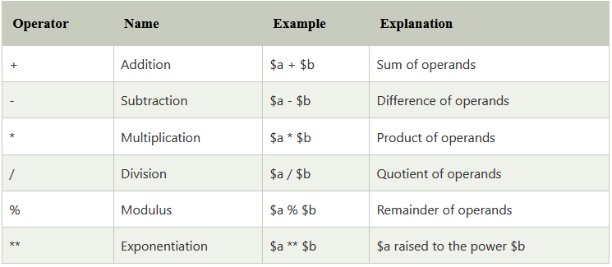
Arithmetic Operators

Slide 4
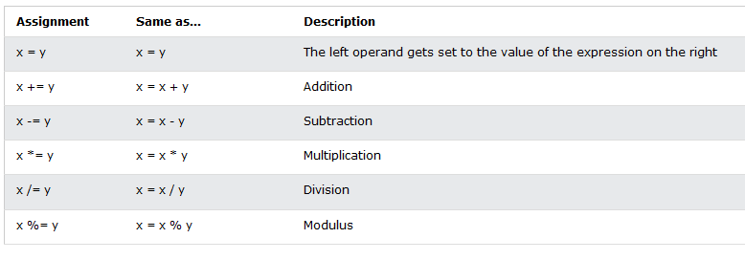
Assignment Operators

Slide 5
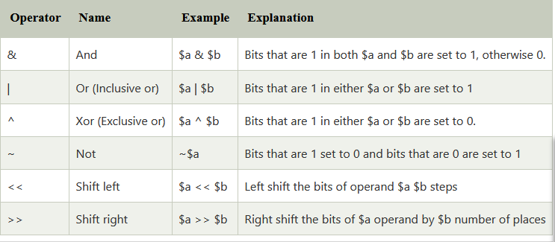
Bitwise Operators

Slide 6
AND Operator (&)
If both side bit is on result will be On
a | b | a & b
0 | 0 | 0
0 | 1 | 0
1 | 0 | 0
1 | 1 | 1

Slide 7
Steps to solve:-
a = 12 (find binary form:1100 )
b = 25 (find binary form:11001)
How to find Binary:
64 32 16 8 4 2 1
0 1 1 0 0
12
25
8
1 1 0 0 1
1 0 0 0

Slide 8
a & b=
01100 (12)
11001 (25)
01000 (8) Ans.

Slide 9
What will be output?
$a=20;
$b=25;
echo ($a&$b);
15
16
20

Slide 10
OR Operator (|)
If any side bit is on result will be On
a | b | a | b
0 | 0 | 0
0 | 1 | 1
1 | 0 | 1
1 | 1 | 1

Slide 11
Steps to solve:-
a = 12 (find binary form:1100 )
b = 25 (find binary form:11001)
How to find Binary:
64 32 16 8 4 2 1
0 1 1 0 0
12
25
29
1 1 0 0 1
1 1 1 0 1

Slide 12
a | b=
01100 (12)
11001 (25)
11101 (29) Ans.

Slide 13
What will be output?
$a=10;
$b=15;
echo ($a|$b);
15
20
22
32

Slide 14
XOR Operator (^)
If both side bit is opposite result will be On
a | b | a ^ b
0 | 0 | 0
0 | 1 | 1
1 | 0 | 1
1 | 1 | 0

Slide 15
Steps to solve:-
a = 12 (find binary form:1100 )
b = 25 (find binary form:11001)
How to find Binary:
64 32 16 8 4 2 1
0 1 1 0 0
12
25
21
1 1 0 0 1
1 0 1 0 1

Slide 16
a ^ b=
01100 (12)
11001 (25)
10101 (21) Ans.

Slide 17
Left Shift Operator(<<)
a=10 (1010)
a<<1
1010.0
10100(20) Ans.
a<<2
1010.00
101000(40) Ans.

Slide 18
Right Shift Operator(>>)
a=10 (1010)
a>>1
1010.
101(5) Ans.
a>>2
1010.
10(2) Ans.

Slide 19
What will be output?
<?php
$a=15;
echo ($a>>1);
?>
Options:
5
6
7
8

Slide 20
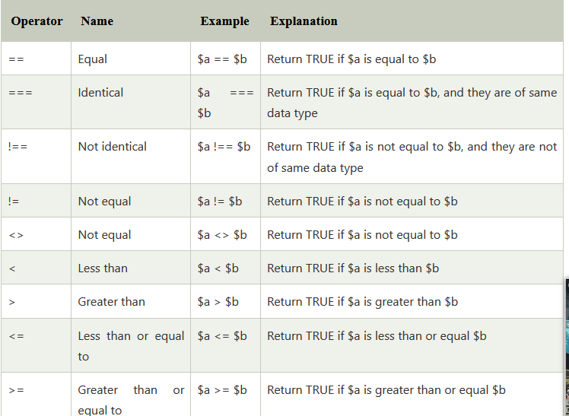
Comparison Operators

Slide 21
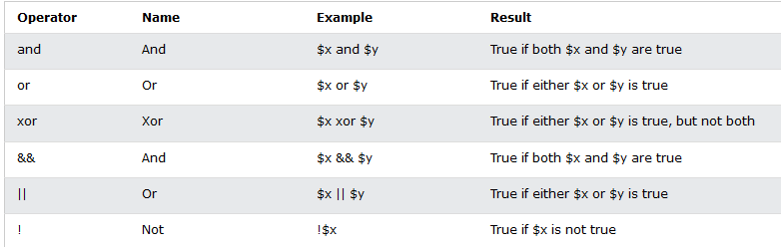
Logical Operators

Slide 22
Control Statement
if
if-else
if-else-if
nested if

Slide 23
The PHP switch Statement
Syntax
switch (n) {
case label1:
code to be executed if n=label1;
break;
case label2:
code to be executed if n=label2;
break;
case label3:
code to be executed if n=label3;
break;
...
default:
code to be executed if n is different from all labels;
}

Slide 24
Example
<?php
$favcolor = "red";
switch ($favcolor) {
case "red":
echo "Your favorite color is red!";
break;
case "blue":
echo "Your favorite color is blue!";
break;
case "green":
echo "Your favorite color is green!";
break;
default:
echo "Your favorite color is neither red, blue, nor green!";
}
?>

Slide 25
PHP Loops
loop types:
while - loops through a block of code as long as the specified condition is true
do...while - loops through a block of code once, and then repeats the loop as long as the specified condition is true
for - loops through a block of code a specified number of times
foreach - loops through a block of code for each element in an array

Slide 26
<?php
for($n=1;$n<=10;$n++){
echo "$n<br/>";
}
?>

Slide 27
foreach
Syntax:
foreach ($array as $value) {
//code to be executed
}
<?php
//declare array
$season = array ("Summer", "Winter", "Autumn", "Rainy");
//access array elements using foreach loop
foreach ($season as $element) {
echo "$element";
echo "</br>";
}
?>

Slide 28
While loop
<?php
$n=1;
while($n<=10){
echo "$n<br/>";
$n++;
}
?>

Slide 29
Do…while loop
<?php
$n=1;
do{
echo "$n<br/>";
$n++;
}while($n<=10);
?>

Slide 30
break
<?php
for($i=1;$i<=10;$i++){
echo $i;
if($i==5){
break;
}
}
?>

Slide 31
continue
<?php
for($i=1;$i<=10;$i++){
echo $i;
if($i==5){
continue;
}
}
?>

Slide 32
Any Query?

