Slide 1
Python

Slide 2
Handling string in python
accessing strings
string length
string traversal
for loop using string
string comparison
find function

Slide 3
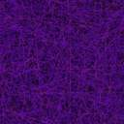
accessing strings
>>>str=“hello”
>>>print(str[1])
>>>e
>>>print(str*3)
>>>hellohellohello
>>>print(str[0:3])
>>>hel
>>>print(str[-1])
>>>o
0 | 1 | 2 | 3 | 4
h | e | l | l | 0
-5 | -4 | -3 | -2 | -1

Slide 4
string length
By using len(string)
>>>len(“hello”)
>>>5

Slide 5
string traversal
By using for loop
For varname in String:
print(varname)

Slide 6
string comparison
By using ==

Slide 7
String functions:
upper():
>>>str=“hello”
>>>str.upper()
>>>HELLO
lower()
replace(oldstring,newstring)
count(substring)

Slide 8
isdigit() returns:
  True if all characters in the string are digits.
  False if at least one character is not a digit.
>>>Str=“1234”
>>>Str.isdigit()
>>>true
str.find(substring, startingindex, endingindex)
  The find() method returns the index of first occurrence of the substring (if found). If not found, it returns -1.

Slide 9
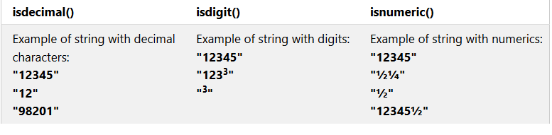
isalpha()
isdigit(), isnumeric() and isdecimal()

Slide 10
Join function in python
The join() method is a string method and returns a string in which the elements of sequence have been joined by str separator.
Syntax:
string_name.join(iterable)
list1 = ['g','e','e','k', 's']
print("".join(list1))

Slide 11
random.sample() function
It returns a particular length list of items chosen from the sequence i.e. list, tuple, string or set.
Syntax : random.sample(sequence, k)

