Slide 1
Machine Learning

Slide 2
Machine Learning is a concept which allows the machine to learn from examples and experience, without being explicitly programmed. So instead of you writing the code, what you do is you feed data to the generic algorithm, and the algorithm/machine builds the logic based on the given data.
Machine Learning (ML) is basically that field of computer science with the help of which computer systems can provide sense to data in much the same way as human beings do.

Slide 3
Algorithms:
Linear Regression
K Nearest Neighbors
Decision Trees
Random Forests
K Means Clustering

Slide 4
What is Clustering?
A bank wants to give credit card offers to its customers. Currently, they look at the details of each customer and based on this information, decide which offer should be given to which customer.
Now, the bank can potentially have millions of customers. Does it make sense to look at the details of each customer separately and then make a decision? Certainly not! It is a manual process and will take a huge amount of time.
So what can the bank do? One option is to segment its customers into different groups. For instance, the bank can group the customers based on their income:

Slide 5
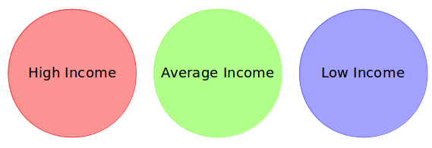
The bank can now make three different strategies or offers, one for each group. Here, instead of creating different strategies for individual customers, they only have to make 3 strategies. This will reduce the effort as well as the time.

Slide 6
The groups I have shown above are known as clusters and the process of creating these groups is known as clustering.
Clustering is the process of dividing the entire data into groups (also known as clusters) based on the patterns in the data.
it is an unsupervised learning problem.

Slide 7
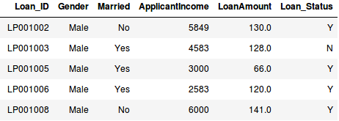
Concept of supervised or unsupervised learning
Suppose a project where your task is to predict whether a loan will be approved or not:
We have a fixed target to predict in both of these situations, we have to predict the Loan_Status depending on the Gender, marital status, the income of the customers, etc.

Slide 8
So, when we have a target variable to predict based on a given set of predictors or independent variables, such problems are called supervised learning problems.
Such problems, without any fixed target variable, are known as unsupervised learning problems. In these problems, we only have the independent variables and no target/dependent variable.
In clustering, we do not have a target to predict. We look at the data and then try to club similar observations and form different groups. Hence it is an unsupervised learning problem.

Slide 9
K-Means Clustering in Python
K-Means Clustering is a concept that falls under Unsupervised Learning. This algorithm can be used to find groups within unlabeled data.
Import module for K-Means Clustering in Python:
Sklearn
Pip install Sklearn

Slide 10
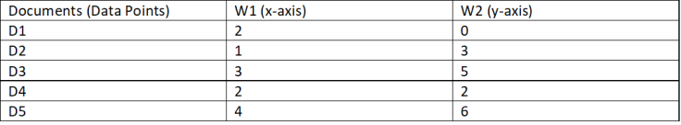
Steps to calculate centroids in cluster using K-means clustering algorithm:
Consider the below data set which has the values of the data points on a particular graph.
Table 1:
We can randomly choose two initial points as the centroids and from there we can start calculating distance of each point.
For now we will consider that D2 and D4 are the centroids.
To start with we should calculate the distance with the help of Euclidean Distance which is
√((x1-y1)² + (x2-y2)²

Slide 11
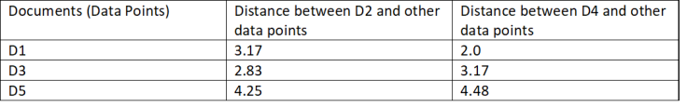
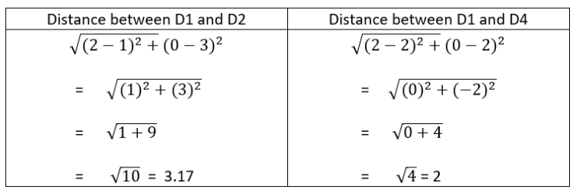
Iteration 1:
Step 1: We need to calculate the distance between the initial centroid points with other data points.
After calculating the distance of all data points, we get the values as below.
Table 2:

Slide 12
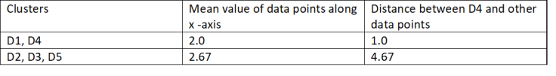
Step 2: Next, we need to group the data points which are closer to centriods. Observe the above table, we can notice that D1 is closer to D4 as the distance is less. Hence we can say that D1 belongs to D4 Similarly, D3 and D5 belongs to D2. After grouping, we need to calculate the mean of grouped values from Table 1.
Cluster 1: (D1, D4) Cluster 2: (D2, D3, D5)
Step 3: Now, we calculate the mean values of the clusters created and the new centriod values will these mean values and centroid is moved along the graph.

Slide 13
From the above table, we can say the new centroid for cluster 1 is (2.0, 1.0) and for cluster 2 is (2.67, 4.67)
Iteration 2:
Step 4: Again the values of euclidean distance is calculated from the new centriods. Below is the table of distance between data points and new centroids.

Slide 14
How k-means works ? Implement in Python

