Slide 1
CAP906:FUNDAMENTALS OF PYTHON
Lecture-2

Slide 2
What is Python?
Python is a general purpose high-level programming language which supports Object Oriented programming approach to develop applications.

Slide 3
Python Applications:
Desktop applications (Tkinter library, toolkits such as the wxWidgets, Kivy, PYQT)
Web applications(frameworks are Django, Flask, Pyramid) web-framework named Django is used on Instagram
Machine Learning and Artificial Intelligence
(Library: Pandas, Scikit-Learn, NumPy)
Data Science and Data Visualization
( Matplotlib, Seaborn)

Slide 4
Enterprise Applications
(Odoo, Tryton)
Scientific and Numeric
(SciPy, Pandas, Numpy)
https://www.python.org/about/apps/

Slide 5
Python used in top industry like:
Google
Facebook
Instagram
Spotify
Netflix
Dropbox
Reddit

Slide 6
Python Job Profiles
Software Engineer
Python Developer
Research Analyst
Data Analyst
Data Scientist
Software Developer
https://www.python.org/jobs/

Slide 7
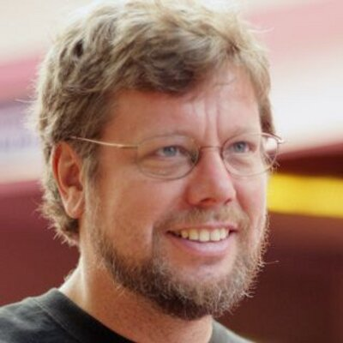
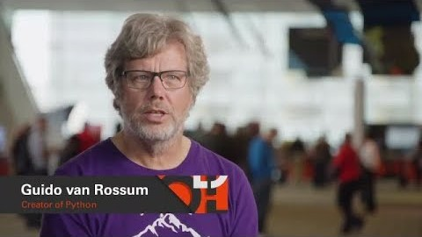
Python was developed in 1989 by Guido Van Rossum

Slide 8
History of Python

Slide 9
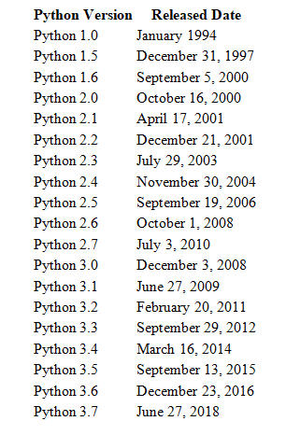
Python 3.8.0 Oct. 14, 2019
Python 3.8.5 July 20, 2020

Slide 10
Introduction to python
basic syntax
understanding python variables
understanding python blocks
applications of python

Slide 11
basic syntax
Comments :
Python supports two types of comments:
1) Single Line Comment:
# This is single line comment.
2) Multi Line Comment:
Multi lined comment can be given inside triple quotes.
“”” (This is also called docstring in python)

Slide 12
Indentation
To define a block of code. Python uses indentation.
A code block (body of a function, loop etc.) starts with indentation and ends with the first un-indented line.
ifor i n range(1,11):
print(i)
for i in range(1,11):
print(i)
Error
Correct

Slide 13
Python Keywords
Keywords are the reserved words in Python
In Python, keywords are case sensitive
All the keywords except True, False and None are in lowercase
We cannot use a keyword as variable name, function name or any other identifier.

Slide 14
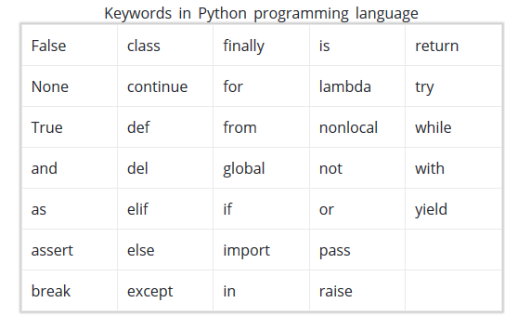

Slide 15
Identifiers
Identifier is the name given to entities like class, functions, variables etc. in Python.
Python is a case-sensitive language. This means, Variable and variable are not the same. Always name identifiers that make sense.
We can also use camel-case style i.e., capitalize every first letter of the word except the initial word without any spaces. For example: camelCaseExample

Slide 16
Rules for naming identifiers
An identifier cannot start with a digit
Do not use any keyword as identifier name
Identifiers can be a combination of letters in lowercase (a to z) or uppercase (A to Z) or digits (0 to 9) or an underscore (_).

Slide 17
Variable
A variable is a named location used to store data in the memory.
In Python, variables do not need declaration to reserve memory space.
The "variable declaration" or "variable initialization" happens automatically when we assign a value to a variable.

Slide 18
Declaring and assigning a value to a variable
name = “kumar“
print(name)
Assigning multiple values to multiple variables
a, b, c = 5, 3.2, "Hello“
print (a)
print (b)
print (c)

