Slide 1
Introduction to python
installation and setting up path
working with python
basic syntax
understanding python variables
understanding python blocks
applications of python

Slide 2
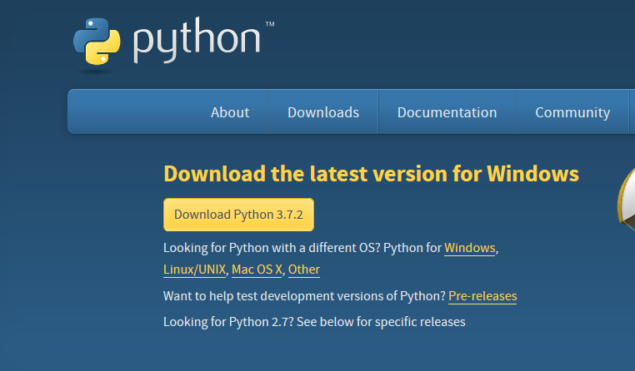
installation and setting up path
Installation on Windows
Visit the link https://www.python.org/downloads/ to download the latest release of Python.

Slide 3
To check python has installed properly or not
  Open Python CLI
  Type
  >>> print(“hello world”) <Enter Key>
  Out put:
  >>>hello world

Slide 4
setting up path
Steps:
Check your python installed path
In shell script
>>> import os
>>> print(os.getcwd())
Example:
C:\Users\work\AppData\Local\Programs\Python\Python37-32
Now copy this path and open System properties

Slide 5
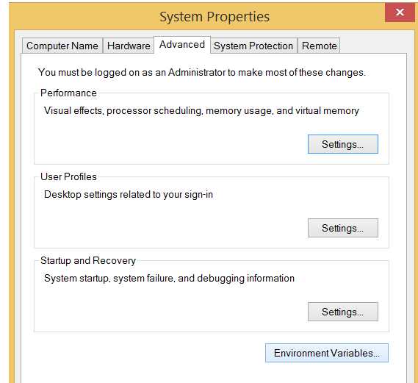

Slide 6
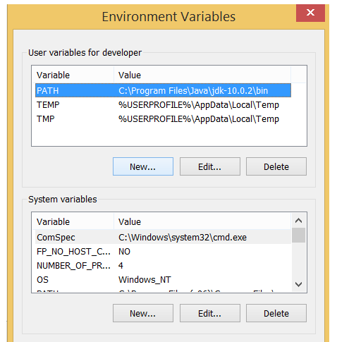
Select Environment Variable

Slide 7
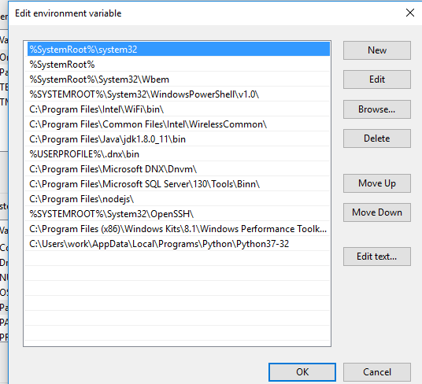
Inside System variable select path and edit

Slide 8
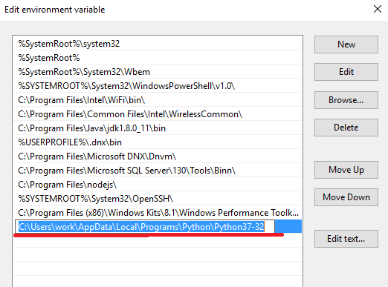
Click on New button and paste python file path

Slide 9
Now open command prompt
Use window +R
On run type cmd + <Enter key>
To check path set correctly or not use command python in command prompt
C:\> python <Enter key>
Out put: you will get python interpreter
>>>

Slide 10
IDLE Python
IDLE (Integrated Development and Learning Environment) is an integrated development environment (IDE) for Python. The Python installer for Windows contains the IDLE module by default.

