Slide 1
CAP906:FUNDAMENTALS OF PYTHON
Lecture-2

Slide 2
History of Python
Python is created by Guido Van Rossum. The design began in the late 1980s and was first released in February 1991.

Slide 3
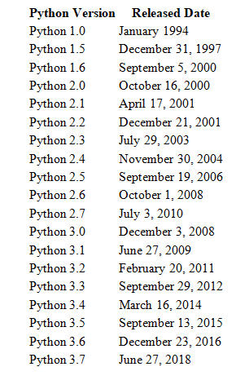

Slide 4
Introduction to python
installation and setting up path
working with python
basic syntax
understanding python variables
understanding python blocks
applications of python

Slide 5
basic syntax
Comments :
Python supports two types of comments:
1) Single Line Comment:
# This is single line comment.
2) Multi Line Comment:
Multi lined comment can be given inside triple quotes.
“”” (This is also called docstring in python)

Slide 6
Indentation
To define a block of code. Python uses indentation.
A code block (body of a function, loop etc.) starts with indentation and ends with the first un-indented line.
for i in range(1,11):
print(i)
for i in range(1,11):
print(i)
Error
Correct

Slide 7
Python Keywords
Keywords are the reserved words in Python
In Python, keywords are case sensitive
All the keywords except True, False and None are in lowercase
We cannot use a keyword as variable name, function name or any other identifier.

Slide 8
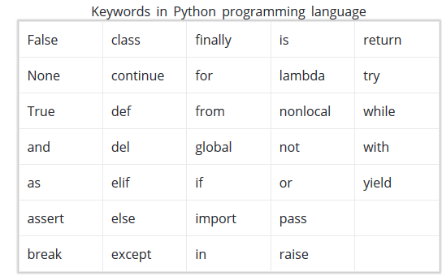

Slide 9
Identifiers
Identifier is the name given to entities like class, functions, variables etc. in Python.
Python is a case-sensitive language. This means, Variable and variable are not the same. Always name identifiers that make sense.
We can also use camel-case style i.e., capitalize every first letter of the word except the initial word without any spaces. For example: camelCaseExample

Slide 10
Rules for naming identifiers
An identifier cannot start with a digit
Do not use any keyword as identifier name
Identifiers can be a combination of letters in lowercase (a to z) or uppercase (A to Z) or digits (0 to 9) or an underscore (_).

Slide 11
Variable
A variable is a named location used to store data in the memory.
In Python, variables do not need declaration to reserve memory space.
The "variable declaration" or "variable initialization" happens automatically when we assign a value to a variable.

Slide 12
Declaring and assigning a value to a variable
name = “kumar“
print(name)
Assigning multiple values to multiple variables
a, b, c = 5, 3.2, "Hello“
print (a)
print (b)
print (c)

Slide 13
What is a Module?
A file containing a set of functions you want to include in your application.
we can use the module we just created, by using the import statement:
import module_name

Slide 14
Constants
A constant is a type of variable whose value cannot be changed.
In Python, constants are usually declared and assigned on a module. Here, the module means a new file containing variables, functions etc which is imported to main file. Inside the module, constants are written in all capital letters and underscores separating the words.

Slide 15
Declaring and assigning value to a constant
Create a constant.py
PI = 3.14
Create a main.py
import constant
print(constant.PI)

