Slide 2
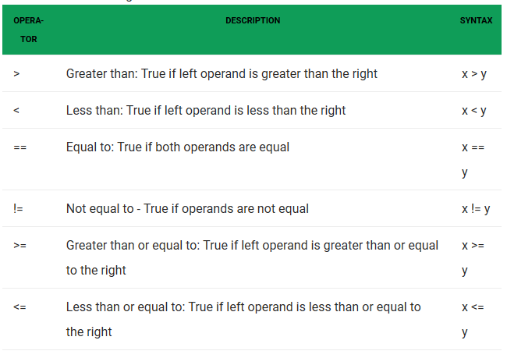
Relational Operator

Slide 3

Logical Operator

Slide 4
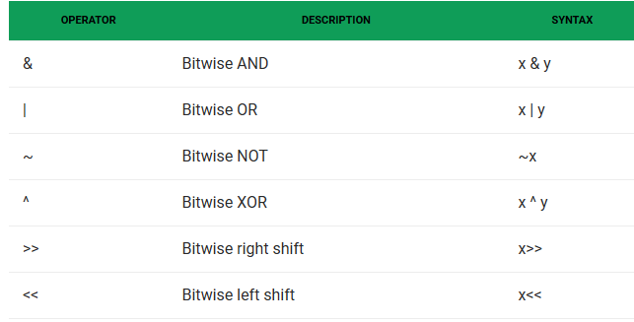
Bitwise Operator

Slide 5
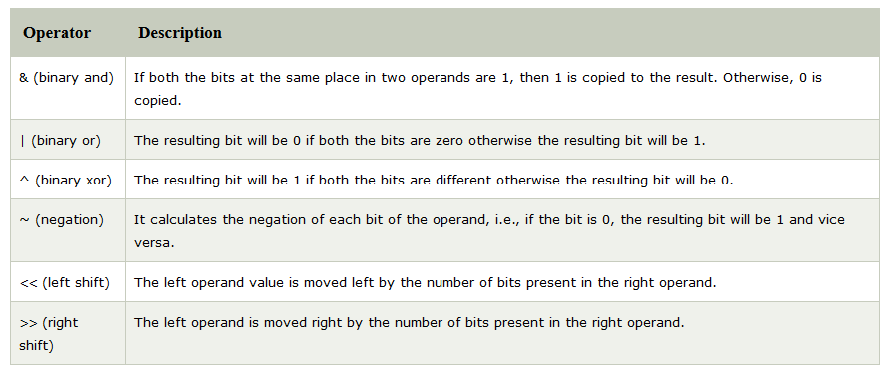

Slide 6
