Slide 1
VISUAL PROGRAMMING
.Net Framework
By kumar Vishal

Slide 2
.Net Framework
The Microsoft .NET Framework is a platform for building, deploying, and running Web Services and applications.
.NET Framework provides an execution environment, simplified development and deployment, and integration with a variety of programming languages, including Visual Basic and Visual C#.
Two major components:
      .Net Class library
      CLR

Slide 3
.Net Class library
The .Net Framework Class Library (FCL) includes a huge collection of reusable classes.
The .Net Framework class library (FCL) organized in a hierarchical tree structure and it is divided into Namespaces.
The System Namespaces is the root for types in the .NET Framework.
We can identify any Class in the .NET Framework Class Library (FCL ) by using the full Namespaces of the class

Slide 4
CLR(Common Language Runtime)
The Common Language Runtime (CLR) is a an Execution Environment .
Common Language Runtime (CLR)'s main tasks are to convert the .NET Managed Code to native code.
Common Language Runtime (CLR) manages Memory Management that is allocation of Objects and Buffers , Garbage Collection (GC) - Clean up the unused Objects and buffers , Exception Handling

Slide 5
Components of CLR:
CTS (Common type system)
CLS (Common language specification)
MSIL(microsoft intermediate language)

Slide 6
CTS (Common type system)
In .NET, every Data Type is internally represented by a class or structure. All the classes and structures related to Data Types are collectively known as CTS.
Every language provides its own keywords for Data Types but internally all the languages which run under .NET framework use the classes and structures available in CTS.
For example, C# has int Data Type and VB.Net has Integer Data Type. Hence a variable declared as int in C# or Integer in vb.net, finally after compilation, use the same structure Int32 from CTS.

Slide 7
CTS (Common type system)
Common Type System (CTS) describes a set of types that can be used in different .Net languages in common .
Common Type System (CTS) provides base set of Data Types which is responsible for cross language integration.
The Common Language Runtime (CLR) can load and execute the source code written in any .Net language, only if the type is described in the Common Type System (CTS)

Slide 8
CLS (Common language specification)
CLS stands for Common Language Specification and it is a subset of CTS. It defines a set of rules and restrictions that every language must follow which runs under .NET framework.

Slide 9
CLS (Common language specification)
For example, one rule is that you cannot use multiple inheritance within .NET Framework. As you know C++ supports multiple inheritance but; when you will try to use that C++ code within C#, it is not possible because C# doesn’t supports multiple inheritance.
One another rule is that you cannot have members with same name with case difference only i.e. you cannot have add() and Add() methods. In case of C# it is case-sensitive but when you will try to use that in VB.NET, it is not possible because VB.NET is not case-sensitive.

Slide 10
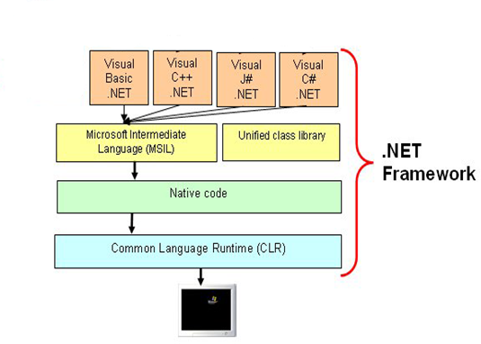
MSIL(microsoft intermediate language)

Slide 11
MSIL(microsoft intermediate language)
During the compile time , the compiler convert the source code into Microsoft Intermediate Language (MSIL) .
Microsoft Intermediate Language (MSIL) is a CPU-independent set of instructions that can be efficiently converted to the native code. During the runtime the Common Language Runtime (CLR)'s Just In Time (JIT) compiler converts the Microsoft Intermediate Language (MSIL) code into native code to the Operating System.

Slide 12
Garbage Collection (GC)
The .Net Framework provides a new mechanism for releasing unreferenced objects from the memory (that is we no longer needed that objects in the program) ,this process is called Garbage Collection (GC).
The programming languages like C++, programmers are responsible for allocating memory for Objects they created in the application and reclaiming the memory when that Object is no longer needed for the program. In .Net languages there is a facility that we can call Garbage Collector (GC) explicitly in the program by calling System.GC.Collect.

Slide 13
Assemblies
Collection of .dll or .exe files
Assembly is a collection of types and resource information that are built to work together and form a logical unit of functionality.
It include both executable application files that you can run directly from Windows without the need for any other programs (.exe files), and libraries (.dll files) for use by other applications.

Slide 14
assemblies in .NET
There are two kind of assemblies in .NET
private
shared
A private assembly is used only by a single application, and usually it is stored in that application's install directory.
A shared Assembly is one that can be referenced by more than one application. If multiple applications need to access an assembly, we should add the assembly to the Global Assembly Cache (GAC).

