Slide 1
VISUAL PROGRAMMING
Window Form Controls
By kumar Vishal

Slide 2
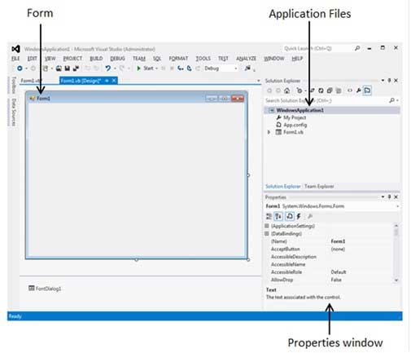
Forms
Steps:->
File -> New Project -> Windows Forms Applications

Slide 3
Form Controls
Common Controls
Containers
Menus and toolbar
Data
Dialogs

Slide 4
Common Controls:
Label
TextBox
Button
CheckBox
CheckedListBox
RadioButton
ListBox
ComboBox
PictureBox
DateTimePicker
MaskedTextBox
RichTextBox
Tooltip
WebBrowser
ProgressBar

Slide 5
Containers
GroupBox
Panel
TabControl

Slide 6
Menus and toolbar
ContextMenuStrip
MenuStrip

Slide 7
Data
DataGridView
DataSet
Chart

Slide 8
Dialogs
ColorDialog
FolderBrowserDialog
FontDialog
OpenFileDialog
SaveFileDialog

