Slide 1
VISUAL PROGRAMMING
Basic Concepts
By kumar Vishal

Slide 2
VB.Net - Program Structure
Comments
Namespace declaration
A class or module
One or more procedures
Variables
The Main procedure
Statements & Expressions

Slide 3
Example: Console App
'This program will display Hello World
Imports System
Module Module1
Sub Main()
Console.WriteLine("Hello World")
Console.ReadKey()
End Sub
End Module

Slide 4
Data types
Boolean Data Type
Byte Data Type
Char Data Type
Date Data Type
Decimal Data Type
Double Data Type
Integer Data Type
Long Data Type
Object Data Type
SByte Data Type
Short Data Type
Single Data Type
String Data Type
UInteger Data Type
ULong Data Type
UShort Data Type

Slide 5
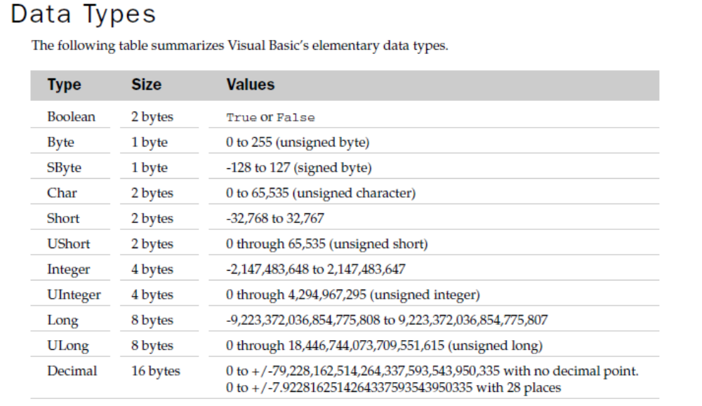

Slide 6
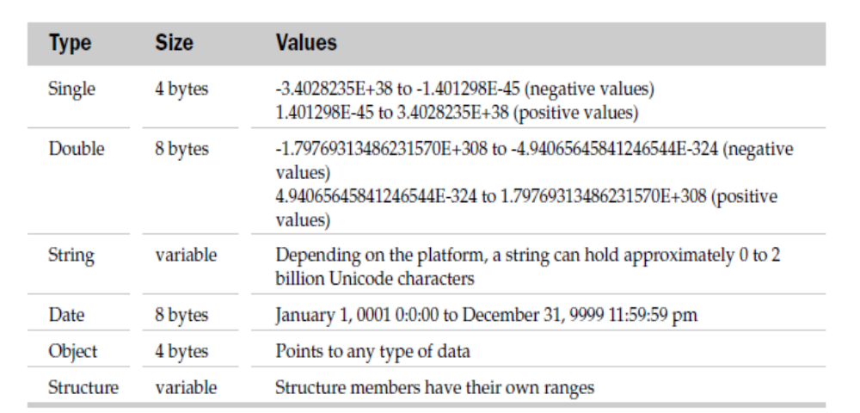
Continued...

Slide 7
Object Data Type
The Object Data Type is the root type in the .NET Framework
You can assign any reference type (string, array, class, or interface) to an Object variable.
An Object variable can also refer to data of any value type (integer, Boolean, Char, Date, structure, or enumeration).

Slide 8
Difference between a Value Type and a Reference Type
The Types in .NET Framework are either treated by Value Type or by Reference Type.
A Value Type holds the data within its own memory allocation and a Reference Type contains a pointer to another memory location that holds the real data.
Reference Type variables are stored in the heap while Value Type variables are stored in the stack.

Slide 9
Boxing and Unboxing
Boxing is simply the process of converting a value type to object type
Unboxing is the process of converting a object type to value type

Slide 10
Example
Dim i As Integer
i = 123
Dim o As Object = i
Dim i As Integer
Dim o As Object = 78
i = CInt(o)

Slide 11
Types of Operators
Arithmetic Operators
Comparison Operators
Concatenation Operators
Logical and Bitwise

Slide 12
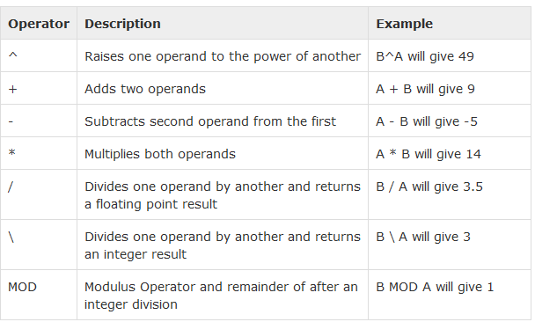
Arithmetic Operators

Slide 13
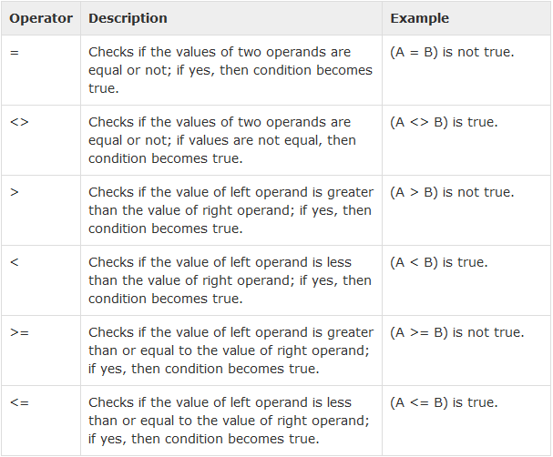
Comparison Operators

Slide 14
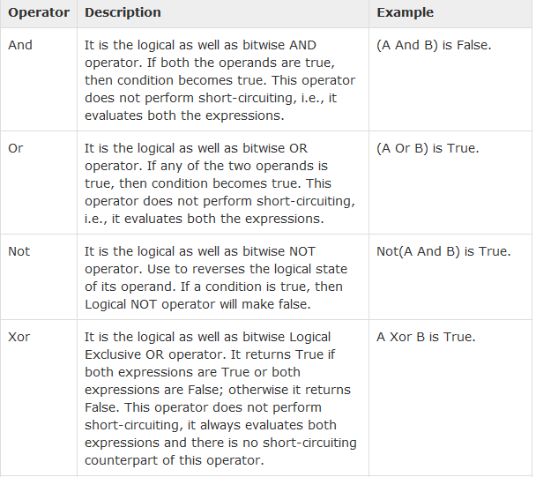
Logical

Slide 15
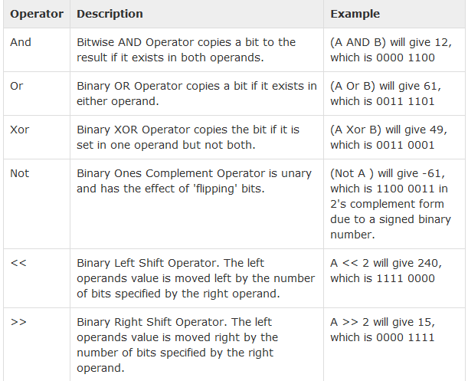
Bit Shift Operators

Slide 16
Concatenation Operators
+ or &
+ : it can concatenate numeric operands with string operands.
&:is defined only for String operands

Slide 17
Loop Statement: Do
Syntax:
  Do
  statements
  Loop while(condition) / Loop Until(condition)
E.g.
  Module Module1
  Sub Main()
  Dim a As Integer = 10
  Do
  Console.WriteLine("value of a: {0}", a)
  a = a + 1
  Loop While (a < 20)
  Console.ReadLine()
  End Sub
  End Module

Slide 18
Do
Console.WriteLine("value of a: {0}", a)
a = a + 1
Loop Until (a = 20)
Console.ReadLine()

Slide 19
While …end while
While condition statements
End While
Ex:-

Slide 20
Loop Statement: For
Syntax:
  For startindex To endindex [Step step]
  Next [index]
E.g.
  Module Module1
  Sub Main()
  Dim loopIndex As Integer
  For loopIndex=0 to 3
  System.Console.WriteLine(“Hello!”)
  Next loopIndex
  End Sub
  End Module

Slide 21
Loop Statement: For Each…Next
Syntax:
  For Each var In Array
  Next
E.g.
  Sub Main()
  Dim intItem As Integer
  Dim intArray() As Integer = {1, 3, 5, 7, 9}
  For Each intItem In intArray
  System.Console.WriteLine(intArray)
  Next intItem
  End Sub

Slide 22
The difference between Functions and Subs
Functions return a value, and Subs don't.
Substring() is a Function, because you want some sort of answer back, and an answer that you can then use elsewhere. You assign the answer to the Substring() function to a variable.
A Sub is some code or job that you want VB to get on with and execute. An example is closing a form down and unloading it with Me.Close(). You don't need to return a value, here; you just want VB to close your form down.

Slide 23
Arrays
Dim intData() As Integer = {12, 16, 20, 24, 28, 32}
Dim names() As String = {"Karthik", "Sandhya", _ "Shivangi", "Ashwitha", "Somnath"}

Slide 24
Dynamic Arrays
Dynamic arrays are arrays that can be dimensioned and re-dimensioned as par the need of the program. You can declare a dynamic array using the ReDim statement.
Dim marks() As Integer
ReDim marks(2)

Slide 25
You can declare a 2-dimensional array of strings as:
Dim twoDStringArray(10, 20) As String
Jagged Array
A Jagged array is an array of arrays. The follwoing code shows declaring a jagged array named scores of Integers:

Slide 26
Ex:
Dim a As Integer()() = New Integer(4)() {}
a(0) = New Integer() {0, 0}
a(1) = New Integer() {1, 2}
a(2) = New Integer() {2, 4}
a(3) = New Integer() {3, 6}
a(4) = New Integer() {4, 8}

