Slide 2
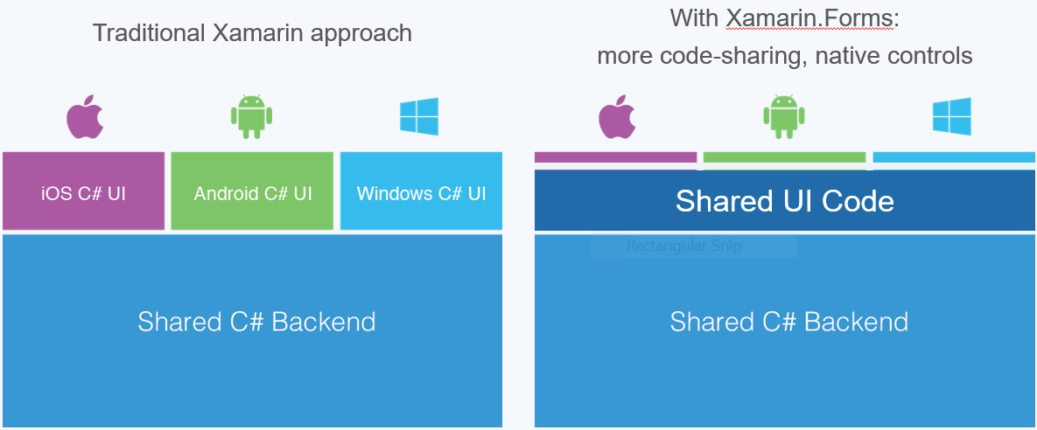

Slide 3
ANATOMY OF APP
In Xamarin.Forms, the objects that appear on the screen are collectively called visual elements. They come in three main categories:
• page
• layout
• view

Slide 4
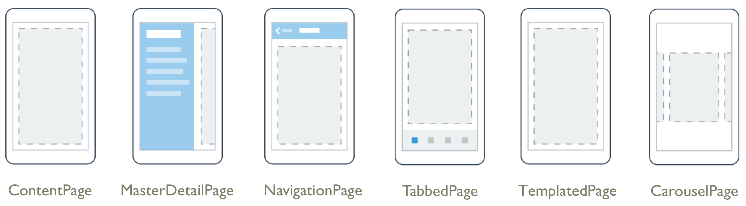
PAGES
Xamarin.Forms Pages represent cross-platform mobile app screens.
The Page class is a visual element that occupies most or all of the screen and contains a single child. A Xamarin.Forms.Page represents a View Controller in iOS or a Page in Windows Phone. On Android each page takes up the screen like an Activity, but Xamarin.Forms Pages are not Activities.

Slide 5
ContentPage: A ContentPage displays a single View, often a container such as a StackLayout or a ScrollView.
MasterDetailPage: A Page that manages two panes of information.
NavigationPage: A Page that manages the navigation and user-experience of a stack of other pages.
TabbedPage: A Page that allows navigation between children pages, using tabs.
TemplatedPage : A Page that displays full-screen content with a control template, and the base class for ContentPage.
CarouselPage: A Page allowing swipe gestures between subpages, like a gallery.

Slide 6
LAYOUTS:
Xamarin.Forms has several layouts for organizing on-screen content. StackLayout, Grid, AbsoluteLayout, ScrollView, and RelativeLayout can each be used to create beautiful, responsive user interfaces.
StackLayout organizes views in a one-dimensional line ("stack"), either horizontally or vertically.
AbsoluteLayout : Positions child elements at absolute requested positions. User assigned anchors and bounds defines the position and size of the control.
Grid : A layout containing views arranged in rows and columns.
RelativeLayout : A Layout that uses Constraints to layout its children.
Scrollview: An element capable of scrolling if it's Content requires.

Slide 7
VIEWS
Xamarin.Forms views are the controls displayed on the user interface, such as labels, buttons, and text entry boxes.

Slide 8
Blank App (Xamarin.Forms Portable / Xamarin.Forms Shared) – These templates will create two flavors of a Xamarin Forms solution.
Blank App (Xamarin.Forms Portable), which will create a solution consisting of 4 projects, one per platform and a PCL library which can be referenced from all these platform specific projects.
Class Library (Xamarin.Forms) – This template will create a class library which can be referenced from any Xamarin.Forms project.

Slide 9
When using the Shared option, Visual Studio creates a project for each platform and a special project you can add files and resources to. All items are considered part of the platform specific projects, creating a single point where changes have an effect over the rest of the projects.
When using the Portable option, Visual Studio creates a project for each platform and a portable class library (PCL). A PCL can be referenced from each project. The compiler will enforce usage of types that are common for every member of the PCL configuration.

Slide 10
Class Library(Xamarin.Forms Portable)
  Is an Portable Class Library you can put classes in, which would then be usable by either an Android, iOS or WP app.
Blank App(Xamarin.Forms Portable)
  Creates a set of apps for Android, iOS and possibly WP using a Portable Class Library for the common parts
Blank App(Xamarin.Forms Shared)
  Creates a set of apps for Android, iOS and possibly WP using a Shared Library for the common parts
The difference between PCL and Shared is that a PCL library is compiled once, and then referenced as a library by each app. A Shared library is compiled directly into each app (and is thus compiled three times as opposed to one for the PCL)

Slide 11
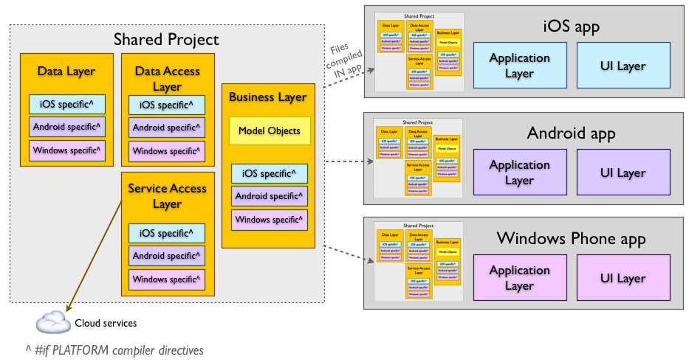

Slide 12
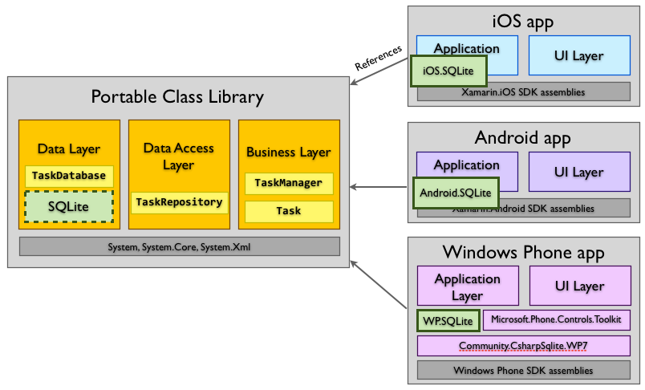

Slide 13
SHARED ASSET PROJECTS AND PORTABLE CLASS LIBRARY (PCL) PROJECTS.
There are two major approaches to code sharing that address this problem: Shared Asset Projects and Portable Class Library (PCL) projects.
Shared Asset Projects use a single set of files and offers a quick and simple way in which to share code within a solution.
Unlike most other project types a shared project does not have any output (in DLL form), instead the code is compiled into each project that references it. This is illustrated in the diagram below - conceptually the entire contents of the Shared Project is "copied into" each referencing project and compiled as though it was a part of them.

Slide 14
<ContentPage xmlns="http://xamarin.com/schemas/2014/forms"
xmlns:x="http://schemas.microsoft.com/winfx/2009/xaml"
x:Class="XamlSamples.HelloXamlPage">
</ContentPage>
The two XML namespace ( xmlns) declarations refer to URIs.
They are simply URIs owned by Xamarin and Microsoft, and they basically function as version identifiers.

Slide 15
The first XML namespace declaration means that tags defined within the XAML file with no prefix refer to classes in Xamarin.Forms, for example ContentPage.
The second namespace declaration defines a prefix of x. This is used for several elements and attributes that are basic to XAML itself.
The x:Class attribute specifies a fully qualified .NET class name: the HelloXamlPage class in the XamlSamples namespace.
This means that this XAML file defines a new class named HelloXamlPage in the XamlSamples namespace that derives from ContentPage-the tag in which the x:Class attribute appears.

Slide 16
SETTING PAGE CONTENT
<ContentPage xmlns="http://xamarin.com/schemas/2014/forms"
xmlns:x="http://schemas.microsoft.com/winfx/2009/xaml"
x:Class="XamlSamples.HelloXamlPage"
Title="Hello XAML Page"
Padding="10, 40, 10, 10">

Slide 17
METHOD DECLARATION: ASYNC AND AWAIT (TO PERFORM LONG-RUNNING TASKS WITHOUT BLOCKING THE MAIN THREAD OF YOUR APPLICATION.)
async
The async keyword is placed in a method declaration to indicate that it contains code that can run asynchronously, ie. not block the caller’s thread.
await
The await operator can be applied to a Task inside a method marked as async. It causes the method to stop execution at that point and wait until the task completes.

