Slide 2
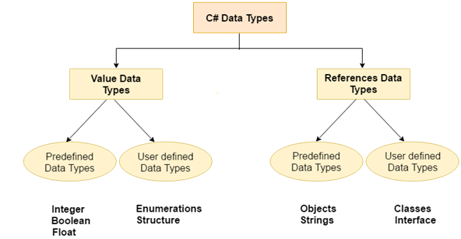

Slide 3
Types | Data Types
Value Data Type | short, int, char, float, double etc
Reference Data Type | String, Class, Object and Interface

Slide 4
Boxing/ Unboxing
C# allows us to convert a Value Type to a Reference Type, and back again to Value Types . The operation of Converting a Value Type to a Reference Type is called Boxing and the reverse operation is called Unboxing.
int Val = 1;
Object Obj = Val; //Boxing
UnBoxing
int Val = 1;
Object Obj = Val; //Boxing
int i = (int)Obj; //Unboxing

Slide 5
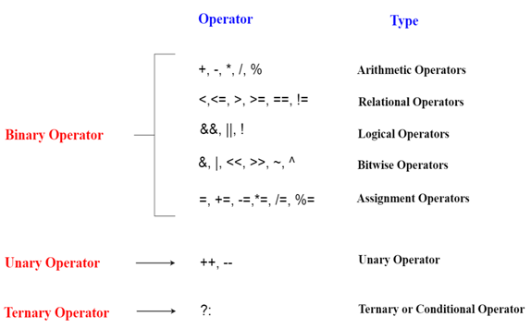
Different types of operators

Slide 6
Enhance For Loop
string[] pets = { "dog", "cat", "bird" };
// ... Loop with the foreach keyword.
foreach (string value in pets)
{
Console.WriteLine(value);
}

Slide 7
Array
int[] arr = new int[5];//creating array
int arr[] = new int[5];//compile time error

Slide 8
Property
Usually inside a class, we declare a data field as private and will provide a set of public SET and GET methods to access the data fields. since the data fields are not directly accessible out side the class. We must use the set/get methods to access the data fields.
<acces_modifier> <return_type> <property_name>
{
get
{
}
set
{
}
Example
}

