Slide 2
AbsoluteLayout – used to arrange views by setting coordinates & size in terms of absolute values.
RelativeLayout – used to arrange views by setting constraints relative to their parent's dimensions & position.
Grid – used to arrange views in a grid. Rows and columns can be specified in terms of absolute values.
ScrollView – used to provide scrolling when a view can't fit entirely within the bounds of the screen.

Slide 3
Views within an AbsoluteLayout are positioned using four values:
X – the x (horizontal) position of the view's anchor
Y – the y (vertical) position of the view's anchor
Width – the width of the view
Height – the height of the view

Slide 4
<AbsoluteLayout>
<BoxView Color="Olive" AbsoluteLayout.LayoutBounds="678,254,100,100">
</BoxView>
<Label Text="Hello Kumar" FontSize="Large" TextColor="White" AbsoluteLayout.LayoutBounds="678,254,100,100" />
</AbsoluteLayout>

Slide 5
RelativeLayout
Positioning and sizing a view within a RelativeLayout is done with constraints. A constraint expression can include the following information:
Type – whether the constraint is relative to the parent or to another view.
Property – which property to use as the basis for the constraint.
Factor – the factor to apply to the property value.
Constant – the value to use as an offset of the value.

Slide 6
<BoxView Color="Green" WidthRequest="50" HeightRequest="50"
RelativeLayout.XConstraint =
"{ConstraintExpression Type=RelativeToParent,
Property=Width,
Factor=0.5,
Constant=-100
}”
RelativeLayout.YConstraint =
"{ConstraintExpression Type=RelativeToParent,
Property=Height,
Factor=0.5,
Constant=-100
}" />

Slide 7
return (.5 * parent.Width) -100
return (.5 * parent.Height) -100

Slide 8
GridLayout
<Grid>
<Grid.RowDefinitions>
<RowDefinition Height="*" />
<RowDefinition Height="*" />
<RowDefinition Height="*" />
<RowDefinition Height="*" />
</Grid.RowDefinitions>
<Grid.ColumnDefinitions>
<ColumnDefinition Width="*" />
<ColumnDefinition Width="*" />
<ColumnDefinition Width="*" />
</Grid.ColumnDefinitions>
<Button Text="1" Grid.Row="0" Grid.Column="0" />
-----------------------------------------------------

Slide 9
scrollview
ScrollView can be used to ensure that larger views display well on smaller phones.
ScrollView contains layouts and enables them to scroll offscreen.
ScrollView is also used to allow views to automatically move to the visible portion of the screen when the keyboard is showing.

Slide 10
<ScrollView>
<StackLayout>
<BoxView BackgroundColor="Red" HeightRequest="600" WidthRequest="150" />
<Entry />
</StackLayout>
</ScrollView>

Slide 11
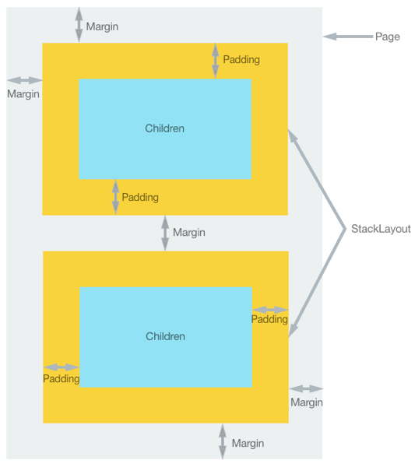
Margin and Padding

Slide 12
The Margin and Padding properties are both of type Thickness.
The Margin property represents the distance between an element and its adjacent elements, and is used to control the element's rendering position, and the rendering position of its neighbors. Margin values can be specified on layout and view classes.
The Padding property represents the distance between an element and its child elements, and is used to separate the control from its own content. Padding values can be specified on layout classes.
Padding=left,top,right,bottom

