Slide 2
Visual studio and Solutions
When you create an app, application, website, Web App, script, plug-in, etc in Visual Studio, you start with a project.
In a logical sense, a project contains of all the source code files, icons, images, data files and anything else that will be compiled into an executable program or web site, or else is needed in order to perform the compilation.
A project also contains all the compiler settings and other configuration files that might be needed by various services or components that your program will communicate with.

Slide 3
A project is an XML file (*.vbproj, *.csproj, *.vcxproj) that defines a virtual folder hierarchy along with paths to all the items it "contains" and all the build settings.
In Visual Studio, the project file is used by Solution Explorer to display the project contents and settings. When you compile your project, the MSBuild engine consumes the project file to create the executable.
A solution has an associated *.suo file that stores settings, preferences and configuration information for each user that has worked on the project.

Slide 4
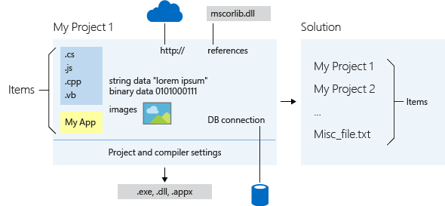

Slide 5
Introduction to Xamarin
Xamarin is a Microsoft-owned San Francisco, California-based software company founded in May 2011 by the engineers that created Mono,Mono for Android and MonoTouch, which are cross-platform implementations of the Common Language Infrastructure (CLI) and Common Language Specifications (often called Microsoft .NET).

Slide 6
Products:
Xamarin platform
Xamarin.Forms
Xamarin Test Cloud
Xamarin for Visual Studio
Xamarin Studio
Xamarin.Mac
.Net Mobility Scanner
RoboVM

Slide 7
Xamarin claims to be the only IDE that allows for native Android, iOS and Windows app development within Microsoft Visual Studio.
Xamarin supplies add-ins to Microsoft Visual Studio that allows developers to build Android, iOS, and Windows apps within the IDE using code completion and IntelliSense.
Xamarin for Visual Studio also has extensions within Microsoft Visual Studio that provide support for the building, deploying, and debugging of apps on a simulator or a device.
On March 31, 2016 Microsoft announced that they were merging all of Xamarin's software with every version of Microsoft Visual Studio including Visual Studio Community (which shall receive Xamarin Studio Community), and this added various Xamarin features to come pre-installed in Visual Studio such as an iOS emulator.

Slide 8
Introduction to Xamarin.Forms
Xamarin.Forms is a framework that allows developers to rapidly create cross platform user interfaces. It provides it's own abstraction for the user interface that will be rendered using native controls on iOS, Android, Windows, or Windows Phone. This means that applications can share a large portion of their user interface code and still retain the native look and feel of the target platform.
There are two techniques to create user interfaces in Xamarin.Forms. The first technique is to create UIs entirely with C# source code. The second technique is to use Extensible Application Markup Language (XAML), a declarative markup language that is used to describe user interfaces.

Slide 9
The Xamarin.Forms option
Xamarin.Forms supports five distinct application platforms:
iOS for programs that run on the iPhone, iPad, and iPod Touch.
Android for programs that run on Android phones and tablets.
The Universal Windows Platform (UWP) for applications that runs under Windows 10 or Windows 10 Mobile.
The Windows Runtime API of Windows 8.1.
The Windows Runtime API of Windows Phone 8.1.

Slide 10
Machines and IDEs
If you want to target the iPhone, you’re going to need a Mac.
Apple requires that a Mac be used for building iPhone and other iOS applications.
You’ll need to install Xcode on this machine and, of course, the Xamarin platform that includes the necessary libraries and Xamarin Studio.
You can then use Xamarin Studio and Xamarin.Forms on the Mac for your iPhone development.

Slide 11
Once you have a Mac with Xcode and the Xamarin platform installed, you can also install the Xamarin platform on a PC and program for the iPhone by using Visual Studio.
The PC and Mac must be connected via a network (such as Wi-Fi). Visual Studio communicates with the Mac through a Secure Shell (SSH) interface, and uses the Mac to build the application and run the program on a de-vice or simulator.
You can also do Android programming in Xamarin Studio on the Mac or in Visual Studio on the PC.

Slide 12
If you want to target the Windows platforms, you’ll need Visual Studio 2015. You can target all the platforms in a single IDE by running Visual Studio 2015 on a PC connected to the Mac via a network.

Slide 13
Devices and emulators
You can test your programs on real phones connected to the machines via a USB cable, or you can test your programs with onscreen emulators.
There are advantages and disadvantages to each approach. A real phone is essential for testing complex touch interaction or when getting a feel for startup or response time. However, emulators al-low you to see how your application adapts to a variety of sizes and form factors.
The iPhone and iPad emulators run on the Mac. However, because Mac desktop machines don’t have touchscreens, you’ll need to use the mouse or trackpad to simulate touch. The touch gestures on the Mac touchpad do not translate to the emulator. You can also connect a real iPhone to the Mac, but you’ll need to provision it as a developer device

