Slide 1
Superstore Sales & Profit Analysis
Exploratory Data Analysis & Interactive Power BI Dashboard
Name: VISHAL
Student ID: INST26DA030224
Email: vk4499573@gmail.com
Internship Domain: Data Analytics
Batch Cohort: Batch-03
Superstore Sales & Profit Analysis • Data Analytics • Batch-03 | 1

Slide 2
Project Overview & Problem Statement
RAW DATA
POWER BI
INSIGHTS
Retail orders
Clean • Analyze • Visualize
Business decisions
Objective: analyze sales, profit, customers, products, categories, segments and regions.
Identify trends, relationships, high/low-performing areas and potential outliers.
Build an interactive Power BI dashboard for data-driven business decisions.
Superstore Sales & Profit Analysis • Data Analytics • Batch-03 | 2

Slide 3
Dataset & Data Preparation
Dataset: Sample Superstore retail sales dataset.
Key fields include Order ID, Order Date, Ship Date, Customer, Region, Category, Sub-Category, Sales, Quantity, Discount and Profit.
Checked data types, missing values, errors and duplicate records.
Validated Quantity, Sales, Discount and Order/Ship Date logic.
Negative-profit transactions were retained when they represented valid business transactions.
DATA SOURCE
Tableau Public
Sample Data – Superstore
public.tableau.com/app/resources/sample-data
Superstore Sales & Profit Analysis • Data Analytics • Batch-03 | 3

Slide 4
Exploratory Data Analysis
Total Sales
Total Profit
Total Orders
Customers
2.30M
286.40K
5K
793
Technology is a leading category in sales and profit.
West is the strongest region by sales.
Consumer is the largest customer segment.
Sales and profit show a moderate positive relationship (correlation ≈ 0.48).
Potential outliers were identified and retained as valid business observations.
Superstore Sales & Profit Analysis • Data Analytics • Batch-03 | 4

Slide 5
Data Visualizations
Trend Analysis
Comparison
Line Chart
Monthly Sales & Profit
Bar / Column
Category & Region
Relationship
Product Analysis
Scatter Plot
Sales vs Profit
Bar Charts
Top 10 Sales & Profit
Superstore Sales & Profit Analysis • Data Analytics • Batch-03 | 5

Slide 6
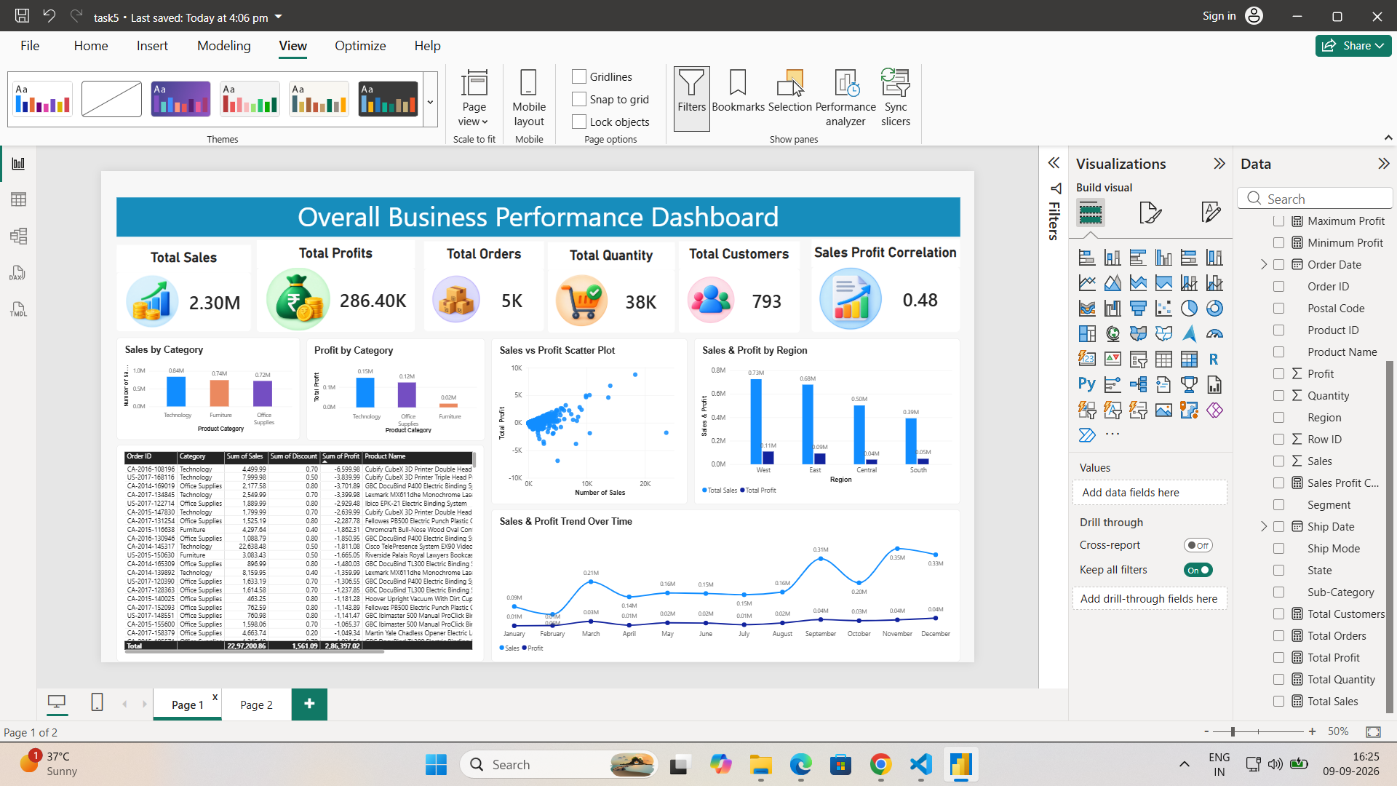
Power BI Dashboard – Page 1
Overall Business Performance Dashboard
Superstore Sales & Profit Analysis • Data Analytics • Batch-03 | 6

Slide 7
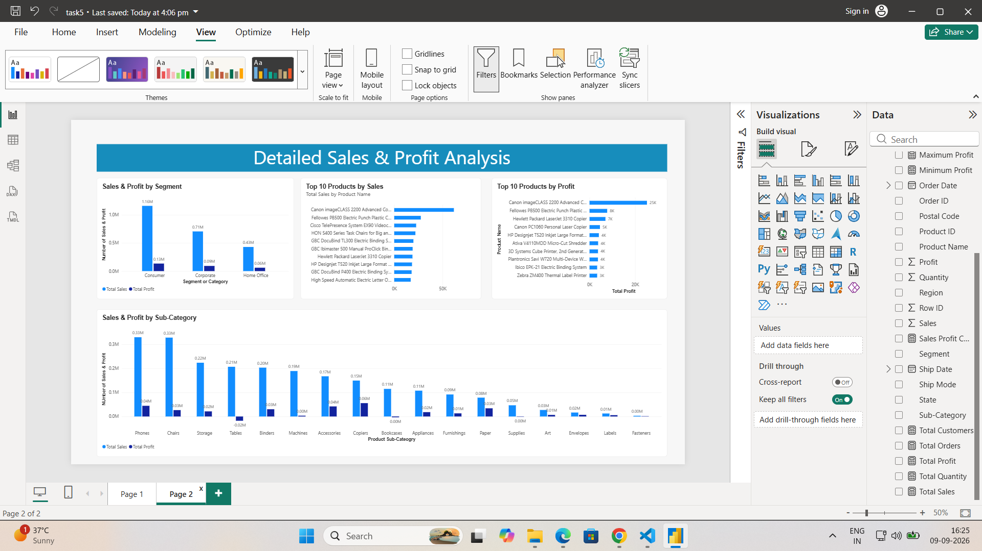
Power BI Dashboard – Page 2
Detailed Sales & Profit Analysis
Superstore Sales & Profit Analysis • Data Analytics • Batch-03 | 7

Slide 8
Key Business Insights
Technology is one of the strongest categories in terms of sales and profit.
West is the strongest region by sales.
Consumer is the largest contributor to sales and profit.
Some sub-categories generate low or negative profit despite having sales.
A small number of products contribute significantly to overall sales and profitability.
Higher sales generally tend to be associated with higher profit, but sales do not guarantee profitability.
Superstore Sales & Profit Analysis • Data Analytics • Batch-03 | 8

Slide 9
Business Recommendations & Conclusion
1. Improve Profitability
2. Focus on Strengths
Review pricing, discounts and costs for low-profit and negative-profit sub-categories.
Prioritize high-performing products and the Consumer segment while improving weaker regions.
Conclusion: Power BI transformed the Superstore data into an interactive view of sales, profitability and business performance.
The dashboard can support decisions related to products, discounts, profitability and regional growth.
Dataset source: Tableau Public – Sample Data
Superstore Sales & Profit Analysis • Data Analytics • Batch-03 | 9

