Slide 1

t-Tests
Math 1150/QMGT-1150
Fall, 2019
Dr. Ken Thompson

Slide 2

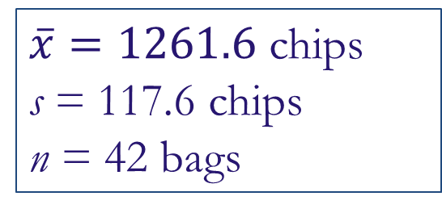
Chips Ahoy!
A group of Air Force cadets bought bags of Chips Ahoy! cookies from all over the country to verify the Nabisco claim that every bag contains 1000 chocolate chips. They hand counted the number of chips in 42 bags.
$\overline{x}=1261.6$ chips
s = 117.6 chips
n = 42 bags

Slide 3
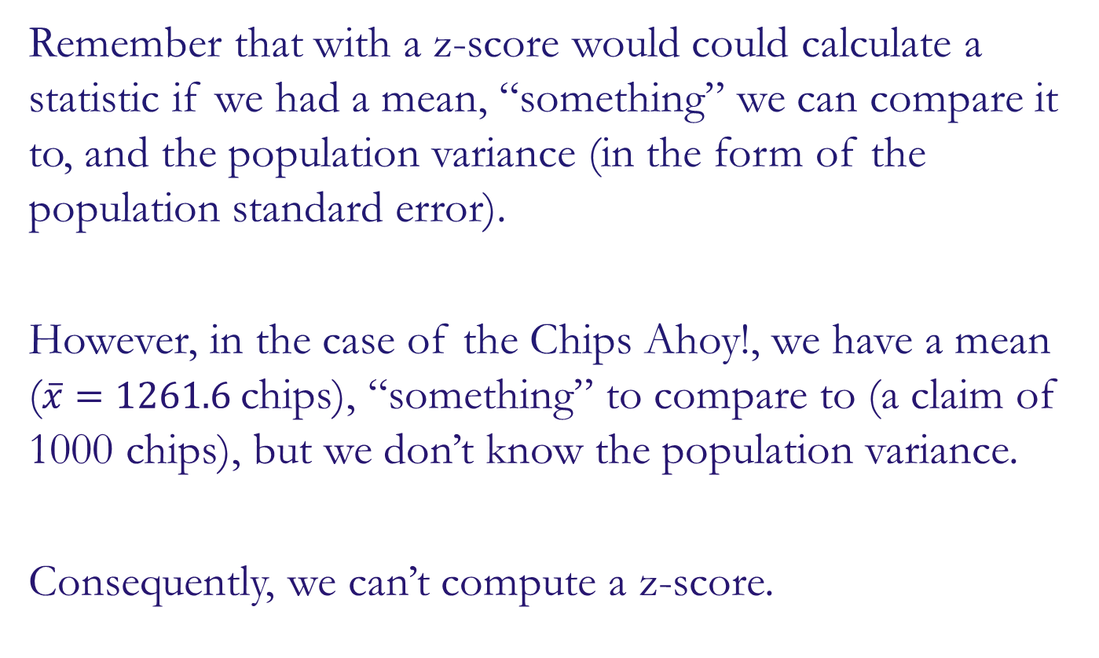
From Z to t
Remember that with a z-score would could calculate a statistic if we had a mean, “something” we can compare it to, and the population variance (in the form of the population standard error).
However, in the case of the Chips Ahoy!, we have a mean ($\overline{x}=1261.6$ chips), “something” to compare to (a claim of 1000 chips), but we don’t know the population variance.
Consequently, we can’t compute a z-score.

Slide 4
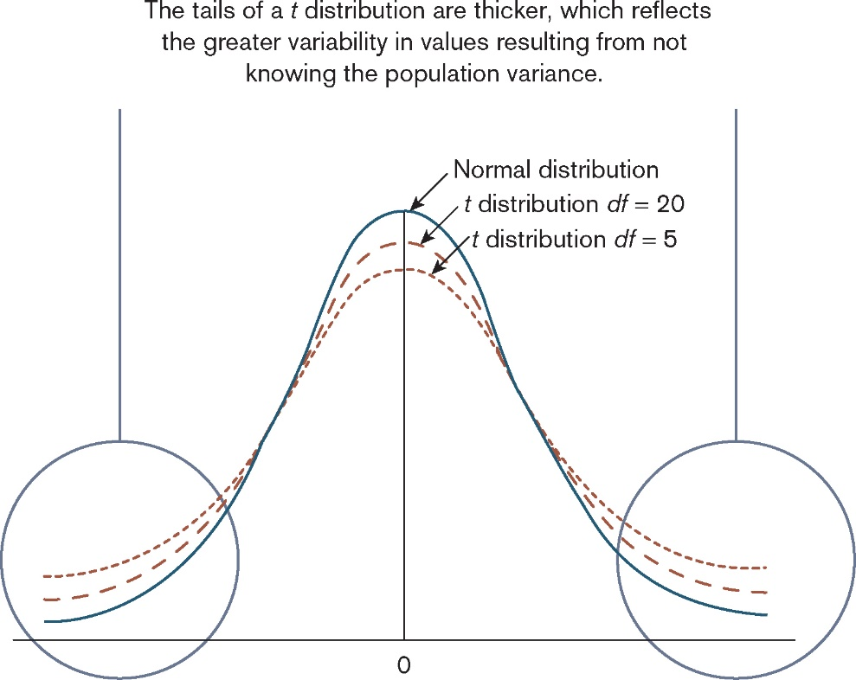
From Z to t
It is like a normal distribution, but with greater variability in the tails…
… because we estimate standard error using the sample standard error.

Slide 5
What is a t Distribution?
However, if the population is approximately normal or if n is large (n ≥ 30), the p-value can be computed as the area in the tail(s) beyond t of a t-distribution with n – 1 degrees of freedom

Slide 6


From Z to t
$$t=\frac{\overline{x}−μ_{0}}{s/{\sqrt{n}}}$$
$$\frac{statistic −null}{SE}$$

Slide 7

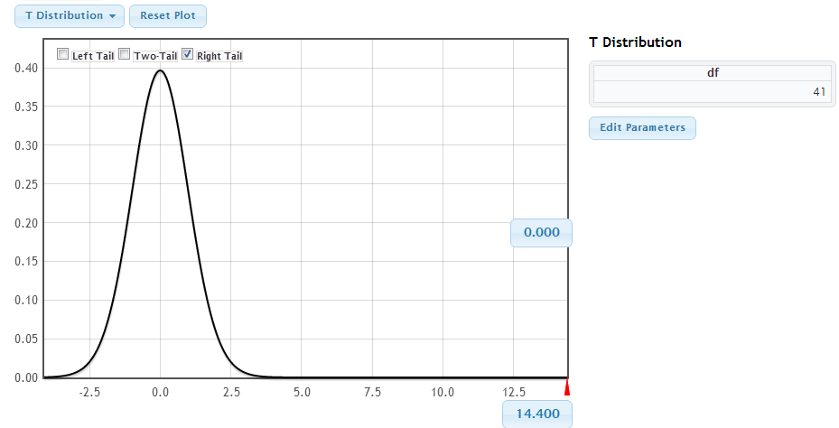
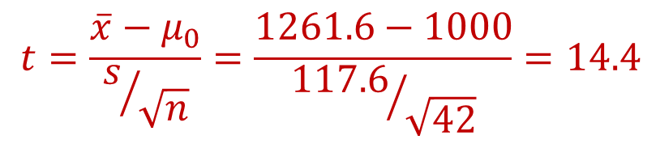
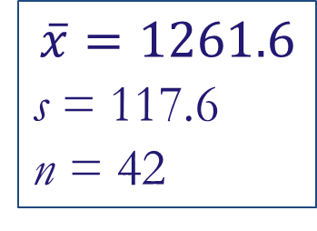
Back to Chips Ahoy!
$$\overline{x}=1261.6$$
s = 117.6
n = 42
H₀: μ = 1000
H_{a}: μ > 1000
1. State hypotheses:
2. Check conditions:
n = 42 ≥ 30
3. Calculate test statistic:
$$t=\frac{\overline{x}−μ_{0}}{s/{\sqrt{n}}}=\frac{1261.6−1000}{{117.6}/{\sqrt{42}}}=14.4$$
4. Compute p-value:
p-value ≈ 0
4. Interpret in context:
This provides extremely strong evidence that the average number of chips per bag of Chips Ahoy! cookies is greater than 1000.

Slide 8
Experiments
The simplest form of experiment that can be done is one with only one independent variable that is manipulated in only two ways and only one outcome is measured.
More often than not, the manipulation of the independent variable involves having an experimental condition and a control.
E.g., Is the movie Scream 2 scarier than the original Scream? We could measure heart rates (which indicate anxiety) during both films and compare them.
This situation can be analysed with a t-test

Slide 9
t-test
Independent t-test
Compares two means based on independent data.
E.g., data from different groups of people.
Dependent t-test
Compares two means based on related data.
E.g., Data from the same people measured at different times.
Data from ‘matched’ samples.
Significance testing
Testing the significance of Pearson’s correlation coefficient
Testing the significance of b in regression.

Slide 10
Rationale for the t-test
Two samples of data are collected and the sample means calculated. These means might differ by either a little or a lot.
If the samples come from the same population, then we expect their means to be roughly equal. Although it is possible for their means to differ by chance alone, we would expect large differences between sample means to occur very infrequently.

Slide 11
Rationale for the t-test
We compare the difference between the sample means that we collected to the difference between the sample means that we would expect to obtain if there were no effect (i.e. if the null hypothesis were true). We use the standard error as a gauge of the variability between sample means.

Slide 12
Rationale for the t-test
If the difference between the samples we have collected is larger than what we would expect based on the standard error then we can assume one of two things:
There is no effect and sample means in our population fluctuate a lot and we have, by chance, collected two samples that are atypical of the population from which they came.
The two samples come from different populations but are typical of their respective parent population. In this scenario, the difference between samples represents a genuine difference between the samples (and so the null hypothesis is incorrect).

Slide 13
Rationale for the t-test
As the observed difference between the sample means gets larger, the more confident we become that the second explanation is correct (i.e. that the null hypothesis should be rejected). If the null hypothesis is incorrect, then we gain confidence that the two sample means differ because of the different experimental manipulation imposed on each sample.

Slide 14
Rationale for the t-test
t | = | observed difference between sample means | − | expected difference between population means (if null hypothesis is true)
 |  | estimate of the standard error of the difference between two sample means

Slide 15
Assumptions of the t-test
Both the independent t-test and the dependent t-test are parametric tests based on the normal distribution. Therefore, they assume:
The sampling distribution is normally distributed. In the dependent t­ test this means that the sampling distribution of the differences between scores should be normal, not the scores themselves.
Data are measured at least at the interval level.

Slide 16
Assumptions of the t-test
The independent t-test, because it is used to test different groups of people, also assumes:
Variances in these populations are roughly equal (homogeneity of variance).
Scores in different treatment conditions are independent (because they come from different people).

Slide 17
The Independent t-Test

Slide 18
Example
Is arachnophobia (fear of spiders) specific to real spiders or is a picture enough?
Participants
24 arachnophobic individuals
Manipulation
12 participants were exposed to a real spider
12 were exposed to a picture of the same spider
Outcome
Anxiety

Slide 19
The Independent t-test Using R
To do a t-test we use the function t.test().
If your data are in long format:
newModel<-t.test(outcome ~ predictor, data = dataFrame, paired = FALSE/TRUE)
If your data are in wide format:
newModel<-t.test(scores group 1, scores group 2, paired= FALSE/TRUE)

Slide 20
Output from the Independent t-Test
Welch Two Sample t-test
data: spiderWide$real and spiderWide$picture
t = 1.6813, df = 21.385, p-value = 0.1072
alternative hypothesis: true difference in means is not equal to 0
95 percent confidence interval:
-1.648641 15.648641
sample estimates:
mean of x mean of y
47 40

Slide 21
Why we like coding
We could have found the t value using the formula.

Slide 22
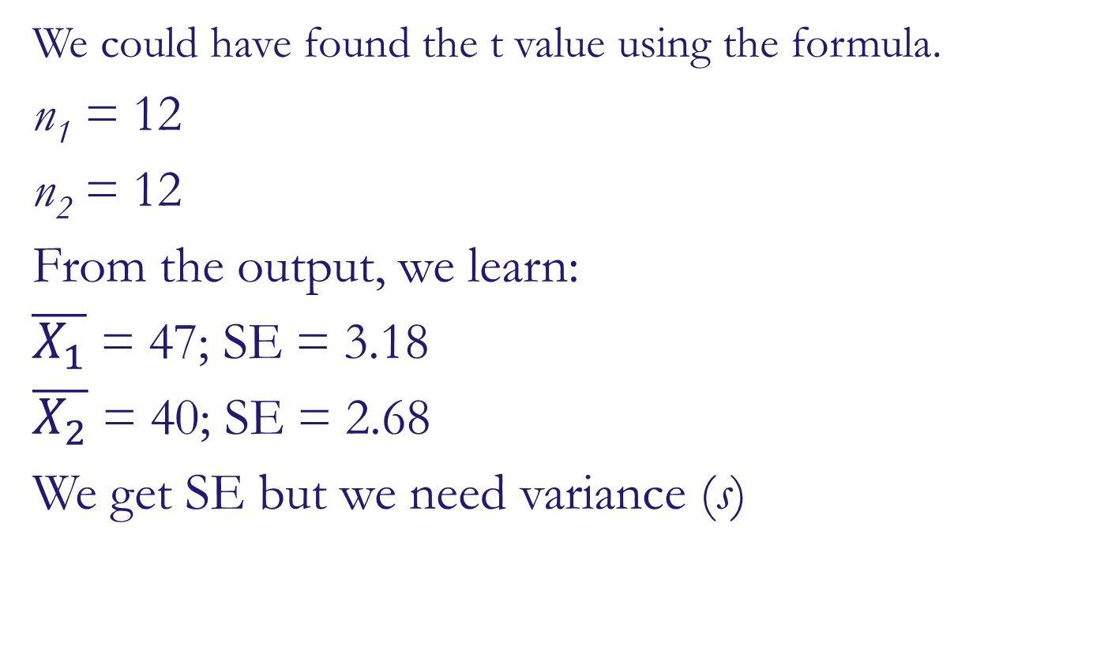
Why we like coding
We could have found the t value using the formula.
n₁ = 12
n₂ = 12
From the output, we learn:
$\overline{X_{1}}$ = 47; SE = 3.18
$\overline{X_{2}}$ = 40; SE = 2.68
We get SE but we need variance (s)

Slide 23

Computing t using the formula
$$SE=\frac{S}{\sqrt{n}}$$
- Or -
$$s=SE(\sqrt{n})$$
So –
$s_{1}=3.18\sqrt{11}=11.0159$
$s_{2}=2.68\sqrt{11}=9.2838$

Slide 24
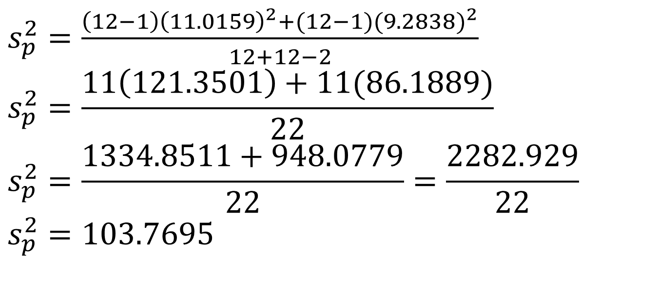
Computing t using the formula
$s_{p}^{2}=\frac{\left(12−1\right){\left(11.0159\right)}^{2}+(12−1){(9.2838)}^{2}}{12+12−2}$
$$s_{p}^{2}=\frac{11\left(121.3501\right)+11(86.1889)}{22}$$
$$s_{p}^{2}=\frac{1334.8511+948.0779}{22}=\frac{2282.929}{22}$$
$$s_{p}^{2}=103.7695$$

Slide 25
Computing t using the formula

Slide 26
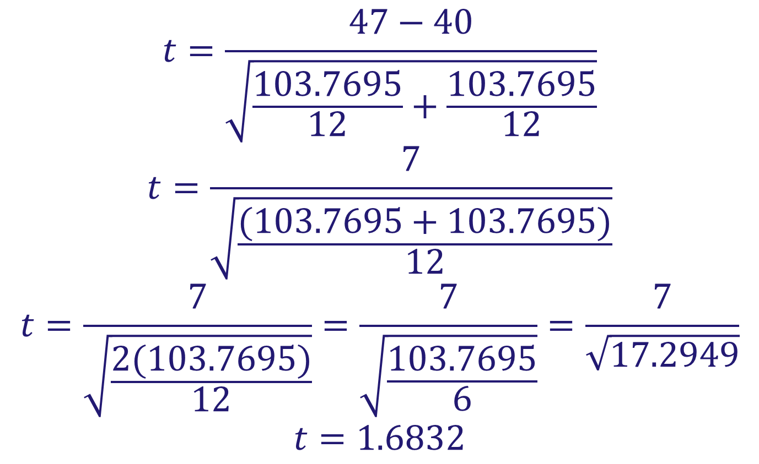
Computing t using the formula
$$t=\frac{47−40}{\sqrt{\frac{103.7695}{12}+\frac{103.7695}{12}}}$$
$$t=\frac{7}{\sqrt{\frac{(103.7695+103.7695)}{12}}}$$
$$t=\frac{7}{\sqrt{\frac{2(103.7695)}{12}}}=\frac{7}{\sqrt{\frac{103.7695}{6}}}=\frac{7}{\sqrt{17.2949}}$$
$$t=1.6832$$

Slide 27
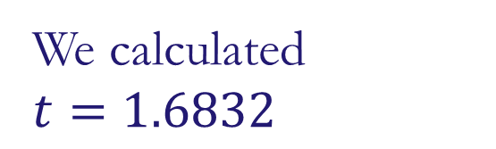
Coding vs Calculating
Welch Two Sample t-test
data: spiderWide$real and spiderWide$picture
t = 1.6813, df = 21.385, p-value = 0.1072
alternative hypothesis: true difference in means is not equal to 0
95 percent confidence interval:
-1.648641 15.648641
sample estimates:
mean of x mean of y
47 40
We calculated
$$t=1.6832$$

Slide 28
Interpreting the Results
On average, participants experienced greater anxiety from real spiders (M = 47.00, SE = 3.18), than from pictures of spiders (M = 40.00, SE = 2.68). This difference was not significant, t(21.4) = 1.68, p > .05.

