Slide 1

AtliQ Hardware Business Insights 360

Slide 2
Problem Statement :
AtliQ Hardware, a rapidly expanding company in the electronics and goods market with a global presence, is encountering significant challenges in its data analysis practices.
Historically, the organization heavily relied on Excel for data analysis, which has proven to be an ineffective approach. Consequently, AtliQ Hardware has incurred losses when attempting to establish new businesses in untapped markets.
In response to this issue, the company has taken the initiative to onboard a data analytics team to gain valuable insights across all departments, ultimately aiming for a comprehensive 360-degree view of their business.

Slide 3

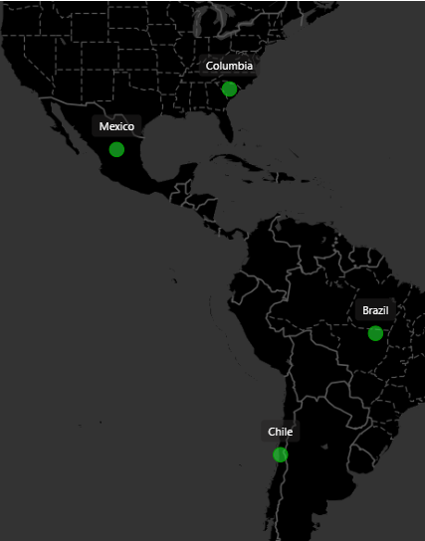
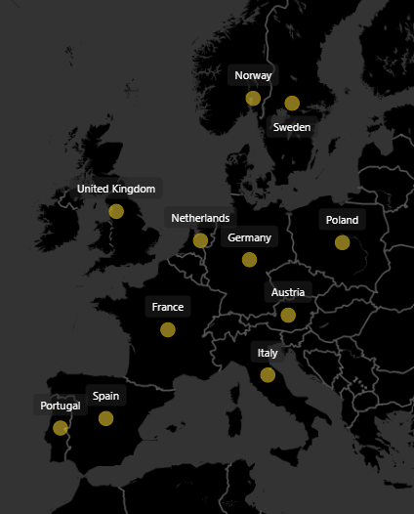
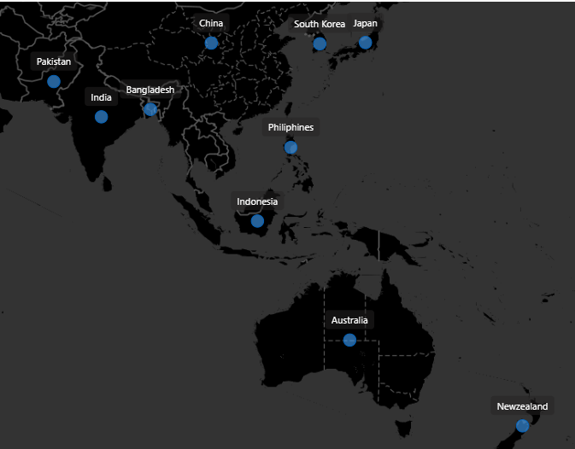
Regions
NA
LATAM
EU
APAC

Slide 4
AtliQ Hardware
PC
N&S
P&A
Division
Desktop
Notebook
Storage
Networking
Peripherals
Accessories
Segment
Business
Laptop
Business
Laptop
External Solid State Drives
Wi fi extender
Internal HDD
Mouse
Personal
Laptop
Categories
Personal
Desktop
Graphic Card
Keyboard
USB Flash Drives
Gaming
Desktop
Processors
Batteries
MotherBoard

Slide 5
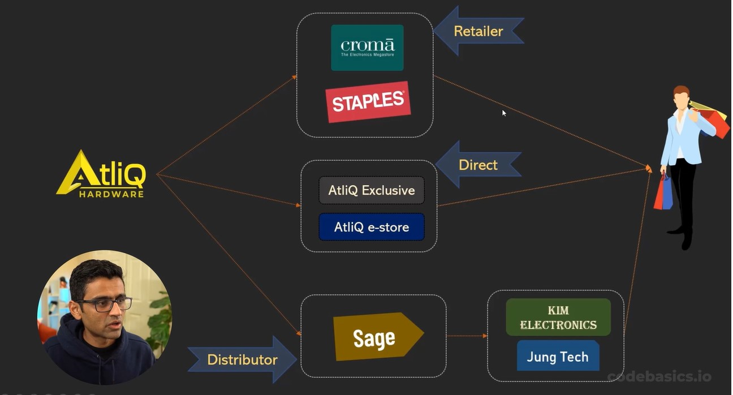
Business Structure

Slide 6
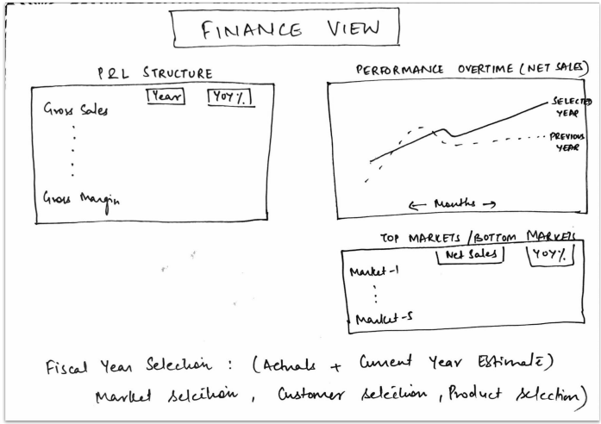
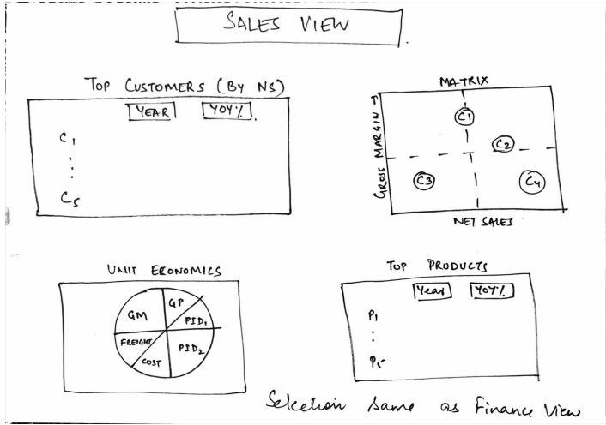
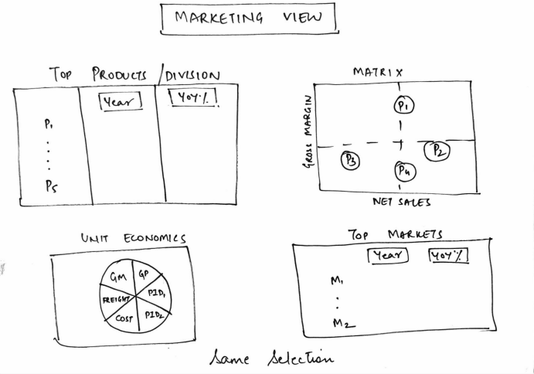
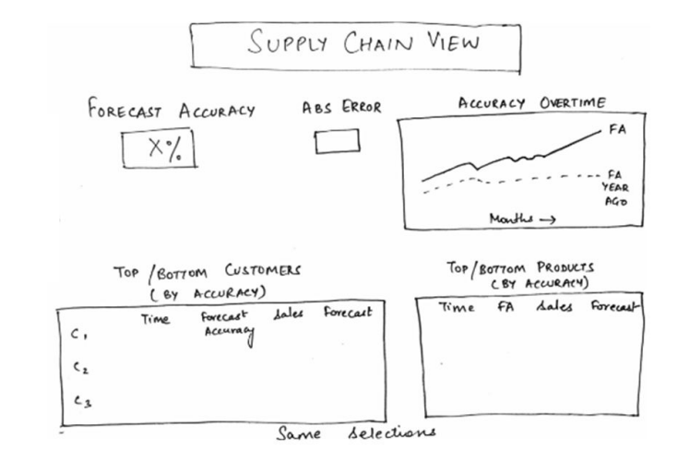
Mock-up's Received

