Slide 1



Telagana's_Growth_Analysis
View in Power BI
Last data refresh:
25/09/2023 10:57:59 UTC
Downloaded at:
25/09/2023 14:06:02 UTC

Slide 2
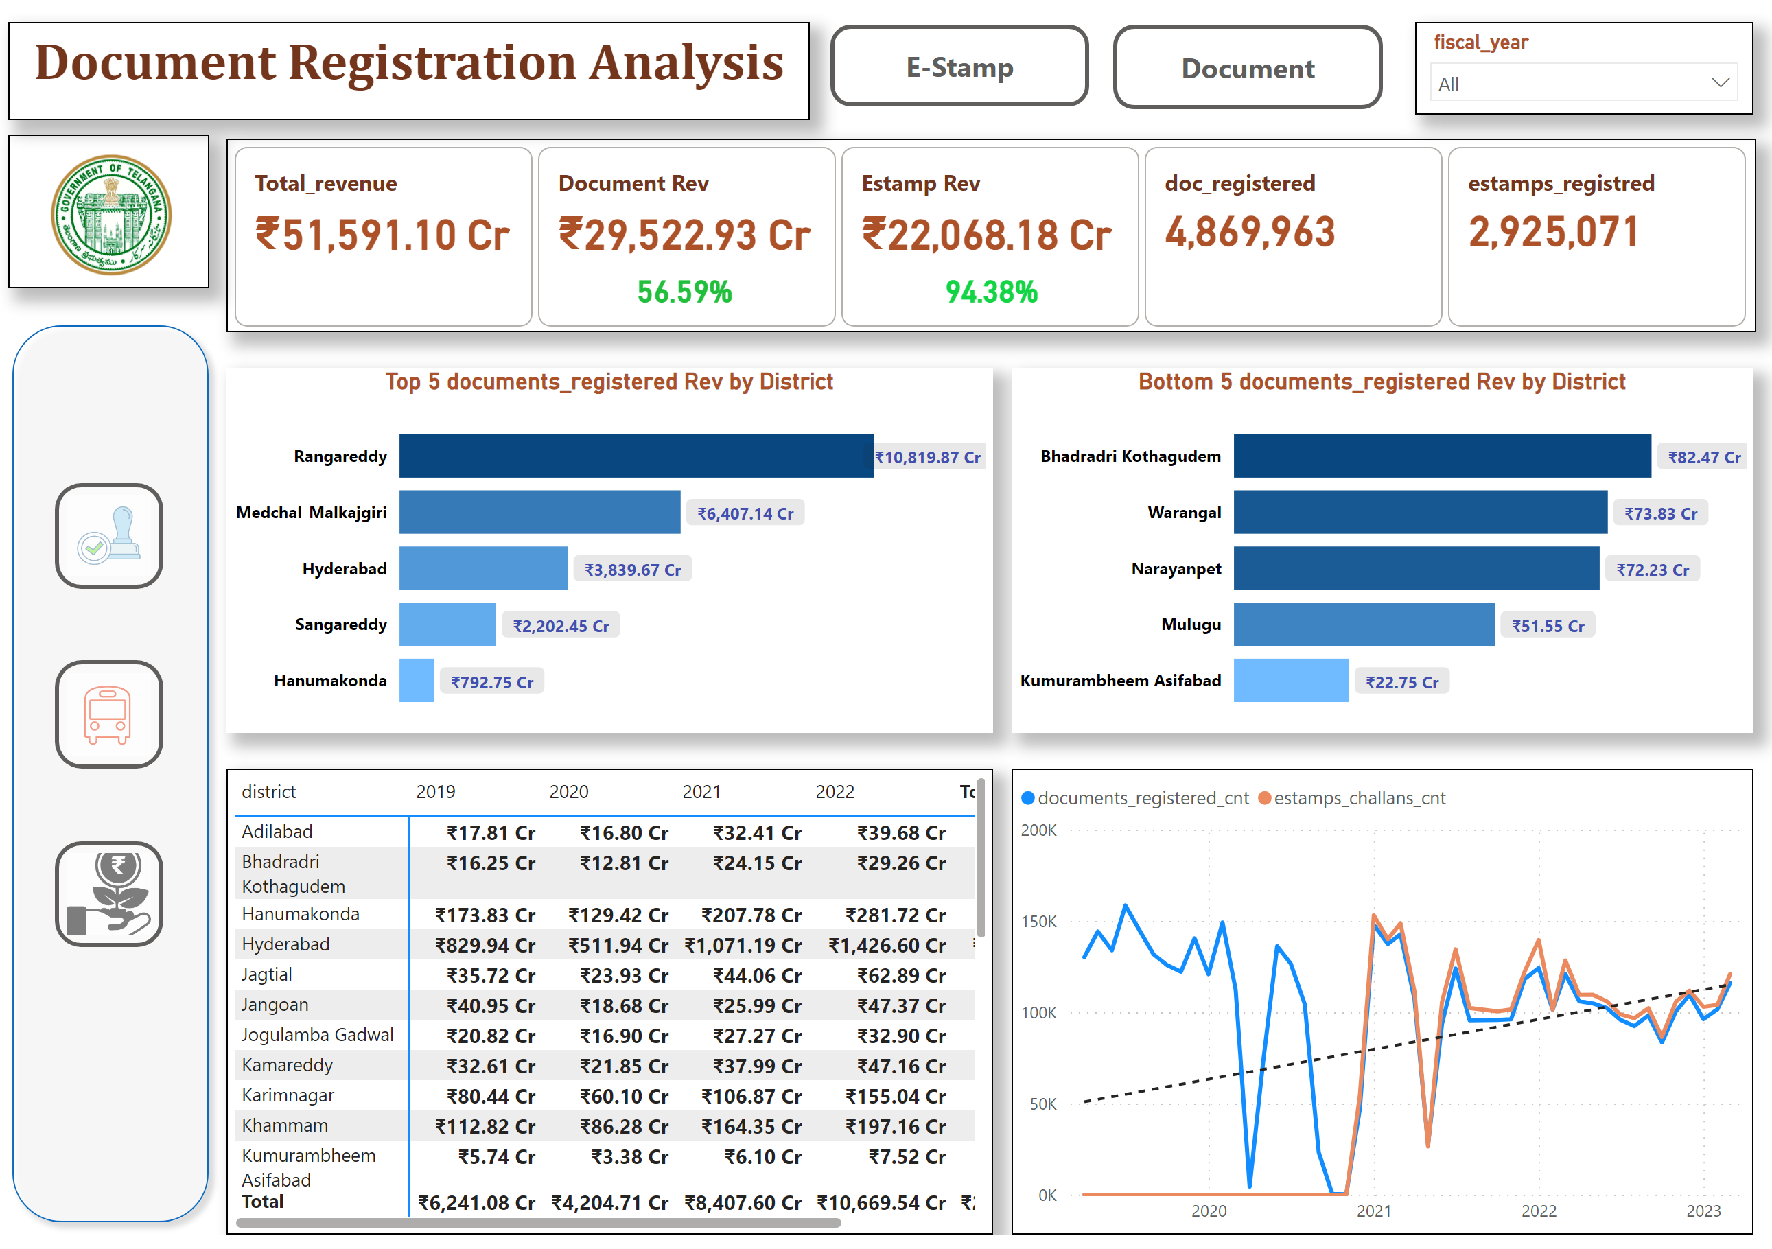
Stamp_doc_analysis
Notes:
Top 5 documents_registered Rev by District
No alt text provided
clusteredBarChart
No alt text provided
growth
No alt text provided
card
No alt text provided
cardVisual
No alt text provided
actionButton
No alt text provided
actionButton
No alt text provided
clusteredBarChart
No alt text provided
Bottom 5 documents_registered Rev by District
No alt text provided
doc_metrix
No alt text provided
pivotTable
No alt text provided
actionButton
No alt text provided
actionButton
No alt text provided
actionButton
No alt text provided
shape
No alt text provided
textbox
No alt text provided
image
No alt text provided
lineChart
No alt text provided
slicer
No alt text provided

Slide 3
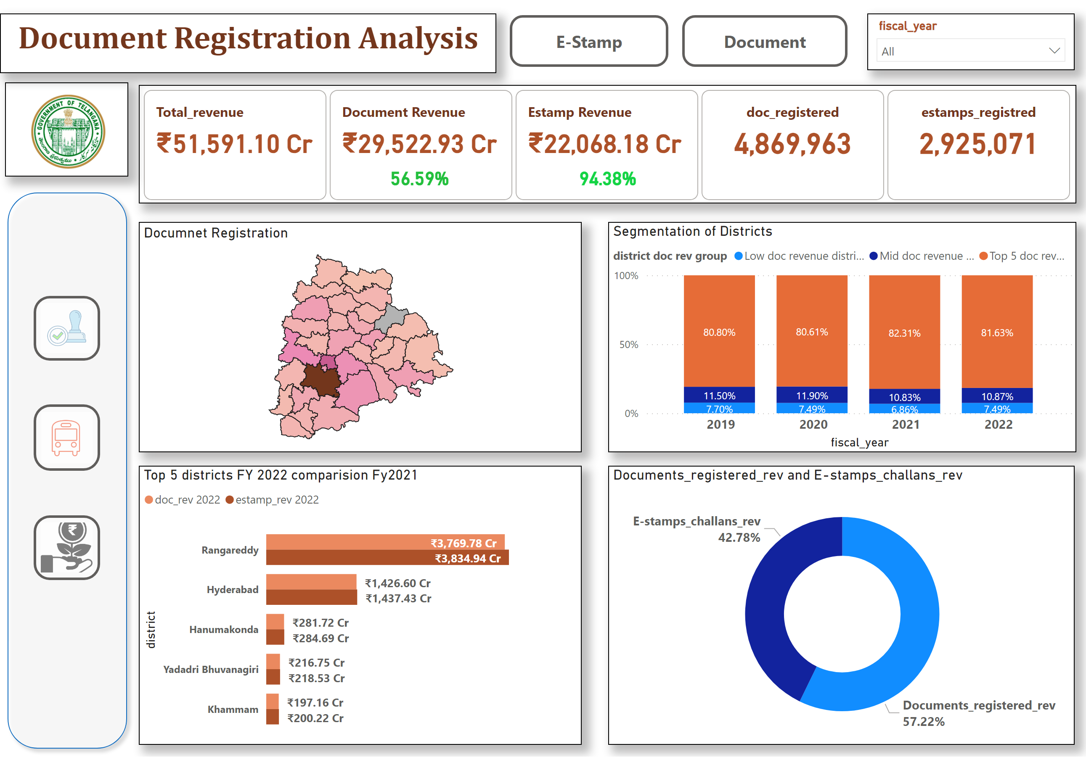
Stamp_doc_analysis_02
Notes:
Documnet Registration
No alt text provided
Segmentation of Districts
No alt text provided
hundredPercentStackedColumnChart
No alt text provided
growth
No alt text provided
card
No alt text provided
cardVisual
No alt text provided
actionButton
No alt text provided
actionButton
No alt text provided
slicer
No alt text provided
Top 5 districts FY 2022 comparision Fy2021
No alt text provided
shapeMap
No alt text provided
actionButton
No alt text provided
actionButton
No alt text provided
actionButton
No alt text provided
shape
No alt text provided
textbox
No alt text provided
image
No alt text provided
donutChart
No alt text provided

Slide 4
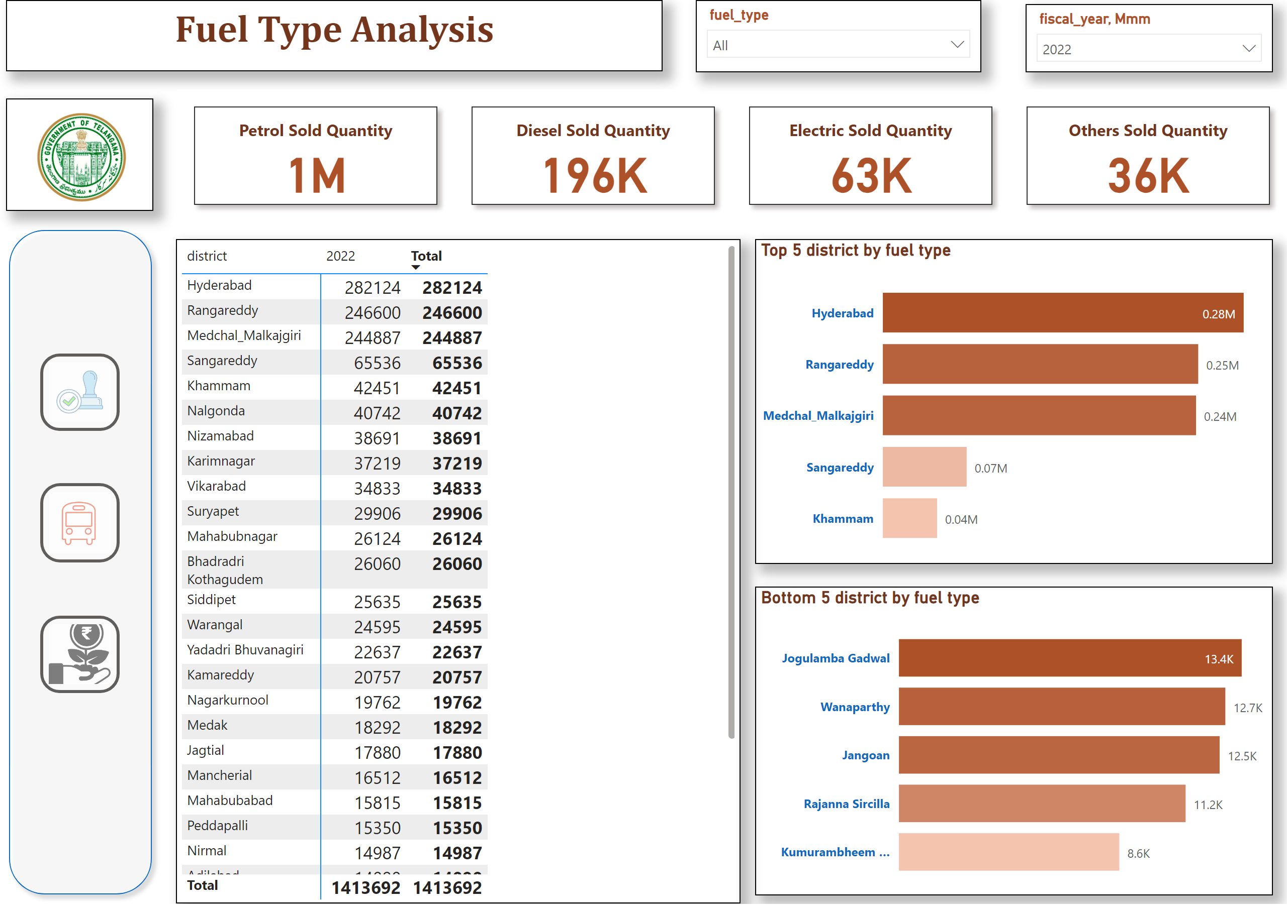
Transport_fueltype
Notes:
slicer
No alt text provided
Top 5 district by fuel type
No alt text provided
Bottom 5 district by fuel type
No alt text provided
textbox
No alt text provided
cardVisual
No alt text provided
image
No alt text provided
slicer
No alt text provided
pivotTable
No alt text provided
actionButton
No alt text provided
actionButton
No alt text provided
actionButton
No alt text provided
shape
No alt text provided

Slide 5
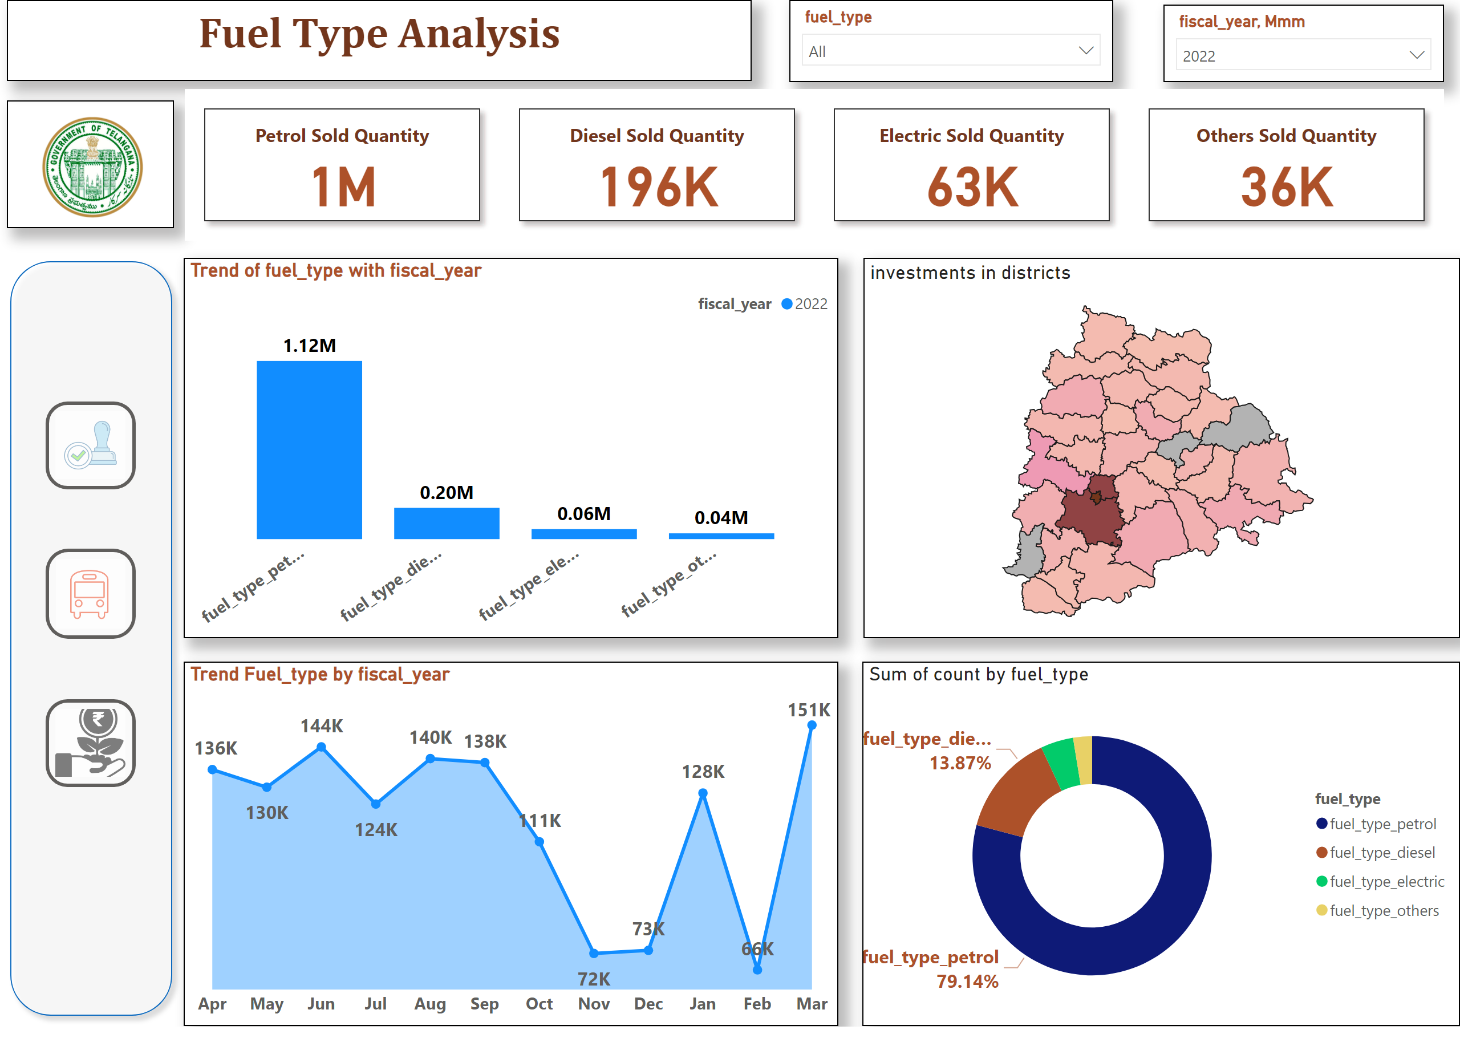
TransportFueltype_02
Notes:
Trend Fuel_type by fiscal_year
No alt text provided
Trend of fuel_type with fiscal_year
No alt text provided
donutChart
No alt text provided
investments in districts
No alt text provided
actionButton
No alt text provided
shape
No alt text provided
image
No alt text provided
textbox
No alt text provided
slicer
No alt text provided
slicer
No alt text provided
actionButton
No alt text provided
actionButton
No alt text provided
cardVisual
No alt text provided

Slide 6
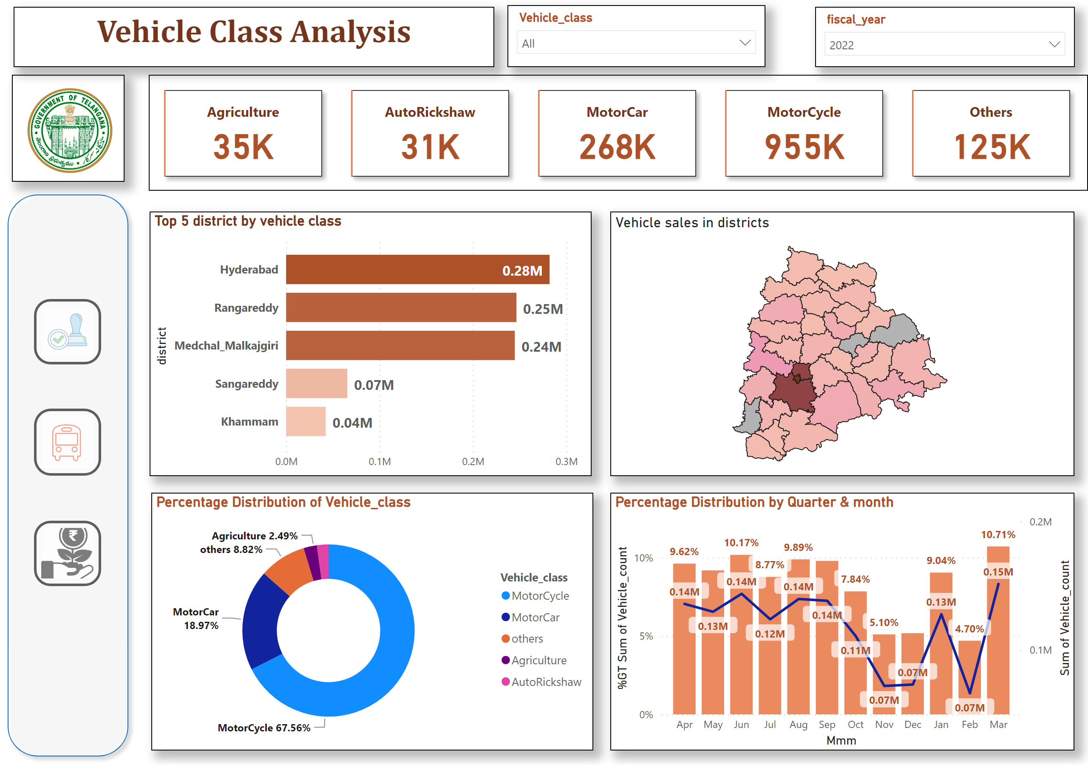
Vehicle Class_01
Notes:
cardVisual
No alt text provided
Percentage Distribution of Vehicle_class
No alt text provided
Top 5 district by vehicle class
No alt text provided
Vehicle sales in districts
No alt text provided
actionButton
No alt text provided
shape
No alt text provided
image
No alt text provided
textbox
No alt text provided
slicer
No alt text provided
actionButton
No alt text provided
actionButton
No alt text provided
slicer
No alt text provided
Percentage Distribution by Quarter & month
No alt text provided

Slide 7
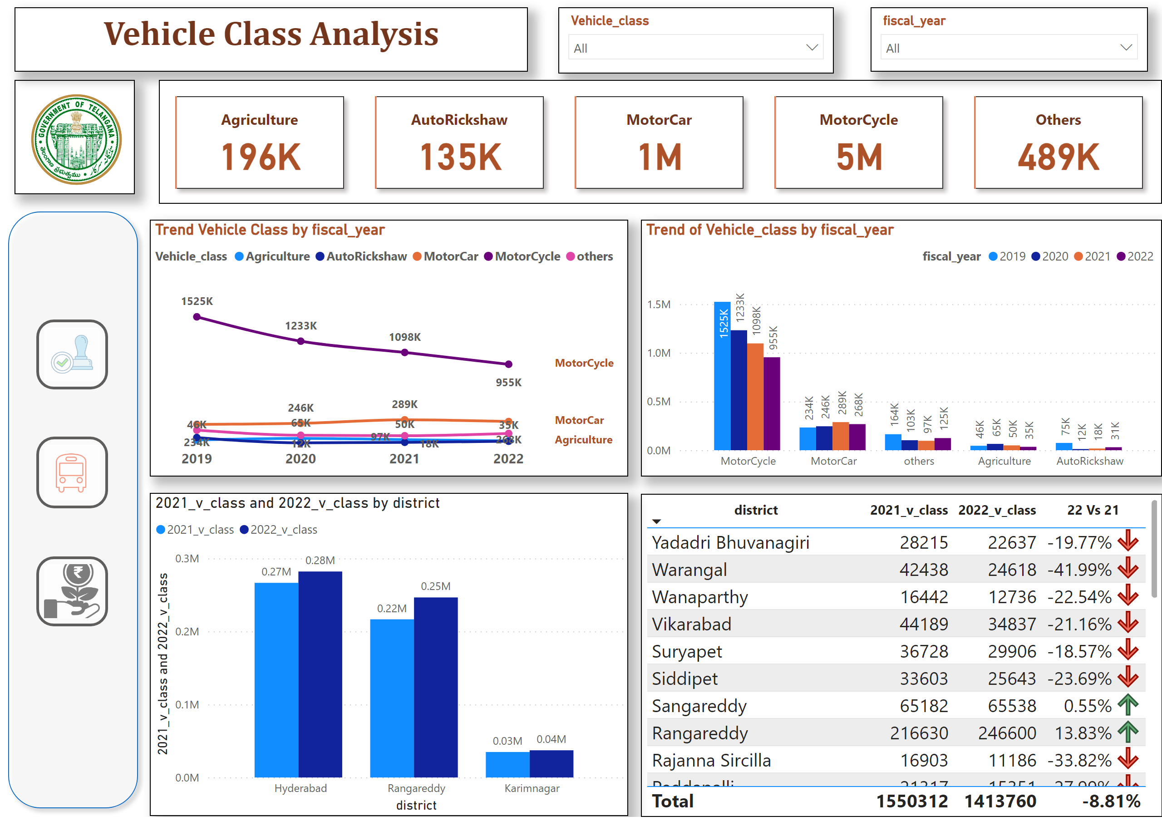
Vehicle Class_02
Notes:
textbox
No alt text provided
slicer
No alt text provided
tableEx
No alt text provided
clusteredColumnChart
No alt text provided
Trend of Vehicle_class by fiscal_year
No alt text provided
Trend Vehicle Class by fiscal_year
No alt text provided
actionButton
No alt text provided
shape
No alt text provided
cardVisual
No alt text provided
image
No alt text provided
actionButton
No alt text provided
actionButton
No alt text provided
slicer
No alt text provided

Slide 8
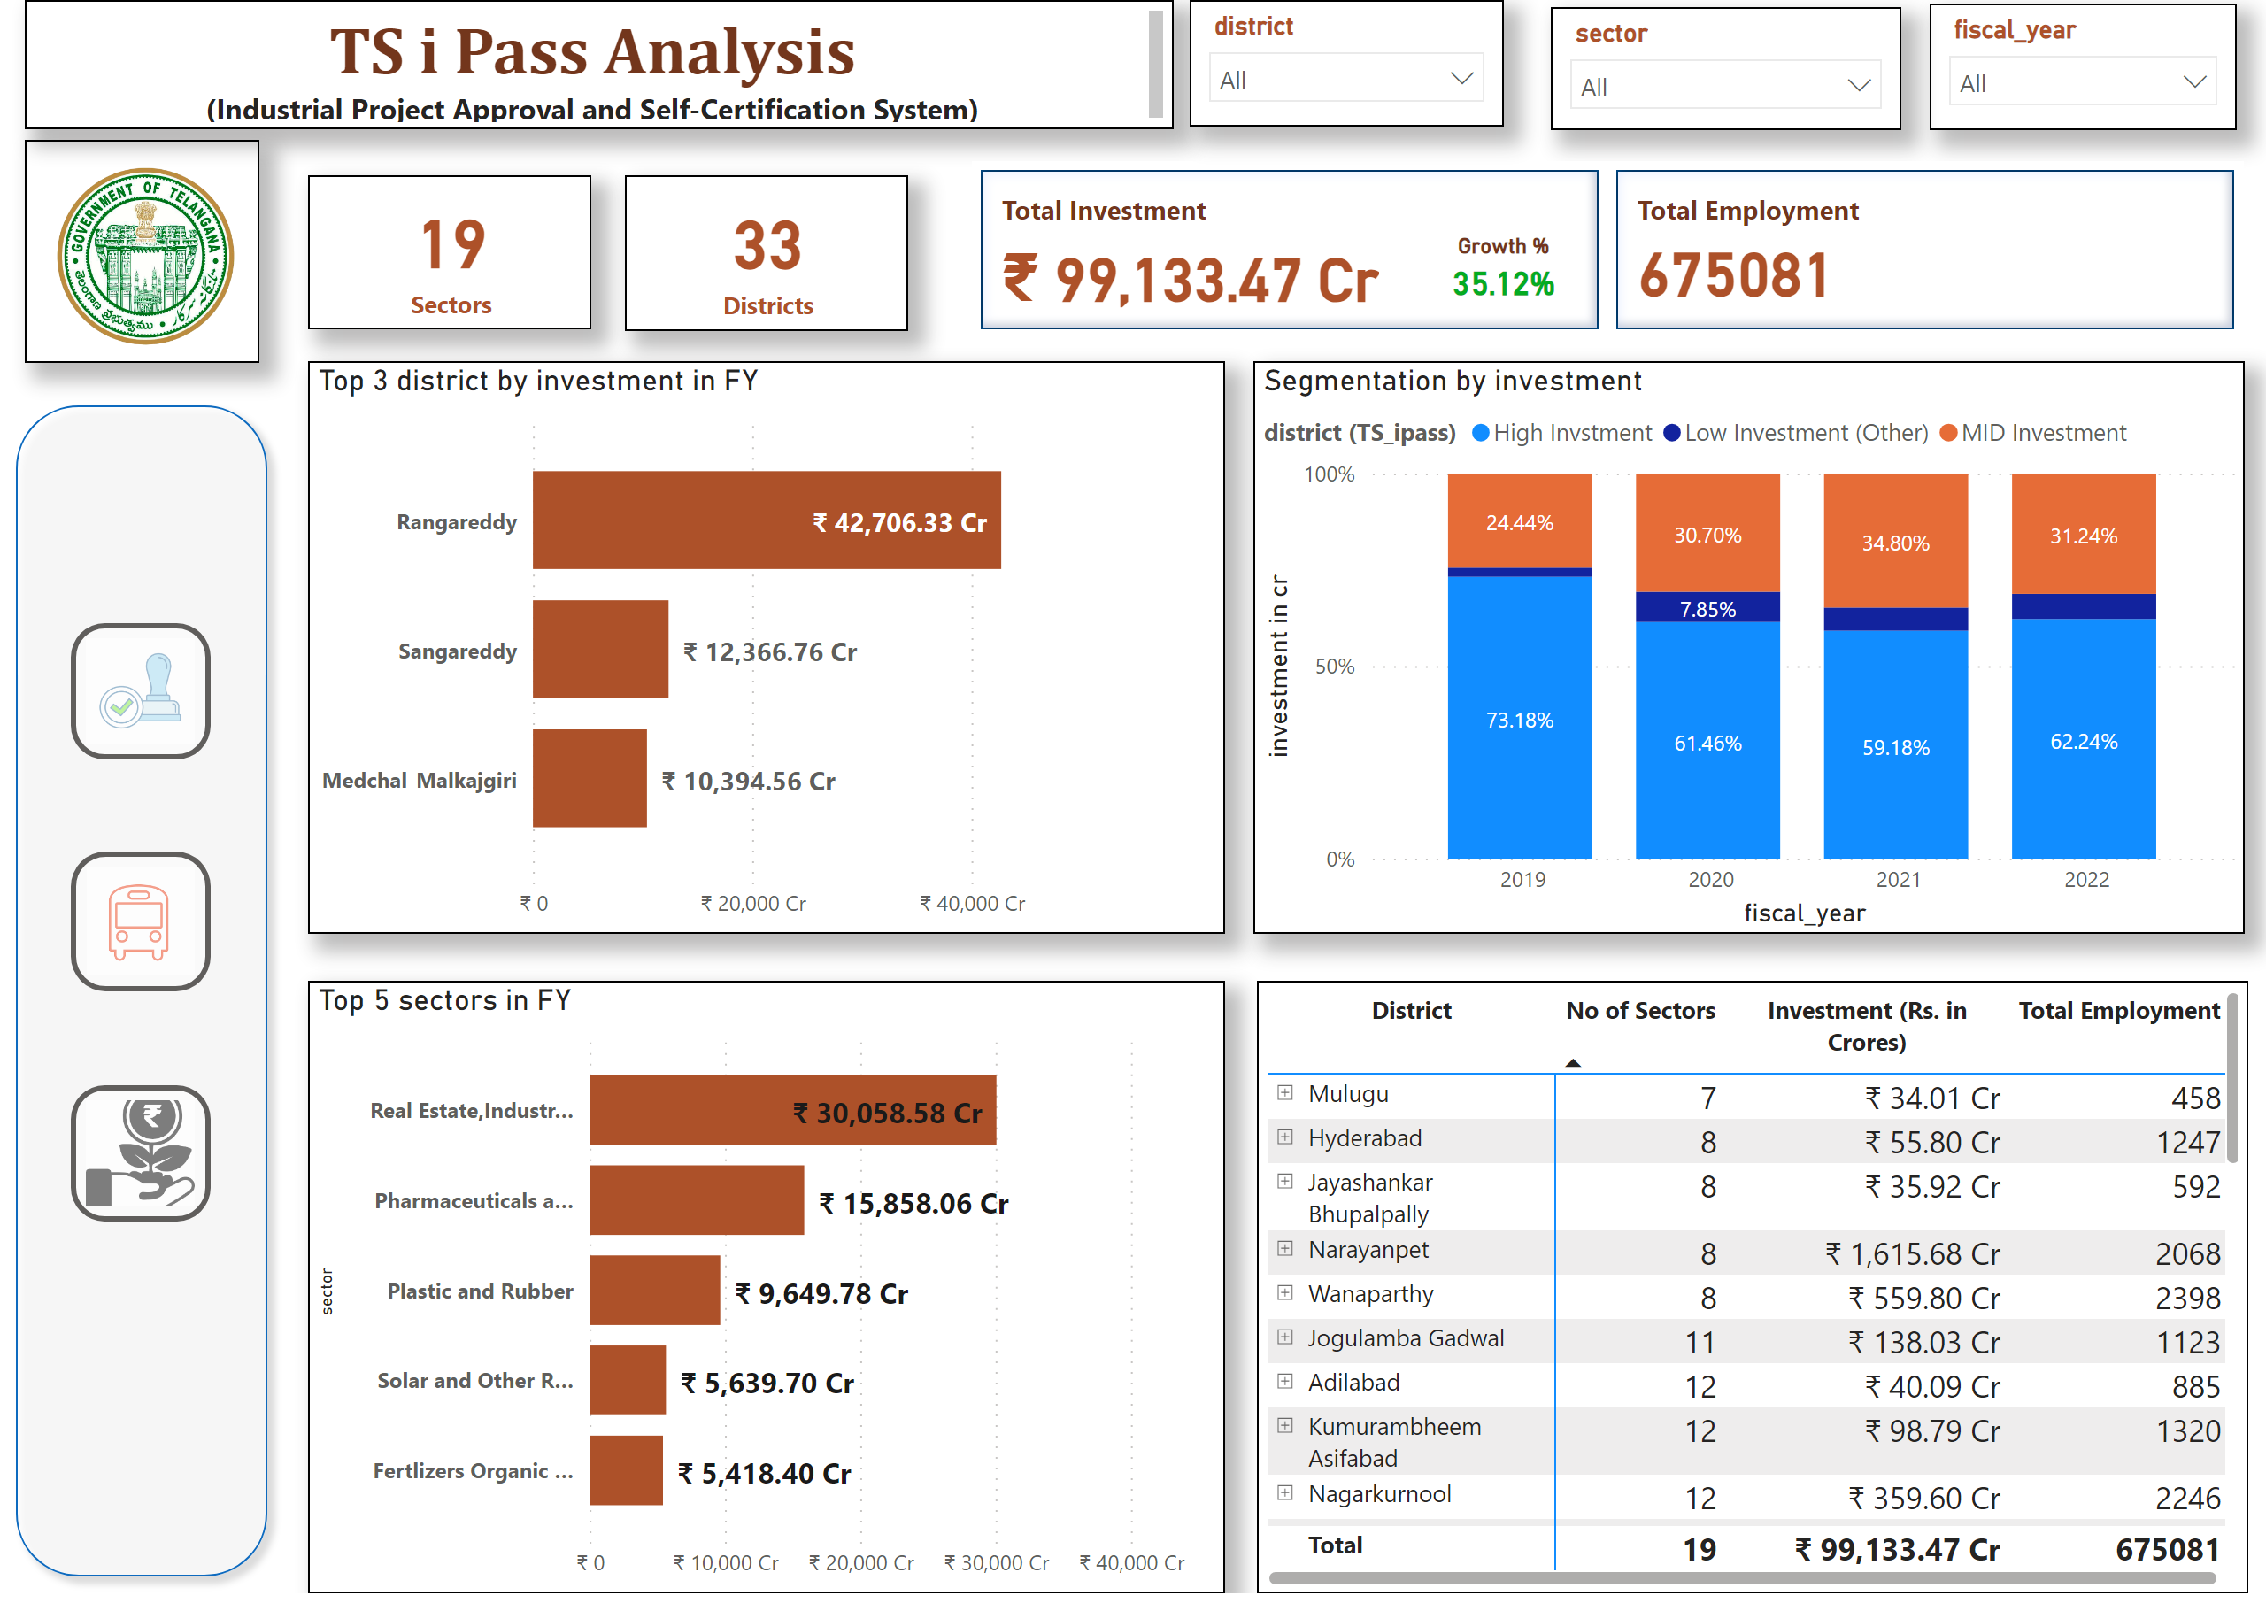
TS iPass
Notes:
slicer
No alt text provided
textbox
No alt text provided
slicer
No alt text provided
Top 5 sectors in FY
No alt text provided
card
No alt text provided
card
No alt text provided
Segmentation by investment
No alt text provided
Top 3 district by investment in FY
No alt text provided
cardVisual
No alt text provided
Growth %
No alt text provided
pivotTable
No alt text provided
image
No alt text provided
actionButton
No alt text provided
shape
No alt text provided
actionButton
No alt text provided
actionButton
No alt text provided
slicer
No alt text provided

Slide 9
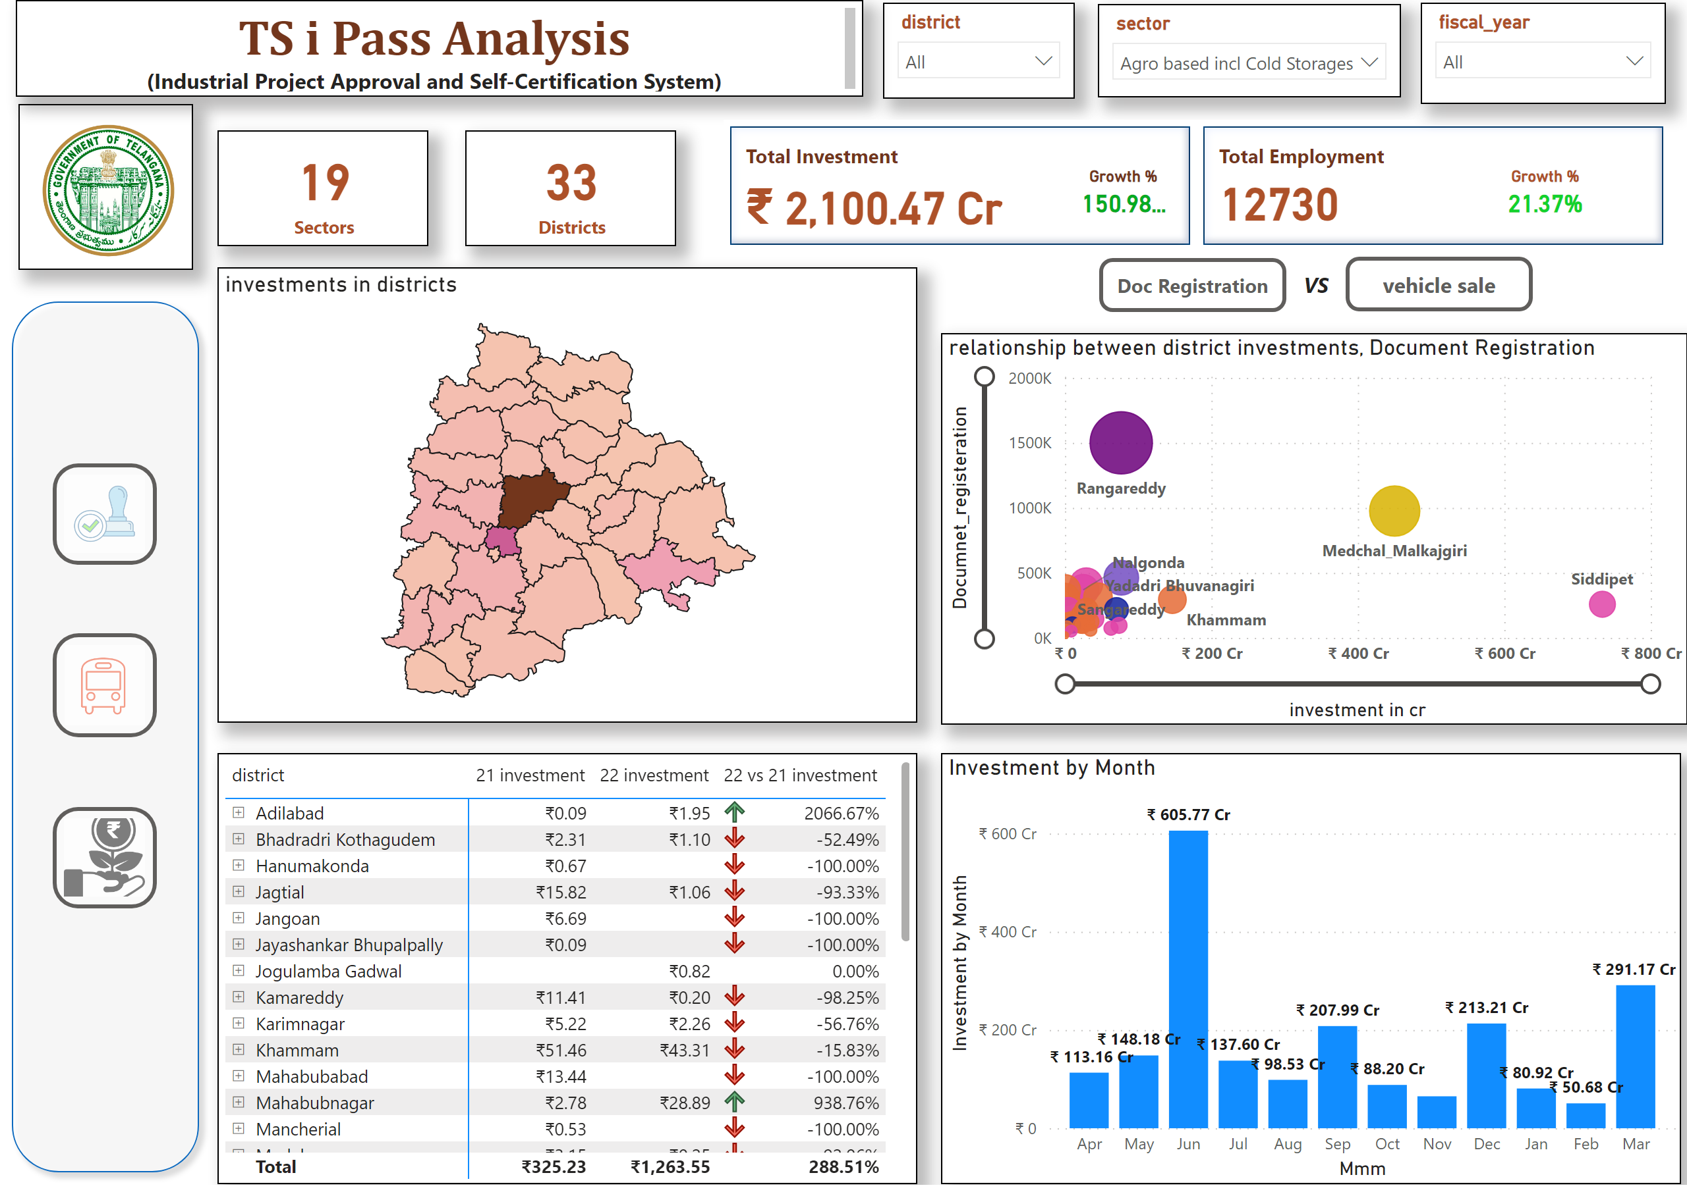
TS iPass2
Notes:
image
No alt text provided
slicer
No alt text provided
scatterChart
No alt text provided
Investment by Month
No alt text provided
slicer
No alt text provided
relationship between district investments, Document Registration
No alt text provided
actionButton
No alt text provided
actionButton
No alt text provided
card
No alt text provided
card
No alt text provided
textbox
No alt text provided
investments in districts
No alt text provided
pivotTable
No alt text provided
textbox
No alt text provided
cardVisual
No alt text provided
Growth %
No alt text provided
actionButton
No alt text provided
shape
No alt text provided
actionButton
No alt text provided
actionButton
No alt text provided
slicer
No alt text provided
Growth %
No alt text provided

Slide 10
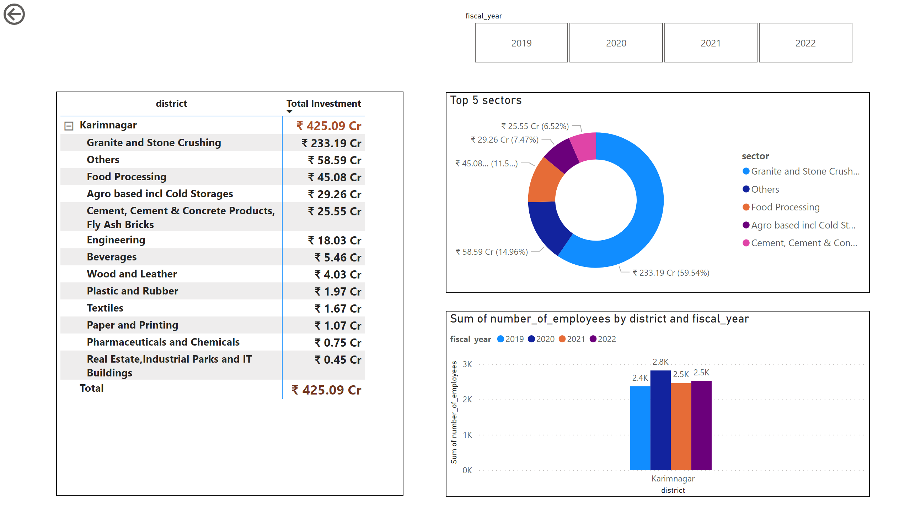
Ipass_report_page
Notes:
pivotTable
No alt text provided
Top 5 sectors
No alt text provided
slicer
No alt text provided
actionButton
No alt text provided
clusteredColumnChart
No alt text provided

