Slide 1
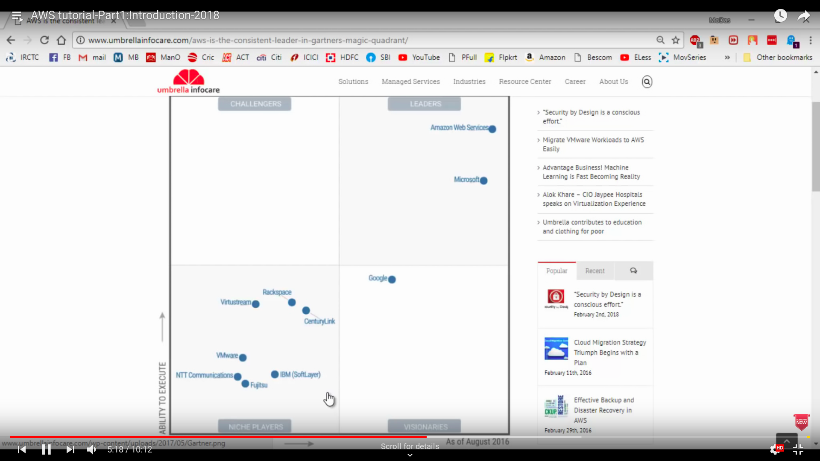
https://www.youtube.com/watch?v=ye7hgGZwSsY&list=PLJIqXVV4K5LXT8gkTJjHAgzZgW1K3se8U

Slide 2
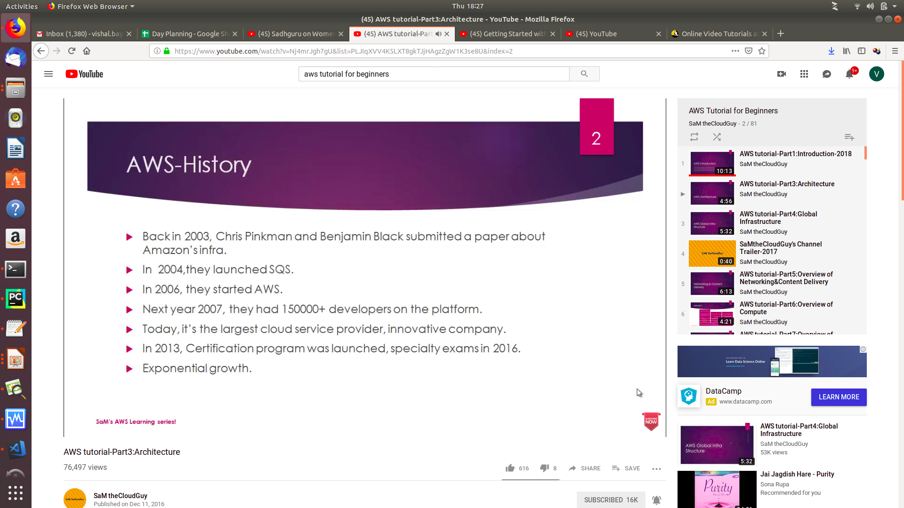

Slide 3
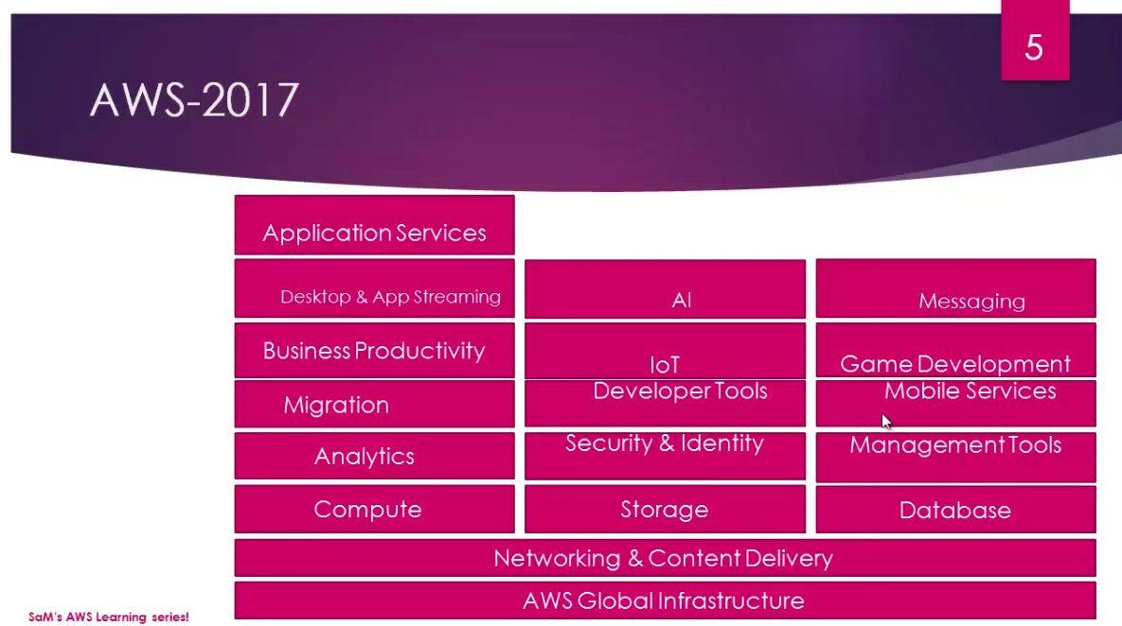

Slide 4
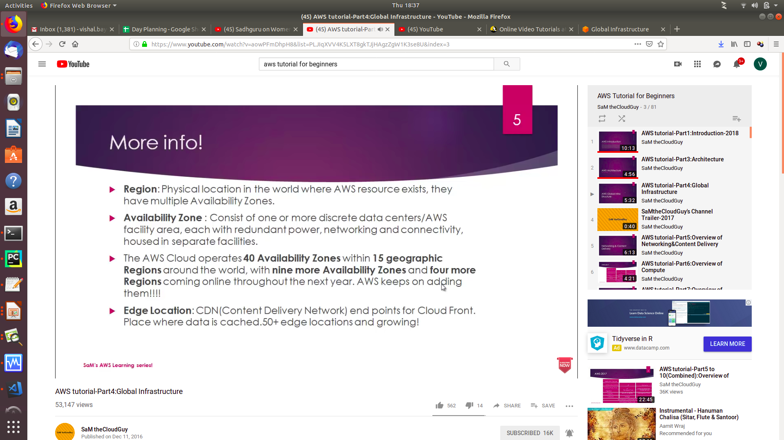

Slide 5
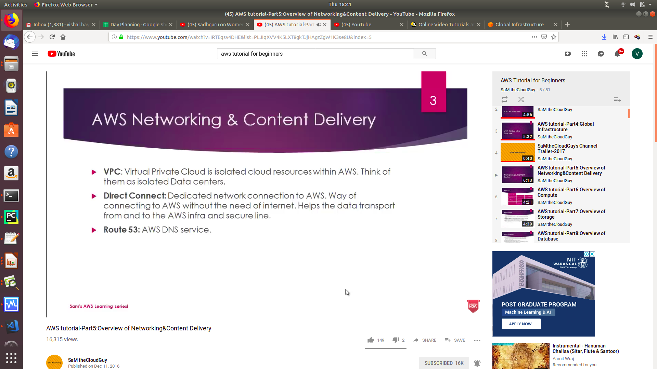

Slide 6
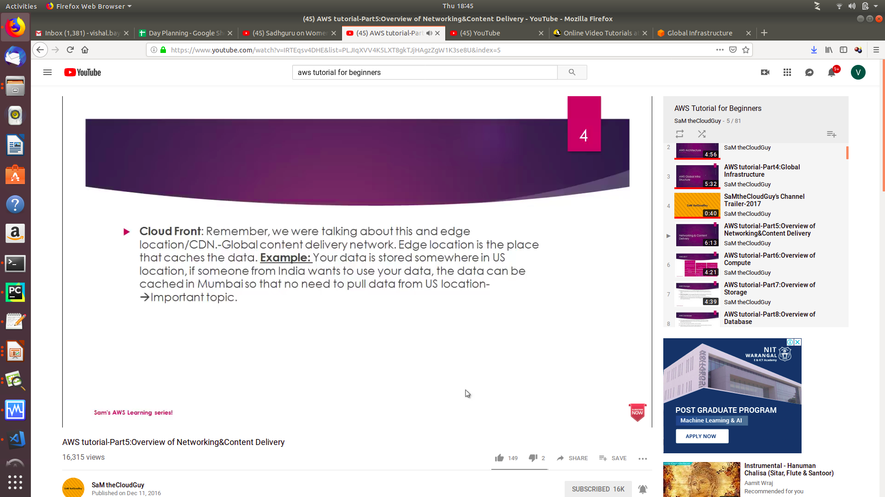

Slide 7


