Slide 1
Clean Coding
"Any fool can write code that a computer can understand.
Good programmers write code that humans can understand.“
- Martin Fowler
Compiled by : Vishal Bayskar

Slide 2
Cover
Bad Code.
Coding norms.
Design Principles.
2

Slide 3
What is bad code? when do you say a code is bad code ? Any symptoms?
Symptom 1. Code that slow you down and because it hard to understand.
Symptom 2. You make some changes at some place and it effect code at other places.
Symptom 3 - Other symptom is you want to use some already writing functionality but that other functionality is coming few more dependencies which make it more difficult to maintain.

Slide 4
Why do you right the bad code?
To go fast, in order to meet the deadline.

Slide 5

Clean Code
Assume : You are on operation table and doctors are operating on you, what would you like how doctor should act?
Doctor also have deadlines.
.
5

Slide 6
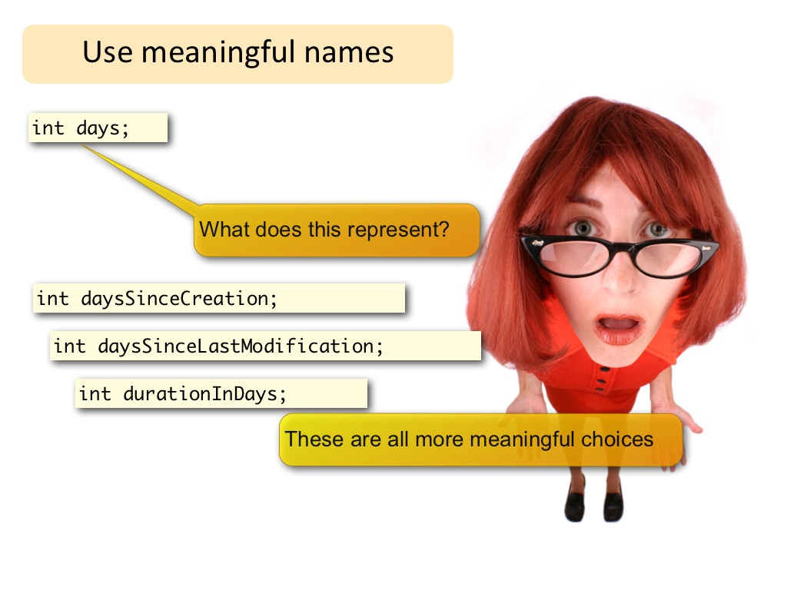
Clean Code - Naming
Don’t let the user think.
6

Slide 7
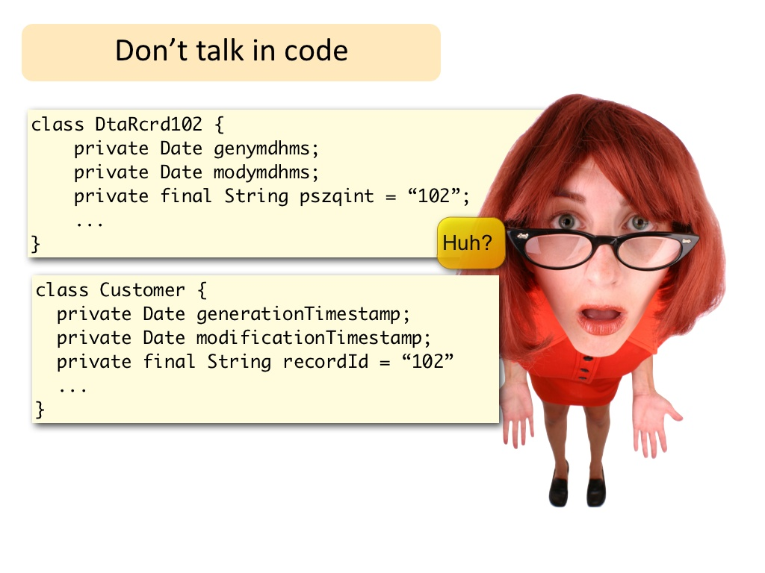
Clean Code - Naming
7

Slide 8
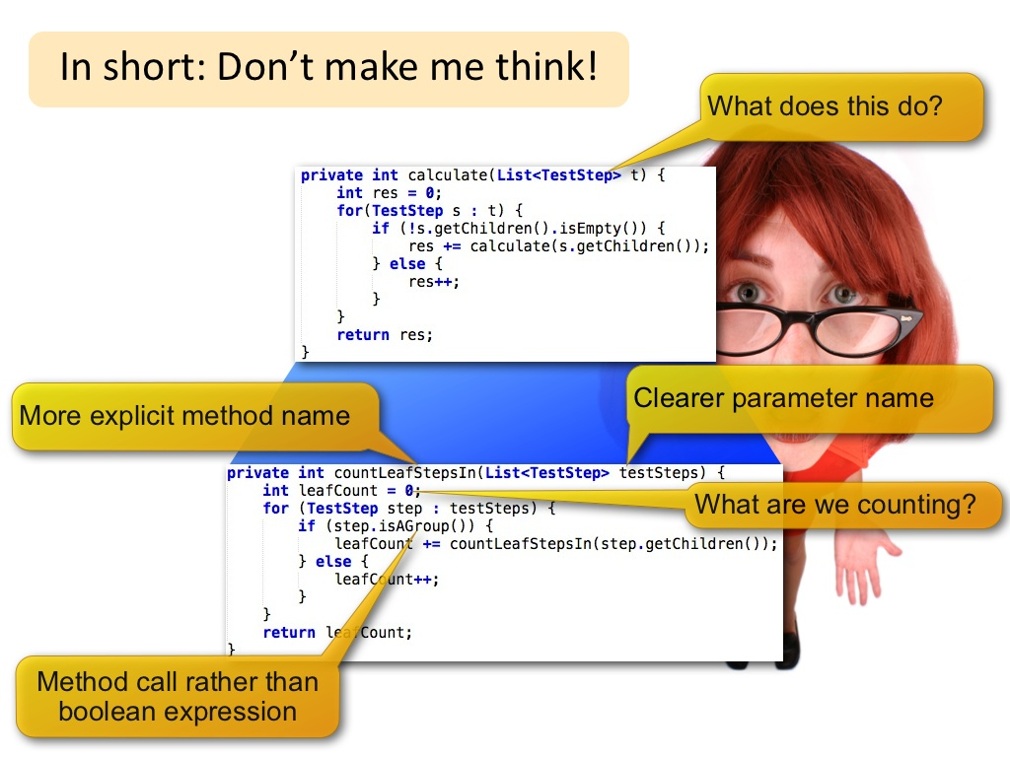
Clean Code - Naming
8

Slide 9
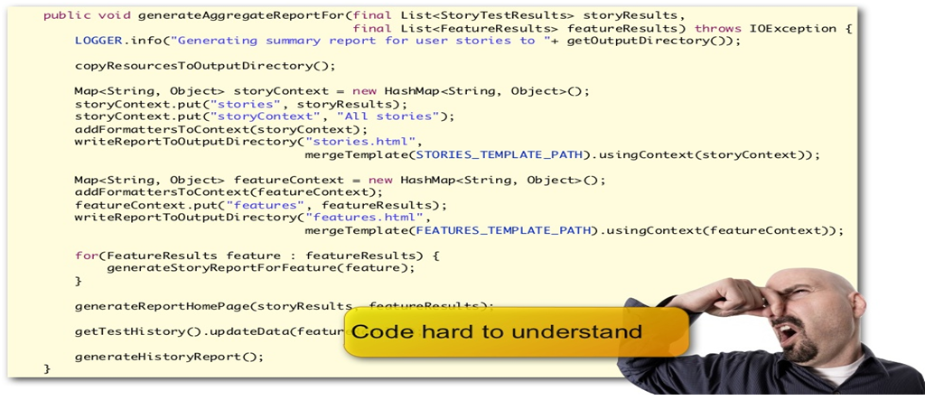
Clean Code – Methods/Functions
“The ratio of time spent reading (code) versus writing is well over 10 to 1 ... (therefore) making it easy to read makes it easier to write/extend.”
9

Slide 10
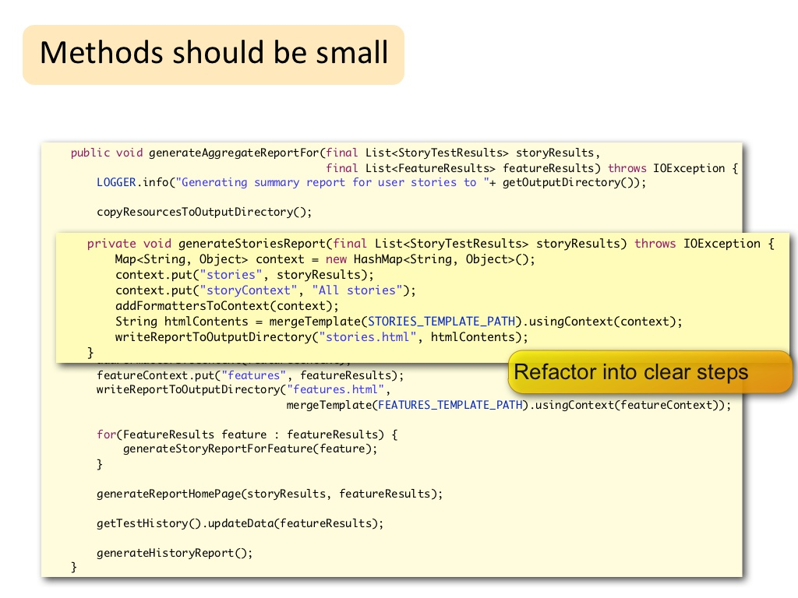
Clean Code – Methods/Functions
10

Slide 11
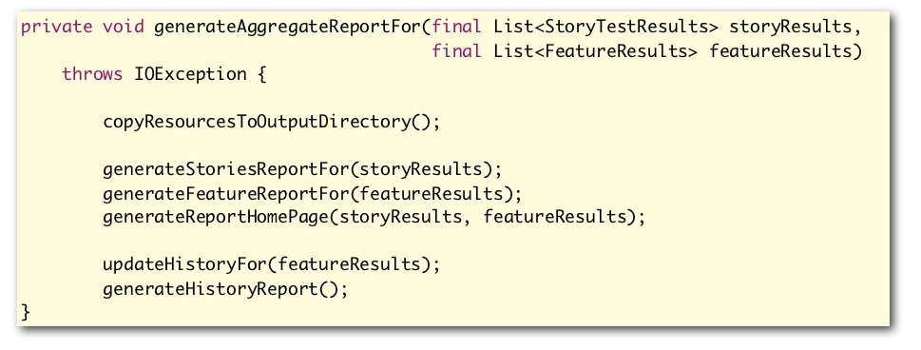
Clean Code – Methods/Functions
"Master programmers think of systems as stories to be told rather than programs to be written.“
It should be boring to read your program.
11

Slide 12
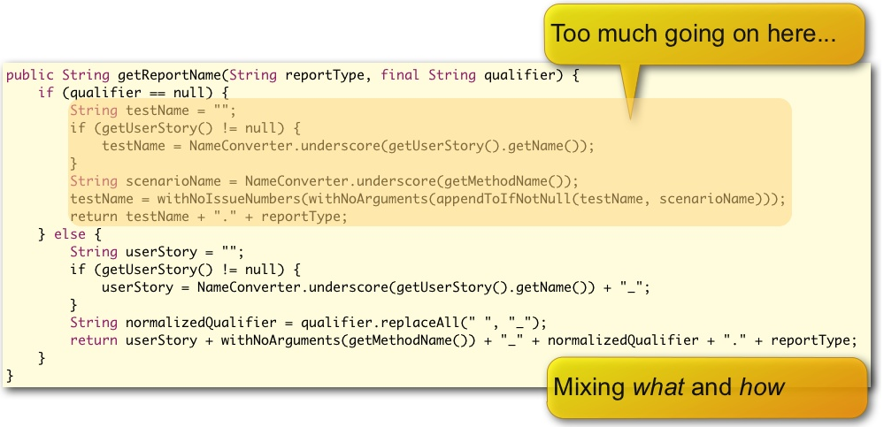
Clean Code – Methods/Functions
Try not to mix what and how
12

Slide 13
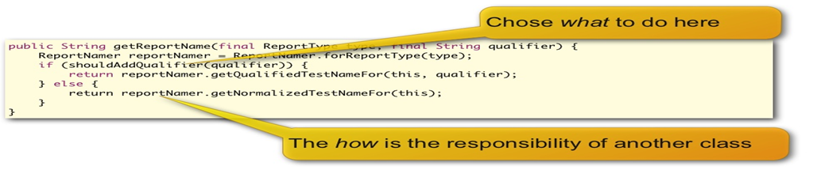
Clean Code – Methods/Functions
13

Slide 14
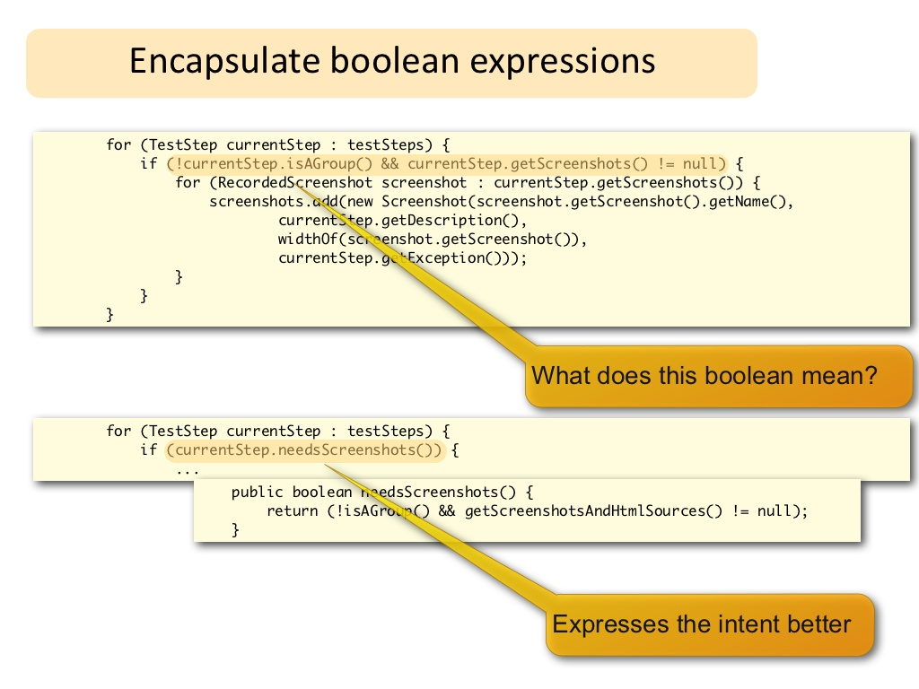
Clean Code - Boolean Expressions
14

Slide 15
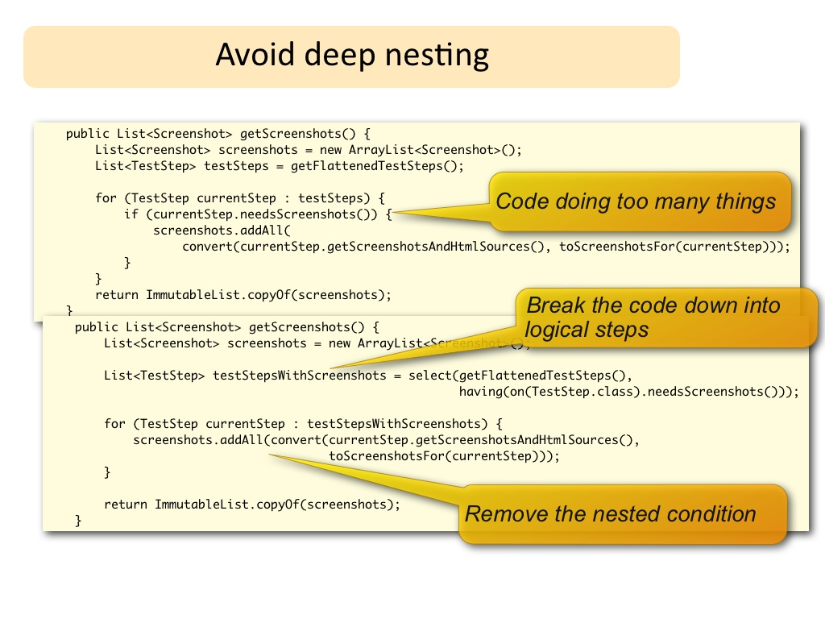
Clean Code – Overly Complex Code
15

Slide 16
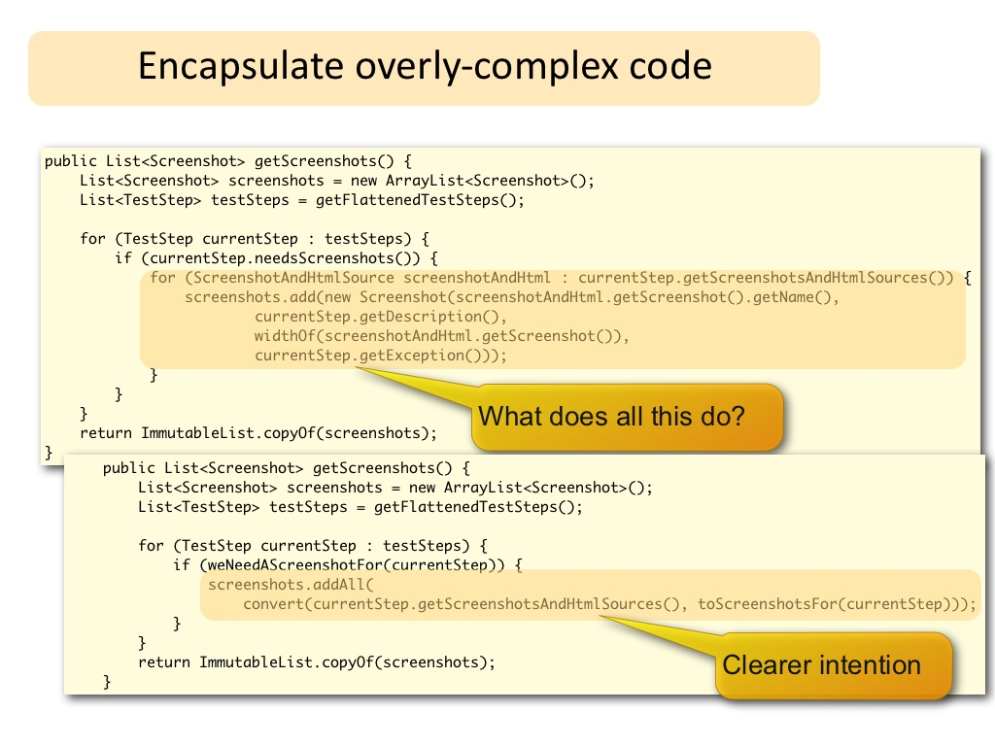
Clean Code – Overly Complex Code
16

Slide 17
Have the small function and do not assign them multiple tasks to do.
Analogy that helps is Unix utilities.
Unix provides a large number of utilities such as grep, cat and find. Each utility does exactly one thing, often exceptionally well, and can be combined with other utilities using a shell script to perform complex tasks.

Slide 18
Clean Code – S/W Design Principles.
Single Responsibility Principle(SRP)
Open Close Principle(OCP)
Liskov's Substitution Principle(LSP)
Interface Segregation Principle (ISP)
Dependency Inversion Principle(DIP)
18

Slide 19
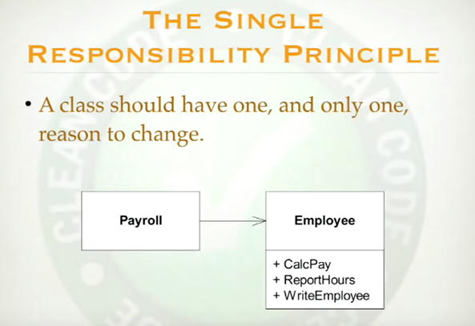
Clean Code – S/W Design Principles - Single Responsibility Principle
Don’t mix the concerns in the class, or different reason for change in a class.

Slide 20
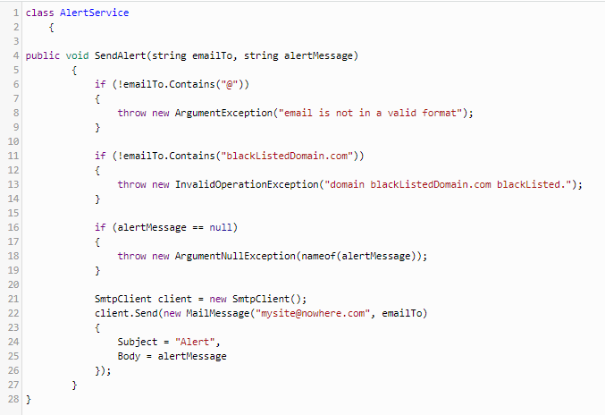
This method, for example, is doing too much. Because of that, the SendAlert class could change if the validation criteria changes, and that is not the main purpose of the class.
20

Slide 21
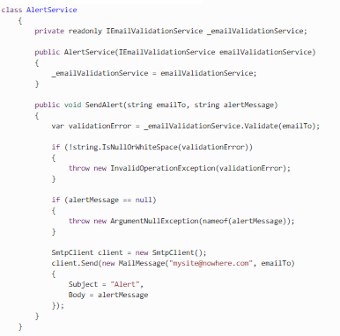


Slide 22
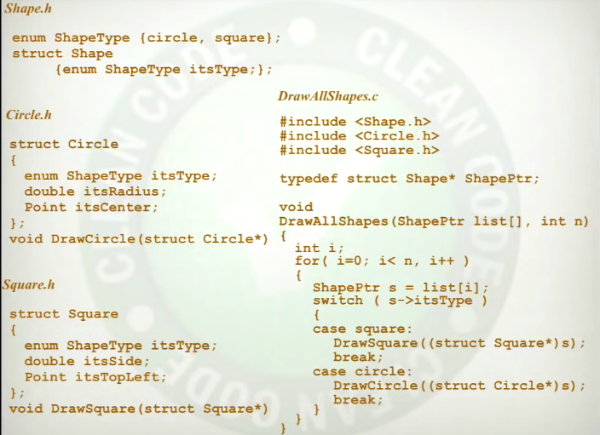
Open Close Principle
You can change the behaviour of the module, without changing the module.
You can extend the behaviour of the system without changing the system, don’t need to compile the old Module.

Slide 23
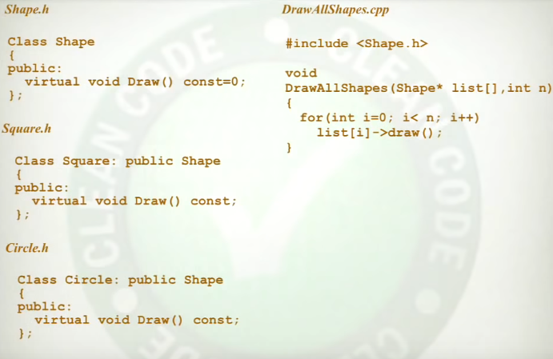

Slide 24
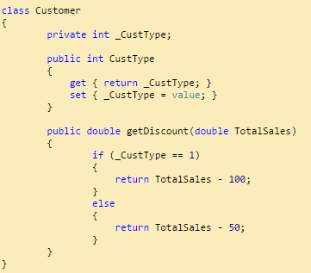
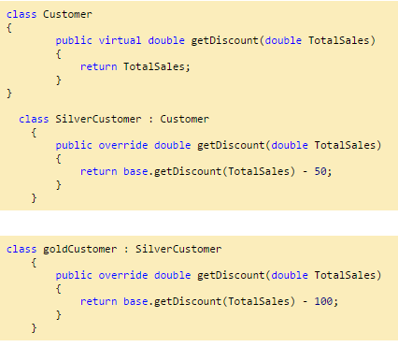
Open Close Principle
See getDiscount() method, based on the customer type it calculate the discount.
Code in a way that you don’t need to compile your old code.
24

Slide 25
Dependency Inversion Principle
High-level modules should not depend on low-level modules.
Main
M
N F
SC
FC
HL modules
HL modules
LL modules
LL modules
If there is any change in lower level module
Every module which using it needs to be
Recompile.
LL modules
LL modules

Slide 26
Polymorphism
I
F
SC
N F
N F
M
M
SC
SC
FC
FC

Slide 27
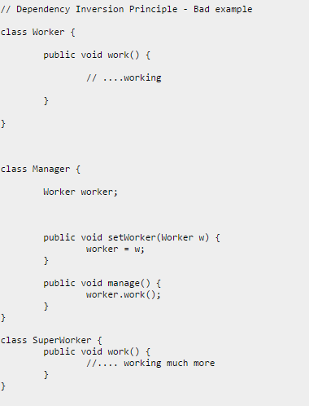
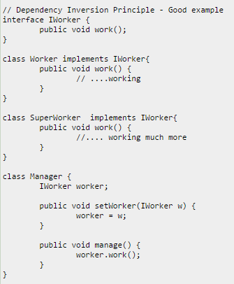
Dependency Inversion Principle
27

Slide 28
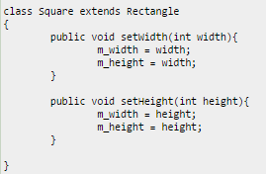
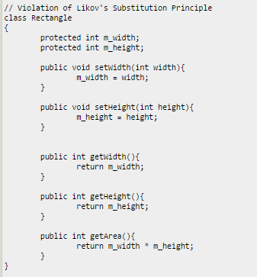
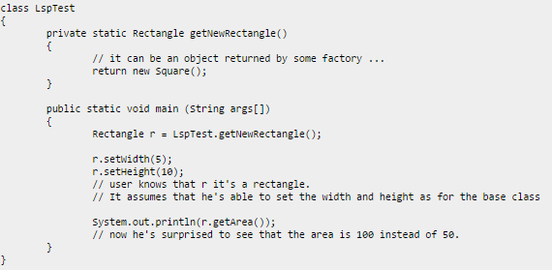
Liskov's Substitution Principle(LSP)
Derived types must be completely substitutable for their base types.
We must make sure that the new derived classes just extend without replacing the functionality of old classes. Otherwise the new classes can produce undesired effects when they are used in existing program modules.
28

Slide 29
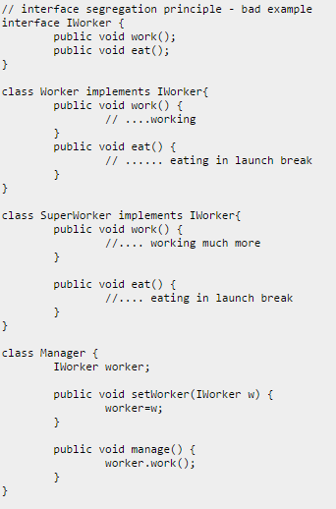
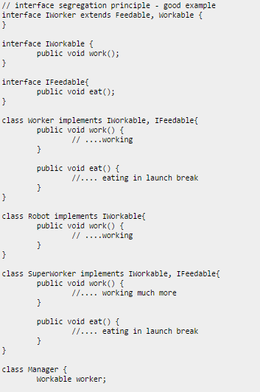
Interface Segregation Principle (ISP)
The Interface Segregation Principle states that clients should not be forced to implement interfaces they don't use.
29

Slide 30
Always check the diff when you commit your code and ensure that you are delivering what you wanted to.
Can use, winmerge, gitdiff, vimdiff.
Don’t make exits from multiple places in the scripts, have control at some particular location.
Don’t repeat anything, if you see repetition make function out of it.
30

Slide 31
References
http://www.oodesign.com/
https://www.slideshare.net/wakaleo/clean-codingpractices
https://www.codeproject.com/Articles/703634/SOLID-architecture-principles-using-simple-Csharp
Book – Clean Code by Robert C. Martin.
31

Slide 32
Some sites where coding practice can be done.
http://codingbat.com
https://www.techgig.com/
http://code.google.com/codejam/
https://www.topcoder.com/
https://www.codechef.com/
32

Slide 33
Leave you with some of the quotes.
“Clean code always looks like it was written by someone who cares.”
“Always code as if the guy who ends up maintaining your code is a violent psychopath who knows where you live.”- Martin Golding
“Leave the campground cleaner than the way you found it.”
33

Slide 34
Thank you
34

Slide 35
BACKUP SLIDES

Slide 36
OO
Encapsulation -> In C encapsulation was better we just need to provide the .h file and no other inside data structures were visible but in OO
Some variables are having public, private and protected, and compiler need to have extra checks to insure that private is not accessible from outside.
OO weekend the encapsulation.
Inheritance -> We can perform inheritance in C also using struct and union. But OO gives some simple ways to handle it.
struct parent {
int parent_i;
char parent_c;
};
struct descendant {
struct parent parent_data;
int descendant_d;
};
#define descendant_i parent_data.parent_i
#define descendant_c parent_data.parent_c
https://www.codeproject.com/Articles/108830/Inheritance-and-Polymorphism-in-C
https://softwareengineering.stackexchange.com/questions/338926/implement-inheritance-in-c

Slide 37
In strict type languages you need inheritance to use polymorphism but not strict type language like python or ruby you don’t need inheritance to use polymorphism.
In Non Strict type language, inheritance is not for polymorphism, it is basically used for taking the behaviour.
Polymorphism ->
In c
Void copy (){
Int c;
While (c = getchar() != EOF) {
printf (c);
}
}
getchar and printf can get the input from any device and print to any device. It was a polymorphism.
Every IO driver have 5 function with same signature.
1. Read 2. Write 3. Open 4. Close and 5. Seek.

Slide 38
Average lines
Function - 20
Class - 77

Slide 39
Cohesion and coupling.
Cohesion is a degree (quality) to which a component / module focuses on the single thing. | Coupling is a degree to which a component / module is connected to the other modules.
While designing you should strive for high cohesion i.e. a cohesive component/ module focus on a single task (i.e., single-mindedness) with little interaction with other modules of the system. | While designing you should strive for low coupling i.e. dependency between modules should be less.
Cohesion is Intra – Module Concept. | Coupling is Inter -Module Concept.

