Slide 1
IT 601: Mobile Computing
Session 2
Wireless Transmission Basics
Prof. Anirudha Sahoo
IIT Bombay

Slide 2
Spectrum and bandwidth
Electromagnetic signals are made up of many frequencies
Shown in the next example

Slide 3
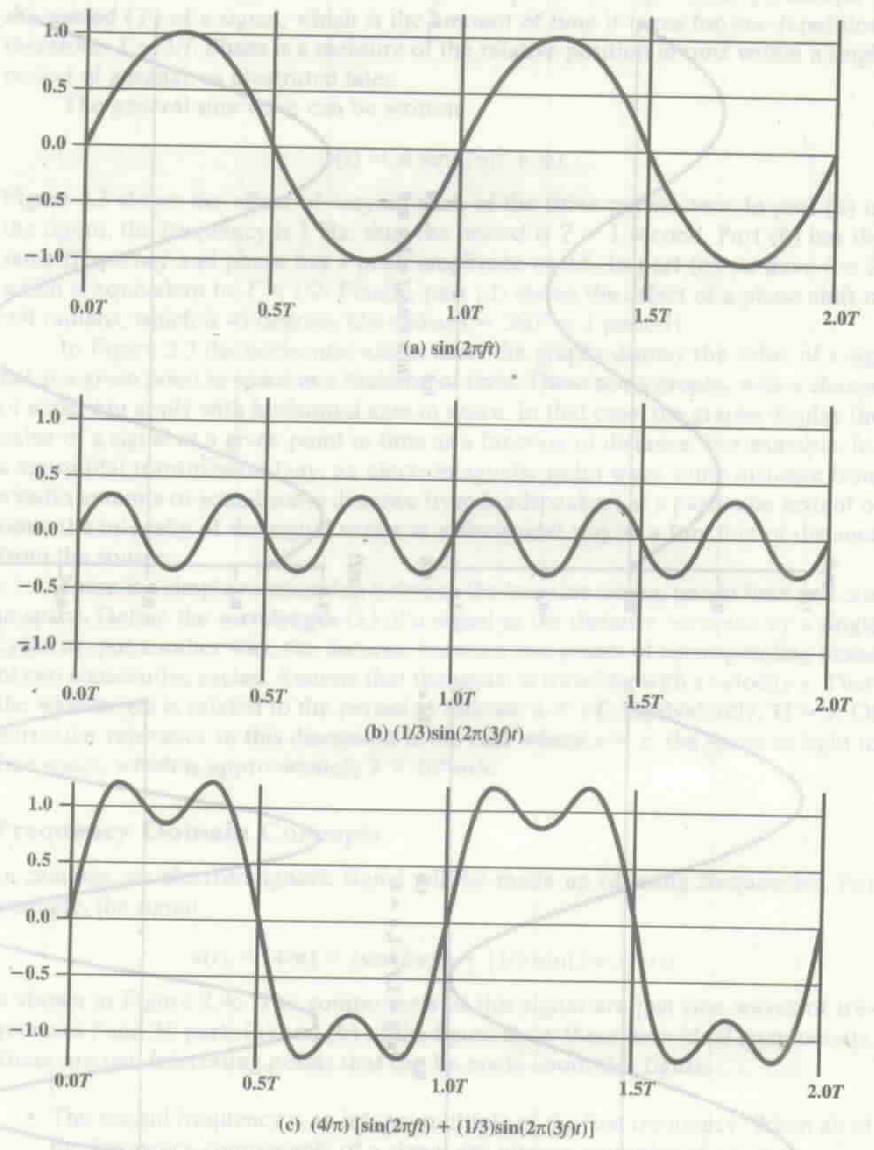
FIG 1
Source: Stallings

Slide 4
Spectrum and bandwidth
The 2nd frequency is an integer multiple of the first frequency
  When all of the frequency components of a signal are integer multiples of one frequency, the latter frequency is called fundamental frequency (f)
  period of the resultant signal is equal to the period of the fundamental frequency
    Period of s(t) is T=1/f

Slide 5
Fourier Analysis
Any signal is made up of components at various frequencies, in which each component is a sinusoid.
  Adding enough sinusoidal signals with appropriate amplitude, frequency and phase, any electromagnetic signal can be constructed

Slide 6
Spectrum and bandwidth
It is the range of frequencies that a signal contains (among its components)
  In the example, spectrum is from f to 3f
  absolute bandwidth is the width of the spectrum
    3f-f = 2f

Slide 7
Data Rate and bandwidth
There is a direct relationship between data rate (or signal carrying capacity) and bandwidth
Suppose we let a positive pulse represent 1 and negative pulse represent 0
  Then the waveform (next slide) represents 1010..
  Duration of each pulse is t_{bit} = (1/2) (1/f)
  Thus data rate is 1/ t_{bit} = 2f bits/sec
As we add more and more frequencies the wave looks more like a square wave

Slide 8
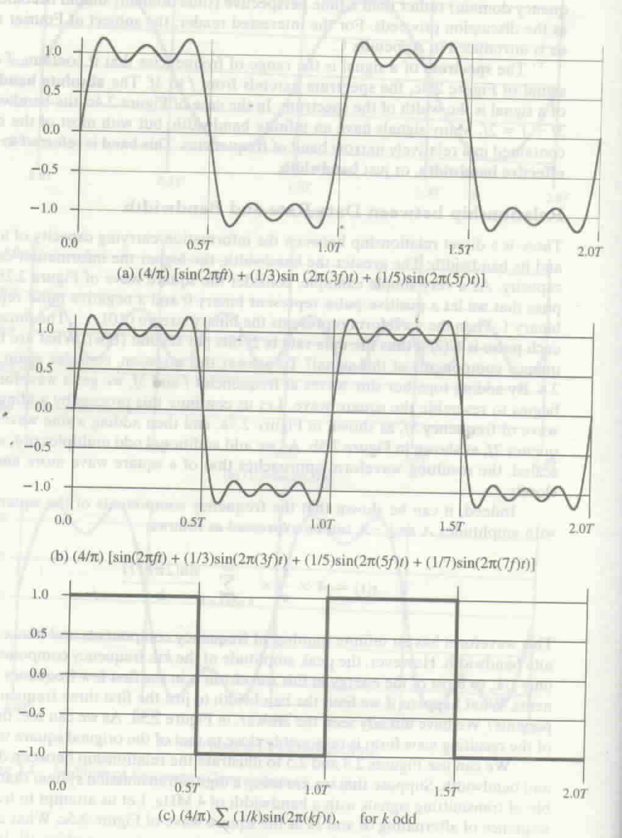
Source: Stallings
FIG 2

Slide 9
Example
Looking at FIG 2(a) the bandwidth = 5f-f = 4f
  If f=1MHz = 10⁶ cycles/sec, then bandwidth = 4MHz
  The period of the fundamental frequency = T = 1/f = 1 μs
  So each bit takes up 0.5 μs i.e. data rate is 1/0.5 Mbps = 2 Mbps

Slide 10
Example
Looking at FIG 1(c) the bandwidth = 3f-f = 2f
  If f=2MHz = 2x10⁶ cycles/sec, then bandwidth = 4MHz
  The period of the fundamental frequency = T = 1/f = 0.5 μs
  So each bit takes up 0.25 μs i.e. data rate is 1/0.25 Mbps = 4 Mbps

Slide 11
Example
Thus a given bandwidth can support different data rate, depending on the ability of the receiver to discern the difference between 0 and 1 in the presence of noise and interference

Slide 12
Gain and Loss
Ratio between power levels of two signals is referred to as Gain
  gain (dB) = 10 log₁₀ (P_{out}/P_{in})
  loss (dB) = -10 log₁₀ (P_{out}/P_{in}) = 10 log₁₀ (P_{in}/P_{out})
  P_{out} is output power level and P_{in} is input power level
Signal of power 10mw transmitted over wireless channel, and receiver receives the signal with 2mw power:
  gain (db) = 10 log₁₀ (2/10) = -10 (0.698) = -6.98 dB
  loss (db) = 6.98 dB

Slide 13
dBW power
dB-Watt
  power in dB transmitted with respect to a base power of 1 Watt
    dBW = 10 log₁₀ P
      P is power transmitted in Watt
  if power transmitted is 1 Watt
    dBW = 10 log₁₀ 1 = 0 dBW
  1000 watt transmission is 30 dBW

Slide 14
dBm power
dB-milliwatt
  better metric in wireless network
  power in dB transmitted with respect to a base power of 1 milliwatt
    dBm = 10 log₁₀ P
      P is power transmitted in milliwatt
  if power transmitted is 1 milliwatt
    dBm = 10 log₁₀ 1 = 0 dBm
  10 milliwatt transmission is 10 dBm
  802.11b can transmit at a maximum power of 100mw = 20 dBm

Slide 15
Channel Capacity
Four concepts :
Data Rate : rate (in bps) at which data can be communicated
Bandwidth: bandwidth of the transmitted signal as constrained by the transmitter and the medium, expressed in Hz
Noise : interfering electromagnetic signal that tend to reduce the integrity of data signal
Error rate : rate at which receiver receives bits in error i.e. it receives a 0 when actually a 1 was sent and vice-versa

Slide 16
Nyquist Bandwidth
Given a bandwidth of B, the highest signal rate that can be carried is 2B (when signal transmitted is binary (two voltage levels))
  When M voltage levels are used, then each signal level can represent log₂M bits. Hence the Nyquist bandwidth (capacity) is given by
    C = 2 B log₂M

Slide 17
Shannon’s Capacity Formula
When there is noise in the medium, capacity is given by
  C <= B log₂ (1 + SNR)
    SNR = signal power/noise power
  SNR_{dB} = 10 log₁₀ SNR

Slide 18
Bandwidth Allocation
Necessary to avoid interference between different radio devices
  Microwave woven should not interfere with TV transmission
  Generally a radio transmitter is limited to a certain bandwidth
    802.11channel has 30MHz bandwidth
  Power and placement of transmitter are regulated by authority
    Consumer devices are generally limited to less than 1W power

Slide 19
ISM and UNII Band
Industrial, Scientific and Medical (ISM) band
  902-928 MHz in the USA
  433 and 868 MHz in Europe
  2400 MHz – 2483.5 MHz (license-free almost everywhere)
  Peak power 1W (30dBm)
    but most devices operate at 100mW or less
  802.11 uses the ISM band of 2.4GHz
Unlicensed National Information Infrastructure (UNII) bands
  5.725 – 5.875 GHz

Slide 20
Antenna
An electrical conductor or system of conductors used for radiating electromagnetic energy into space or for collecting electromagnetic energy from the space
  An integral part of a wireless system

Slide 21
Radiation Patterns
Antenna radiates power in all directions
  but typically does not radiate equally in all directions
Ideal antenna is one that radiates equal power in all direction
  called an isotropic antenna
  all points with equal power are located on a sphere with the antenna as its center

Slide 22
Omnidirectional Antenna
Produces omnidirectional
  radiation pattern of
  equal strength in all
  directions
Vector A and B are
of equal length
A
B
Antenna location
Omnidirectional Antenna

Slide 23
Directional Antenna
Radiates most power in one
  axis (direction)
  radiates less in other
  direction
  vector B is longer than
  vector A : more power
  radiated along B than A
  directional along X
A
B
X

Slide 24
Dipole Antenna
Half-wave dipole or Hertz
antenna consists of two
straight collinear conductor
of equal length
Length of the antenna
is half the wavelength of
the signal.
λ/2
Half-wave dipole

Slide 25
Quarter-wave antenna
Quarter-wave or marconi antenna
has a veritcal conductor of
length quarter of the wavelength
of the signal
λ/4

Slide 26
Sectorized Antenna
Several directional antenna
combined on a single pole
to provide sectorized antenna
each sector serves receivers
listening it its direction
3 sector antenna

Slide 27
Antenna Gain
A measure of the directionality of an antenna
Defined as the power output, in a particular direction, compared to that produced in any direction by a perfect isotropic antenna
  Example: if an antenna has a gain of 3dB, the antenna is better (in that direction) than isotropic antenna by a factor of 2

Slide 28
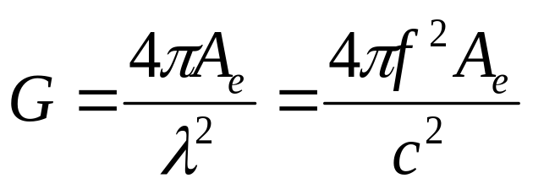
Antenna Gain
Antenna gain is dependent on effective area of an antenna.
  effective area is related to the physical size of the antenna and its shape
  Antenna Gain is given by
  where
  G = antenna gain
  A_{e} = effective area
  f = carrier frequency
  c = speed of light
  λ = carrier wavelength

Slide 29
Signal Propagation
Transmission range:
receiver receives signal with an error rate low enough to be able to communicate
Detection range: transmitted power is high enough to detect the transmitter, but high error rate forbids communication
Interference range: sender interferes with other transmissions by adding to the noise
sender
transmission
detection
interference

Slide 30
Signal Propagation
Radio waves exhibit three fundamental propagation behavior
  Ground wave (< 2 MHz) : waves with low frequency follow earth’s surface
    can propagate long distances
    Used for submarine communication or AM radio
  Sky wave (2-30 MHz) : waves reflect at the ionosphere and bounce back and forth between ionosphere and earth , travelling around the world
    Used by international broadcast and amateur radio

Slide 31
Signal propagation
receiver
transmitter
earth
Ground wave propagation (< 2 MHz)

Slide 32
ionosphere
Signal propagation
receiver
transmitter
earth
sky wave propagation (2 - 30MHz)

Slide 33
Signal Propagation
  Line of Sight (> 30 MHz) : emitted waves follow a straight line of sight
    allows straight communication with satellites or microwave links on the ground
    used by mobile phone system, satellite systems

Slide 34
Signal propagation
receiver
transmitter
earth
Line of Sight (LOS) propagation (> 30 MHz)

Slide 35
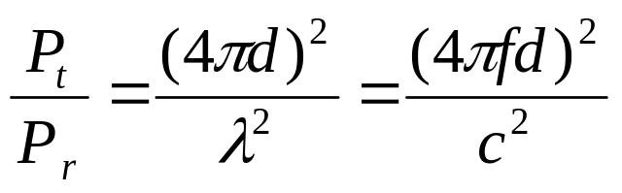
Free Space loss
Transmitted signal attenuates over distance because it is spread over larger and larger area
  This is known as free space loss and for isotropic antennas
  P_{t} = power at the transmitting antenna
  P_{r} = power at the receiving antenna
  λ = carrier wavelength
  d = propagation distance between the antennas
  c = speed of light

Slide 36
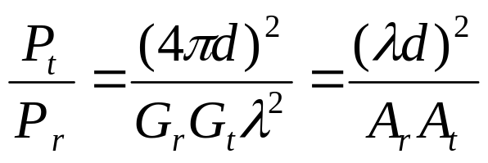
Free Space loss
  For other antennas
  G_{t} = Gain of transmitting antenna
  G_{r} = Gain of receiving antenna
  A_{t} = effective area of transmitting antenna
  A_{r} = effective area of receiving antenna

Slide 37
Thermal Noise
Thermal noise is introduced due to thermal agitation of electrons
  Present in all transmission media and all electronic devices
  a function of temperature
  uniformly distributed across the frequency spectrum and hence is often referred to as white noise
  amount of noise found in a bandwidth of 1 Hz is
  N₀ = k T
  N₀ = noise power density in watts per 1 Hz of bandwidth
  k = Boltzman’s constant = 1.3803 x 10⁻²³ J/K
  T = temperature, in Kelvins
  N = thermal noise in watts present in a bandwidth of B
  = kTB where

Slide 38
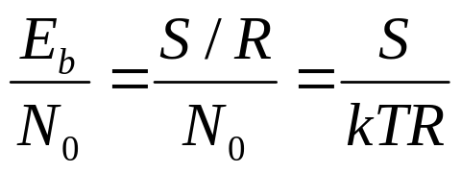
Data rate and error rate
A parameter related to SNR that is more convenient for determining digital data rates and error rates
  ratio of signal energy per bit to noise power density per Hertz, E_{b}/N₀
  R = bit rate of transmission, S= power of the signal,
  T_{b} = time required to send 1 bit. Then R = 1/T_{b}
  E_{b} = S T_{b}
  so

Slide 39
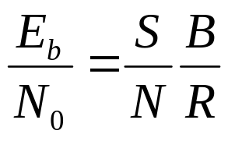
Data rate and error rate
Bit error rate is a decreasing function of E_{b}/N₀
  If bit rate R is to increase, then to keep bit error rate (or E_{b}/N₀) same, the transmitted signal power must increase, relative to noise
E_{b}/N₀ is related to SNR as follows
B = signal bandwidth
(since N = N₀ B)

Slide 40
Doppler’s Shift
When a client is mobile, the frequency of received signal could be less or more than that of the transmitted signal due to Doppler’s effect
If the mobile is moving towards the direction of arrival of the wave, the Doppler’s shift is positive
If the mobile is moving away from the direction of arrival of the wave, the Doppler’s shift is negative

Slide 41
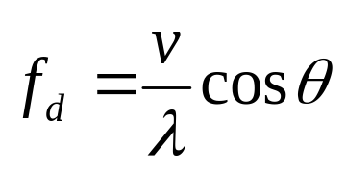

Doppler’s Shift
S
where
f_{d} =change in frequency
due to Doppler’s shift
v = constant velocity of the
mobile receiver
λ = wavelength of the transmission
θ
X
Y

Slide 42
Doppler’s shift
f = f_{c} + f_{d}
where
f = the received carrier frequency
f_{c} = carrier frequency being transmitted
f_{d} = Doppler’s shift as per the formula in the prev slide

Slide 43
Multipath Propagation
Wireless signal can arrive at the receiver through different pahs
  LOS
  Reflections from objects
  Diffraction
    Occurs at the edge of an impenetrable body that is large compared to the wavelength of the signal

Slide 44
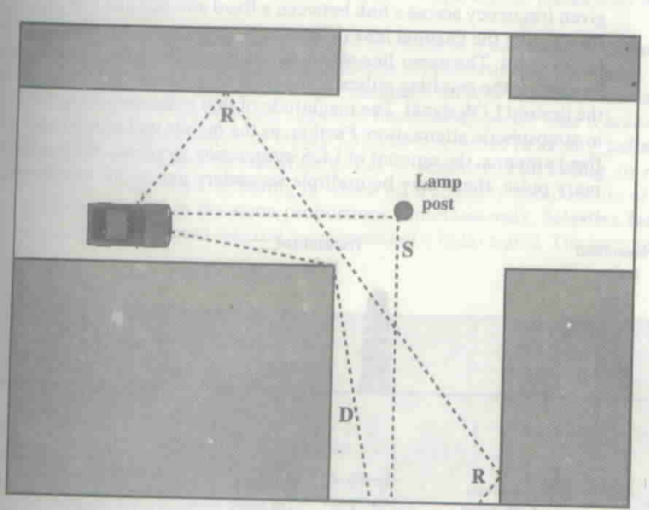
Multipath Propagation (source: Stallings)

Slide 45
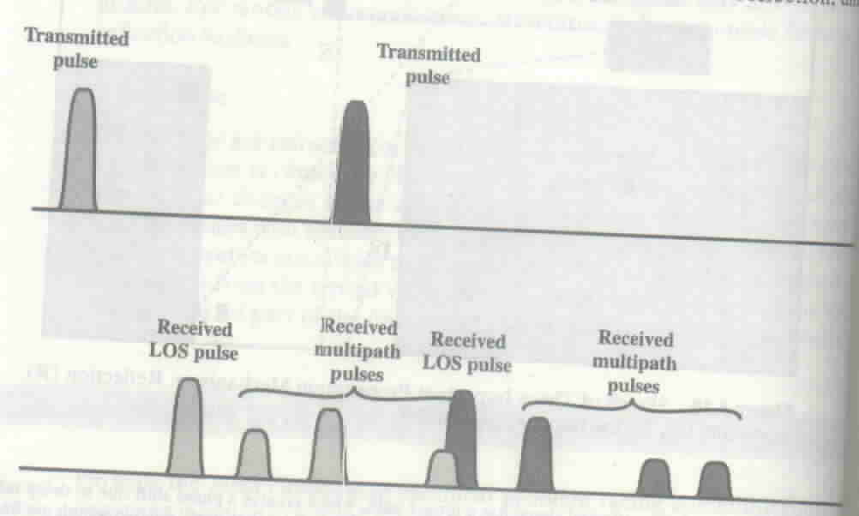
Inter Symbol Interference (ISI) in multipath (source: Stallings)

Slide 46
Effect of Multipath Propagation
Multiple copies of the signal may arrive with different phases. If the phases add destructively, the signal level reduces relative to noise.
Inter Symbol Interference (ISI)

Slide 47
Multiplexing
A fundamental mechanism in communication system and networks
Enables multiple users to share a medium
For wireless communication, multiplexing can be carried out in four dimensions: space, time, frequency and code

Slide 48
Space division multiplexing
Channels are assigned on the basis of “space” (but operate on same frequency)
The assignment makes sure that the transmission do not interfere with each (with a guard band in between)

Slide 49
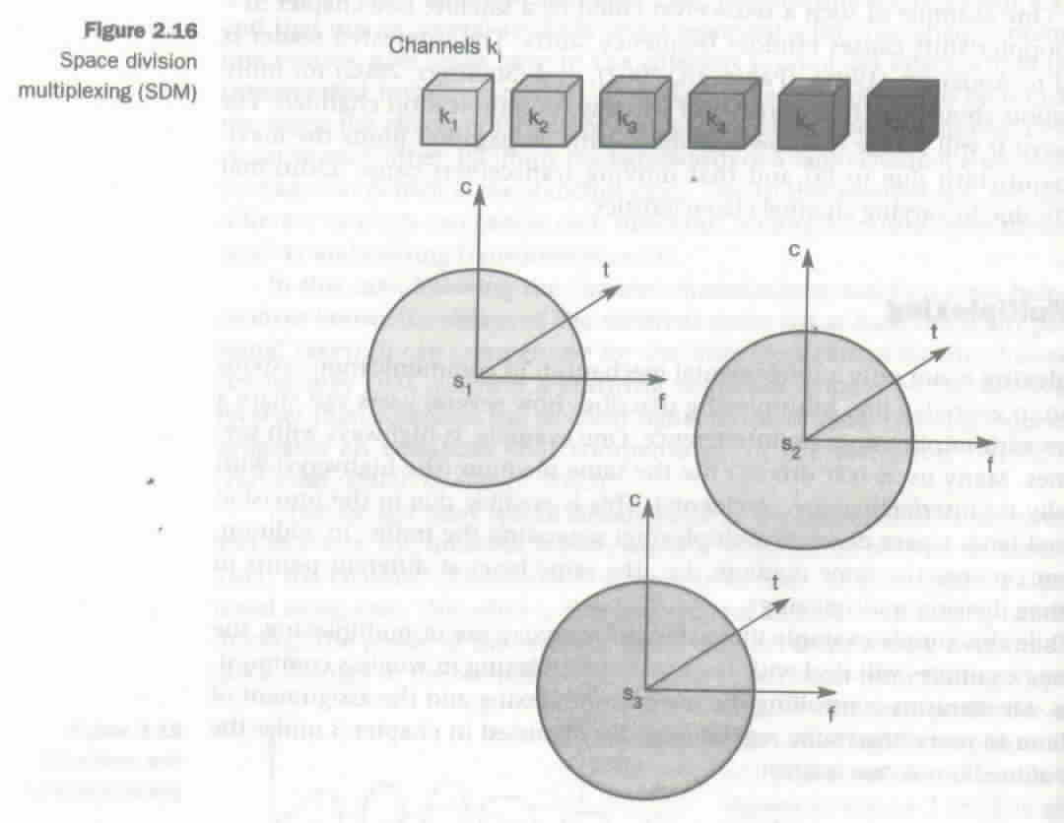
Space division multiplexing
Source: Schiller

Slide 50
Frequency Division Multiplexing
Frequency domain is subdivided into several non-overlapping frequency bands
Each channel is assigned its own frequency band (with guard spaces in between)

Slide 51
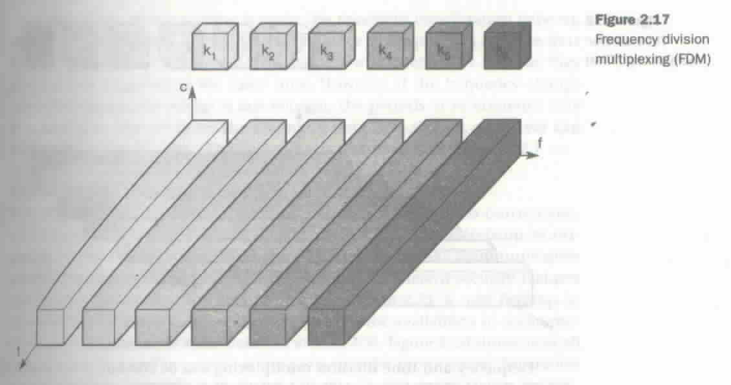
Frequency Division Multiplexing
Source : Schiller

Slide 52
Time Division Multiplexing
A channel is given the whole bandwidth for a certain amount of time
  All senders use the same frequency, but at different point of time

Slide 53
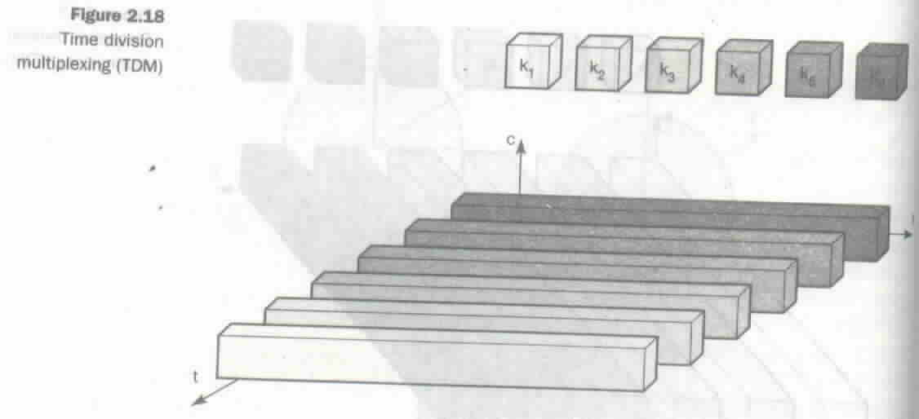
Time Division Multiplexing
Source : Schiller

Slide 54
Frequency and time division multiplexing
A channel use a certain frequency for a certain amount of time and then uses a different frequency at some other time
  Used in GSM systems

Slide 55
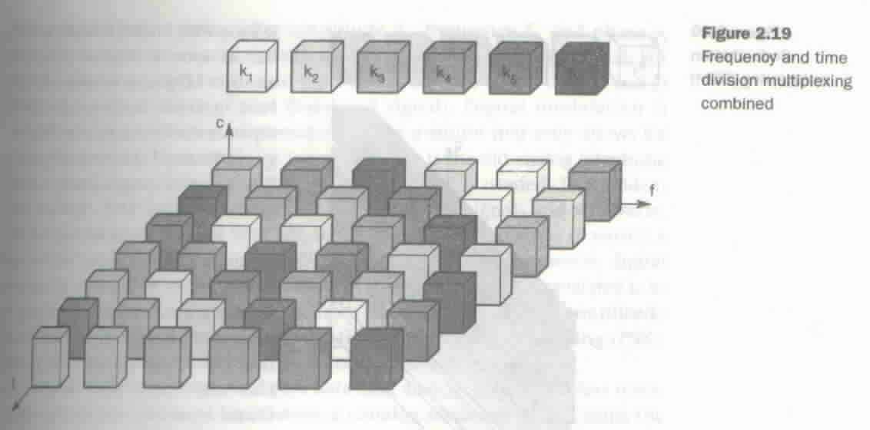
Frequency and time division multiplexing
Source : Schiller

Slide 56
Code division multiplexing
separation of channels achieved by assigning each channel its own code
guard spaces are realized by having distance in code space (e.g. orthogonal codes)
transmitter can transmit in the same frequency band at the same time, but have to use different code
Provides good protection against interference and tapping
but the receivers have relatively high complexity
  has to know the code and must separate the channel with user data from the noise composed of other transmission
  has to be synchronized with the transmitter

Slide 57
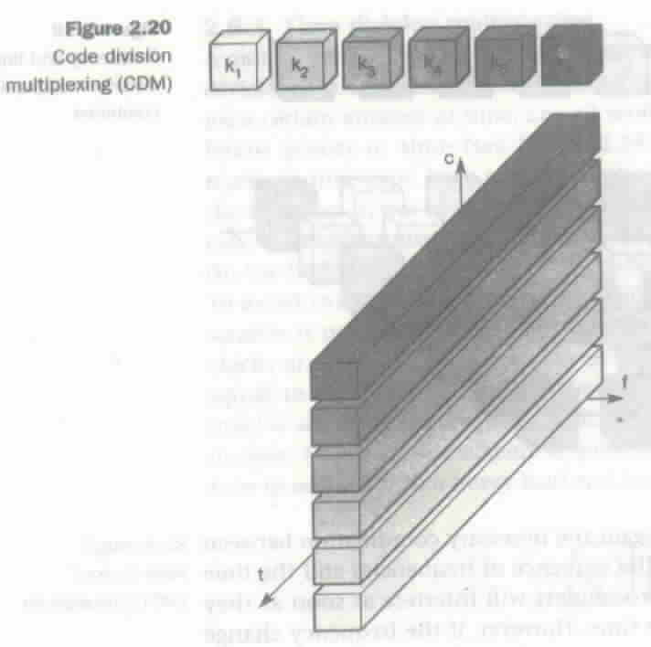
Code division multiplexing
Source: Schiller

Slide 58
Modulation
Process of combining input signal and a carrier frequency at the transmitter
Digital to analog modulation
  necessary if the medium only carries analog signal
Analog to analog modulation
  needed to have effective transmission (otherwise the antenna needed to transmit original signal could be large)
  permits frequency division multiplexing

Slide 59
Amplitude Shift Keying (ASK)
ASK is the most simple digital modulation scheme
Two binary values, 0 and 1, are represented by two different amplitude
In wireless, a constant amplitude cannot be guaranteed, so ASK is typically not used

Slide 60
Amplitude Shift Keying (ASK)
1
0
1

Slide 61
Frequency Shift Keying (FSK)
The simplest form of FSK is binary FSK
  assigns one frequency f₁ to binary 1 and another frequency f₂ binary 0
Simple way to implement is to switch between two oscillators one with f₁ and the other with f₂
The receiver can demodulate by having two bandpass filter

Slide 62
Frequency Shift Keying (FSK)
1
0
1

Slide 63
Phase Shift Keying (PSK)
Uses shifts in the phase of a signal to represent data
Shifting the phase by 180⁰ each time data changes: called binary PSK
The receiver must synchronize in frequency and phase with the transmitter

Slide 64
Phase Shift Keying (PSK)
1
0
1

Slide 65
Quadrature Phase Shift Keying (Q-PSK)
Higher bit rate can be achieved for the same bandwidth by coding two bits into one phase shift.
45⁰ for data 11
135⁰ for data 10
225⁰ for data 00
315⁰ for data 01
10
11
00
01

Slide 66
Spread Spectrum
Spreading the bandwidth needed to transmit data
  Spread signal has the same energy as the original signal, but is spread over a larger frequency range
  provides resistance to narrowband interference

Slide 67
Spread Spectrum
dP/df
dP/df
dP/df
spreading
with interference
user signal
f
f
f
sender
dP/df
dP/df
despread
apply bandpass filter
user signal
f
f
broadband interference
receiver
narrowband interference

Slide 68
Direct Sequence Spread Spectrum
Takes a user bit sequence and performs an XOR with, what is known as, chipping sequence
Each user bit duration t_{b}
chipping sequence has smaller pulses t_{c}
If chipping sequence is generated properly it may appear as random noise
  sometimes called pseudo-noise (PN)
t_{b}/t_{c} is known as the spreading factor
  determines the bandwidth of the resultant signal
Used by 802.11b

Slide 69
Direct Sequence Spread Spectrum
user data
t_{b}
0
1
XOR
t_{c}
chipping sequence
0 1 1 0 1 0 0 1 0 1 0 1
spread signal
0 1 1 0 1 0 1 0 1 0 1 0

Slide 70
Frequency Hopping Spread Spectrum
Total available bandwidth is split into many channels of smaller bandwidth and guard spaces
Transmitter and receiver stay on one of these channels for a certain time and then hop to another channel
Implements FDM and TDM
Pattern of channel usage : hopping sequence
Time spent on a particular channel: dwell time

Slide 71
Frequency Hopping Spread Spectrum
Slow hopping
  Transmitter uses one frequency for several bit period
  systems are cheaper, but are prone to narrow band interference
Fast hopping
  Transmitter changes frequency several times in one bit period
  Transmitter and receivers have to stay synchronized within smaller tolerances
  Better immuned to narrow band interference as they stick to one frequency for a very short period
Receiver must know the hopping sequence and stay synchronized with the transmitter
Used by bluetooth

Slide 72
Frequency hopping spread spectrum
t_{b}
user data
0 1 0 1 1
t
f₃
t_{d}
f₂
slow hopping 3bits/hop
f₁
t_{d}
t
f₃
fast hopping 3hops/bit
f₂
f₁
t
t_{d} = dwel time

