Slide 1
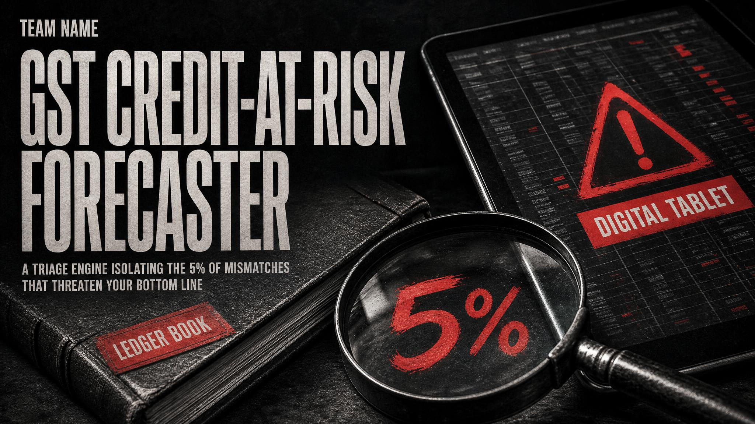
Notes:
Welcome judges and investors. Every month, Indian enterprises face a recurring multi-million rupee compliance dilemma: reconciliations between purchase registers and GSTR-2B. Under Section 16(2)(aa) and Rule 37A, missing invoices trigger mandatory credit reversals with 18% statutory interest. Our platform changes this with autonomous triage.

Slide 2
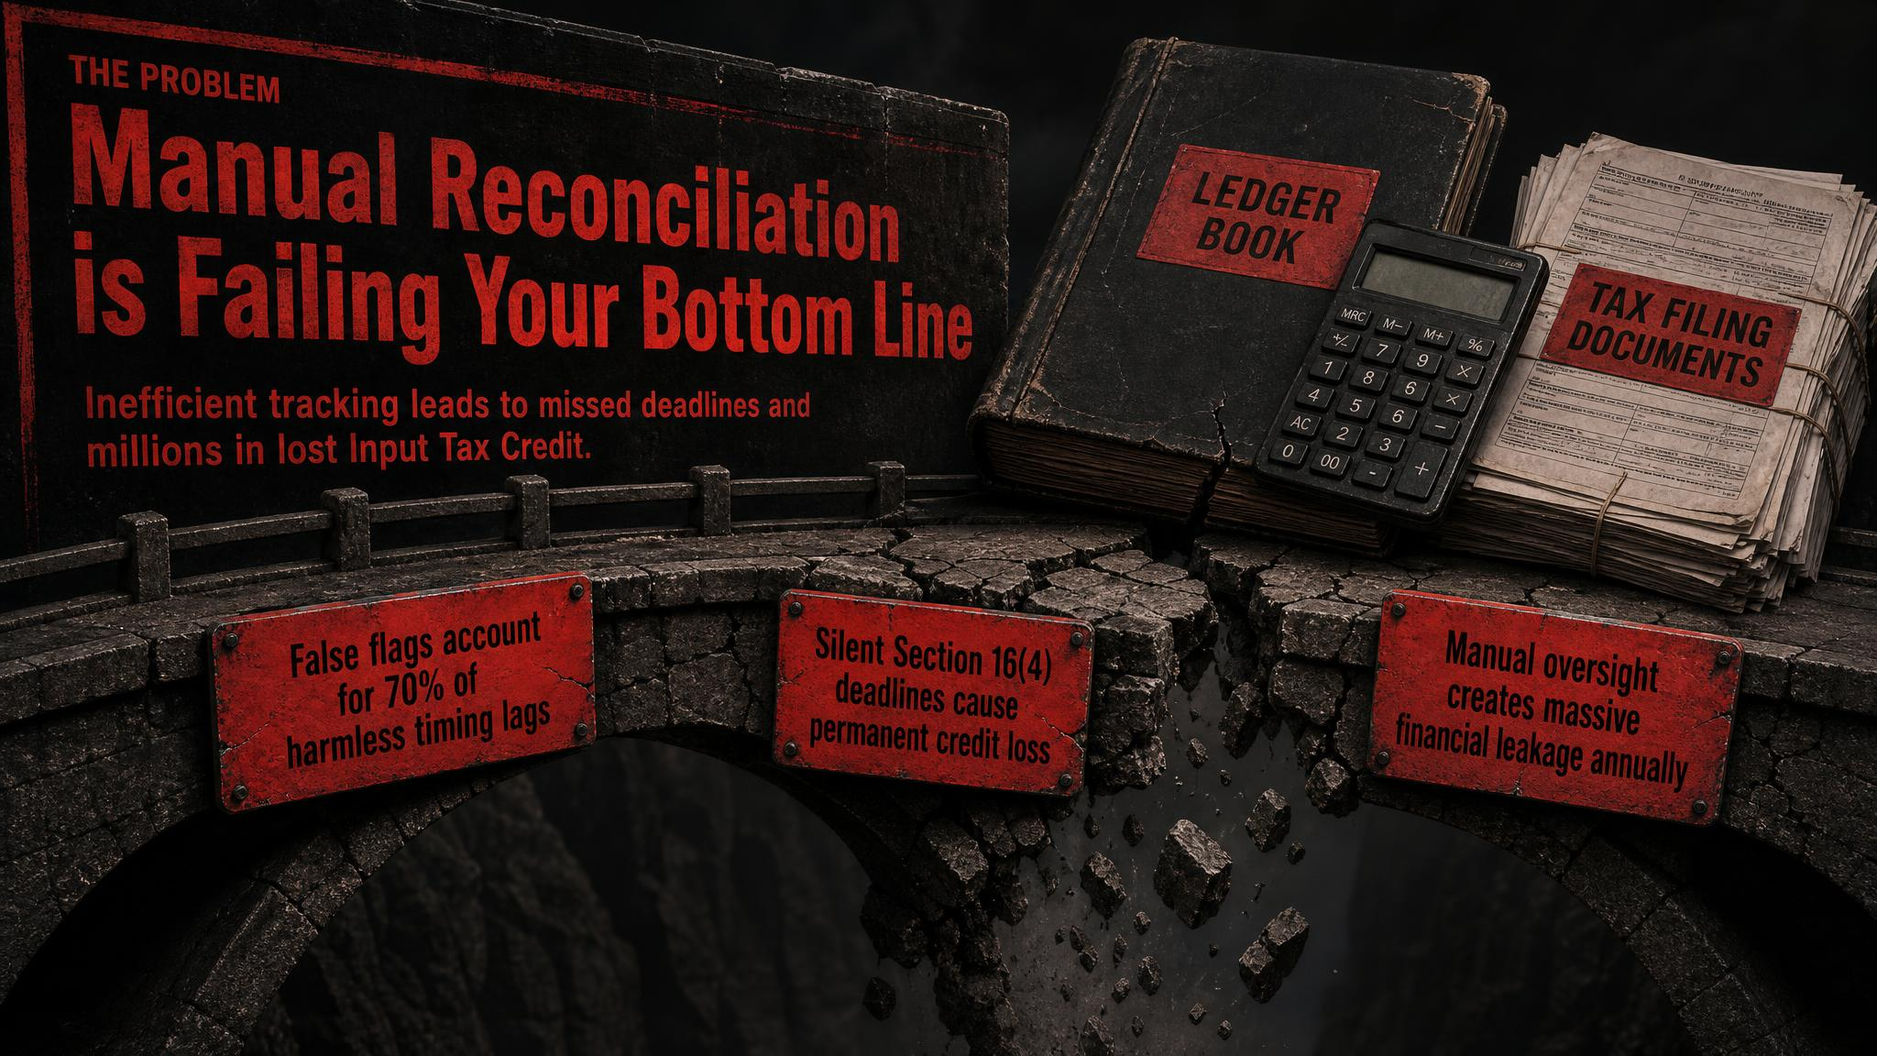
Notes:
Reconciliation mismatches are treated identically by existing accounting tools. A missing invoice from a habitual late-filer with 100% payment retention is flagged the same as an unverified supplier with zero retention. Our solution cuts through this noise.

Slide 3

Notes:
Our engine computes an explainable 0 to 100 risk score. In our benchmark fixture of 30 missing invoices: 25 route to Safe to Hold (₹1.4L protected), 4 to Watch (₹32k monitored), and exactly 1 to Chase Now (₹2.4k urgent default). Finance teams take targeted action in seconds instead of days.

Slide 4

Notes:
TinyFish connects our application to live government portals. If an external portal times out or encounters a captcha, our Zero-Penalty Defense defaults to ABSENT_UNKNOWN with 0 penalty points. We never convert a government portal glitch into an unwarranted vendor penalty.

Slide 5
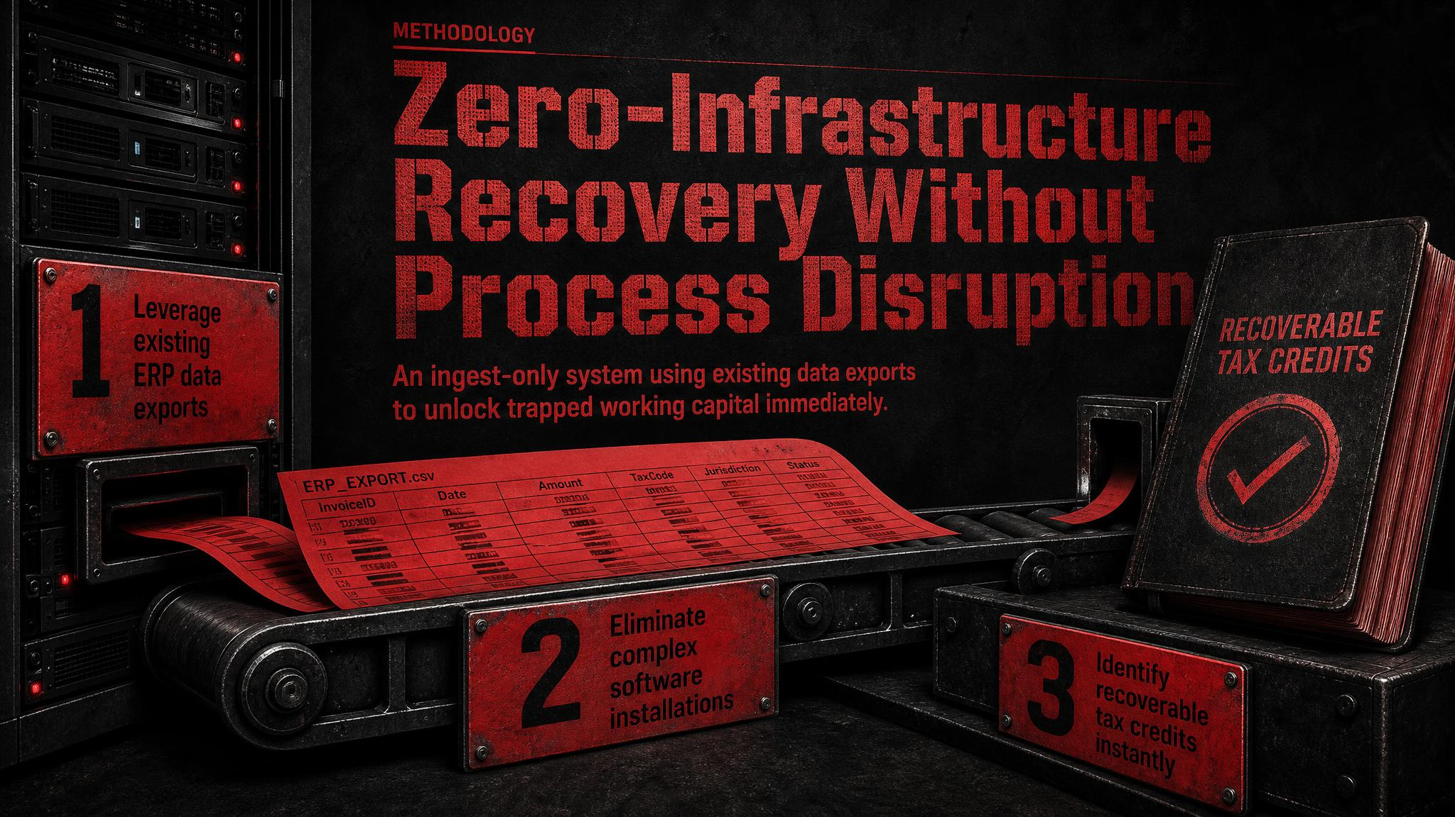
Notes:
Unlike heavy ERP overhauls, our solution is ingest-only. Finance teams upload standard Purchase Register and GSTR-2B CSV/Excel files. The reconciliation and triage take under 2 seconds, giving immediate actionable clarity.

Slide 6
MACHINE LEARNING BACKTEST (MODULE C)
LightGBM Gradient Boosted Forecaster
Trained on 1,200 multi-month cohort transactions across 6 tax periods with validated self-resolution prediction.
0.9858
ROC-AUC Score
vs. 0.6510 Logistic Baseline
0.0383
Brier Prob Error
Calibrated confidence probabilities
91.9%
Balanced Accuracy
Tested on 240 unseen hold-out invoices
87.0%
Default Catch Rate
Flags 40 of 46 non-resolving invoices
Empirical Confusion Matrix on 240 Held-Out Invoices
• True Negatives (High Risk Default Accurately Identified): 9 Invoices (Zero-Tolerance Recovery Flag)
• True Positives (Self-Correcting Timing Lags Protected): 198 Invoices (94.7% Self-Resolve Accuracy)
• Feature Importance Hierarchy: Commercial AP Leverage Ratio (42%) > IRN Portal Registry (34%) > Filing Periodicity Lags (24%)
Notes:
In addition to our deterministic 3-signal rules, we built a LightGBM ML forecaster. On 240 held-out test transactions, it achieved an AUC of 0.9858, 95.0% plain accuracy, and 91.9% balanced accuracy, verifying that historical filing periodicity strongly predicts whether a late invoice will self-correct.

Slide 7
BUSINESS MODEL & MARKET SIZING
A ₹240 Billion Market Opportunity
SaaS tiers for SMEs, Chartered Accountants, and Enterprises addressing 8 Million GST taxpayers.
India Market Sizing Funnel
• TAM: ₹240 Billion ($2.9B)
8M GST-registered businesses filing GSTR-3B monthly in India
• SAM: ₹24 Billion ($290M)
800,000 businesses facing recurring monthly GSTR-2B discrepancies
• SOM: ₹24 Crore ($2.9M)
Defensible Year 1 capture across mid-sized enterprises & CA networks
SaaS Monetization Strategy
• Free (₹0/mo)
Up to 50 invoices/mo, 3-signal triage, CSV upload
• Pro (₹2,499/mo)
Unlimited invoices, TinyFish live IRN lookup, 4-state engine, priority CA export
• Enterprise (₹12,999+/mo)
Multi-GSTIN workspace, SAP/Tally direct ERP sync, custom retention rules
Notes:
Competitive moat: ClearTax charges ₹5 Lakhs+ annually for enterprise suites. Tally and Vyapar provide bookkeeping with zero triage intelligence. We occupy the lucrative middle: a high-margin, explainable, action-first triage layer priced at ₹2,499/month.

Slide 8
LIVE DEMO RECAP & ROADMAP
Production-Ready Impact: 83% Noise Reduction
Proven reduction in accounts payable chase fatigue with 100% statutory compliance.
170 Matched Invoices
Auto-reconciled with RapidFuzz fuzzy lock — claimed immediately without human intervention.
25 Safe to Hold Invoices
₹1.4 Lakhs in credit safely held — verified IRN and healthy commercial AP leverage.
4 Watch Invoices
₹32,000 in nominal risk — monitored automatically for the next filing deadline.
1 Urgent Chase Now
₹2,400 high-risk invoice isolated — zero leverage, broken filing record, prompt recovery action.
Notes:
Summary: The GST Credit-at-Risk Forecaster transforms compliance from an adversarial, manual guessing game into a deterministic, data-driven science. Thank you!

