Slide 1

SUMMER INTERNSHIP PROGRAM WEEK -1

Slide 2

SUBMITTED BY : SUBMITTED TO :
VISHAL BHARDWAJ DR. ARUN TRIPATHI SIR
(2000290140133)

Slide 3
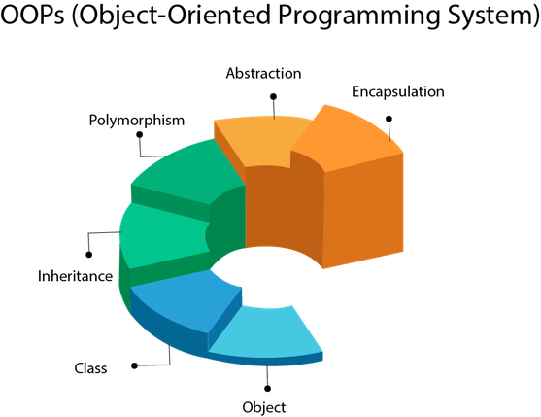
FIRST WEEK LEARINING OF JAVA
Java OOPs Concepts:-
In this page, we will learn about the basics of OOPs. Object-Oriented Programming is a paradigm that provides many concepts, such as inheritance, Encapsulation,Abstraction, polymorphism etc.

Slide 4
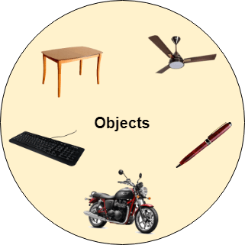
Object
Any entity that has state and behavior is known as an object. For example, a chair, pen, table, keyboard, bike, etc. It can be physical or logical.
An Object can be defined as an instance of a class. An object contains an address and takes up some space in memory.
Example: A dog is an object because it has states like color, name, breed, etc. as well as behaviors like wagging the tail, barking, eating, etc.

Slide 5
Class:-
Collection of objects is called class. It is a logical entity.
A class can also be defined as a blueprint from which you can create an individual object. Class doesn't consume any space.
Inheritance
When one object acquires all the properties and behaviors of a parent object, it is known as inheritance. It provides code reusability. It is used to achieve runtime polymorphism.
Polymorphism
If one task is performed in different ways, it is known as polymorphism. For example: to convince the customer differently, to draw something, for example, shape, triangle, rectangle, etc.
In Java, we use method overloading and method overriding to achieve polymorphism.

Slide 6

Abstraction
Hiding internal details and showing functionality is known as abstraction. For example phone call, we don't know the internal processing.
In Java, we use abstract class and interface to achieve abstraction.
Encapsulation
Binding (or wrapping) code and data together into a single unit are known as encapsulation. For example, a capsule, it is wrapped with different medicines.
A java class is the example of encapsulation. Java bean is the fully encapsulated class because all the data members are private here.

Slide 7
USED OF JAVA:-
Java is a popular programming language, created in 1995.
It is owned by Oracle, and more than 3 billion devices run Java.
It is used for:
(1)-Mobile applications (specially Android apps)
(2)Desktop applications
(3)-Web applications
(4)-Web servers and application servers
(5)-Games
(6)-Database connection
And much, much more!

Slide 8


