Slide 1
Voice AI building blocks
From an Airtel call to an AI agent: telecom, SIP, Genesys + Amazon Connect, Amazon Lex, and the protocols in between · October 2026
Notes:
Companion files in the GitHub repo: docs/07-building-blocks-qa.md (58 questions and answers), docs/08-use-case-v2-india-hybrid.md, simulator/building-blocks.html (call-path explorer) and simulator/index.html (WISMO bot).

Slide 2
Foundations before containment
1
Building blocks
2
AI bot
3
Containment
A real call travels operator → SIP trunk → SBC → platform → bot → API → agent, on both platforms, with one working cross-platform transfer.
Amazon Lex "Where is my order?" bot live for a small share of calls, with a summary on the agent screen for every hand-over.
Grow the bot share 5% → 30% → 50%, tune hand-over rules, measure verified containment against a holdout group.
Done when every test call and every failure path lands somewhere
Done when the bot answers correctly and hand-overs carry context
Done when numbers stay stable for two weeks per step
Today's focus: phase 1. Containment only makes sense once every building block is solid.
Notes:
The ask was to be clear on building blocks and basics before containment. Phase 1 proves the plumbing on both platforms, phase 2 adds the bot, phase 3 optimises.

Slide 3
The building blocks
01
How a normal phone call becomes something a cloud contact center and an AI bot can handle

Slide 4
One call, end to end
PSTN
SIP
SIP
Customer phone
Airtel / Jio / BSNL
Telecom operator
licensed TSP
SIP trunk
logical "pipe" of calls
SBC
security + routing
SIP + RTP
(voice)
webhook
Lex / WebSocket
Order system API
your business data
AI bot
Amazon Lex / Nova Sonic
CCaaS platform
Genesys / Connect
WebRTC
Telecom layers deliver a SIP call to the platform.
The platform answers, routes, queues and records.
AI and business data are reached with WebSocket streams and webhook calls.
Agent
browser softphone
Notes:
Explorer journey 1 animates this path hop by hop. Protocols: PSTN in the operator network; SIP signalling and RTP/SRTP voice into the platform; WebSocket (Audio Connector) or native Lex integration to the bot; webhooks/HTTPS to business systems; WebRTC for agent softphones.

Slide 5
Who does what
Category | Analogy | What you get | Examples
Telecom operator (TSP) | The road network | Numbers, call delivery, SIP trunks | Airtel, Tata, Jio, Vi, BSNL
CPaaS | Bricks and cement | APIs to add calls / SMS / WhatsApp to your own apps | Twilio, Vonage, Sinch, Exotel
CCaaS | A finished building | IVR, routing, queues, agent desktop, recording, analytics | Genesys Cloud CX, Amazon Connect, NICE, Twilio Flex
UCaaS | The office phones | Employee calling and meetings | Teams, Zoom Phone, Webex
Conversational AI | A receptionist hired in | Speech understanding and conversation | Amazon Lex, Nova Sonic, Genesys virtual agent
CPaaS = APIs you plug into your own apps. CCaaS = a ready-made contact-center application.
Notes:
Source for the CPaaS vs CCaaS one-liner: GetVoIP. Twilio is mostly CPaaS but also sells Flex (CCaaS).

Slide 6





Five telecom words to know
Phone number (DID / toll-free)
A routing address leased from a licensed operator. Whoever holds it decides where calls go.
e.g. 1800 toll-free; 140 / 1600 series for outbound
Telecom operator (TSP)
Carries the call across the public phone network and hands it to your trunk.
Airtel, Tata, Jio, Vi, BSNL
SIP trunk
A logical connection that delivers calls as SIP over an IP link. It replaces PRI/E1 lines.
Sized in concurrent calls ("channels")
SBC (Session Border Controller)
A firewall built for phone calls: security, header fixes, encryption, routing and splitting.
AudioCodes, Ribbon, Oracle; can run in AWS
Codec
How voice is compressed. Phones use G.711 (8 kHz); browsers use Opus.
One codec end to end = best quality
Notes:
SIP trunks are logical, not physical: they run over the internet, MPLS or leased lines. In India they come from DoT-licensed operators, typically over dedicated circuits.

Slide 7
India: what is different
Licensed operators only
PSTN access and SIP trunks must come from DoT-licensed providers (Unified Licence).
OSP rules relaxed
Since the 2020–2021 reforms, no OSP registration; cloud telephony and work-from-home agents allowed.
VoIP dial-out restricted
Domestic VoIP-to-PSTN dial-out is still prohibited; SIP trunks run on dedicated circuits.
CDRs stay in India
Call records with the handling agent, kept in India with IST timestamps, on DoT request.
140 and 1600 series
140 for promotional calls (any sector); 1600 for BFSI service and transactional calls.
Watch: Telecom Act 2023
DoT is finalising authorisation rules; SIP-over-internet liberalisation may follow.
Confirm every design with legal counsel and your telecom provider, as Genesys's own India guide advises.
Notes:
Sources: Ozonetel VoIP in India 2026; KS&K OSP guide; Genesys Cloud CX India guide (CDRs in India with IST timestamp); TRAI press release 91/2026 on 1600/140 series.

Slide 8
Getting calls into each platform
Genesys Cloud: bring your own carrier
Amazon Connect: AWS-managed telephony
Genesys Cloud Voice: Genesys is the carrier (where available).
BYOC Cloud: your operator's SIP trunk, via your SBC, to Genesys's cloud (TLS 5061 + SRTP).
BYOC Premises: Genesys Edge devices on your site.
India: connect through an Indian TSP (Tata, Airtel…).
Claim or port numbers inside Connect: DID / toll-free in 158 countries.
Partners (e.g. AVOXI) add numbers where AWS has no coverage.
Or forward calls from another provider's number.
No BYOC: it does not accept your own SIP trunk. India numbers via AWS Support / partner.
Design consequence: with an Indian operator trunk, land phone calls on Genesys; use Connect where AWS hosts the number or for web/app calling.
Notes:
Genesys BYOC: TLS 1.2 on 5061 with SRTP, no mutual TLS, 500 ms handshake. 2026: Genesys Dynamic Cloud Voice platform with new SIP IPs for coexistence. Connect telephony: 158 countries DID/toll-free, 72 national outbound (AWS). "Amazon Connect does not support BYOC as a platform feature" (Global Call Forwarding, United World Telecom). India numbers for Connect: AWS re:Post.

Slide 9
SIP in sixty seconds
Operator
SBC / Genesys
SIP is not the voice
SIP sets up, transfers and ends calls (port 5060 / TLS 5061). RTP carries the sound.
INVITE (to 1800…, codec offer)
100 Trying
180 Ringing
Transfers
REFER hands the call off; a bridged transfer keeps the first platform in the middle (and billing).
200 OK (codec agreed)
ACK
RTP / SRTP voice both ways
Context travels in headers
User-to-User (UUI) or X-headers carry a short key. Genesys reads UUI; Connect only sends it.
BYE
200 OK
Notes:
Common SIP failures: 404 not found, 486 busy, 403 forbidden (IP not allowed), 503 unavailable. OPTIONS pings keep trunks healthy. DTMF travels as RFC 4733 RTP events. Genesys UUI: reads User-To-User then x-User-To-User, discards duplicates, recommends 128 characters or less.

Slide 10
WebSocket vs WebRTC vs webhook
 | Webhook / REST API | WebSocket | WebRTC
Like | A doorbell | An open phone line between offices | A walkie-talkie built into the browser
Connection | One request, one reply | Stays open for the session | Stays open for the call
Transport | HTTPS over TCP | TCP (wss:// = encrypted) | Mostly UDP, DTLS-SRTP, ICE/STUN/TURN
Carries | Small JSON | Text + binary audio frames | Live audio / video (Opus)
Between | Server ↔ server | Server ↔ server | Person's device ↔ media server
In our design | Order lookup, Genesys data actions, Lex → Lambda | Genesys Audio Connector to our AI; Connect A2A voice | Website "Call us"; agent softphones
And SIP + RTP is how telephony systems (operators, SBCs, CCaaS platforms) talk to each other.
Notes:
Why not stream audio over webhooks? A new connection per message is far too slow for audio every 20 ms. Why not WebRTC between servers? Its strengths (NAT traversal, lossy Wi-Fi, echo cancellation) matter for people's devices; inside data centers a WebSocket is simpler.

Slide 11
What Amazon Lex actually does
Caller speaks
ASR
NLU
Dialog
Lambda
Polly
"Where is my parcel?"
speech → text, trained on 8 kHz phone audio
intent + slots, with confidence
asks for missing details, keeps context
your business logic and APIs
text → natural speech
Lex = ears + understanding + conversation manager (+ Polly for the voice)
Assisted NLU
LLM constrained to your intents; ~92% intent accuracy reported by AWS
QnAIntent
answers FAQs from your documents (RAG)
Versions + aliases
safe test → production releases
Native in both
Connect "Get customer input"; Genesys "Call Lex V2 Bot"
Notes:
Sources: AWS Lex features page (ASR trained on 8 kHz telephony audio; context management; Polly NTTS), AWS ML blog on Assisted NLU (92% intent, 84% slot accuracy; no additional cost), QnAIntent. Genesys Lex V2 integration uses an IAM role and is supported in secure (PCI) flows.

Slide 12
Is Lex "just a bot"?
Service | Role | Analogy | Use it when
Amazon Polly | Text → speech only | The voice | You need a natural voice
Amazon Transcribe | Speech → text only | The ears | Analytics, captions
Amazon Lex | Ears + understanding + conversation | A trained receptionist with a script | Defined tasks, strict control, PCI, both platforms
Connect AI agents + Nova Sonic | Generative, agentic self-service | A receptionist who improvises within rules | Natural, open conversations on Connect
Amazon Bedrock | General LLMs you call from code | A smart consultant you brief | Custom AI logic, summaries, tools
Lex is the structured, predictable conversation engine, the right first step. Generative agents come next.
Notes:
Genesys has its own equivalent (Agentic Virtual Agent). Our repo uses Lex because both Genesys and Connect integrate with it natively, so one bot serves both platforms.

Slide 13
Where Twilio fits
Twilio products
AI
Lex, Nova Sonic, Bedrock
Do we need Twilio?
Usually not. Genesys and Connect already provide telephony, IVR, AI hooks and agents.
Consider it for a programmable carrier in a specific country, custom calling apps, or an AI vendor that connects through Twilio.
CCaaS
Genesys, Connect, NICE
Twilio Flex (competitor)
CPaaS
APIs for calls / SMS / WhatsApp
Programmable Voice, ConversationRelay
Carrier
Airtel, Tata, Jio
Elastic SIP Trunking (BYOC for Genesys)
SIP is the language; the operator carries the call; the platform decides what to do with it.
Notes:
Twilio publishes Elastic SIP Trunking configuration guides including Genesys Cloud. For India, check in-country capabilities: PSTN access must come from licensed operators.

Slide 14
Genesys + Amazon Connect
02
How to connect them, how to split calls, and the optimised way to run both

Slide 15
Six ways to connect them
Pattern | Calls cross? | When
1 · Genesys uses AWS AI directly (Lex, Bedrock, Nova Sonic) | No | You want AWS AI; agents stay on Genesys
2 · Split at the edge: numbers / lines of business | No | Both platforms live for different teams
3 · Connect → Genesys via external voice transfer + SBC + UUI | Yes, private SIP | Connect front door or AI, Genesys agents
4 · Genesys → Connect via a Connect number + API context | Yes, via a number | Rare; prefer pattern 2
5 · Shared data: CRM, context store, data lake | No | Always
6 · Analytics bridge: SIPREC or AudioHook to AWS | Copy only | Unified QA during migration
Prefer the patterns at the top: the fewer calls that move between platforms, the cheaper and safer.
Notes:
Pattern 1 is often overlooked: Genesys can call Amazon Lex natively, and AWS models through Audio Connector, so "using AWS AI" does not require moving calls to Connect.

Slide 16
Connect → Genesys, step by step
Amazon Connect
Lambda + store
SBC
Genesys
Agent
1 · Save context, get key
2 · key → User-to-User value
3 · INVITE + UUI (external voice transfer)
4 · INVITE to BYOC trunk
5 · Data action: fetch context
6 · Queue + screen pop
7 · On failure: error branch → fallback
Notes:
Prerequisites: AWS quota increase for external voice transfer connectors; SBC with TLS/SRTP and header normalisation; Genesys BYOC Cloud trunk and a handoff DID routed to a "Handoff from Connect" Architect flow. Check whether Connect stays in the media path (and keeps per-minute billing) after the transfer. Connect sends UUI but does not read inbound SIP headers.

Slide 17
Four ways to split calls
Method | Where | Transfers | Best for
By number / line of business | Operator | None | Default: each team on its platform
By SBC rules (number, caller, time, %) | SBC | None* | Controlled migrations
Overflow when busy | Platform A | Peaks only | Resilience, seasonal peaks
Front door + transfer | Platform A | Every moved call | Only when A adds value first (AI bot)
* Connect does not accept your SIP trunk, so an SBC "split to Connect" means forwarding to a Connect-claimed number (an extra phone leg).
Percentage splits are weighted random choices (SBC weights, Connect "Distribute by percentage", Genesys Random()). Hash the caller number to keep each caller on the same side.
Notes:
Try all four in the explorer's "Split calls" panel: it routes 100 calls and counts the cross-platform transfers for each method.

Slide 18
Cross-platform: worth it?
Benefits
Use each platform's strengths
Migrate gradually, not big-bang
Overflow and resilience
Keep agents and processes during change
Costs and risks
Two platforms billing while bridged
Extra latency and failure points
Split reporting across systems
Context loss if hand-over is weak
THE OPTIMISED WAY
1. Decide the platform before the call lands
2. Bring AI to the platform, not calls to the AI
3. Move calls only for escalation or overflow
4. Private SIP + context by reference
Notes:
Also: one anchor per call; a shared customer/journey ID so reporting can join both platforms; test the transfer path weekly because rarely used paths break silently.

Slide 19
Design, demo and next steps
03
ShopNow India: the recommended design, two live demos, and the questions you will be asked

Slide 20
Recommended: ShopNow India
by number
Customer
Airtel / Jio
Licensed TSP
SIP trunk
SBC
Mumbai
Genesys Cloud
BYOC
Genesys agents
screen pop
Call Lex V2
escalation:
SIP + UUI
Amazon Lex
WISMO bot
Lambda +
order API
same bot
Phone calls land on Genesys (it accepts the Indian trunk)
AWS AI without moving calls
One cross-platform path, for escalations only
Website
"Call us"
WebRTC
Amazon
Connect
Notes:
Details and phase plan: docs/08-use-case-v2-india-hybrid.md. Sales and Support numbers are split at the SBC by dialled number, so phone calls never cross platforms. Connect is used for web/app calling (WebRTC) with the same Lex bot; escalations go to Genesys agents over private SIP with a UUI key.

Slide 21
How we make outbound calls
Agent
browser softphone
Genesys / Connect
picks trunk + caller ID
SBC
Licensed TSP
Airtel / Tata
Customer's phone rings
WebRTC
SIP INVITE
SIP
PSTN
Licensed trunk
Domestic VoIP-to-PSTN dial-out is restricted: outbound goes through the TSP trunk.
140 series
Promotional / telemarketing calls, any sector, with consent and DND rules.
1600 series
Service and transactional calls by RBI / SEBI / IRDAI / PFRDA-regulated entities.
DLT + penalties
Register with operators; misuse can bar every SIP/PRI trunk of the sender.
Notes:
Explorer journey 6 animates this. Sources: Ozonetel (VoIP rules 2026), TRAI press release 91/2026 and TCCCPR amendments (140/1600 series), TRAI regulation of 12 Feb 2025 on barring PRI/SIP trunks for UCC violations.

Slide 22
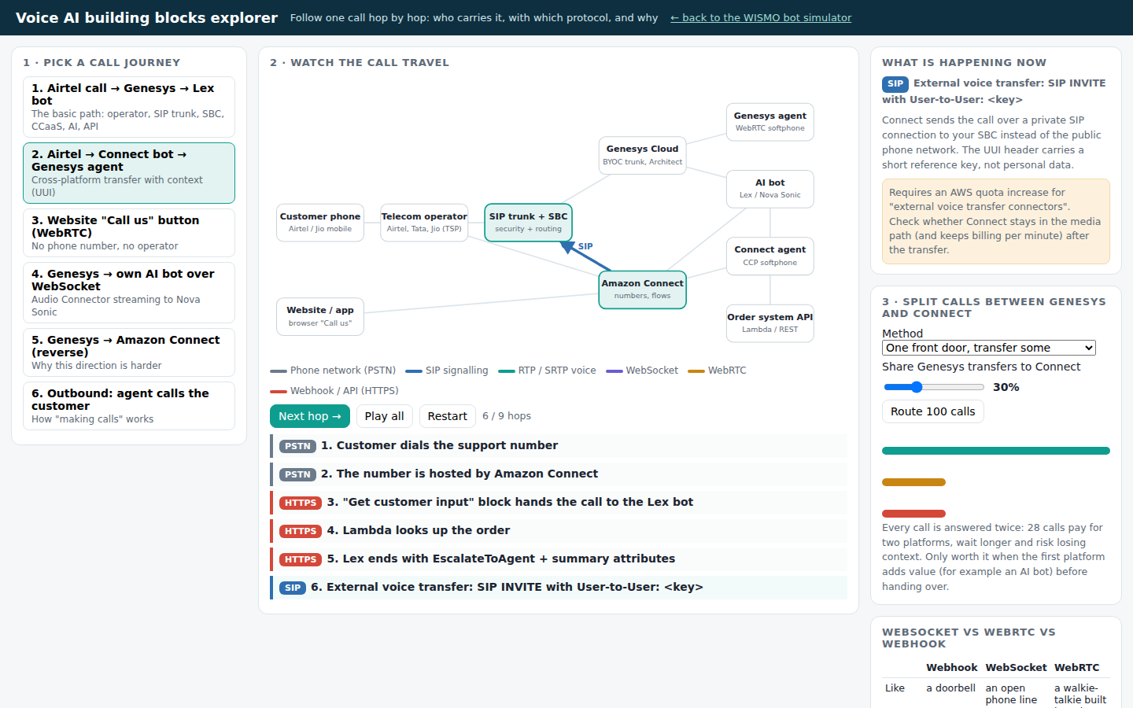
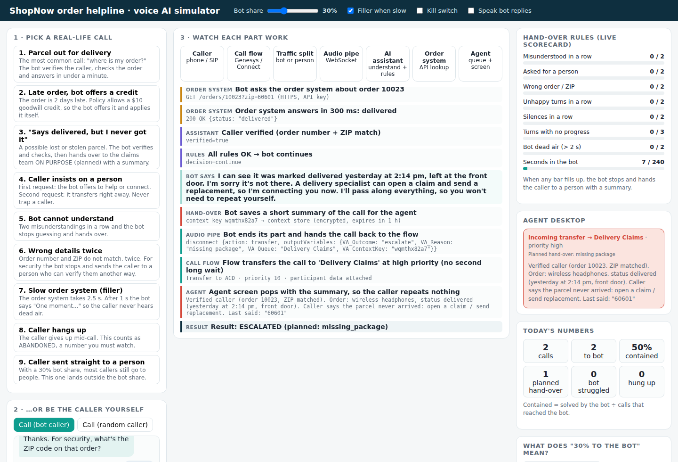
Two live demos
Building blocks explorer
Follow a call hop by hop: Airtel → SIP trunk → SBC → Genesys / Connect → bot → API → agent. Every hop shows its protocol and why.
WISMO bot simulator
The real bot logic: verify, look up the order, answer, or hand over with a summary on the agent screen.
Notes:
Demo order: explorer journeys 1 (basic path), 2 (Connect → Genesys with UUI), the split panel (by number vs front door), journey 6 (outbound + India rules); then the WISMO simulator call 3 (planned hand-over with summary). Run locally with npm start, or open the HTML files directly.

Slide 23
Questions you will be asked
How does an Airtel call get in?
Operator → SIP trunk → SBC → Genesys BYOC. Connect needs AWS-hosted numbers.
How do we split calls?
By number at the edge. SBC weights for migration. Transfers only for escalation.
How do Connect and Genesys talk?
Private SIP via the SBC with a UUI key; context fetched by API.
What does Lex do?
Listens, understands, runs the dialog, calls Lambda, speaks with Polly.
Where does Twilio fit?
Mostly CPaaS and SIP trunking; Flex competes. Usually not needed here.
WebSocket, WebRTC or webhook?
Streams to AI · browser voice · one-off data lookups.
All 58 questions with detailed answers: docs/07-building-blocks-qa.md
Notes:
Full handbook in the repo. Sections: big picture, getting calls in (incl. India), SIP, Twilio and outbound, Lex, WebSocket/WebRTC/webhook, Genesys + Connect, splitting calls, AI building blocks, security, demo.

Slide 24
Next steps
1
Telephony Agree the Indian TSP trunk + SBC design; get test numbers on both platforms
2
Connectivity Build one BYOC trunk to Genesys and one Connect → Genesys transfer with UUI
3
AI Deploy the Lex WISMO bot from the repo; call it from Genesys and Connect
4
Then Pilot with 5–10% of support calls; containment work starts here
Notes:
Repo: github.com/<you>/order-helpline-voice-ai. Everything in this deck is backed by the Q&A handbook and the two demos.

