Slide 1
BANK TELEMARKETING SUCCESS PREDICTION
Group 10:
Narayana Sudheer Vishal Basutkar
Aryan Fernandes
Phani Bhavana Atluri
Manasvi Mittal

Slide 2
INTRODUCTION
The dataset encompasses data collected from a Portuguese banking institution's telemarketing campaigns conducted between 2008 and 2013, a period coinciding with the 2008 financial crisis.
Since the banking industry underwent significant changes during this period, the project seeks to evaluate the effectiveness of telemarketing as a marketing strategy for promoting banking services to clients.
By comparing and contrasting the performance of different models, the project seeks to establish the most effective approach for improving the efficiency of telemarketing campaigns within the banking industry.

Slide 3
OBJECTIVE
The primary goal of this project is to gain a comprehensive understanding of the Bank Telemarketing dataset by carrying out data preprocessing, univariate and bivariate analysis, and determining the usefulness of the dataset columns. Furthermore, the project aims to test and compare three different classification models - Logistic Regression, Gaussian Naive Bayes, and Neural Networks - to identify the most effective algorithm for predicting the outcome of telemarketing campaigns conducted by the banking institution.

Slide 4
DATA DESCRIPTION
The dataset consists of 41188 rows and 21 columns. Upon analyzing the target variable, it was observed that the count for 'no' is almost 9 times more than the count of 'yes'. This indicates a higher likelihood of bias-variance tradeoff in the model's predictions.

Slide 5
DATA DICTIONARY
The client data variables comprise of age, job type, marital status, education, default, housing, and loan. The variables related to the last contact of the current marketing campaign include contact communication type, the last contact month of the year, the last contact day of the week, the last contact duration in seconds, and the number of days that passed (pdays) by after the client was last contacted from a previous campaign.
Additionally, the dataset includes the number of contacts performed before this campaign and for this client (numeric) and the outcome of the previous marketing campaign (categorical: 'failure', 'nonexistent', 'success').
The dataset also includes social and economic context attributes such as the employment variation rate - quarterly indicator (numeric) and the consumer price index - monthly indicator (numeric).

Slide 6
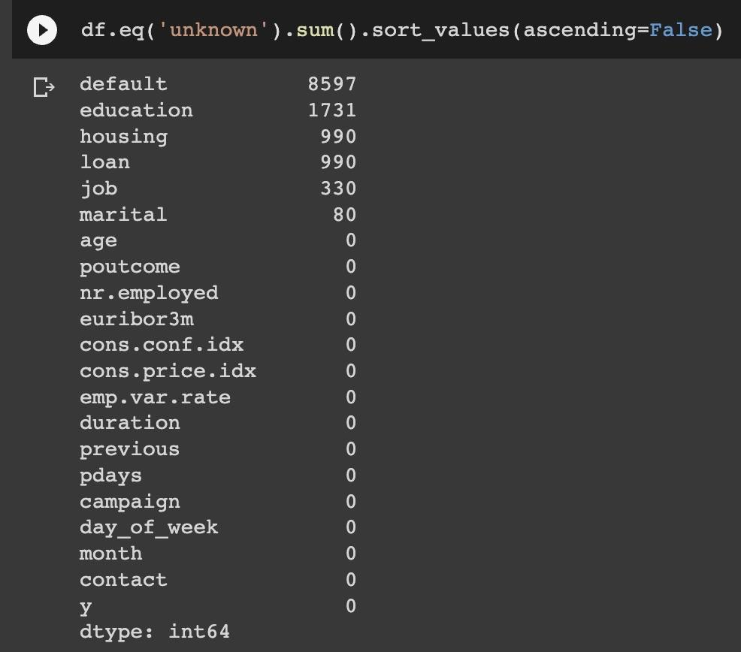
EXPLORATORY DATA ANALYSIS
Initially, dataset had 11 categorical columns and 10 numerical columns in total
Univariate Analysis:
‘Default’ column had many unknown values Also, it doesn't make any difference between who get a term deposit and who don't. So, this column is dropped
Only some unknown values are present in the columns ‘job’ and
‘marital’. So, dropped corresponding rows from the dataset

Slide 7
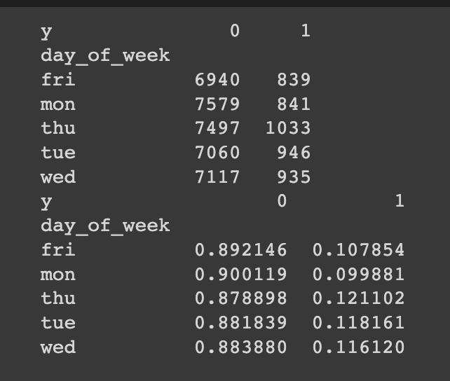
For the column ‘housing’, It appeared that having a housing loan may not have a significant impact on the subscription rate for the term deposit, given that approximately 10% of people without housing loans and 11% of people with housing loans subscribed to the term deposit. Hence, dropped the column
The attribute ‘loan’ has same variation of housing and so dropped this column
‘day_of_week’ column values are quite evenly distributed so it seems like the day of the week doesn't signify any difference between those who get a term deposit and those who do not.
So, dropped this feature

Slide 8
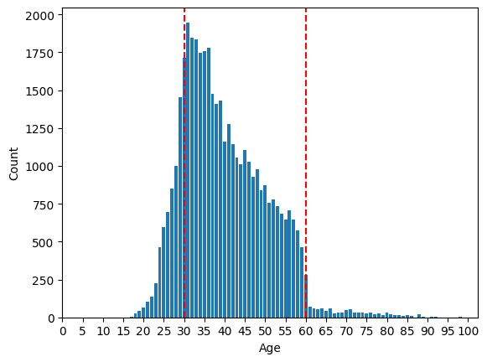
For the column ‘month’, Label encoding and fit transform was applied as there is a variation in probabilities of categories in this column
Converted numerical column ‘age’ to categorical as we can see from the graph that the bank targets more people aged between 30 and 60 but very few subscribe to the term deposit. While, those who are above 60 are more likely to subscribe though bank the bank does not target them. Converting the column to categorical as in bins helps to avoid the model to be
affected by outliers - high or low numbers.
Then applied label encoder and fit transform

Slide 9
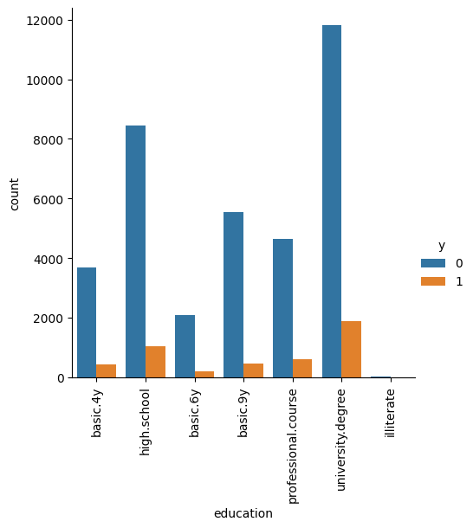
Columns ‘campaign’ and ‘duration’ are numerical. So, directly applied standard normalization to these features
There are a good number of unknown values in ‘education’. The probability distribution is similar to university degree and also because university degree has the majority of records, we imputed the unknown values to university degree

Slide 10
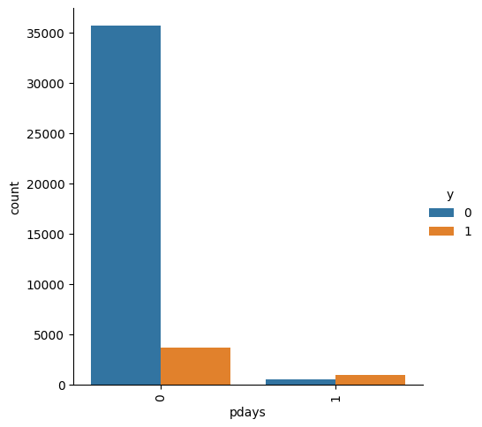
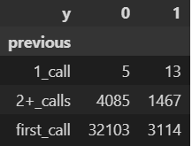
For the column ‘pdays’, If clients weren’t contacted previously, i.e. their value was 999. We renamed them to 0 and rest of those that were contacted before, we cumulated them to one value - 1
‘previous’ is a numeric feature. Since the number of calls after the
second didn’t matter much about the success, we categorized the
numbers in the above format. We later one-hot encoded this feature.
Performed one hot encoding to all of the categorical columns except for the columns which are label encoded and dropped

Slide 11
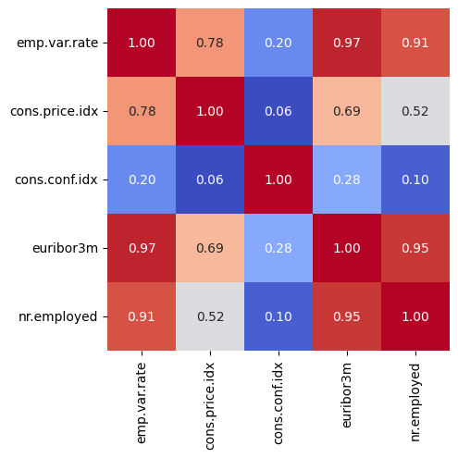
Bivariate Analysis on socio-economic features:
Dropping the emp.var.rate feature as it is highly correlated with euribor3m and nr.employed
5 columns were dropped in total namely, ‘housing’, ‘loan’, ‘default’, ’emp.var.rate’ and ‘day_of_week’
Lastly, the target variable ‘y’ with ‘yes’ and ‘no’ values are mapped to 1 and 0 respectively
Rest of the 16 columns remain and standard normalization is performed for all the columns in the dataset

Slide 12
DATA SPLIT
The code first splits the original data frame into two datasets - a training set and a test set. We randomly split the data into two sets based on a specified test size (in this case, 20% of the data).
We performed the SMOTE function on the training dataset because of the imbalance in the dataset. We resampled the success-indicating rows to a size that is 40% of the failure.

Slide 13
MACHINE LEARNING MODELS
We have considered 3 Machine Learning models namely Logistic Regression, Gaussian Naive Bayes and Neural Networks
Our baseline model is Logistic Regression and we compare other models’ performance with the baseline model and check for the corresponding evaluation metrics which are accuracy, F1 Score, precision and recall

Slide 14
Logistic Regression:
We performed Logistic regression with L2 Regularization and Gradient Descent algorithm from scratch and tested the model for precision, recall, f1_score, and accuracy. We tuned the learning rate hyperparameter by running over a loop of learning rates and picked the best one
We also compared our performance metrics with the metrics achieved from applying logistic regression using sklearn library and we got very similar results. The results are tabulated in the results section

Slide 15
Gaussian Naive Bayes:
We trained our own Gaussian Naive Bayes model which we have written from scratch with the final preprocessed dataset as the columns follow Gaussian distribution.
We also added the Laplace smoothing method as the Naive Bayes classifier will be more robust to outliers and small sample sizes, and provide more accurate predictions on test data. Correspondingly, we have seen an increase in accuracy when the Laplace smoothing method is added.

Slide 16
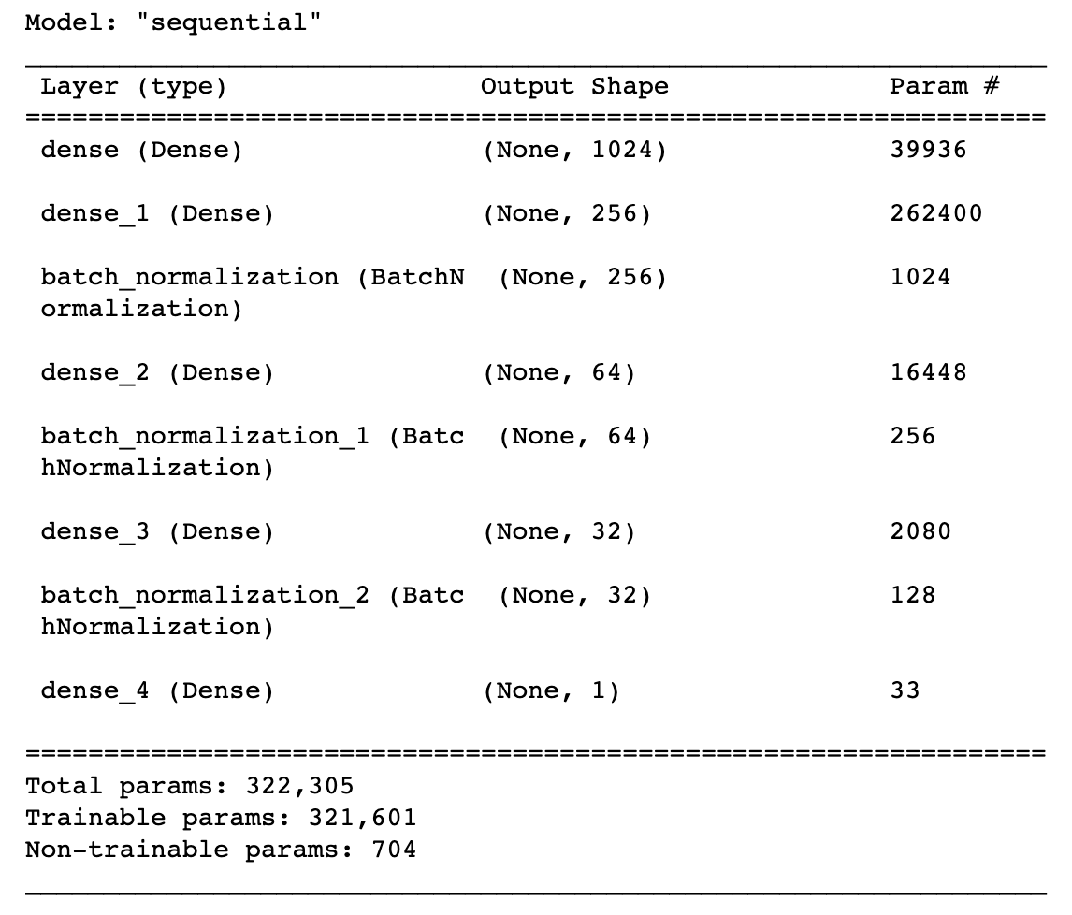
Neural Networks:
We created a Deep Neural Network using Tensorflow and added L2 regularization and Batch Normalization after each layer to eradicate the vanishing gradient problem.

Slide 17
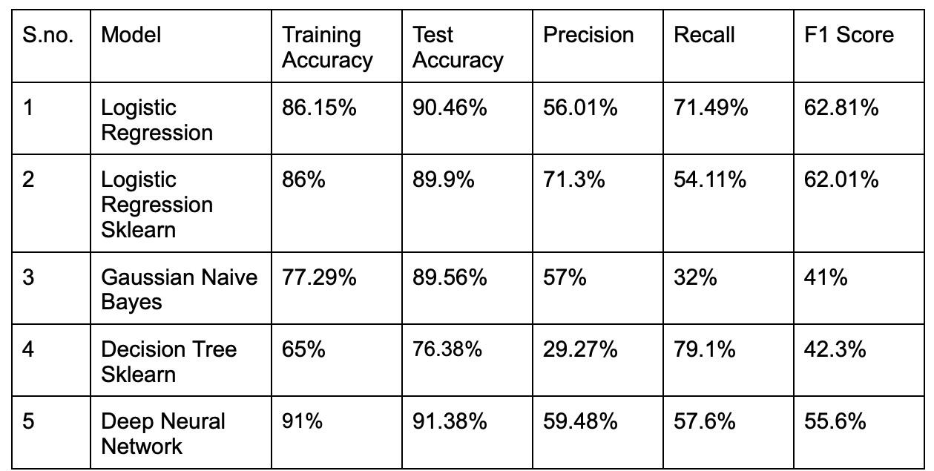
RESULTS

Slide 18
Thank you!

