Slide 1
BACKPROPAGATION
TEAM: Avinash,Vishal,Hari,Vikas
TA: Kalpit Thakkar
Prof: Vineet Gandhi

Slide 2
Introduction
The Backpropagation algorithm is a supervised learning method for multilayer feed-forward networks from the field of Artificial Neural Networks.
The principle of the backpropagation approach is to model a given function by modifying internal weightings of input signals to produce an expected output signal

Slide 3
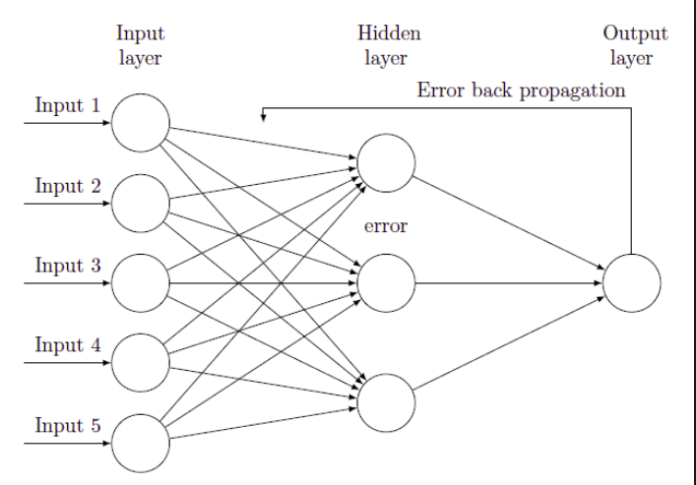
Introduction

Slide 4
Introduction
The system is trained using a supervised learning method, where the error between the system’s output and a known expected output is presented to the system and used to modify its internal state.
Backpropagation can be used for both classification and regression problems
Backpropagation algorithm is dependent on some fundamental equations.

Slide 5
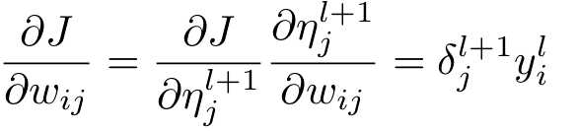
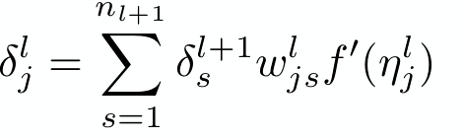
Fundamental Equations
1.
2.

Slide 6
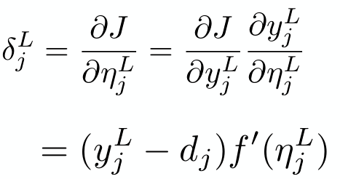

Fundamental Equations
3.
4.

Slide 7
Implementation
1.Initialize Network 5.Back Propagate Error
2.Forward Propagate 6.Predict
3.Activation Function
4.Error using Cost Function

Slide 8
Initialize Network
Initialize network with number of layers ,number of nuerons in input layer , hidden layer , output layer.
Initialize the network weights to small random numbers .(Also consider Bias)
Initialize learning rate
Each neuron in the hidden layer has n_inputs+1 weights one for each input value and additional one for the bias.

Slide 9
Forward Propagate
In Forward Propagation we first calculate the output of each neuron as weighted sum of inputs .
We apply the activation function on the output.
Some of the activation functions are:-
1.Sigmoid 3.Relu
2. Tanh

Slide 10
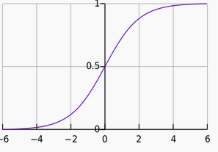

Activation Functions
Sigmoid:-

Slide 11
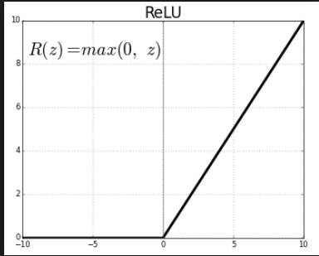
Activation Functions
Relu:-

Slide 12
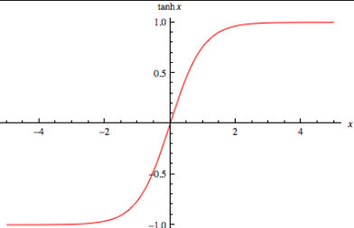

Activation Functions
Tanh:-

Slide 13
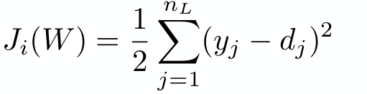
Cost Function
A cost function is a measure of "how good" a neural network did with respect to it's given training sample and the expected output.
We used Euclidean Cost function

Slide 14
Back Propagate Error
Error is calculated between the expected outputs and the outputs forward propagated from the network.
These errors are then propagated backward through the network from the output layer to the hidden layer .
Once errors are calculated for each neuron in the network via the back propagation method above, they can be used to update weights.

Slide 15
Predict
After Training the network we use the final weights to predict the classes for the test data.
We can use the output values themselves directly as the probability of a pattern belonging to each output class.
We select the class with larger probability with argmax function.

Slide 16
Results
For Opt-Digits Dataset :(https://archive.ics.uci.edu/ml/machine-learning-databases/optdigits/)
Initialization :
Number of input nuerons : 10
Number of hidden nuerons : 10
Learning rate : 0.3
Cost Function : Euclidean
Activation Function : Tanh(hidden layer), Sigmoid (Last layer)

Slide 17
Results
Mean Errors obtained for 5 iterations are as follows for Opt-digits Dataset.
Iteration number | Mean Error
1 | 0.34
2 | 0.24
3 | 0.22
4 | 0.21
5 | 0.19
Accuracy After 5 iterations: 82.3%

Slide 18
Results
For Opt-Digits Dataset :
Initialization :
Number of input nuerons : 10
Number of hidden nuerons : 20
Learning rate : 0.3
Cost Function : Euclidean
Activation Function : Tanh(hidden layer), Sigmoid (Last layer)

Slide 19
Results
Mean Errors obtained for 5 iterations are as follows for Opt-digits Dataset.
Iteration number | Mean Error
1 | 0.41
2 | 0.27
3 | 0.24
4 | 0.22
5 | 0.21
Accuracy After 5 iterations: 87.3%

Slide 20
Results
For Opt-Digits Dataset :
Initialization :
Number of input nuerons : 10
Number of hidden nuerons : 50
Learning rate : 0.3
Cost Function : Euclidean
Activation Function : Tanh(hidden layer), Sigmoid (Last layer)

Slide 21
Results
Mean Errors obtained for 5 iterations are as follows for Opt-digits Dataset.
Iteration number | Mean Error
1 | 0.82
2 | 0.43
3 | 0.34
4 | 0.29
5 | 0.26
Accuracy After 10 iterations: 85.7%

Slide 22
Results
For Opt-Digits Dataset :
Initialization :
Number of input nuerons : 10
Number of hidden layers : 2 each of 10 neurons
Learning rate : 0.3
Cost Function : Euclidean
Activation Function : Tanh(hidden layer), Sigmoid (Last layer)

Slide 23
Results
Mean Errors obtained for 5 iterations are as follows for Opt-digits Dataset.
Iteration number | Mean Error
1 | 0.32
2 | 0.20
3 | 0.16
4 | 0.15
5 | 0.14
Accuracy After 10 iterations: 86.8%

Slide 24
Results
For Opt-Digits Dataset :
Initialization :
Number of input nuerons : 10
Number of hidden layers : 2 each of 20 neurons
Learning rate : 0.3
Cost Function : Euclidean
Activation Function : Tanh(hidden layer), Sigmoid (Last layer)

Slide 25
Results
Mean Errors obtained for 5 iterations are as follows for Opt-digits Dataset.
Iteration number | Mean Error
1 | 0.32
2 | 0.18
3 | 0.16
4 | 0.15
5 | 0.14
Accuracy After 10 iterations: 87.8%

Slide 26
Results
For Opt-Digits Dataset :
Initialization :
Number of input neurons : 10
Number of hidden neurons : 100
Learning rate : 0.3
Cost Function : Euclidean
Activation Function : Tanh(hidden layer), Sigmoid (Last layer)

Slide 27
Results
Mean Errors obtained for 1 iterations are as follows for OptdigitsDataset.
Iterations | Accuracy
1 | 21%
5 | 30%
20 | 35%

Slide 28
Results
For Mnist Dataset :
Initialization :
Number of input nuerons : 10
Number of hidden neurons: 10
Learning rate : 0.3
Cost Function : Euclidean
Activation Function : Tanh(hidden layer), Sigmoid (Last layer)

Slide 29
Results
Mean Errors obtained for 2 iterations are as follows for MnistDataset.
Iteration number | Mean Error
1 | 0.337
2 | 0.332
Accuracy After 10 iterations: 53%

