Slide 1
Introduction to Agile
What is Agile Project Management
NAME: VISHAL DILIP CHAFALKAR
EMPLOYE ID: 46224638
09/06/2022

Slide 2
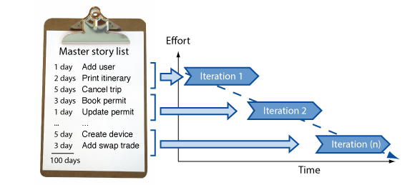
What is Agile?
At its simplest , Agile simply means continuous incremental improvement through small and frequent releases. The term Agile is most commonly associated with software development as a project management methodology.

Slide 3
Evolution of Project Management
Simple Comparison
Traditional Project Management | Modern Project Management (Agile)
Elements impacting execution of a project: Planning Control | Elements impacting execution of a project: Competitive environment Creativity and Innovation Planning Control
Project Success is measured by having: Well defined requirements Approved budget On-Time Delivery | Project Success is measured by: Delivery of Business Value (what does customer want) Less important are: Having well defined requirements Budget constraints Set Schedule Today’s world has a much higher level of uncertainty which makes it difficult to always start a project with well-defined requirements
Requires a Project Manager | Project Manager Role is distributed among: Product Owner Scrum Master Project Team

Slide 4
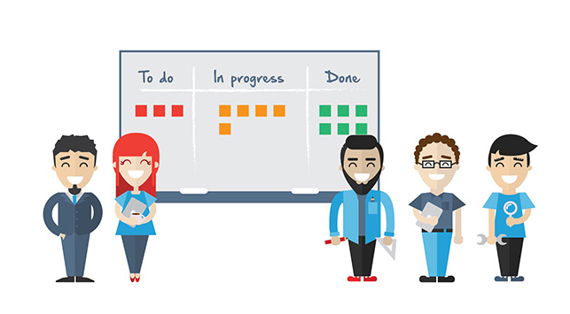
Scrum, Kanban & XP Agile Methodologies
Scrum is a framework that helps teams work together. Much like a Rugby team ,Scrum encourages teams to learn through experiences ,self –organize while working on a problem.
Extreme Programming (XP) is an agile software development framework that aims to produce higher quality software, while focusing on customer satisfaction.
Kanban method is a means to design , manage, and improve flow systems for knowledge.
It displays task workflows so the flow of task is optimized between different teams.

Slide 5

Difference between Scrum & XP
Scrum teams typically work in iterations (called sprints) that are from two weeks to one month long. XP teams typically work in iterations that are one or two weeks long
Scrum teams do not allow changes into their sprints. XP teams welcome changes as long as work has not started

Slide 6
Principles of AGILE
1.Satisfy the Customer
2.Welcome Changing Requirements
3.Deliver Working Software Frequently
4.Frequent interaction with Stakeholders
5.Face-to Face Communication
6.Measure by working software
7.Maintain constant pace
8.Sustain technical excellence and good design
9.Keep it simple
10.Reflect and Adjust continuously

Slide 7

How To Implement Agile?
Step 1: Set your project vision and scope with a planning meeting
Step 2: Build out your product roadmap
Step 3: Create a release plan
Step 4: Sprint planning
Step 5: Keep your team on track with daily standup
Step 6: Sprint reviews

Slide 8
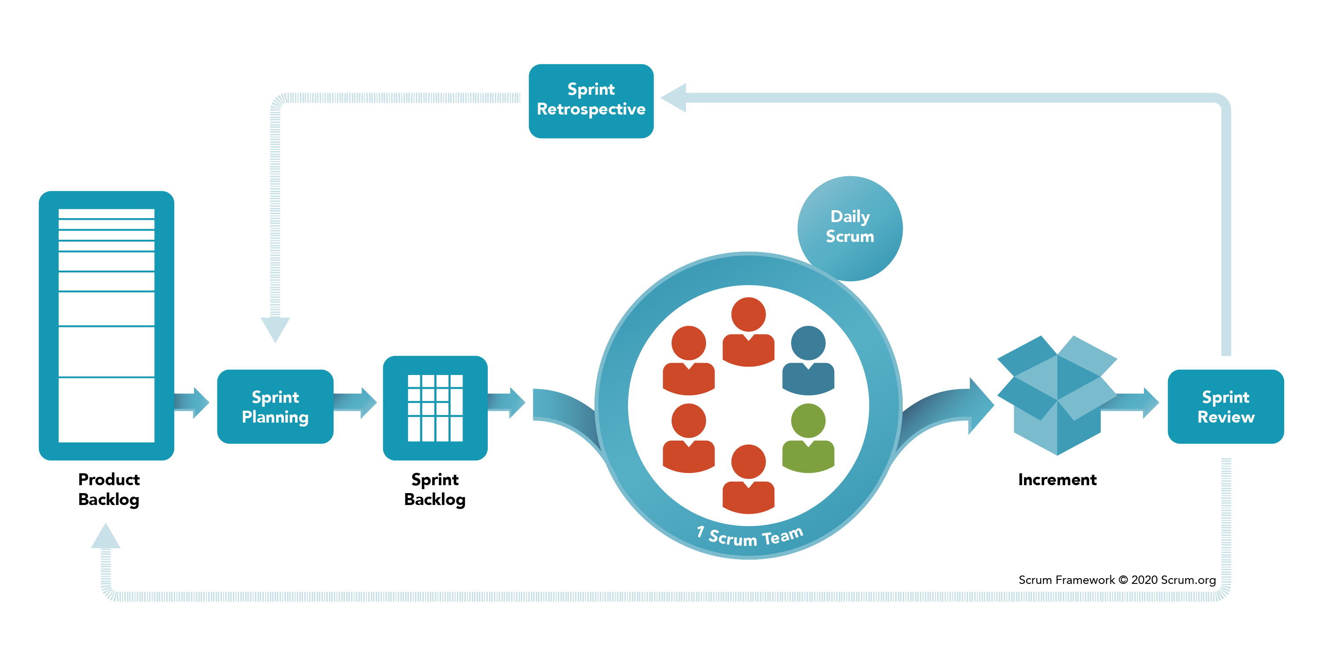

Slide 9
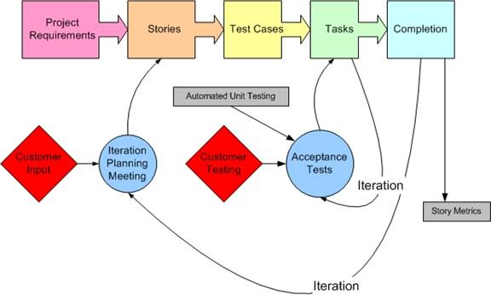
Extreme Programming(XP)

Slide 10
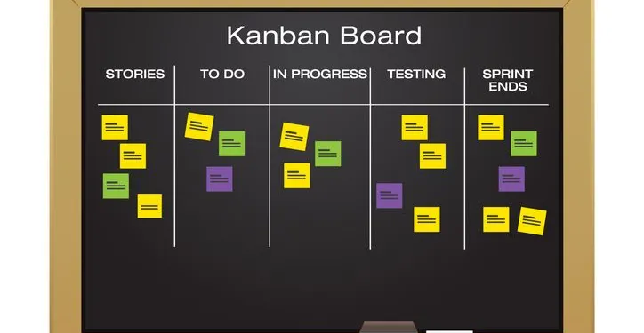
Kanban

Slide 11


