Slide 1
Capstone Report Kaggle Competition: Outbrain Click Prediction
Vishal Changrani
Springboard Data Science Intensive
03/21/2017

Slide 2
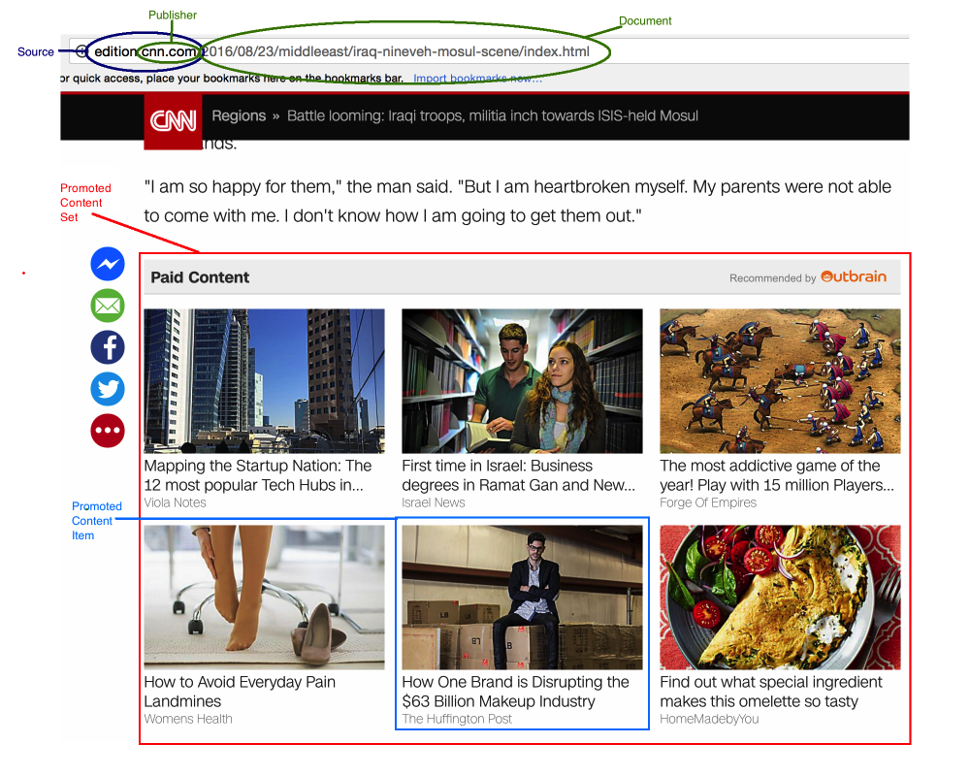
Problem definition
Outbrain Click Prediction competition hosted by Kaggle
https://www.kaggle.com/c/outbrain-click-prediction
Predict which of the ads has the most likelihood of being clicked

Slide 3

Evaluation metric
Submission were evaluated using the Mean Average Precision @12(MAP@12)
where |U| is the number of display_ids, P(k) is the precision at cutoff k and n is the number of predicted ad_ids.
The Kaggle leaderboard for this competition had a maximum MAP@12 of 0.70145.
MAP is the mean precision calculated over the average precision (AP) of each query. The AP at k of each query in turn is a percentage of correct items among first k recommendations. Since here the maximum number of ads is twelve, k = 12.

Slide 4
Structure of data
Clicks_train was the training data for which the dependent variable – ‘clicked’ was provided.
Clicks_test was the test data for which the clicked probability needed to be predicted.
Training and test data was provided for a 15 day window – 14th June to 28th June 2016.
There was meta data associated with both the source document on which the promoted content is shown and the target document to which the promoted content points.
The meta data included the possible topics, categories and entities the document may belong to. One document could belong to more than one topic, more than one category and more than one entity. The relationship was quantified using a measure called ‘confidence_level’ which ranged from 0 to 1 depending on how confident Outbrain was in classifying the document with that topic, category or entity.
User attributes such as platform (pc, smart phone or tablet), location (region and country), UUID and time of access was also provided.

Slide 5
Data Cleansing
Not much of data cleansing was needed
Simple cleansing such as making the user platform id coherent (1, 2 or 3) and dropping 5 entries due to missing platform id was performed on the events dataframe.

Slide 6
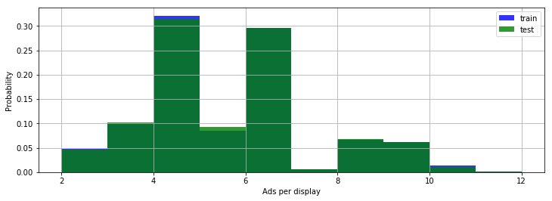
Data Exploration: Number of ads
Between 2 to 12 ads were shown each time
Displays with 4 or 6 ads were at least thrice more likely than displays of any other number of ads

Slide 7
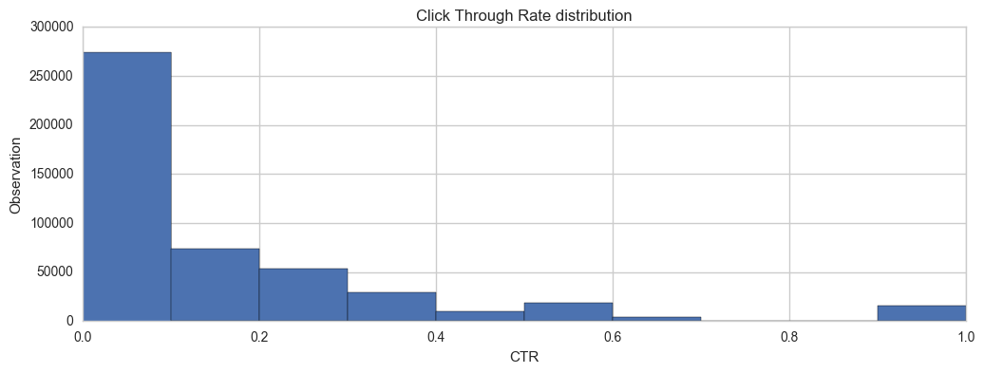
Data Exploration: Click through rate (CTR)
The CTR distribution was right skewed and 14% on average.
The low CTR can be attributed to the fact that for each display only one of the x number of ads displayed were clicked.
53% ads were clicked at least once or in other words 47% of ads were never clicked. Hence any ad had an approximately 50-50 chance of being clicked on average.

Slide 8
Data Exploration: Ad repetitions
Each Ad was repeated on an average 182 times
The range of ad repetition was from 1 to 211824 (inclusive).
The median number of times an ad was repeated was 5.
The large disparity in the number of times an ad was repeated indicated that the ad selection logic may be skewed one way or the other.
The correlation between the number of times an ad was repeated to its CTR was negligible (0.02) indicating that ad repetition didn’t affect its probability of being clicked one way or the other. The correlation for ads that were clicked at least once and their CTR was negative but negligible as well (-0.04).

Slide 9
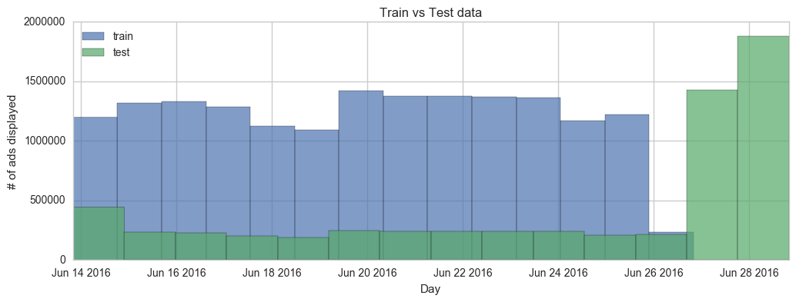
Data Exploration: Clicks distribution (daily)
The number of ads clicked daily remained fairly constant throughout the 15-day period.
The prediction needed to be done for the complete 15-day period however for the last two days – 27th and 28th June there was no training data available.

Slide 10
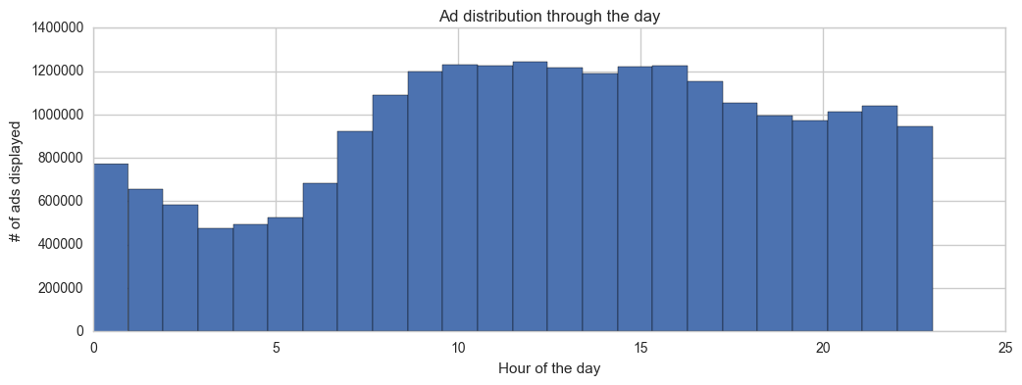
Data Exploration: Clicks distribution (hourly)
Activity picked up after 8:00am in the morning till around 5:00pm in the evening which are the regular business hours and then around 6:00 pm to 11:00pm in the night

Slide 11
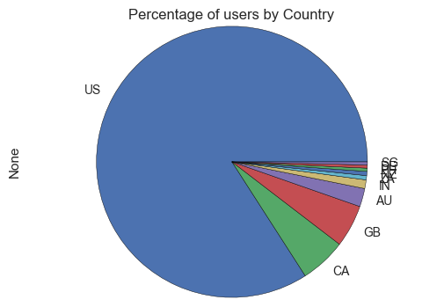
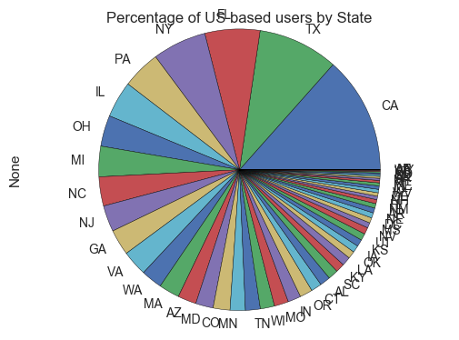
Data Exploration: Source of user traffic
Most of the user traffic originated in the US
Within US, user requests mainly came from California

Slide 12
Data Exploration: Clicks distribution (hourly US only)
User traffic was more during normal business hours and during the evenings
(Distribution of ads during the day only for the US such that all times have been normalized to EST such that 8:00 AM in NY is also 8:00 AM in Atlanta and 8:00 AM in California by subtracting 2 hours and 3 hours etc. respectively)

Slide 13
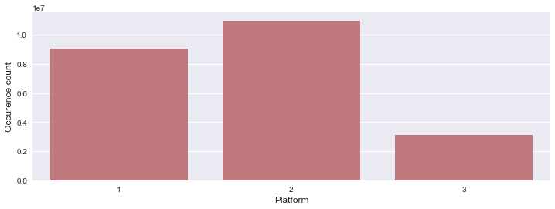
Data Exploration: Source of traffic by platform
Most of the user traffic originated from mobile phone
(1 – PC, 2 – Mobile, 3 – tablet)

Slide 14
Data Exploration: Topics, Categories and Entities
There are 300 unique topics, 97 unique categories and 1,326,009 unique entities that the source and the target documents belong to.
Not all documents have an associated topic or category or entity
Distribution of topics, categories and entities was sparse.
Number of topics that appear more than 1% times: 19
Number of topics that appear more than 5% times: 1
Number of topics that appear more than 10% times: 0
Number of topics that appear more than 20% times: 0
Number of topics that appear more than 50% times: 0
Number of topics that appear more than 100% times: 0
Number of categories that appear more than 1% times: 28
Number of categories that appear more than 5% times: 4
Number of categories that appear more than 10% times: 1
Number of categories that appear more than 20% times: 0
Number of categories that appear more than 50% times: 0
Number of categories that appear more than 100% times: 0
Number of categories that appear more than 0.5% times: 6
Number of categories that appear more than 1% times: 3
Number of categories that appear more than 5% times: 1
Number of categories that appear more than 10% times: 0
Number of categories that appear more than 20% times: 0
Number of categories that appear more than 50% times: 0
Number of categories that appear more than 100% times: 0

Slide 15
Data Exploration: Data Volume
The sheer amount of data for this problem was overwhelming.
I kept running into out-of-memory errors during data exploration and model evaluation.
Hence I selectively choose only part of the data for further exploration and model building.
# File sizes
page_views_sample.csv 454.35MB
documents_meta.csv 89.38MB
documents_categories.csv 118.02MB
events.csv 1208.55MB
clicks_test.csv 506.95MB
promoted_content.csv 13.89MB
documents_topics.csv 339.47MB
documents_entities.csv 324.1MB
sample_submission.csv 273.14MB
clicks_train.csv 1486.73MB

Slide 16
Feature Selection: Topic, Category and Entity
Topics, Categories and Entity represent nominal data hence I added dummy variables to the test and training data for each topic, category and entity.
To deal with the large feature set thus produced I considered a document belonging to a single topic, category and entity for which it had the maximum confidence level and dropping the other document topic, category and entity associations.
I considered only the top five most frequent category, topic and entity for model building.

Slide 17
Feature Selection: Topic, Category and Entity
To reduce multicollinearity I performed a Chi-Squared Test of Independence between the Topics, Categories and the Entities under the assumption that documents of the same categories may have the same topics and same entities.
The null hypothesis’ were,
There is no association between topics and categories
There is no association between categories and entities
And the alternate hypothesis’ were,
Topics and Categories are associated (related) with each other
Categories and Entities are associated (related) with each other
P-value for both the chi-square test, topics and categories and categories and entities came out to be 0
Thus there is indeed was a relationship between the topics and the categories and categories and the entities suggesting that all three were related. Hence I just chose only categories as features.
Hence I just chose only categories as features

Slide 18
Feature Selection: Display size & Reg. CTR
Display Size
The likelihood of any ad being clicked would depend on the total number of ads it is shown with in a display
For e.g. if an ad is shown in a display along with one other ad it is more likely to be clicked than if it is shown with five other ads.
Hence I chose the size of the display as a feature for the model.
Regularized CTR
CTR represents popularity of the ad
However, CTR for ads that were shown less number of times may be high as compared to those that were shown more number of times.
e.g., an ad that was shown four times and was clicked three times will have a CTR of 0.7 while an ad that was shown a thousand times and clicked six hundred times would have a CTR of 0.6
Hence I regularized CTR with a regularization factor of 10 with the formula below,
reg_ctr = number of times an ad was clicked / (number of times an ad was shown + regularization factor)

Slide 19
Classifier Selection: Random Forest
I chose Random Forest as the classifier because,
It is based on Decision Tree and easy to comprehend.
Provided me feature selection for free.
It is an ensemble method which creates several decision trees and then combines their prediction. Hence I thought it would not overfit and generalize well.
Has inbuilt support for cross validation.
Not all features had a linear relationship with the click probability hence logistic regression may not have been a good fit.

Slide 20
Hyper-parameter tuning
Although I tried to choose all the different hyper-parameters of Random forest such as min_sample_size, number of estimators etc. using Grid Search I had no luck in getting the optimal values of all of the parameters using Grid Search since it would run forever even on a 16 core Azure VM. Hence I had to mostly choose parameters such that the classifier ran in modest amount of time.
The final parameters I passed to Random forest were,
Criterion: gini (derived via grid searh)
n_estimators: 3
max_features: n_features (all features)
n_jobs: 4 (utilizing 4 cores)
min_samples_leaf: 0.10 (I added pruning only due to hardware limitations. Without pruning the depth of the tree would be large and the classifier wouldn’t finish running)

Slide 21
Conclusion
I created the model using the Random Forest classifier and fitted it on the training data with features: display_size, reg_ctr, platform, source document and target document values for dummy variables of the top five most frequent categories. In all thirteen features.
I got a MAPK score of 0.61415 by using the model over the test data.
Strangely though Random Forest reported the reg_ctr as the only feature with importance value as 1 and rest all features had values 0.
The high importance of reg_ctr indicates that CTR value is one of the most important feature in ad prediction.
The sparsity of categories, topics and entities may not qualify them as good features.
This was my first attempt at a data science problem and I realized that finding good features is as difficult as tuning the model.
I learnt how to approach a data science problem, how to explore data and make sense out of it and how to tune a model.
Finally, I also learnt that how much fun, interesting and rewarding data science can be demanding a lot of perseverance at the same time.

Slide 22
Thank you
Special thanks to my mentor – Ankit Jain!

Slide 23
References
http://hamelg.blogspot.com/2015/11/python-for-data-analysis-part-25-chi.html
https://www.kaggle.com/c/outbrain-click-prediction/discussion
https://makarandtapaswi.wordpress.com/2012/07/02/intuition-behind-average-precision-and-map/
http://fastml.com/what-you-wanted-to-know-about-mean-average-precision/
https://www.analyticsvidhya.com/blog/2016/04/complete-tutorial-tree-based-modeling-scratch-in-python/

Slide 24
Appendix A
Python notebook available at:
https://github.com/vishalchangrani/outbrain/blob/master/OutbrainFinalSolution.ipynb
https://github.com/vishalchangrani/outbrain/blob/master/OutbrainInitial.ipynb
https://github.com/vishalchangrani/outbrain/blob/master/FeatureAnalysis.ipynb
Capstone Report :
https://github.com/vishalchangrani/outbrain/blob/master/finalreport/vishalchangrani_Kaggle_outbrain_report.pdf

