Slide 1
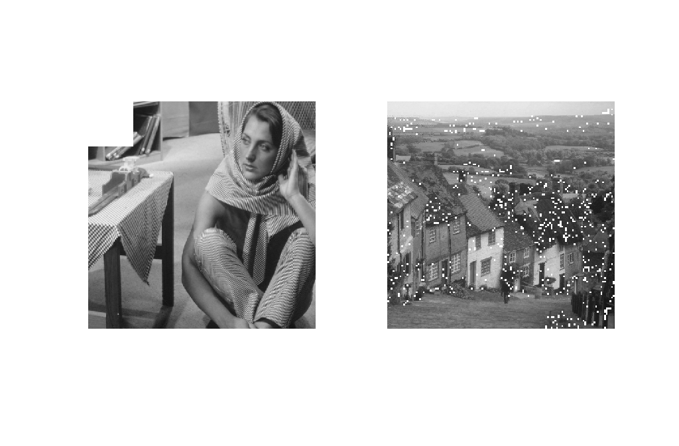
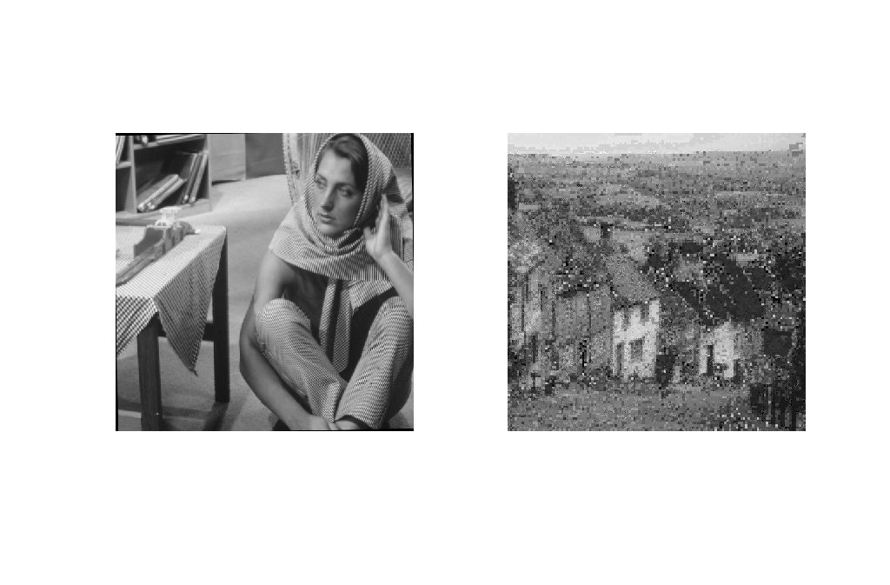


Attacks
Cropping:20%
Rotation:1 degree
AWGN: SNR,30 dB
JPEG Compression

