Slide 1
DIGITAL WATERMARKING
GROUP 8
Vishal Coelho 300208
Anuradha Rao 300242
Brinda Manoharan 300263
Pradnya Mhaskar 300124
Guide : Ms. Megha Kolhekar
Co-guide : Ms. Pushpa U.S.

Slide 2
Outline of the Presentation
Scope and objective of the project
Methodology
Results
Conclusion
Future scope

Slide 3
Scope and Objective of the Project
Digital watermarking is used for copyright protection, authentication and data monitoring
Goal of project:
  Study and implementation of existing methods
  Develop own algorithms based on existing methods
  Compare the different algorithms implemented
  Discuss their robustness to attacks

Slide 4
METHODS
DCT
BTC
Binary
watermark
Binary
watermark
Grayscale
watermark
Color
watermark
Text
Logo
Image
Image
Text
Logo
Attacks Implemented
Cropping
Rotation
AWGN
JPEG Compression

Slide 5


Images Used
Host Image 1, 512 x 512
Host Image 2, 512 x 512
General method: Embedding and extraction of watermark using respective techniques, in MATLAB.
Performance evaluation: MSE, PSNR, Normalized correlation, by plotting graphs
Notes:
Normalised correlation = ∑∑ W (i, j) W’ (i, j)
∑∑[ W (i, j)]²

Slide 6

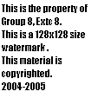
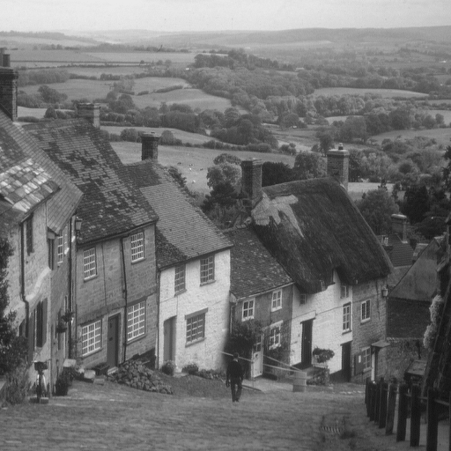

Watermark Images Used
Binary Logo Watermark : 128 x 128
Binary Text Watermark : 128 x 128
Grayscale Watermark : 512 x 512
Color Watermark : 96 x 96

Slide 7
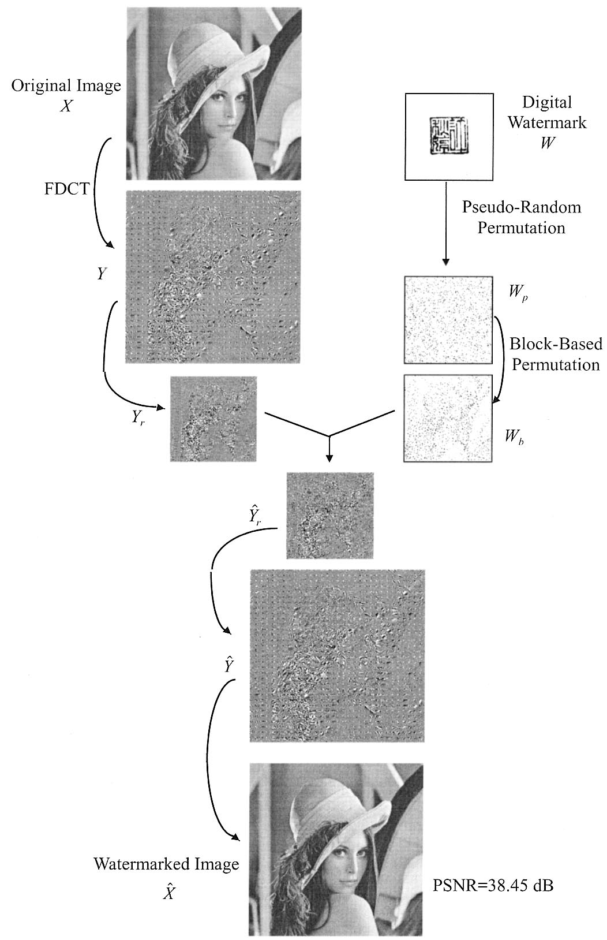
DCT
Watermark Embedding

Slide 8
DCT Variance mapping ( hidden slide)
Matches watermark blocks and host image blocks according to number of signed in watermark and variances of host bits image.
Index of image block | Variances
4 | 33.2
0 | 30.5
3 | 22.2
1 | 16.7
2 | 8.2
Index of watermark block | Signed pixels
2 | 10
3 | 8
1 | 7
0 | 3
4 | 2
Permutation mapping of
the Watermark block
0
1
2
3
4
0
1
2
3
4
W
H

Slide 9
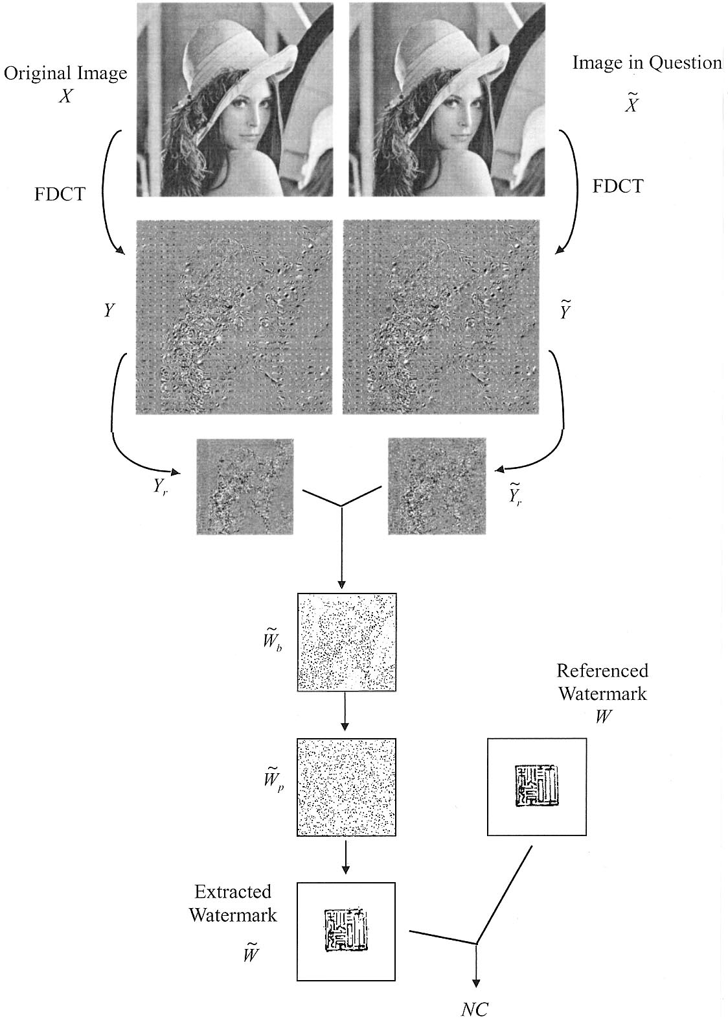
Extraction of Watermark

Slide 10
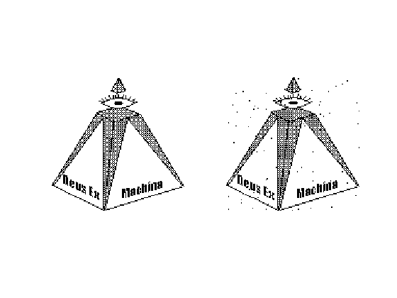
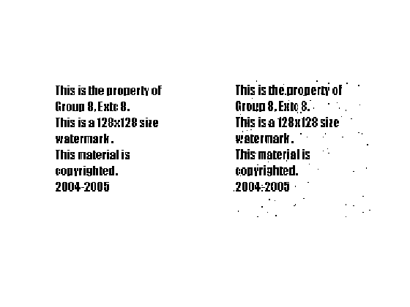
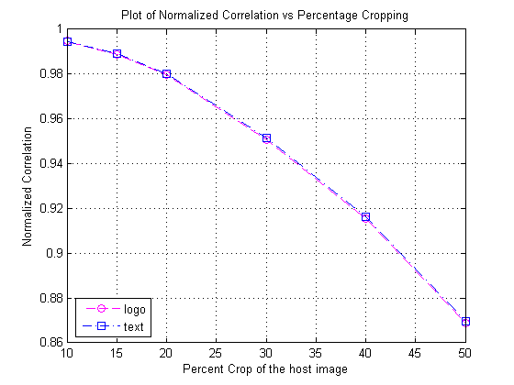
Attack 1: Cropping

Slide 11

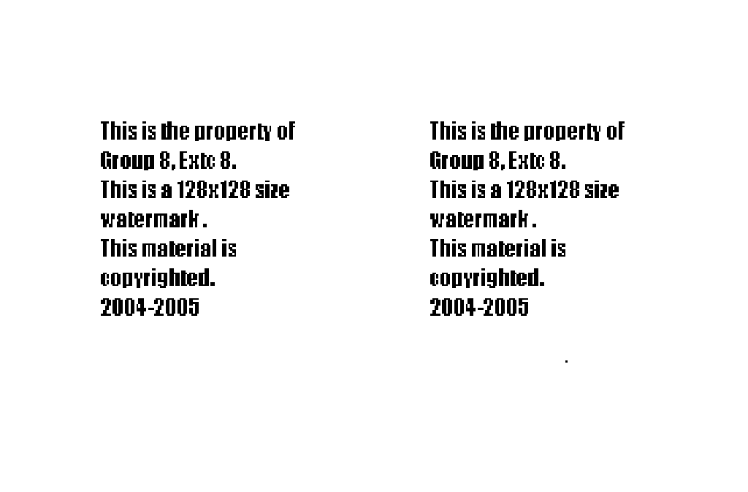
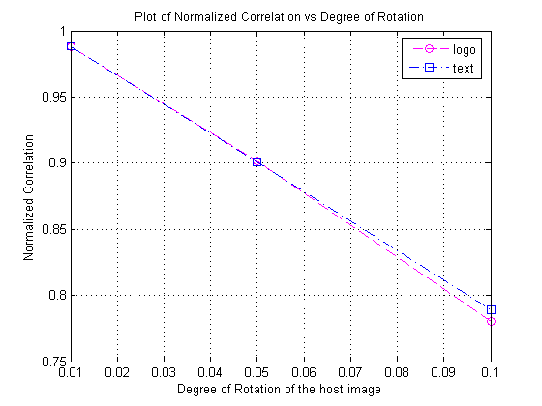
Attack 2: Rotation

Slide 12


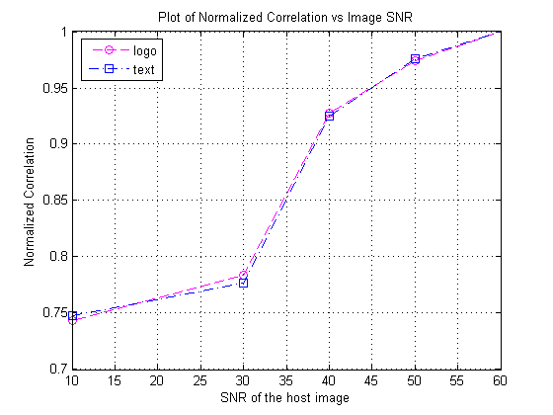
Attack 3: AWGN

Slide 13
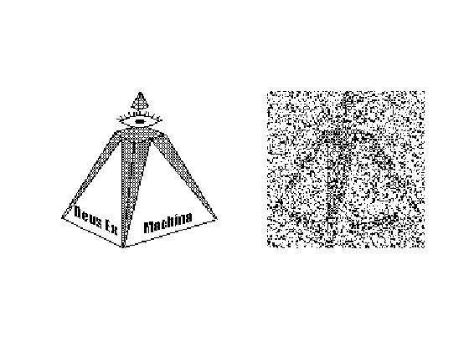
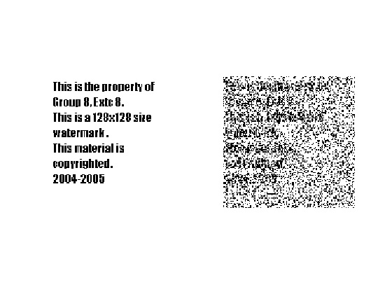
Attack 4: JPEG Compression

Slide 14
Block Truncation Coding (BTC)
Lossy Compression Technique
Image is divided into blocks of m pixels each (m=2, 4 8 or 16)
Bit-plane is generated for each block
First two moments (mean & variance) are preserved
In BTC Watermarking, original image is unaltered
Multiple watermarks can be used for single host image
Ensures robustness and security
Notes:
11/07/2611/07/26

Slide 15
p₀₀
P₀₁
b₀₁
b₀₂
p₀₂
b₀₀
p₁₀
p₁₁
p₁₂
b₁₀
b₁₁
b₁₂
p₂₀
p₂₁
p₂₂
BTC
b₂₀
b₂₁
b₂₂
The permuted host image H’
A block
b of H’
The bit plane of b
w₀₀
w₀₁
w₀₂
q₀₀
q₀₁
q₀₂
w₁₀
w₁₁
w₁₂
q₁₀
q₁₁
q₁₂
w₂₀
w₂₁
w₂₂
q₂₀
q₂₁
q₂₂
The watermark
image W
A block of W
The ownership
Share O
Casting of Watermark

Slide 16
p₀₀
P₀₁
b₀₁
b₀₂
p₀₂
b₀₀
p₁₀
p₁₁
p₁₂
b₁₀
b₁₁
b₁₂
p₂₀
p₂₁
p₂₂
BTC
b₂₀
b₂₁
b₂₂
The permuted
image G’
A block
b of G’
The bit plane of b
q₀₀
q₀₁
q₀₂
w₀₀
w₀₁
w₀₂
q₁₀
q₁₁
q₁₂
w₁₀
w₁₁
w₁₂
q₂₀
q₂₁
q₂₂
w₂₀
w₂₁
w₂₂
The ownership
share O
A bit plane of O
The corresponding
block of W
The watermark
image W
Watermark Detection

Slide 17
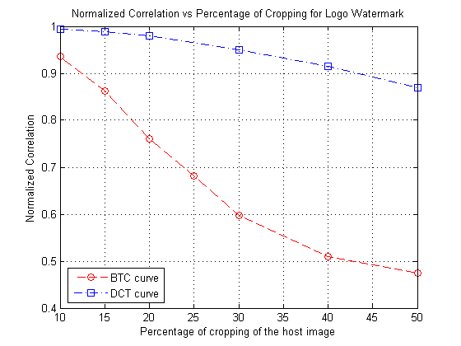
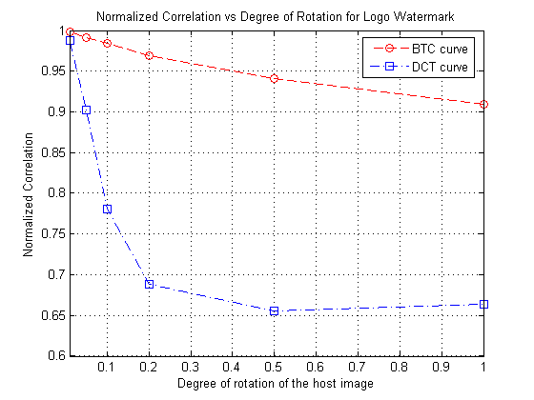
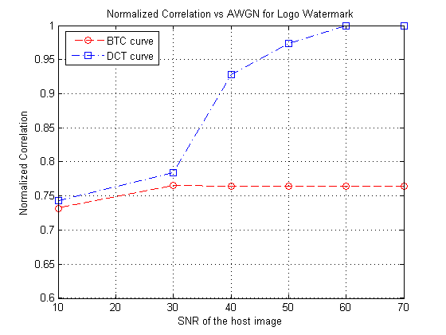
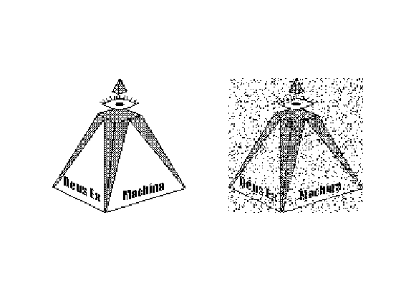
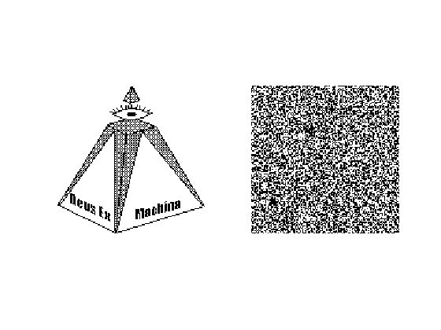
Comparison of BTC and DCT with reference to various attacks
Cropping
Rotation
AWGN
BTC – JPEG
DCT - JPEG

Slide 18
BTC-based method using grayscale watermark
Block permutation is performed on the watermark image
Vector map is created for mapping watermark image into host image
Ownership share is generated using the bit planes of both the images

Slide 19
p₀₀
P₀₁
b₀₀
b₀₁
b₀₂
p₀₂
p₁₀
p₁₁
p₁₂
b₁₀
b₁₁
b₁₂
p₂₀
p₂₁
p₂₂
BTC
b₂₀
b₂₁
b₂₂
The permuted host image H’
A block
b of H’
The bit plane
Block statistical
parameter
mapping
Vector map
w₀₀
w₀₁
w₀₂
b₀₀
b₀₁
b₀₂
q₀₀
q₀₁
q₀₂
w₁₀
w₁₁
w₁₂
`
b₁₀
b₁₁
b₁₂
q₁₀
q₁₁
q₁₂
w₂₀
w₂₁
w₂₂
BTC
b₂₀
b₂₁
b₂₂
q₂₀
q₂₁
q₂₂
The permuted
watermark
image W’
A block of W’
The bit plane
1 block of
ownership
Share O
Embedding of Watermark

Slide 20
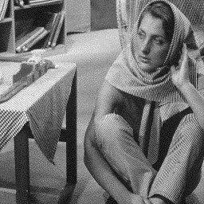

Block Permutation with block size m x m
(m=2,4,8,16)
Host image I (u ,v)
Permuted host image
I ’(u ,v)

Slide 21
p₀₀
P₀₁
b₀₁
b₀₂
p₀₂
b₀₀
p₁₀
p₁₁
p₁₂
b₁₀
b₁₁
b₁₂
p₂₀
p₂₁
p₂₂
BTC
b₂₀
b₂₁
b₂₂
The permuted
image G’
A block
b of G’
bit plane
of G’
q₀₀
q₀₁
q₀₂
w₀₀
w₀₁
w₀₂
q₁₀
q₁₁
q₁₂
w₁₀
w₁₁
w₁₂
q₂₀
q₂₁
q₂₂
w₂₀
w₂₁
w₂₂
The ownership
share O
Block of O
block of W’
Bit plane W’
BTC
reconstruction
Vector map
Watermark reconstruction
Reconstructed
watermark W

Slide 22
Color watermark in grayscale host image
Color watermark of size 96x96 is split into R, G and B planes
1-dimensional array (1x9216) of 24-bit elements is generated which is mapped into a binary image of size 432x512
The remaining 80 rows are replicas of the last row, hence a 512x512 binary image is obtained

Slide 23
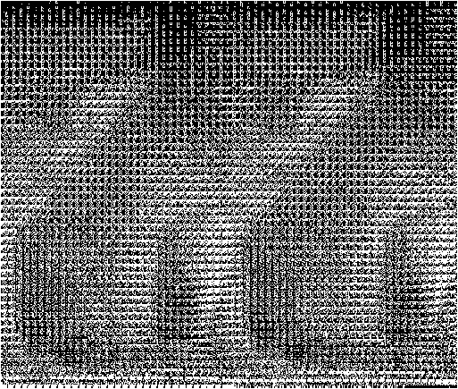


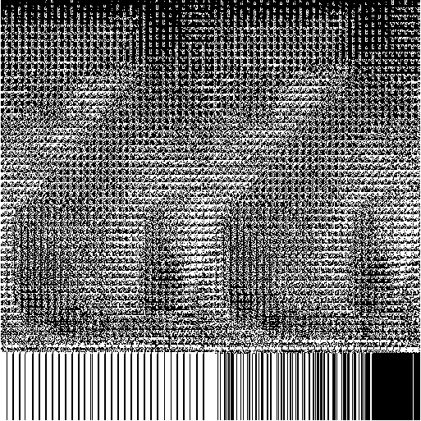

10001001
10110011
01001110
Pixel No.
R plane
1
2
.
.
.
.
9216
10001001 10110011 01001110
Bit plane W’ (432x512)
110110101001011011011010
Padding
W
G plane
24-bit RGB Pixel Matrix
B plane
Bit plane W’’(512x512)
Operations on color watermark image (illustration)

Slide 24



Block permuted
host image I’ with BTC
block size 4x4 (m = 4)
Bit plane of
host image I”
(512x512)
Host image I (u ,v)
512x512 (N=512)
Operations on the host image (illustration)

Slide 25




Host image I
(512x512)
Block permuted
host image I’(512x512)
Bit plane of
host image I”(512x512)
Ownership share O
(512x512)
Watermark image W
(96x96)
Bit plane of
Watermark W’(432x512)
Last row is padded
W”(512x512)
Watermark casting process with 4x4 block size & BTC size 4x4

Slide 26
Grayscale vs. Color watermarking schemes
Type of attacks |  | BTC Grayscale watermark in grayscale host image |  | BTC color watermark in grayscale host image
 |  | MSE | PSNR (dB) | MSE | PSNR (dB)
Cropping (%) | 10% | 254.75 | 24.07 | 70.62 | 29.42
 | 20% | 842.37 | 18.88 | 656.86 | 19.96
 | 30% | 1136.49 | 17.58 | 1754.26 | 15.69
 | 40% | 1745.7 | 15.71 | 3141.41 | 13.16
 | 50% | 3221.77 | 13.05 | 5014.26 | 11.13
Rotation (degrees) | 0.01 | 37.68 | 32.37 | 13.80 | 36.73
 | 0.1 | 77.84 | 29.22 | 126.69 | 27.71
 | 0.2 | 131.83 | 26.93 | 273.35 | 23.76
 | 0.5 | 274.86 | 23.74 | 568.27 | 20.59
 | 1 | 496.21 | 21.17 | 909.87 | 18.54

Slide 27
Continued……
Type of attacks |  | BTC color watermark in grayscale host image |  | BTC color watermark in grayscale host image
 |  | MSE | PSNR (dB) | MSE | PSNR (dB)
AWGN (SNR, dB) | 20 | 264.34 | 23.91 | 553.97 | 20.7
 | 30 | 114.23 | 27.55 | 51.95 | 30.57
 | 40 | 65.42 | 29.97 | 49.48 | 31.19
 | 50 | 44.45 | 31.65 | 13.07 | 36.97
 | 60 | 35.76 | 32.6 | 0 | Infinity
JPEG |  | 110.45 | 27.70 | 205.91 | 24.99

Slide 28
Conclusion
Watermarking of grayscale and color images was done using BTC technique. Watermarking of binary images was also performed with classical DCT technique and BTC technique.
As the two methods, viz. DCT and BTC, are fundamentally different, resistance to attacks is different:
  Cropping: DCT performance is better
  Rotation: BTC performance is better
  AWGN: Above 30 dB SNR, DCT gives better results while BTC performance is constant, i.e., BTC not resistant to AWGN
  JPEG compression: Both methods are not resistant
The BTC-based block permuted methods using grayscale and color watermarks are comparable and resistant to all four attacks

Slide 29
Future Scope
To make both the methods resistant to JPEG compression
To perform cryptographic attacks, i.e. attempts to crack the permutation key, and improve the security aspects
To watermark MPEG clips, i.e. moving images using BTC

Slide 30
We would like to mention a very special thanks to
Prof. S.N. Merchant for his informal and
invaluable guidance and support for our project work.
THANK YOU !!!

Slide 31
References
“Hidden Digital Watermarks In Images”, Chiou-Ting Hsu and Ja-Ling Wu;
Image Processing, IEEE Transactions on, Volume 8, Issue 1, Jan. 1999, pp 58-68
“A BTC-Based Watermarking Scheme for Digital Images”, Chiou-Ting Hsu and Ja-Ling Wu,Information and Security, an International Journal, Vol. 15, No. 2, 2004, pp 216-228
“Hiding Digital Watermarks Using Multiresolution Wavelet Transform”, Ming-Shing Hsieh, Din-Chang Tseng, Member, IEEE, and Yong-Huai Huang. IEEE Transactions on Industrial Electronics, Vol. 48, No. 5, October 2001
“Attacks on Digital Watermarks: Classification, estimation based attacks, and benchmarks”, Sviatolsav Voloshynovskiy, Shelby Pereira and Thierry Pun, University of Geneva, IEEE Communications Magazine, August 2001
“Image Compression Using Block Truncation Coding”, Edward J. Delp and O. Robert Mitchell, IEEE Transactions on Communications 27, No. 9 (September 1979), pp 1335-1342
“Digital Watermarking: A Technology Overview”, WHITE PAPER, WIPRO; http://www.wipro.com/insights/digitalwatermarking.htm
“Data Compression: The Complete Reference”, Third Edition, David Salomon, Springer (India) Private Limited, New Delhi, 2005

