Slide 1
LOCALIZATION USING ULTRASOUND SENSORS
Vishal Coelho

Slide 2


SYSTEM DESIGN
Beacon
Receiver
)
)
)
Start of Transmission
End of Transmission
Setup consists of two ultrasound transducers, one acting as beacon, the other receiver
Beacon will transmit a frame of 13 ultrasound pulses at 42KHz with 1 second interval between frames
A wire is used for signaling purposes between beacon and receiver

Slide 3
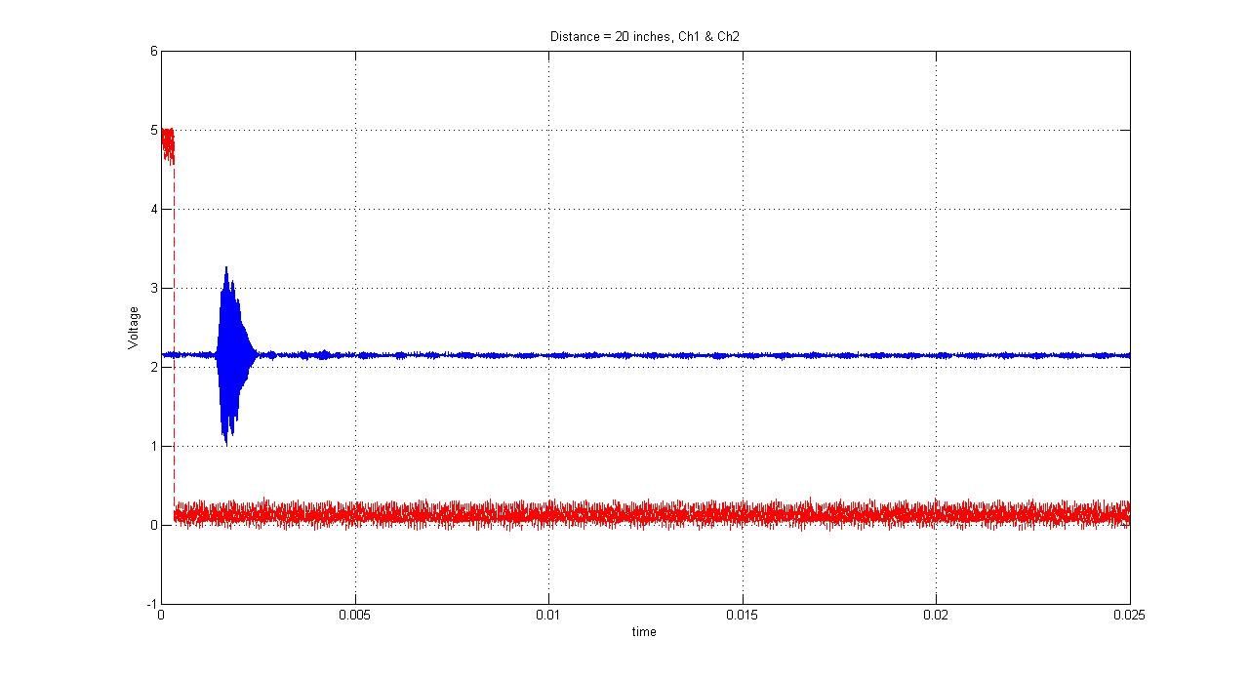
SYSTEM DESIGN (CONTD..)
Received signal
Receiver passes received signal through two log-amplifiers and an integrator before digitally processing the signal

Slide 4
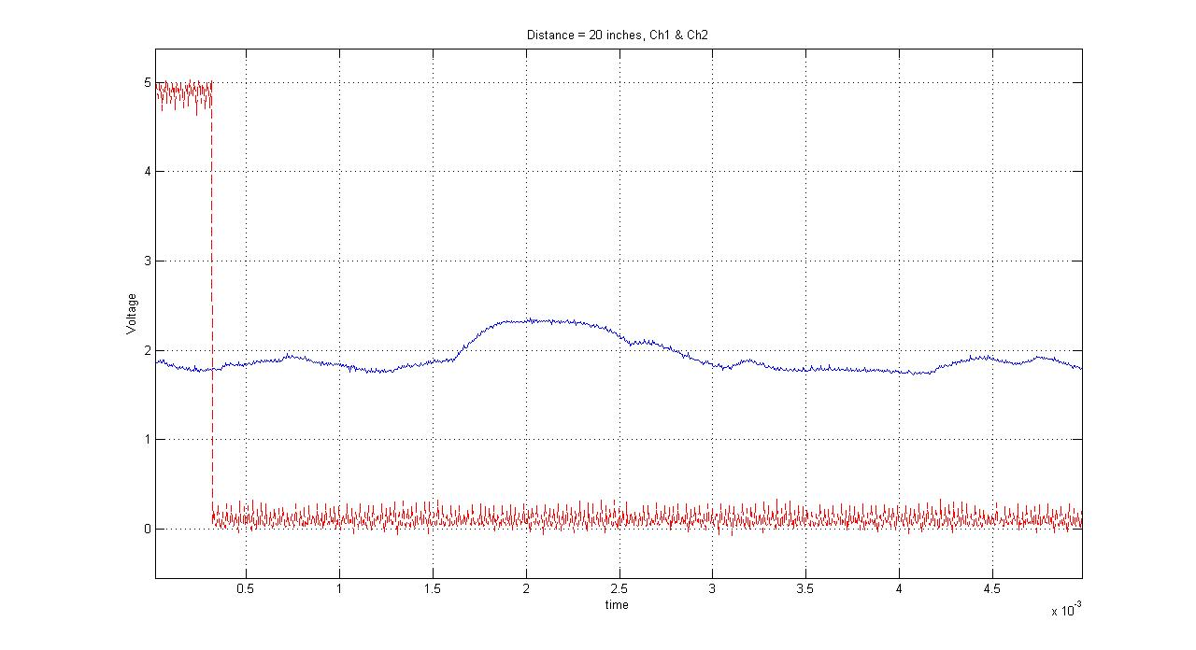
PRINCIPLE OF OPERATION
Start of transmission
Pulse Detected
Fixed Threshold
T₀-T₁
T₁
T₀
The receiver starts a timer (0) when the transmission begins and another timer (1) when the signal crosses a predetermined threshold
When the signal falls below the threshold, both timers are stopped and their difference gives time of travel
Distance Travelled = Time of Travel x Speed of Sound

Slide 5
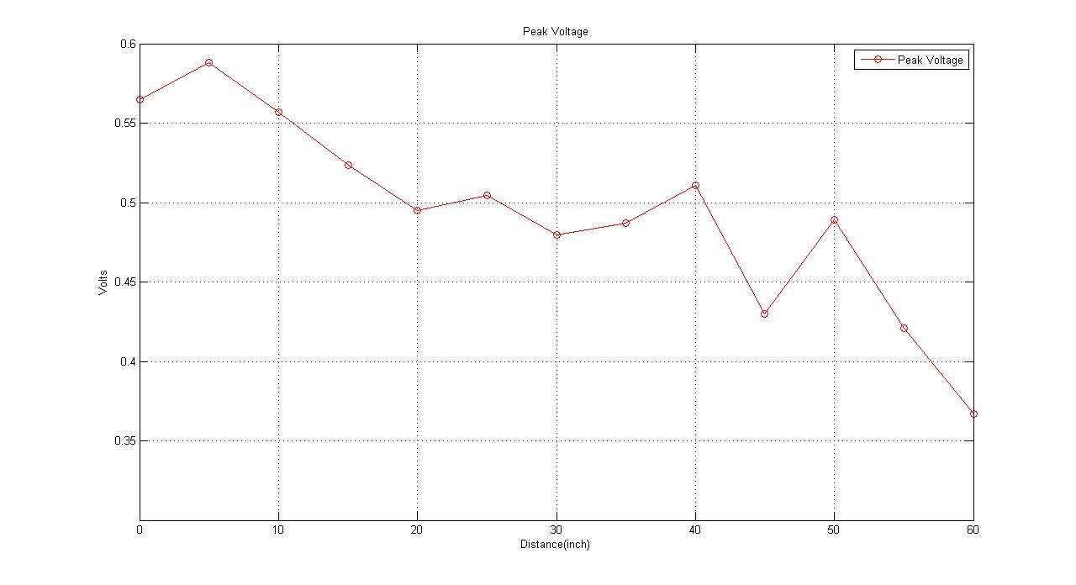
CURRENT WORK
Start of transmission
Pulse Detected
Fixed Threshold
AdaptiveThreshold
T₀-T₁
T₁
T₀
Adaptive threshold based on variation of peak voltage of the received signal with distance to improve robustness
Increased range of detection, current range up to 60 inches

