Slide 1
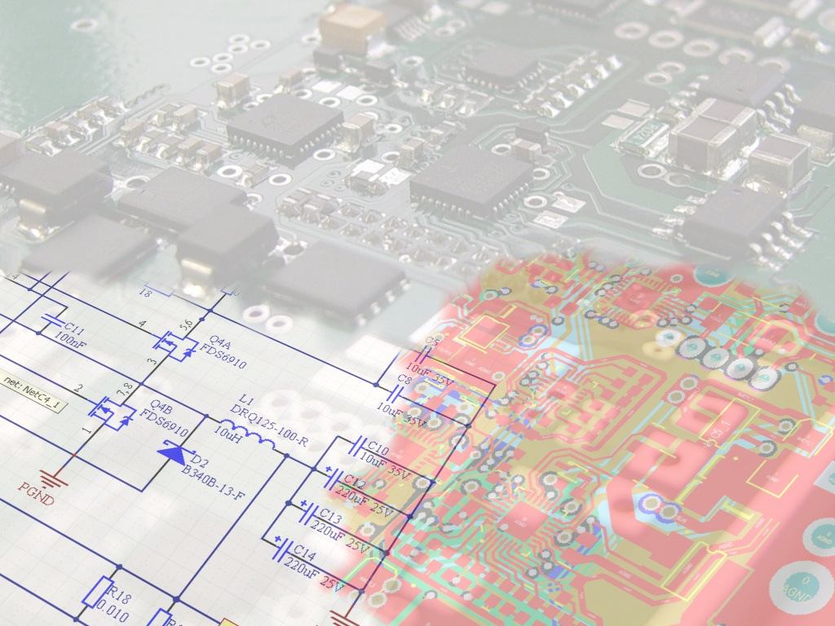
Automation & Robotics Research Institute
University of Texas at Arlington
Localization System for UAV/UGV in Urban Environments
Vishal Coelho
Supervisor: Frank Lewis
Supported by
ARO grant W91NF-05-1-0314
NSF grant ECCS-0801330

Slide 2
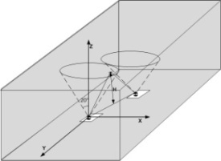
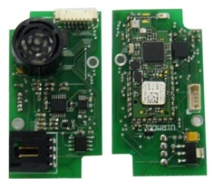
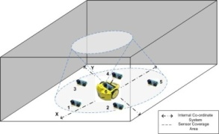
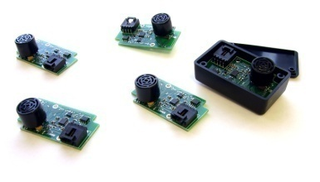
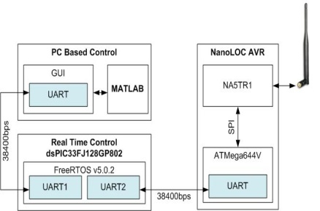
Contents of the talk
Motivation
Localization and Ranging
Construction of the Sensor Nodes
System Evaluation
Hardware Organization
Conclusion and Future Work
Control Flow

Slide 3
What is new?
Radio used for localization and not just communication
Replaces GPS indoors
Actual implementation of Pritpal’s algorithm.
What is the use of it? Motivation
Formation control indoors
Determine position of all robots in an uncontrolled environment( cant install install video cameras or sensors in specific locations like a grid), videos not feasible which picks up on floor features.
Sensors can be thrown in the environment
Cost (10 sensors would cost 2000$), VICON cost half a million
Mechanism used for ranging by radios is more precise and reliable than RSSI based solutions (which depend on antenna orientation, objects in between)
Resolution of the radio is good enough for big distances between robots and at close distances ultrasound will enchance the resolution and robustness
Compared to CRICKETS , higher transmission rates can be used for communication between robots.

Slide 4
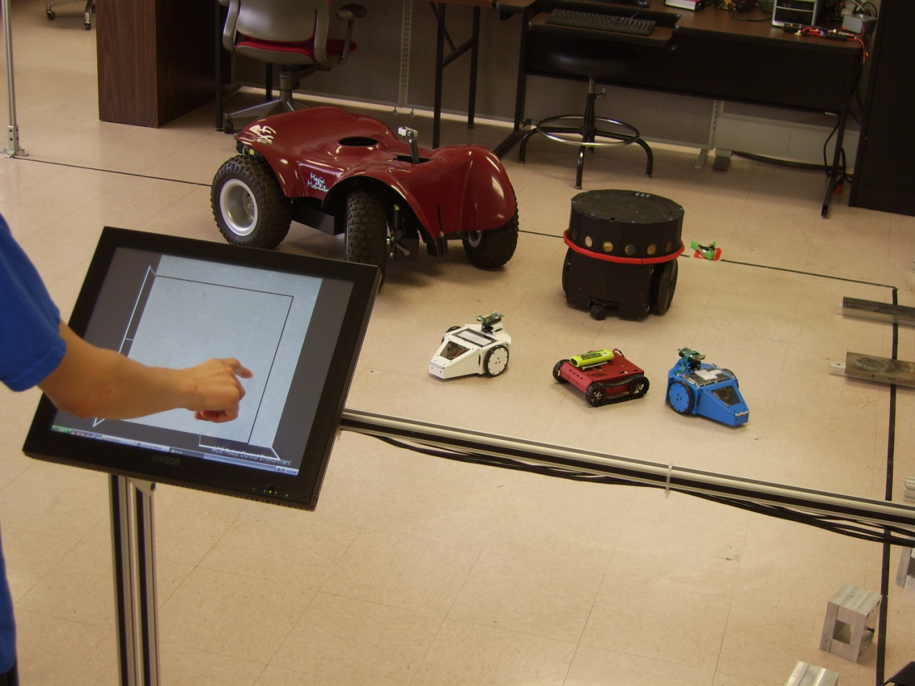
Motivation
Multi Vehicle Formation control indoors
The system can determine position of all robots in an uncontrolled environment
Resolution of the radio is good enough for big distances between robots and at close distances ultrasound enhances the resolution and robustness

Slide 5
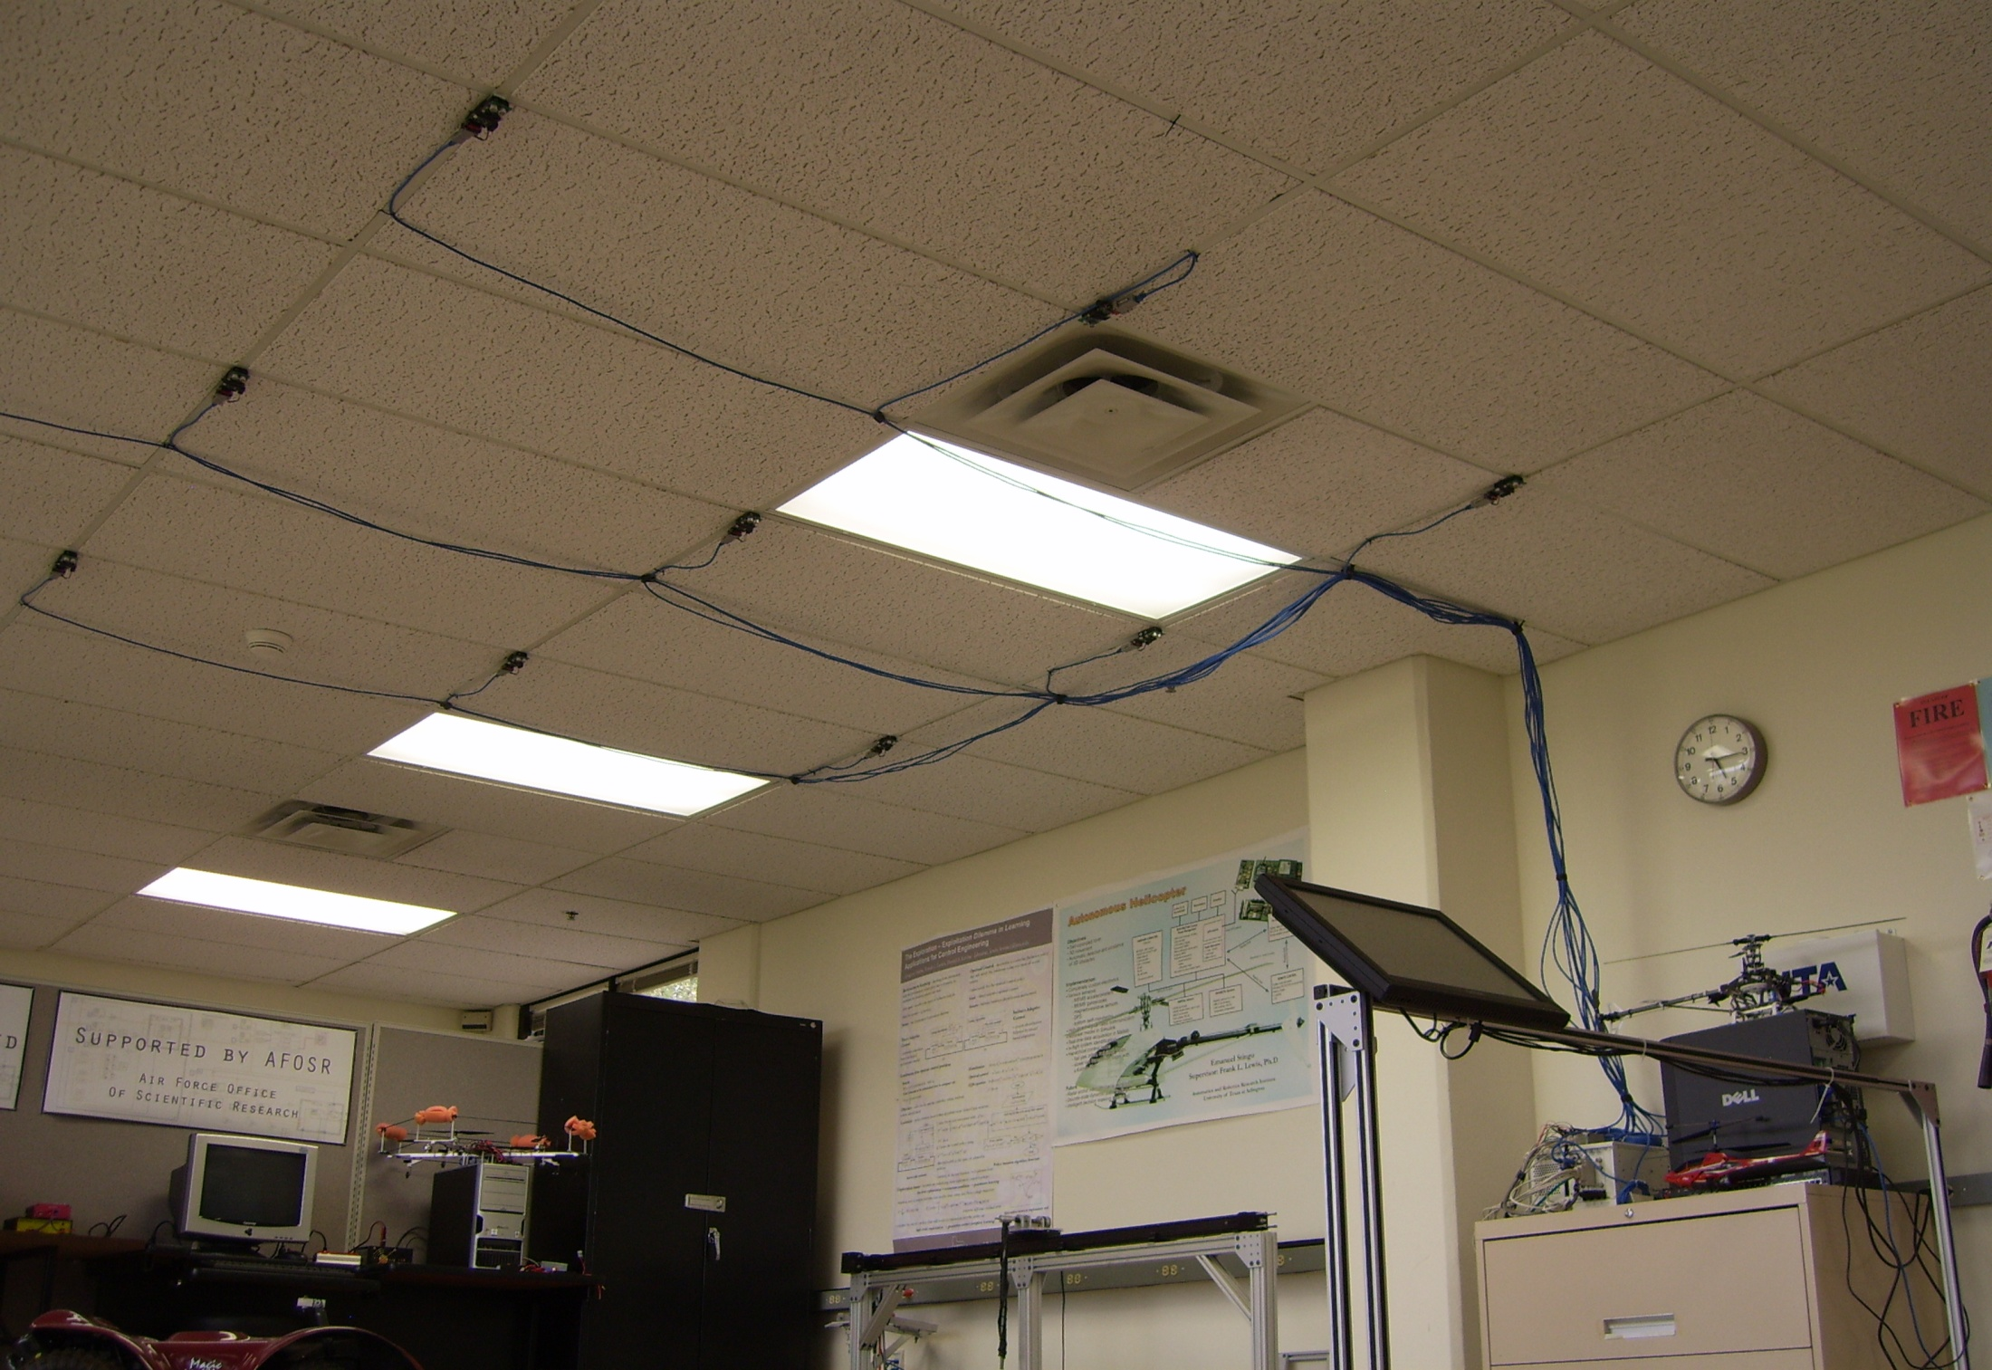
In Comparison to the CRICKETS
nodes can be thrown into a room (random deployment)
higher radio transmission rate (useful for multi vehicular communication)
In Comparison to VICON
10 boards ~ $2000
VICON ~ $500000

Slide 6

Construction of the Sensor Nodes
Ultrasonic Sensor manufactured by MaxBotix Inc.- http://www.maxbotix.com
Analog Signal Conditioning Block
nanoLOC AVR Module from NanoTron Technologies GmbH.- http://www.nanotron.com Operates in 2.4GHz ISM band using Chirp Spread Spectrum Modulation (IEEE 802.15.4a) Performs ranging using proprietary SD-TWR, ranging up to 60 meters indoors

Slide 7
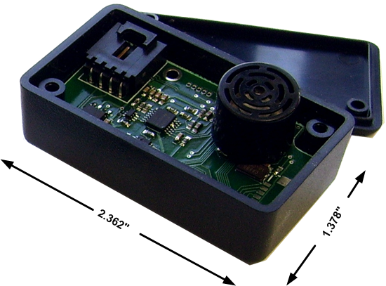
Small Form Factor
Fits in a Hammond 1551H box
Box provides mechanical support increasing durability
Can be powered using on-board LiPo batteries or external 9V Type D batteries

Slide 8
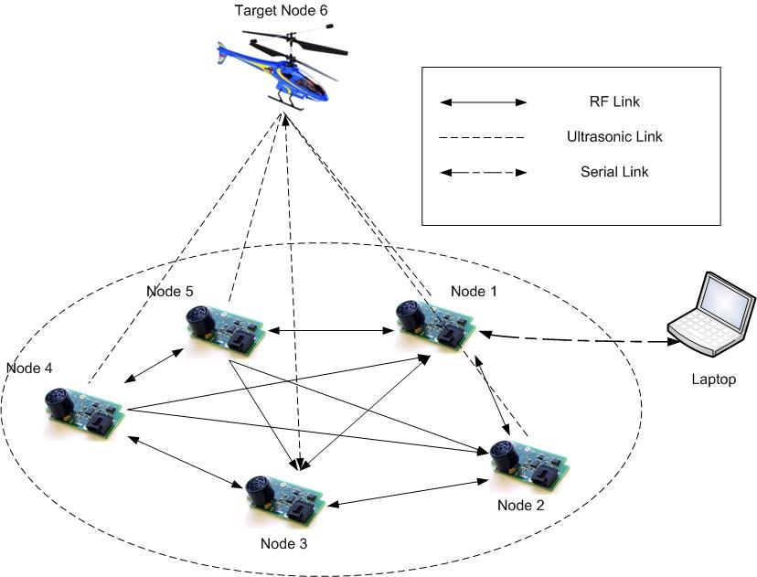
Hardware Organization
Nodes placed at random within a room
Nodes communicate via radio (CSS Modulation)
Single node acts as data collection point (Node 1), collects and relays data to PC via Serial port
Ranging using radios at large distances and ultrasound within 6 meters

Slide 9
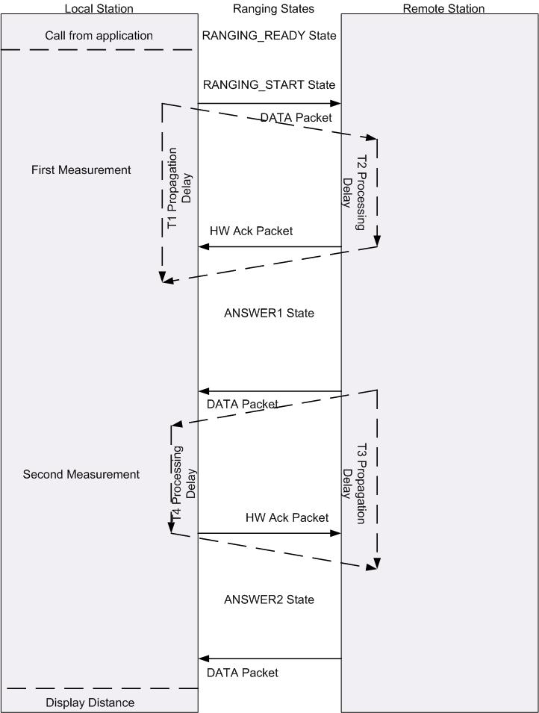
Radio Ranging Operation
Ranging technique : Symmetrical Double- Two Way Ranging (SD-TWR) developed at Nanotron Tech.
Two Ranging modes:
Normal : symmetrical ranging(ABA-BAB)
Fast : not symmetrical i.e. (ABA)

Slide 10
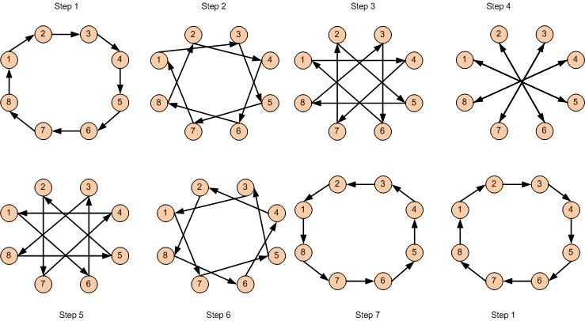
Ranging takes place in 50 ms frames (20 Hz)
3 radio localizations and 1 ultrasonic localization per frame
Ranging takes place in logical steps of 1 to 7

Slide 11
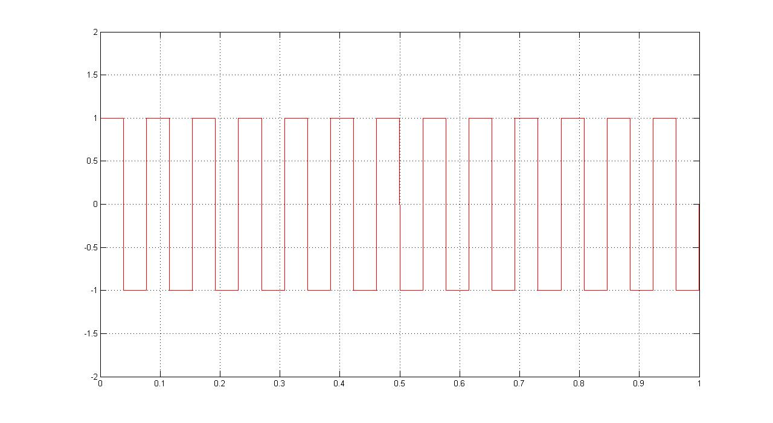
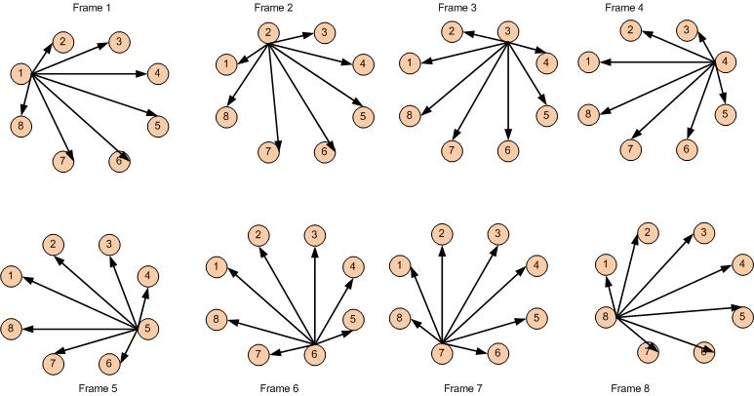
Ranging with Ultrasound
Nodes take turns in performing ultrasound localization (round robin)
Node transmits ultrasonic pulse train at start of frame
Distance to rest of nodes determined by time of travel of pulse train from transmitting node
Notes:
Ranging takes place in 50 ms frames so there are 20 frames a second
In each frame, there are 3 radio localizations and 1 ultrasonic localization
At the beginning of the frame, the node whos turn it is to localize, lets say node 0 will send out an ultrasonic pulse. Since all nodes are sync’d they know that in this frame node 0 has sent out an ultrasonic pulse so they start their timers at the beginning of this frame and continuously look for node 0’s pulse train.
When the pulse train is detected they turn off their timers and use the time of travel to figure out their distance from node 0
Similarly in the next frame its node 1’s turn to perform and ultrasonic localization and it goes on like that in a round robin fashion

Slide 12
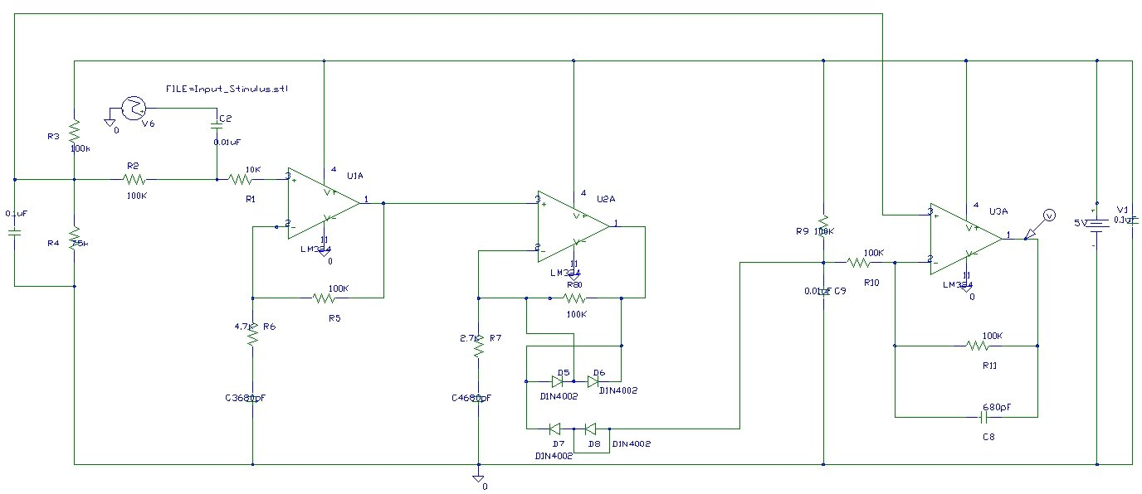
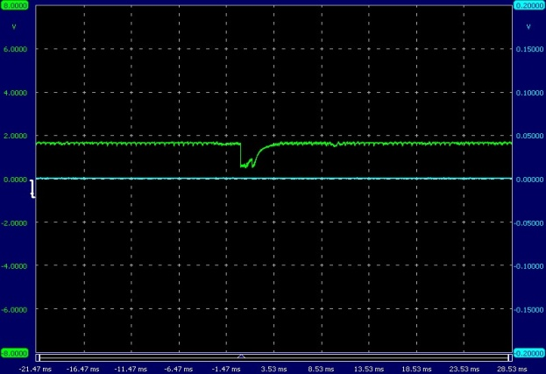
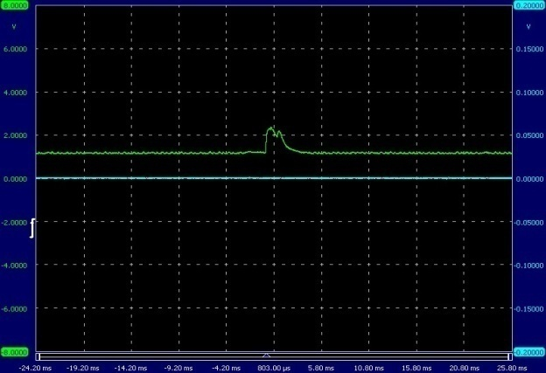
Analog Signal Conditioning
Do the math and see if its really a log amplifier and take the comparator output, also compare no ultrasound with ultrasound signal
Bandpass Amplifier
Variable gain bandpass Amplifier
Integrator

Slide 13
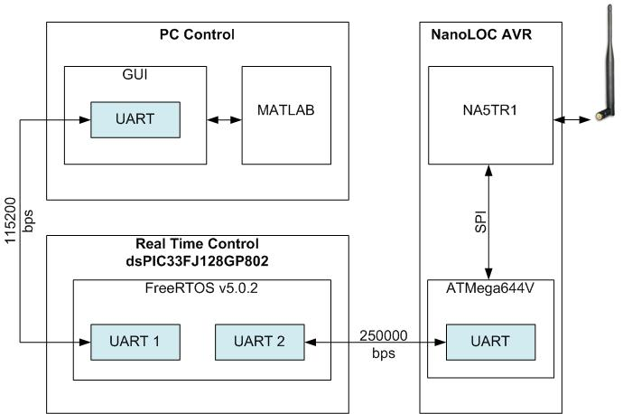
Control System : Architecture
UART(serial) communication between PC, Real Time Controller and Radio Module
Radio Module : On-board controller uses SPI to communicate with the transceiver IC
RTOS : FreeRTOS v5.0.2 ported to support the dsPIC33F series.
Works in preemptive mode, where tasks yields control to the scheduler after a certain time interval. Ensures equal time distribution for all tasks.
Localization algorithm is run in MATLAB on a PC

Slide 14
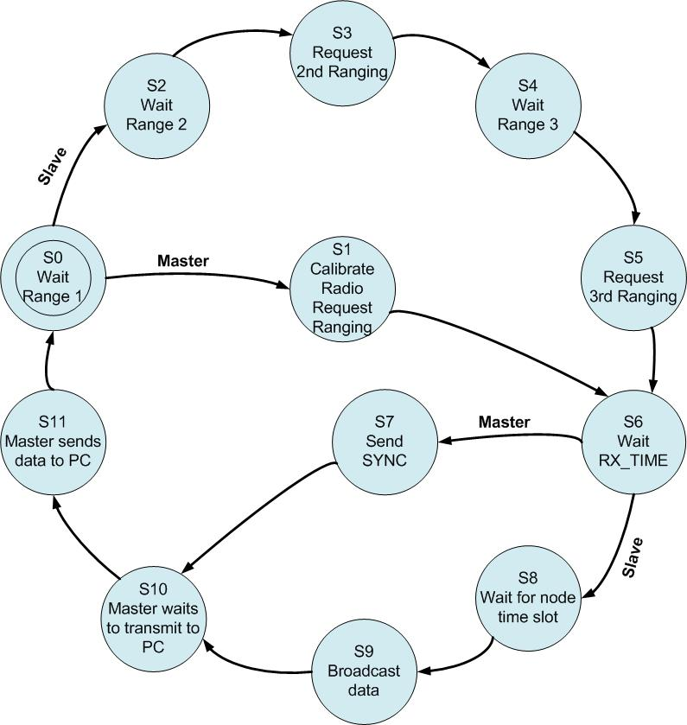
The Control flow has 12 states
Calibration : correct for frequency shifts in the local oscillator of the radio
Radio communication and localization is done in specific time slots during a 50 ms frame for each node
During each 50 ms frame an ultrasonic localization and three radio localizations are done
Nodes broadcast data to each other, master node transmits data to the PC
Notes:
The whole control flow takes place in frames, there are 20 frames each second.
50 ms a frame
The system is currently designed to accommodate 8 transmitting nodes only, any number of observer nodes
Nodes have addresses from 0 to 7, 0 being the master, the others slaves
When the entire system is started up for the first time, the slaves must synchronize to the timing of the master. The master transmits SYNC pulses every frame for this purpose
There are 3 radio localizations and 1 ultrasonic localization every frame.
As mentioned in previous slides, they perform the ranging in a round robin fashion. For the radios, in the first frame , first localization cycle every node will find its distance to its immediate logical neighbour, so node 0 finds distnace to node 1, node 2 to 3, 4 to 5 and so on, next localization cycle, you increase the range step to 2, so node 0 to node 2, node 1 to 3 and so on. So with each step you increase the logical distance until you reach 7 and circle back to 1.

Slide 15
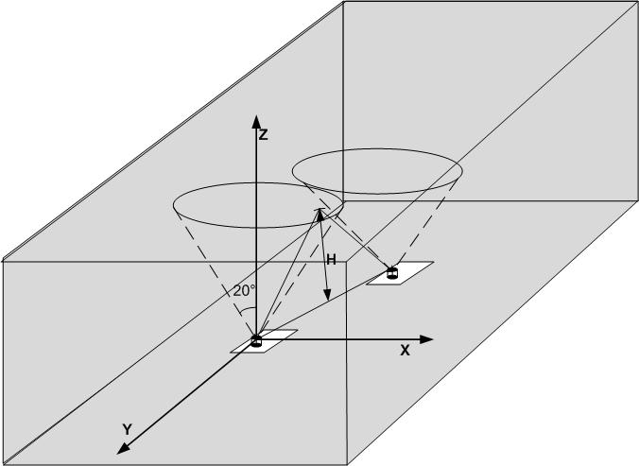
Localization and Ranging
Ranging using Ultrasound : Determine the height of the room at the position of node
Ultrasonic sensor records time it takes for a pulse train to reflect off the ceiling , Tr
= Speed of sound @ 25°C (346.65 m/s)

Slide 16
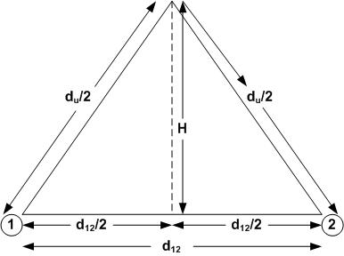
Ranging : d₁₂ ,distance between nodes 1 and 2 found as follows:
Node 1 transmits 13 ultrasonic pulses in the range 38 – 42KHz at start of frame
Node 2 starts a timer at the start of the frame, samples signal from the sensor and stops timer when it crosses the statistically determined threshold
Time of travel : T_{u}
Propagation distance (ultrasound) , d_{u} = T_{u} x V_{s}
Lateral Distance

Slide 17
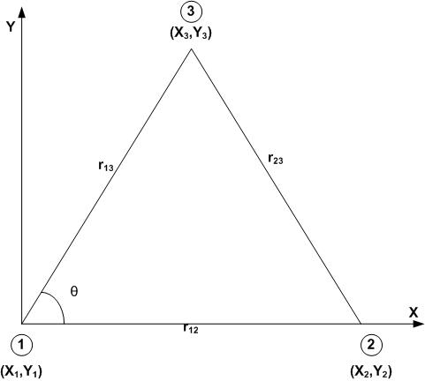
Localization : Process of determining an internal frame of reference for a set of points given the set of distances between each point
Initial assumptions:
Node 1 is at the origin (0,0)
Node 2 lies along the x-axis (r₁₂,0)
Node 3 position
-x₃ = r₁₃Cosθ , y₃ = r₁₃Sinθ
Θ is calculated from the law of cosines

Slide 18
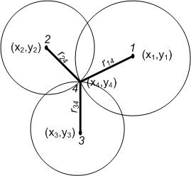
Trilateration : Given the position of 3 known nodes , the position of a 4th node can be found by drawing 3 circles which intersect at the 4th node
Each added node ‘s initial position estimate is found using the method of trilateration

Slide 19
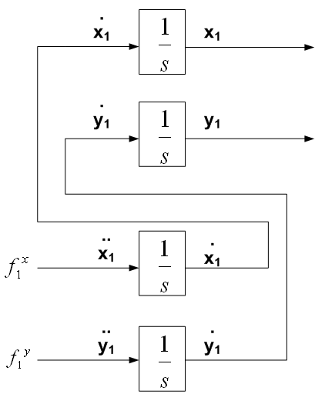
State Space Model
Virtual Force applied along x and y direction to obtain optimal position estimates
System Estimator tries to reduce the error in estimated range and measured range between nodes (cost function)
Measured Output
Control input
System Estimator :
Cost Function :
Notes:
The state estimator is shown in this slide
Virtual forces along both x and y directions are applied to drive the states to some particular desired state
The states of the system are the position and velocities of a node
There is a cost function that must be minimized each time a node is added to the system. This cost function or potential is a function of the error in estimated range and what was actually measured
So when a new node is added, we arbitrarily estimate its position, which is obviously incorrect. So we have incorrect distances to all the other nodes. The estimator tries to drive this error to a minimum value and so it applies forces on the node. If the error along a direction is large, a larger force is applied until it achieves a global minimum

Slide 20
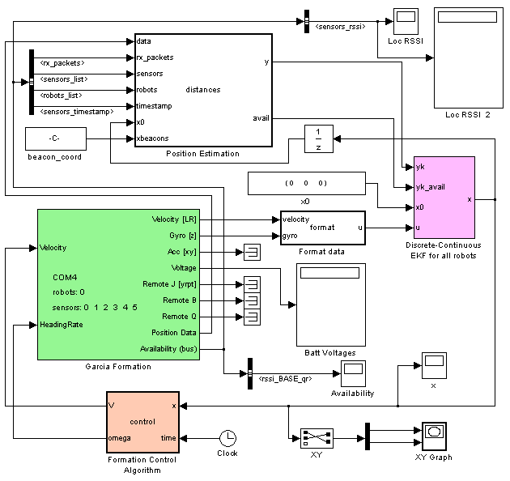
The Kalman Filter
Virtual Force applied along x and y direction to obtain optimal position estimates
System Estimator tries to reduce the error in estimated range and measured range between nodes (cost function)
Notes:
Inputs to the kalman filter are the measure velocity linear and angular of the garcias
Tries to predict the path of the garcia and succeeds to an extent
Have to tweak the matrices for the noise correlation matrices

Slide 21
It’s a search algorithm that’s has dynamics for the node.
The potential field provides the path towards the minimum but not necessarily over the path of greatest steepness,
But each node is like a ball having its own mass, moving along a hill having its inertia, it will go along the steepest gradient but because of its inertia it will try to move in its own direction and will slowly get pulled along the gradient and not instantaneously as in a gradient search method which moves immediately along the steepest gradient.

Slide 22
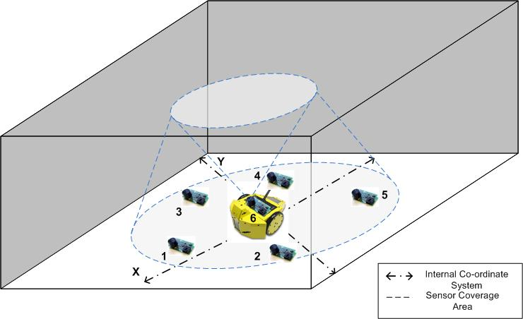
System Evaluation
Ground Network
All nodes within ultrasonic range of each other
UGV equipped with a sensor module (Node 6)
Tracking information relayed by Node 1 to the PC

Slide 23
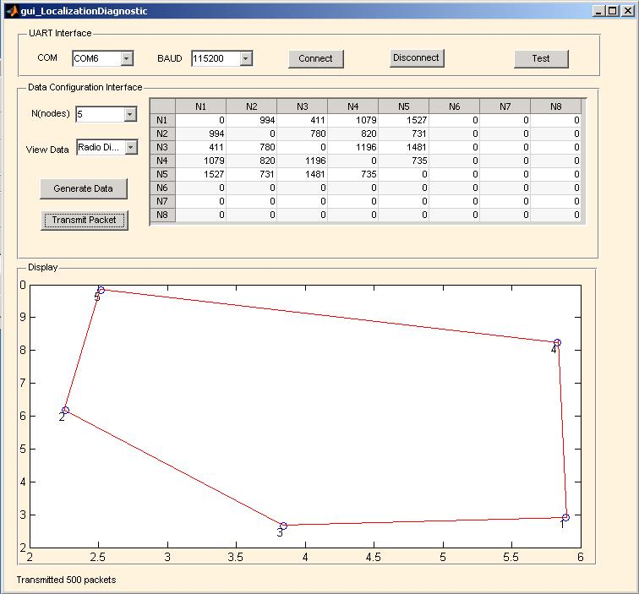
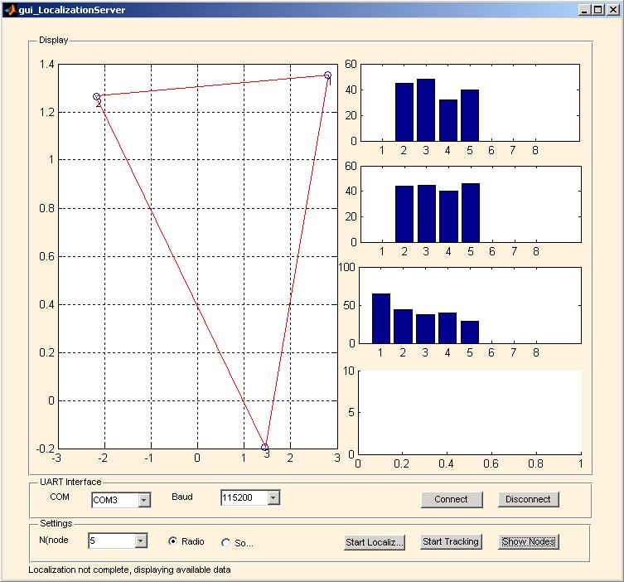
A generator function randomly creates a set of 5 node locations, packetizes the data and sends it across the serial port
Localization GUI picks up the packets and starts the localization algorithm
First step is to localize three nodes

Slide 24
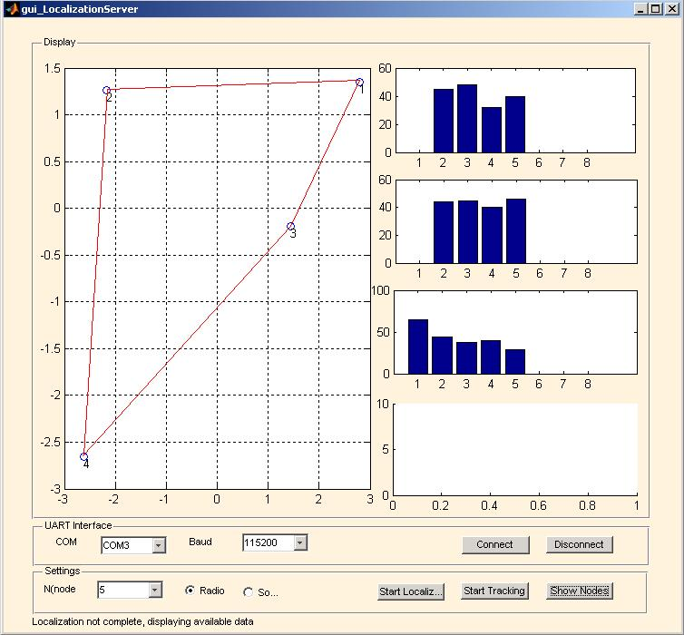
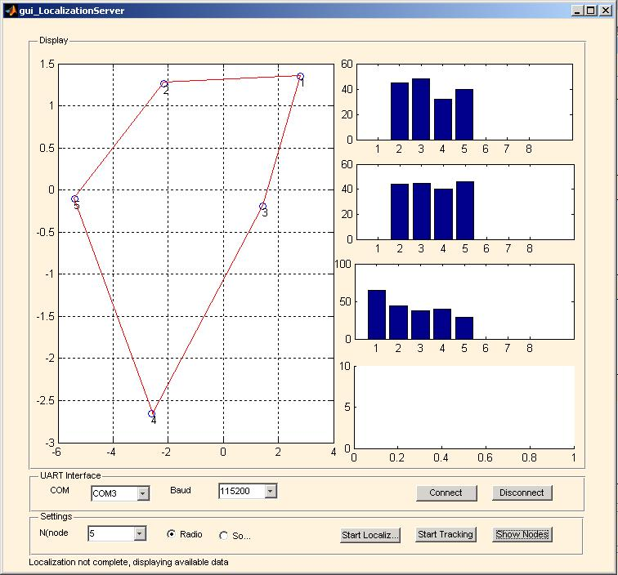
Addition of the fourth node
Addition of the fifth node

Slide 25

All nodes data available
Run localization algorithm for all nodes to get their final position
The result after localization was the nodes maintained the distance to each other with a maximum relative error of 5%
Lack of absolute position and depth (z) information often causes the network to undergo rotation and mirroring

Slide 26
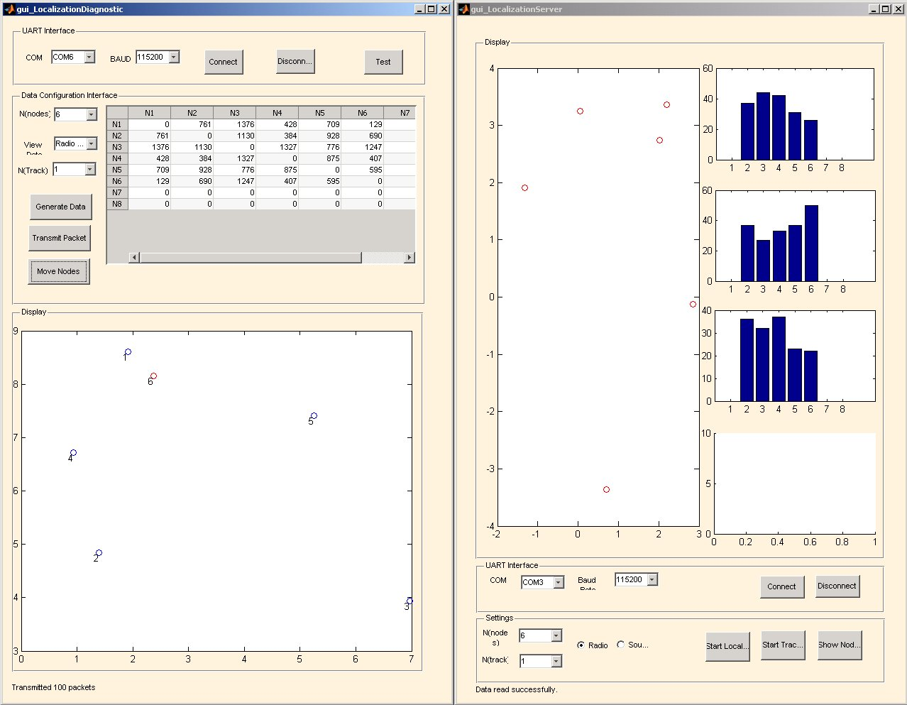
Watch 6 Node Simulation

Slide 27
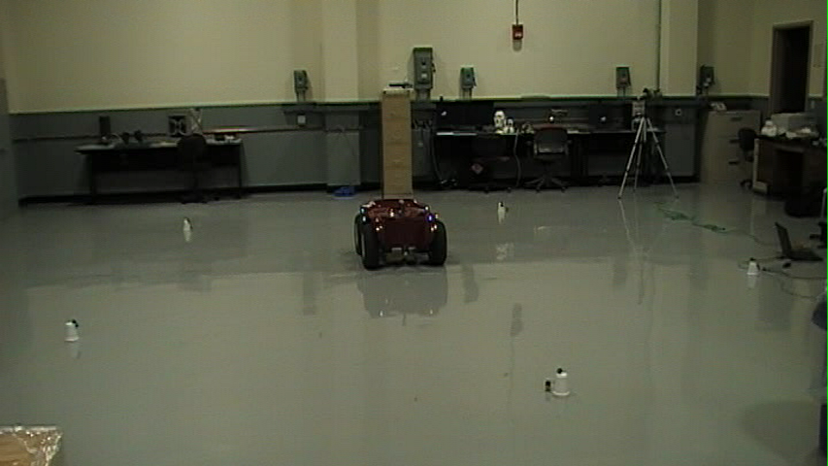
Watch Implementation Results

Slide 28
Conclusion and Future Work
Conclusion
Matlab algorithm can not keep pace with the inflow of data, a Simulink model is required for better performance especially during tracking
Localization is possible only using radios at the moment as the beam of the ultrasound sensors is too narrow to catch more than one or two other nodes at a time
Algorithm yields a high percentage relative error in estimated range when distances between nodes are below a meter
Future Work
Tweak the Kalman Filter (Simulink Model) to give better estimates and display the real time data in a graphical interface
Data routing for multi-room environments where some nodes are out of communication range
Nodes are able to track a target’s position but not orientation using the potential field method, consider multiple node arrangement on the target vehicles

Slide 29
Thank you
Thank you

