Slide 1
Psychological Aid For Victims in Emergency
2019PCS2006 - Vishal Kumar
2017UCO1550 - Anubhav Dhankhar 2017UCO1576 - Mansi Joshi
2017UCO1621 - Prabhat Kumar

Slide 2
Problem Statement
Design an application identifying the need of psychologist for counselling in an area by finding sentiments of the population location wise

Slide 3
Division Of Work
VISHAL KUMAR, ANUBHAV DHANKHAR: Integrating sentiments and tweets of a location and study how to classify tweets.
MANSI JOSHI : Pre-processing of dataset , sentiment analysis of tweets and their classification ,Plotting of results
PRABHAT KUMAR : Find and explored various API’s that can be used for this work , Extracted the live tweets using TWEEPY API, added the filter to get location wise tweets.

Slide 4
Dataset Used
The twitter API has been used to fetch tweets that are used as a dataset in this project .
Live tweets have been extracted and the process is dynamic .
Tweets are by nature short-form and contain diverse and relevant topics, making it an excellent dataset for sentiment analysis.
It is also a great dataset to analyze user engagement with their respective locations, since geo locations can be identified.

Slide 5
Pre-processing of dataset
The raw data having polarity is highly susceptible to inconsistency and redundancy.
Remove all URLs (e.g. www.xyz.com), hash tags (e.g. #topic), targets (@username)
Correct the spellings ( sequence of repeated characters is to be handled )
Replace all the emoticons with their sentiment.
Remove all punctuations ,symbols, numbers
Remove Stop Words Expand Acronyms(we can use a acronym dictionary)
Remove Non-English Tweets

Slide 6
Getting tweets of a Location

Slide 7
API Employed
Tweepy is a Python library for accessing the Twitter API. It is great for simple automation and creating twitter bots.
The Twitter API exposes dozens of HTTP endpoints that can be used to retrieve, create and delete tweets, retweets and likes.
The Twitter streaming API is used to download twitter messages in real time
We can filter tweets using its geolocation after identifying the bounding box of its longitude and latitude.

Slide 8
Models and Soft computing Technology

Slide 9
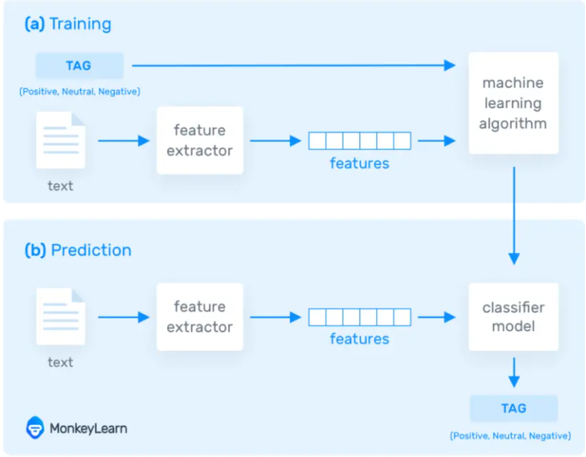
Used NLP for the Sentiment analysis.

Slide 10
Natural Language Processing using TextBlob
TextBlob is a python library and offers a simple API to access its methods and perform basic NLP tasks.
Sentiment analysis is basically the process of determining the attitude or the emotion of the writer, i.e., whether it is positive, negative or neutral.
The sentiment function of textblob returns polarity.
Cleaning of tweets to remove special characters
Textblob returns a polarity for each tweet
Polarity is a value which lies in the range of [-1,1] where positive value means positive statement, negative value means negative statement, and 0 means neutral statement.

Slide 11
Analysing the sentiment of a tweet

Slide 12
Workflow
Inputs - User feeds in the name of the place and the number of tweets required for his study
Tweepy client makes the API call to fetch tweets of that location
Fetched tweets saved in an output file
Cleaning of tweets to remove special characters
Textblob returns a polarity for each tweet
Classification of tweets and plotting of results
Run for multiple cities and suggest a psychologist in a strongly negative environment

Slide 13
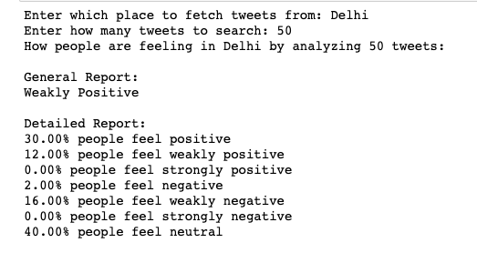
Sample query

Slide 14
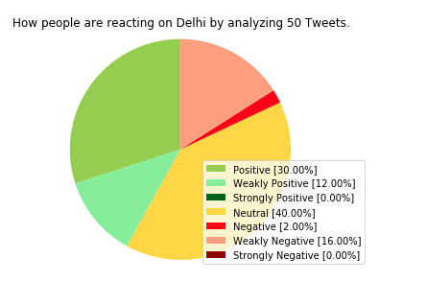
Pie chart classification

Slide 15
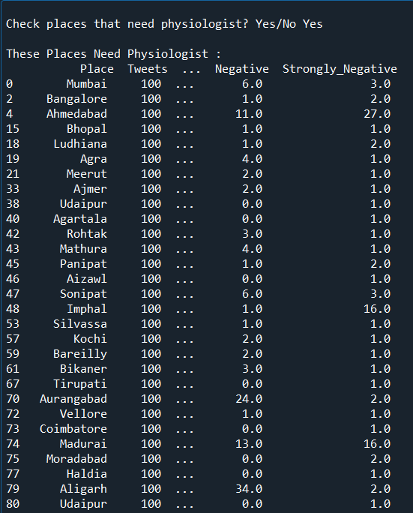
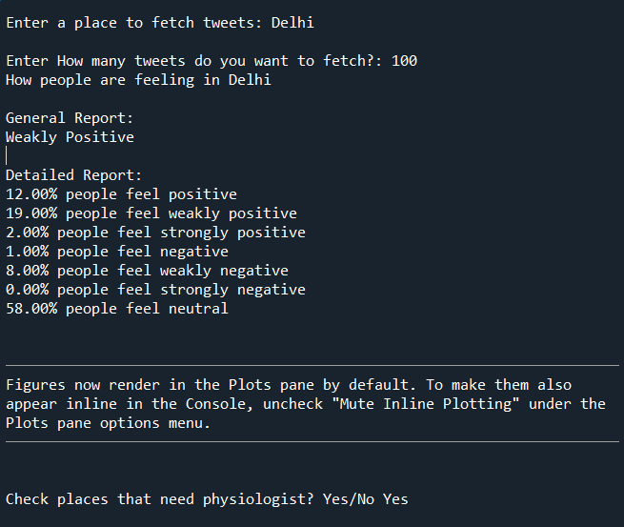
Running for multiple cities
Psychologist suggested to these

Slide 16
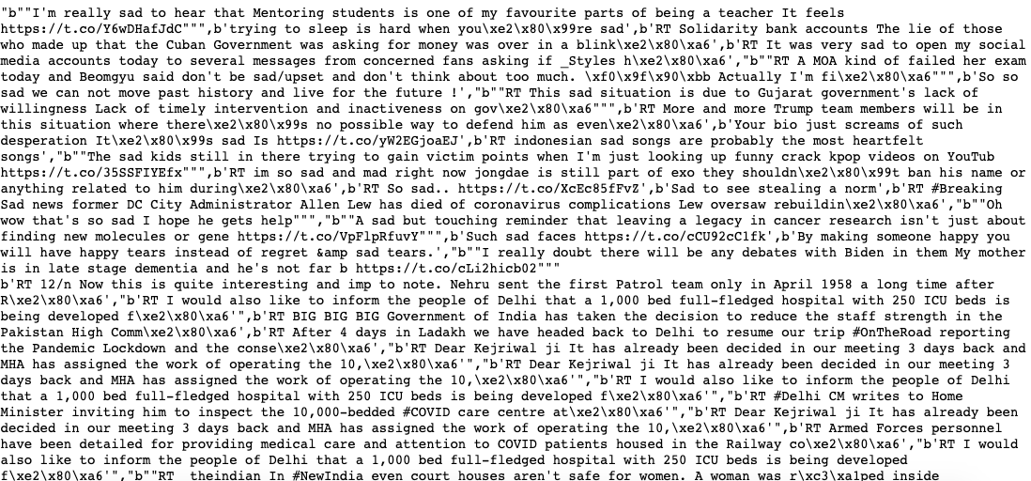
Tweet text

Slide 17
Progress Achieved
Learnt to use the Twitter API.
Obtained tweets for given coordinates.
Sentiment Analysis and Classification of a given tweet achieved.
Tried integrating step 2 and step 3.

Slide 18
Challenges
Developer account approval
A lot of unstructured data.
Fake profiles on twitter.
Only 1% tweets are geotagged.
Execution error when trying to integrate “tt.py” and Sentiment module.
There is a limit of accessing tweets using API.
Lack of communication with all the group members making the project somewhat cumbersome.
Ongoing internships.

Slide 19
Learnings from the Project
Vishal - Python, NLP using TextBlob
Anubhav - Python, NLP
Mansi - Python, Use of Twitter APIs and tweepy client, Sentiment Analysis
Prabhat -Python , Using API , cleansing of data

Slide 20
References :
Tweepy documentation http://docs.tweepy.org/
Stack overflow
https://www.bmc.com/blogs/track-tweets-location/
https://arxiv.org/ftp/arxiv/papers/1601/1601.06971.pdf
https://monkeylearn.com/sentiment-analysis/
TextBlob documentation

