Slide 1

ML FINAL PROJECT
Forecasting Sales of Walmart
TEAM NAME: VV
TEAM MEMBERS:
Vishal Vijayaraghavan, Varun Vimal

Slide 2





Agenda
Problem Background
Dataset Overview
Journey to the best Model
Application of Models
Future Work and Questions

Slide 3
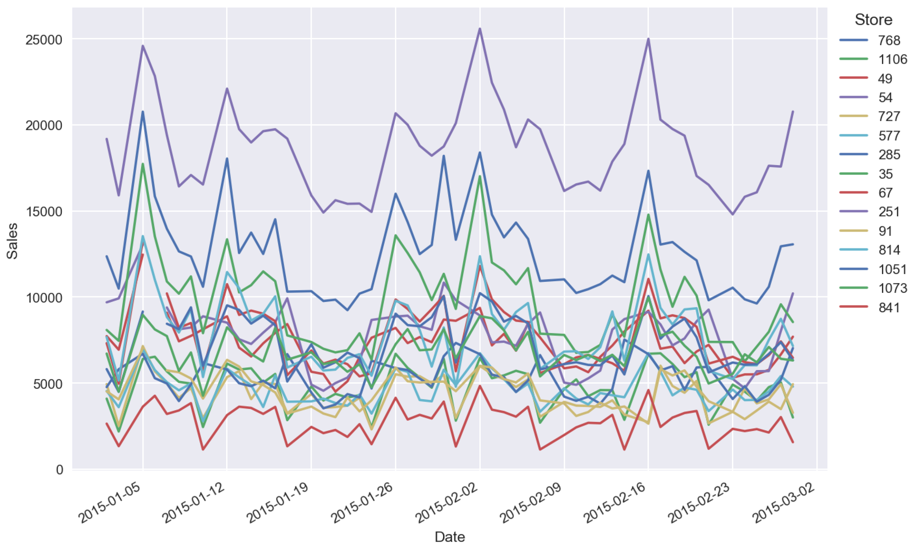
Dataset Overview
Time Series: Forecasting Walmart Daily Sales
A Kaggle competition where we have to try to accurately forecast Walmart’s daily sales.
We will have to use traditional time series methods along with machine learning methods to improve forecast accuracy.
Accurate forecasting in retail business is very important because inaccurate business forecasts will result in a lot of actual losses or opportunity losses.

Slide 4
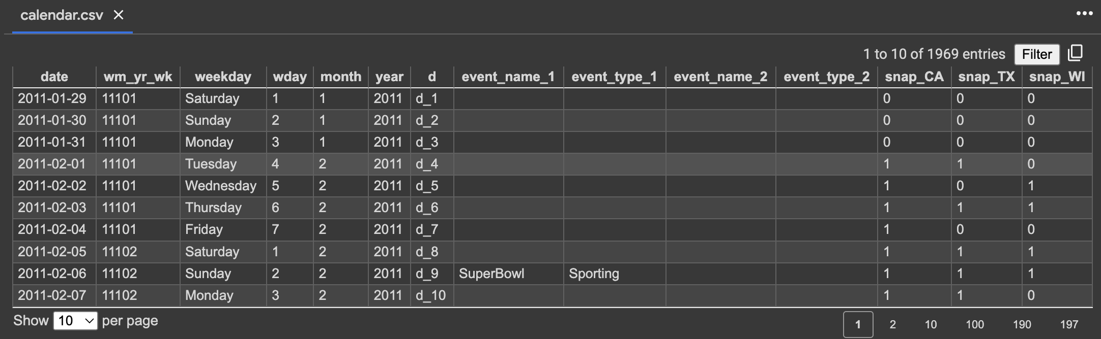
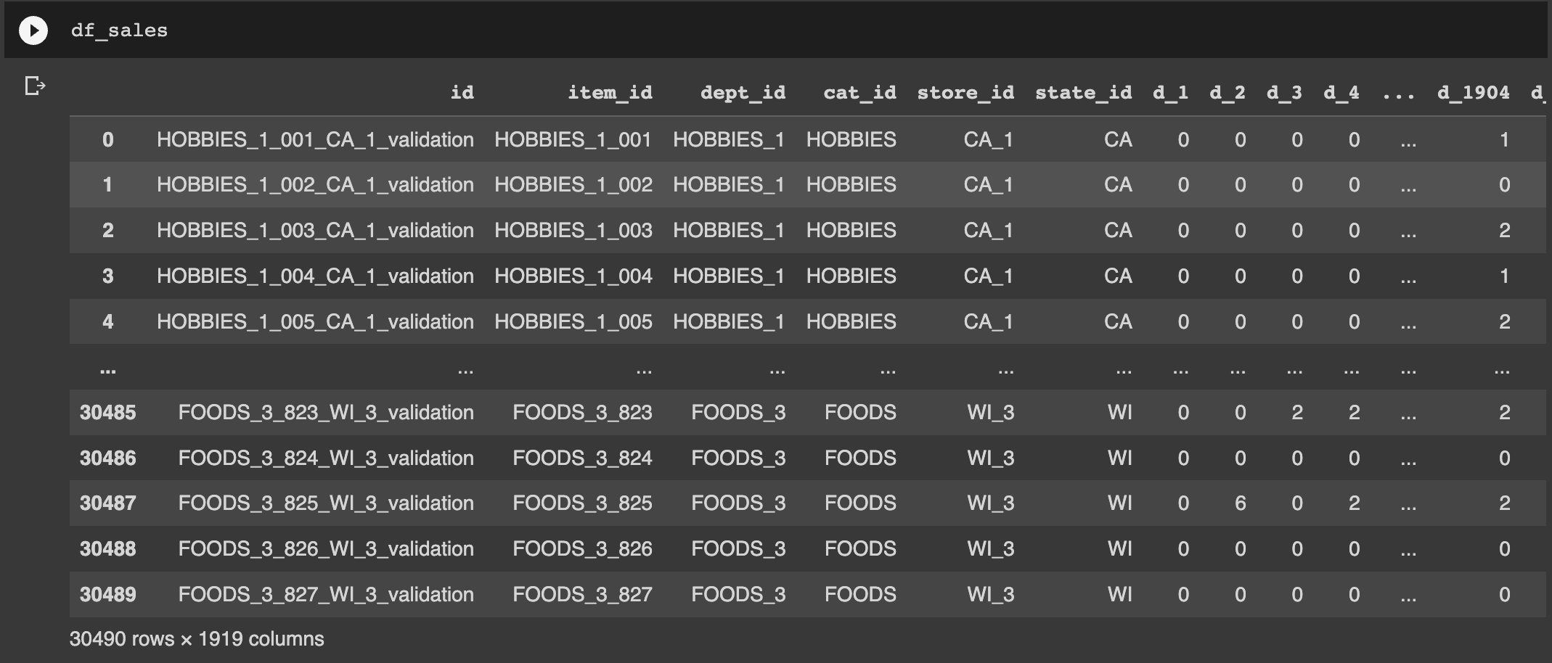
Dataset Overview
Variables of Importance
WEEKDAY
EVENT NAMES
SNAP_CA
EVENT TYPES
CAT_ID
DEPT_ID
STATE_ID
ITEM_ID

Slide 5
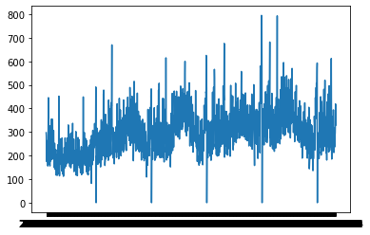
Dataset Overview
States x Categories x Departments x Items
48,000 Time Series
Out of these 48,000 Time Series, we chose the following aggregated Time Series to forecast
State = CA
Category = Foods
Department = Foods_1

Slide 6
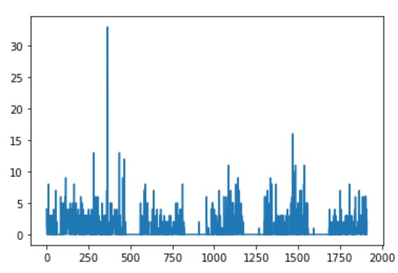
Dataset Overview
Why are trying to model food wise time series and not item wise time series?!
Naked Eye Test: There is no discernable pattern in this which can be captured by a model
Many inconsistent peaks and falls which makes it difficult to model
Item X Sales

Slide 7
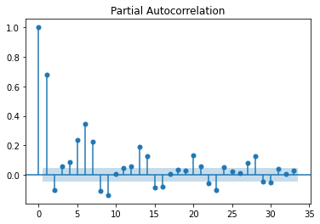
Journey to the best Model : PACF
Daily Sales of Foods_1 in CA_1
Dickey-Fuller Test P-Value = 0.00429
This Time Series is Stationary
Confirmed by Dickey-Fuller Test where P-Value < 0.05
This means we can now go ahead with ARIMA modelling!

Slide 8
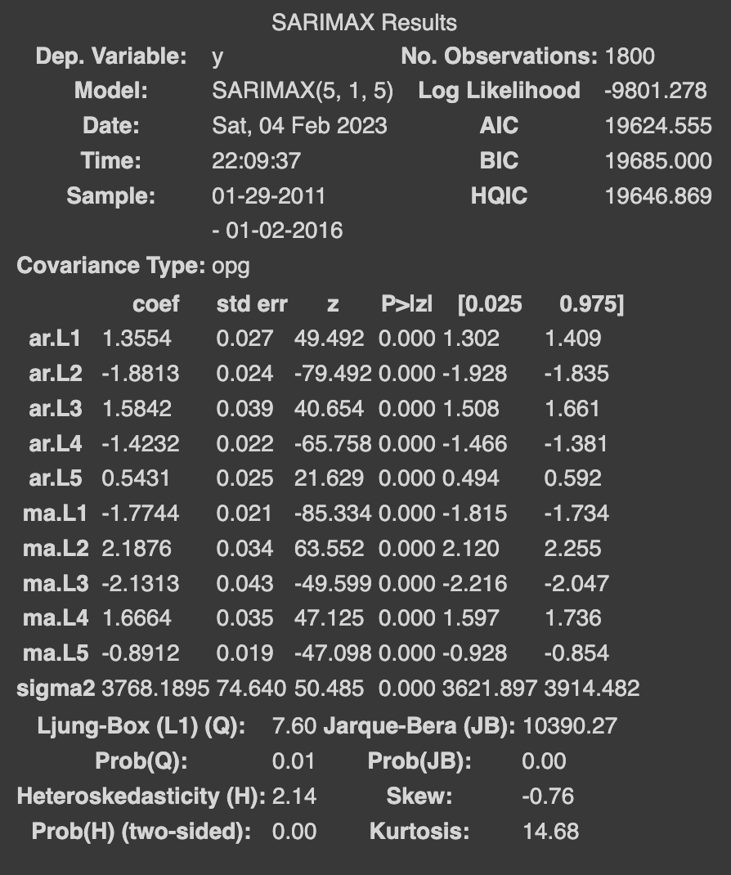
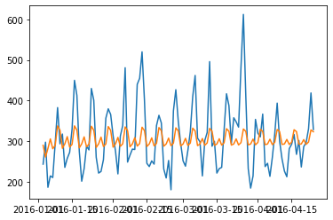
Journey to the best Model : SARIMA Results
SARIMA Model Summary
Test Set Actual vs Prediction
Test MAPE = 30.37%
This model uses 5 lags to forecast values
It performs bad with respect to error, but it gets a sense of the seasonality in the trend
Maybe if we incorporate recent and old history in the predictions, forecast accuracy might increase?!

Slide 9
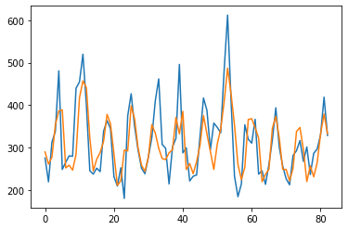
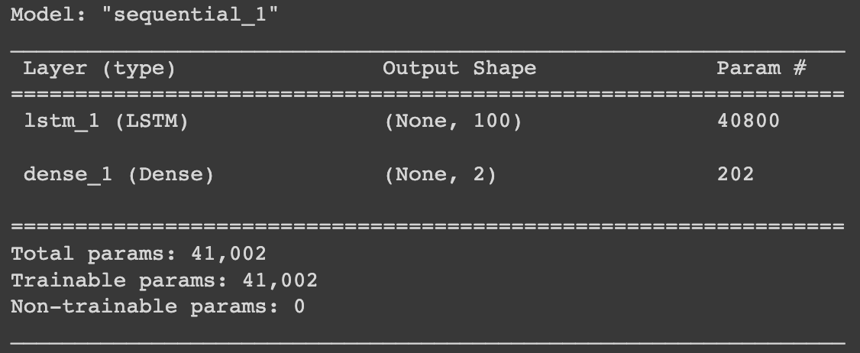
Journey to the best Model : Univariate LSTM
Univariate LSTM Best Model Specifics
Test Set Actual vs Prediction
5 lags underfit 50 lags overfit 30 lags sweet spot
100 input LSTM units
Test MAPE = 14.17%
This model uses lags (history) to forecast values
It performs really better than the previous model, but it still can be improved as it is unable to capture some residuals which might be due to other factors like maybe festivals?!
Let’s try predicting the sales with just the other factors and not the lags!

Slide 10
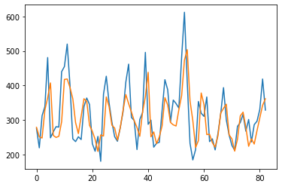
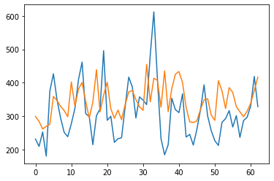
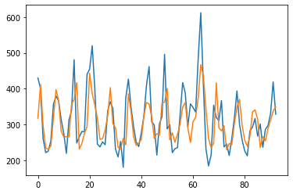
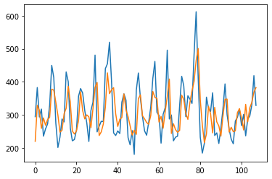
Journey to the best Model : Univariate LSTM all attempts
Test Set Actual vs Prediction
30 lags, 50 input LSTM units
30 lags, 100 input LSTM units
50 lags, 50 input LSTM units
20 lags, 50 input LSTM units
5 lags, 50 input LSTM units

Slide 11
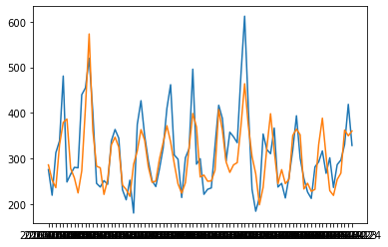
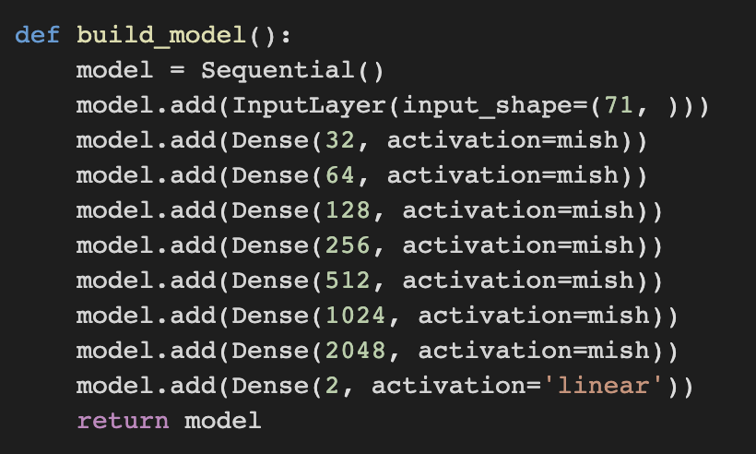
Journey to the best Model : DNN
DNN Best Model Specifics
Test Set Actual vs Prediction
Predictor Variables are the Categorical Variables like Weekday, SNAP_CA, Event Names, Event Types
Dummy Variables for all these variables were created
Shape of Training dataset: (1800,71) :: (Time Points, Dummy Variables)
New Activation Function – MISH – Multiplication of Softplus and Tanh – Better accuracy than Relu for this task
Batch Size = 100 gave best results
Test MAPE = 13.83%
This DNN Performs better than Univariate LSTM. Now why don’t we try including all these categorical variables in our already existing LSTM model?
We call it Multivariate LSTM!

Slide 12
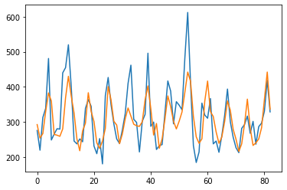
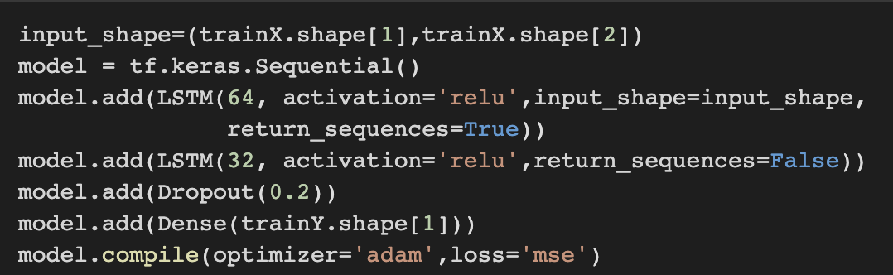
Journey to the best Model : Multivariate LSTM
Multivariate LSTM Best Model Specifics
Test Set Actual vs Prediction
Predictor Variables are the Categorical Variables like Weekday, SNAP_CA, Event Names, Event Types + 30 lags
We added an extra hidden layer to the Univariate LSTM architecture as there is more information to capture here
Test MAPE = 13.47%
This Model is the best one till now when we talk about just the MAPE
The downside is that it is not able to predict the troughs and crests every single time!
Time to see if combining a DNN and LSTM can help us capture the trend in residuals!

Slide 13
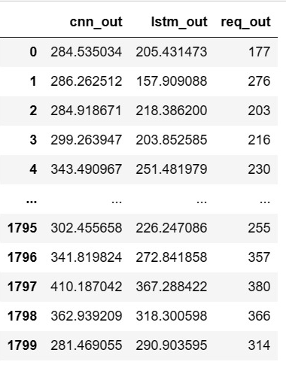
Journey to the best Model : Combining DNN + LSTM
DNN
LSTM
Categorical Variables – Weekday, SNAP_CA, Event Names, Event Types
Categorical Variables – Weekday, SNAP_CA, Event Names, Event Types
INPUT
It captures the Seasonality well
Captures the other Variations well
PROS
DNN PREDICTION
LSTM PREDICTION
These two OUTPUTS to predict the actual sales?
Will this help capture the trends in the residuals?
Let’s build an unorthodox DNN with
Inputs = DNN Prediction and LSTM Prediction
Output = Actual Sales

Slide 14
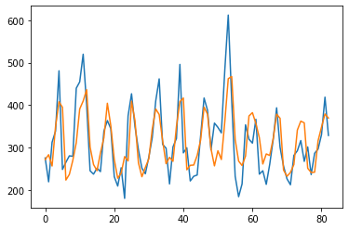
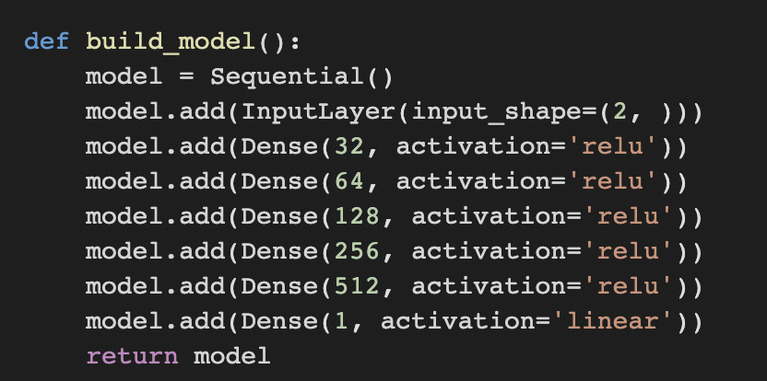
Journey to the best Model : Unorthodox DNN
Unorthodox DNN Best Model Specifics
Test Set Actual vs Prediction
Predictor Variables are the Predicted Sales(LSTM) & Predicted Sales (DNN)
Activation Function – RELU
Batch Size – 10
Input Layer Shape – (2,1) owing to only two Predictor Variables described above
Test MAPE = 15.00%
This Model does not perform better than our Multivariate LSTM(best model) as it has a slightly higher error
However, it can capture the troughs and crests well
So, depending on the user objective, this model can come into use!

Slide 15
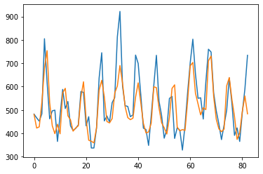
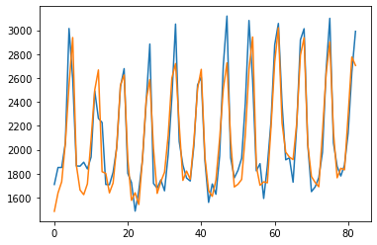
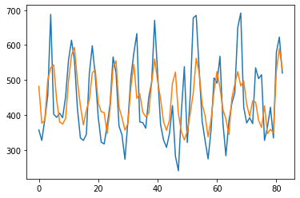
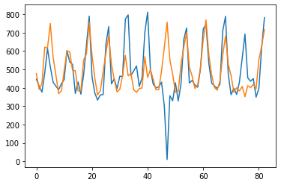
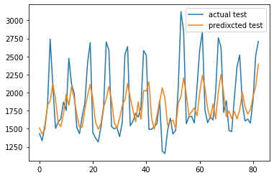
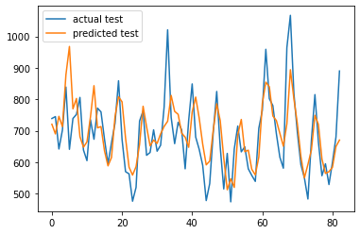
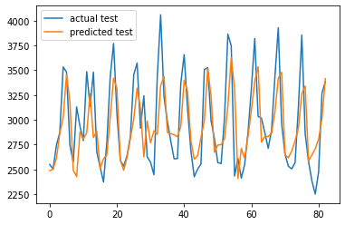
Application of Models
We can conclude that Multivariate LSTM with lags and Categorical variables was the best model.
We used it for modelling the sales for all of Foods in CA_1 , CA_2 & CA_3 and it gave good results!
FOODS_2 in CA_1
FOODS_3 in CA_1
FOODS_1 in CA_2
FOODS_2 in CA_2
FOODS_3 in CA_2
FOODS_1 in CA_3
FOODS_2 in CA_3
FOODS_3 in CA_3

Slide 16
Application of Models
Final Test MAPE of all the Time Series after Modelling with Multivariate LSTM (Best Model)
TIME SERIES | TEST MAPE
FOODS 1 in CA 1 | 13.47%
FOODS 2 in CA 1 | 10.13%
FOODS 3 in CA 1 | 6.29%
FOODS 1 in CA 2 | 15.77%
FOODS 2 in CA 2 | 115.3%
FOODS 3 in CA 2 | 14.95%
FOODS 1 in CA 3 | 18.79%
FOODS 2 in CA 3 | 10.05%
FOODS 3 in CA 3 | 8.42%

Slide 17
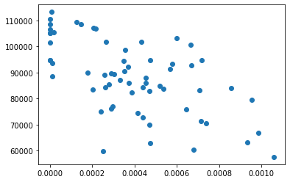
Future Work & Appendix
The R-squared for this relationship is 0.61!
This definitely means we can model this relationship to predict % of item in the food category sales given the food category sales
Total Foods 3 Sales
Percentage of Item 3 in Foods 1

Slide 18
THANK YOU!
Any Questions?

