Slide 1
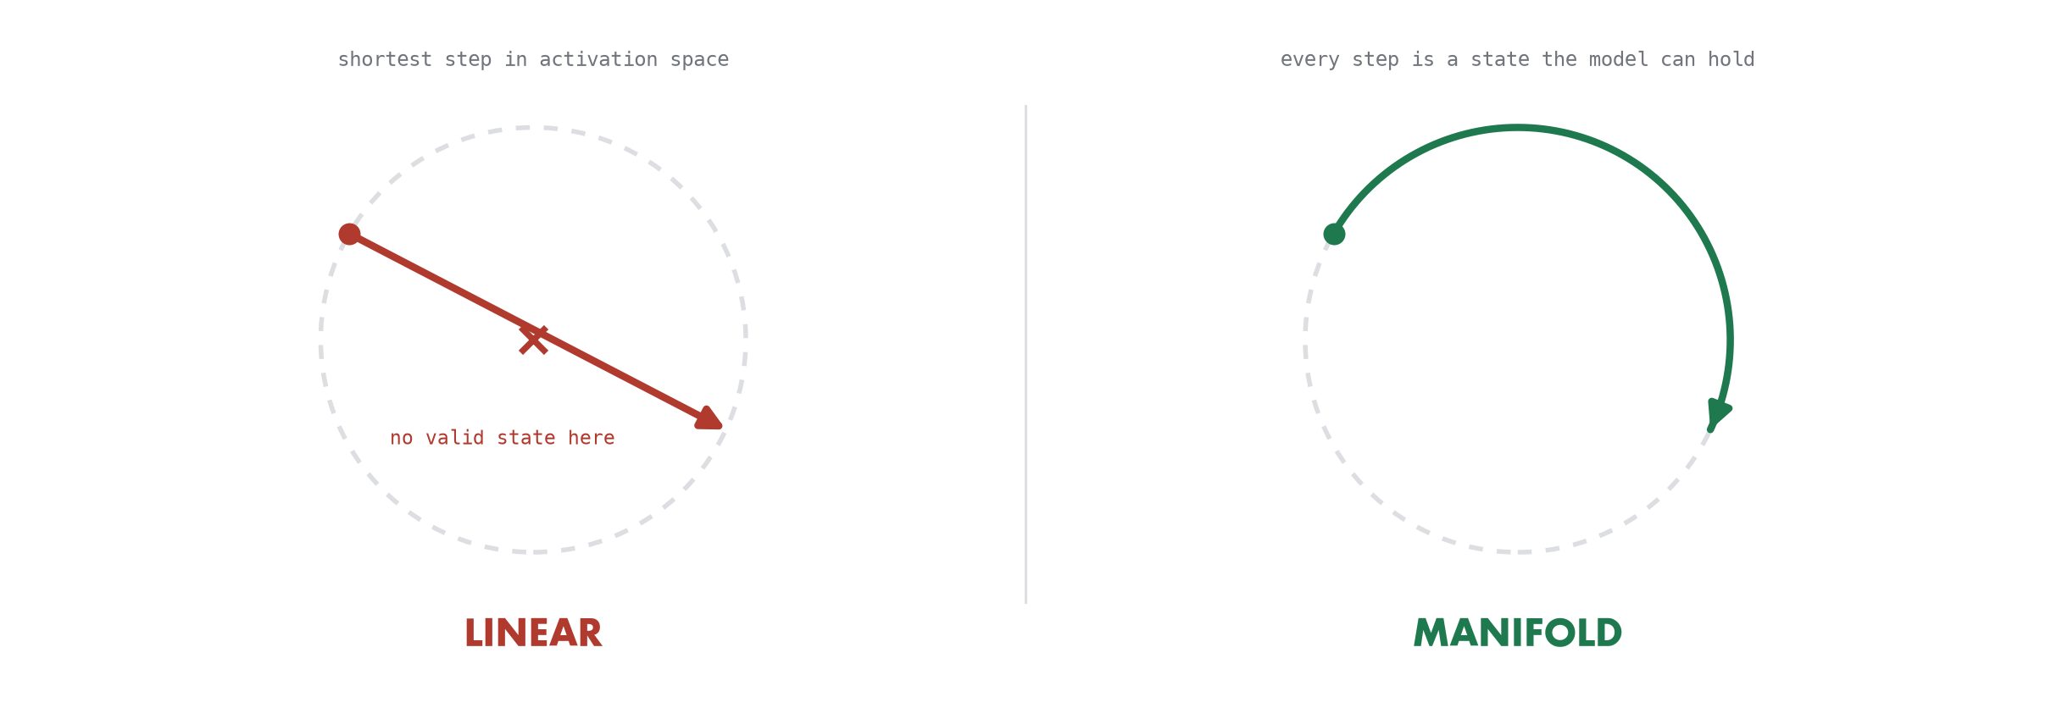
OPENING
thesis
To control a world model, follow its geometry
V-JEPA 2 ViT-L/16, frozen. 4,572 synthetic clips of one disk moving on an empty field. Speed and acceleration turn out to be ordinary scalars. Direction is a ring — and that difference decides whether you can steer it.
CLIPS
RESIDUAL STREAM
ENCODER
4,572
26 states
frozen
direction · speed · acceleration
layers 0–24 plus post-LayerNorm
probes and splines fitted on top
V-JEPA 2 ViT-L/16-256 · frozen encoder · 4,572 clips
01
Notes:
Two sentences to set the hook. We already know video world models learn physics. The open question is how they ORGANISE it — because that decides whether we can control them.
The punchline of the next fifteen minutes: speed and acceleration behave like the scalars they are. Direction is a closed ring with a real second harmonic. Steer it in a straight line and the model represents a physical paradox — and its attention mechanism throws the edit away within four blocks.

Slide 2
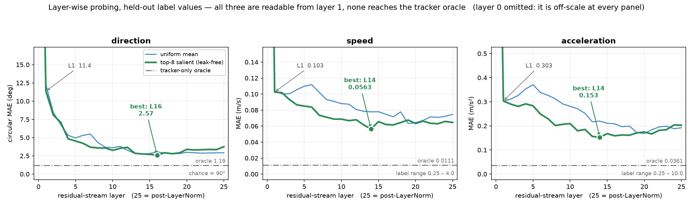
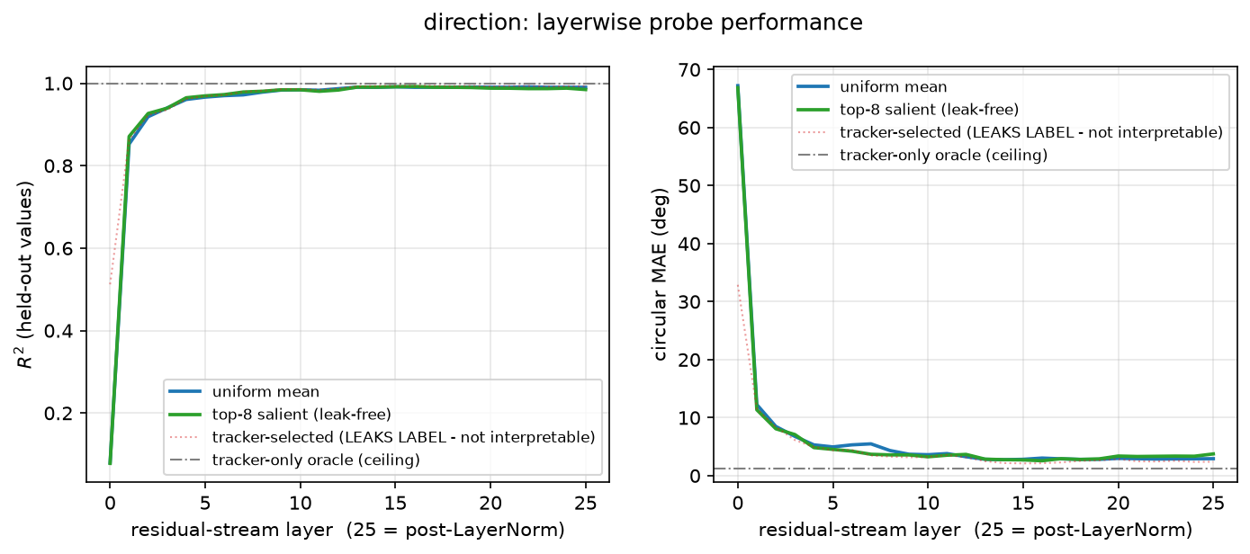
ACT 1 — WHAT IS THERE
F1 · F2 · F6
Physics is readable almost immediately
Layer-wise linear probes for all three variables, on held-out label values. The dash-dot line is what a perfect pixel tracker achieves on the same clips. Layer 0 is omitted — it is off-scale in every panel.
LAYER 0 → 1
BEST, ALL THREE
TRACKER ORACLE
66.9° → 11.4°
L16 / L14 / L14
1.19° · 0.011 · 0.036
one attention block does it
2.57° · 0.056 · 0.153
the encoder never reaches it
V-JEPA 2 ViT-L/16-256 · frozen encoder · 4,572 clips
02
Notes:
Layer-wise probing for all three variables. Chance for direction is 90 degrees.
THE HEADLINE. Everything is readable after ONE attention block. Direction goes from 66.9 degrees at layer 0 to 11.4 at layer 1; speed from 0.82 to 0.10; acceleration from 2.14 to 0.30. The paper reports direction emerging only at a sharp mid-depth transition. Here there is no step, just a steep rise and a glide.
THE CONTROL that makes that a finding rather than an artefact: the worry is that the probe reads POSITION rather than direction. It does not — the frame-0 centroid alone scores 86.3 degrees against a chance of 90. So this is real, and most likely a dataset-simplicity effect: one high-contrast disk on an empty field.
IF ASKED WHERE EACH VARIABLE 'BECOMES AVAILABLE': be careful with thresholds. R-squared clears 0.95 at layer 1 for both scalars and layer 4 for direction, but R-squared saturates far too early to be informative — at layer 4 direction still has twice its eventual error. On the native metric, the scalars are within 2x of their best at layer 1 and direction at layer 4; within 1.2x at layers 11, 11 and 13. Same ordering, but it says where each variable is genuinely finished.
TWO THINGS TO FLAG. The tracker oracle beats every encoder probe — 1.19 degrees against 2.57 — so V-JEPA loses roughly half the recoverable signal. And pooling moves the apparent best layer by up to six layers, so a single-pooling curve would confound emergence with pooling dilution. A third, tracker-selected pooling exists but is excluded from interpretation: its mask is built from the trajectory, which is the label.

Slide 3
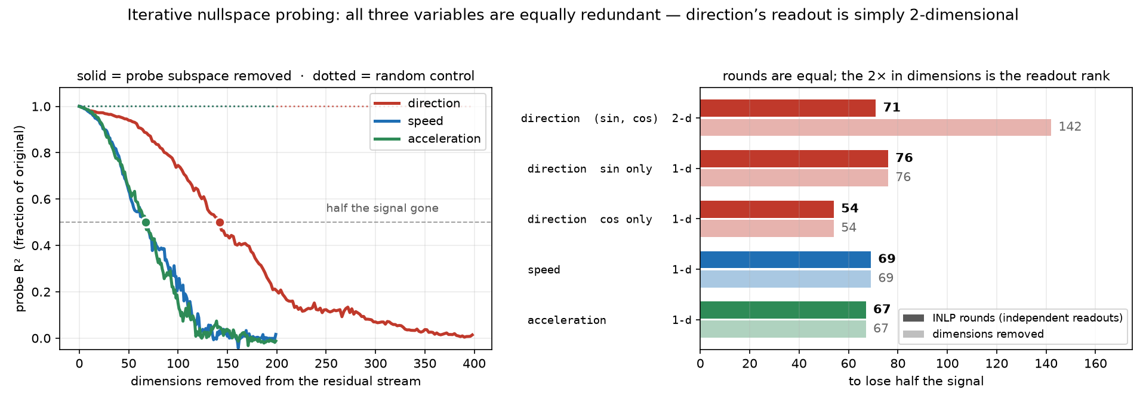
ACT 1 — WHAT IS THERE
F3
Everything is redundant — direction just reads wider
Iterative nullspace probing: fit a probe, project its readout subspace out, refit, repeat. The dotted lines remove random subspaces instead — the control that makes the curve mean anything.
PROBE-DIRECTED REMOVAL
RANDOM REMOVAL, SAME N
INDEPENDENT READOUTS
DIMENSIONS TO HALVE
0.99 → 0.01
0.99 → 0.99
71 / 69 / 67
142 / 69 / 67
the signal is destroyed
flat — the control
dir / speed / accel — equal
2× is readout rank, not redundancy
V-JEPA 2 ViT-L/16-256 · frozen encoder · 4,572 clips
03
Notes:
Removing the probe subspace drives direction from R-squared 0.99 to 0.01; removing the same number of random directions does nothing. THAT contrast is the finding — all three variables are carried by a highly redundant population code.
NOW THE CAREFUL PART, and volunteer it before anyone asks. Each INLP round removes one probe's readout subspace, and that subspace's rank is set by the TARGET, not by the representation: two dimensions for direction's sin-cos pair, one for a scalar. So direction spends dimensions twice as fast per round as pure bookkeeping.
Counted in ROUNDS — independent readouts extractable before the signal dies — the three are essentially equal: 71, 69, 67.
The decisive control is the right panel. Give direction a ONE-dimensional target on the same activations: sin theta alone costs 76 dimensions, cos theta alone 54 — squarely in the scalars' range of 67 to 69. The 142 is just 71 rounds times two.
So do NOT say direction is twice as redundant. Say: all three are equally redundant, and direction's readout is inherently two-dimensional, which is why controlling it costs twice the dimensions per readout. That framing sets up slide 5 exactly — a single probe cannot steer a two-dimensional readout.
One real asymmetry does survive, at the tail rather than the midpoint: reaching 10 percent of the original R-squared takes 133 rounds for direction against 114 and 103 for the scalars. About 1.2 times, not 2. Direction's signal persists a little longer into the low-signal regime.

Slide 4
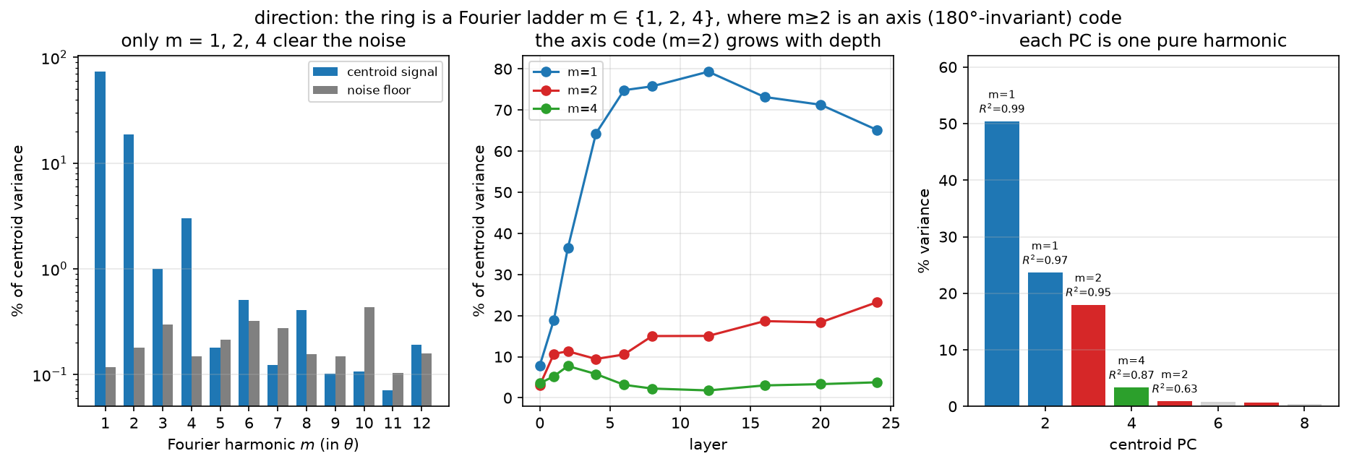
ACT 1 — WHAT IS THERE
F13
The model invents a Fourier ladder
The 64 directions are equally spaced, so a DFT of the per-angle centroids reads the harmonic content off directly. Noise floor from splitting the repetitions in half.
M = 1 · DIRECTION
M = 2 · AXIS
M = 3
M = 4
73.2%
18.7%
at noise
3.0%
PC1–PC2, R² 0.99
PC3 — invariant to a 180° flip
SNR 3.4 — absent
PC4, R² 0.87
V-JEPA 2 ViT-L/16-256 · frozen encoder · 4,572 clips
04
Notes:
Every principal component is almost purely one harmonic. PC1-2 are cos and sin of theta; PC3 is two theta; PC4 is four theta. The ladder is 1, 2, 4 — m=3 sits at the noise floor.
The 180-degree flip correlations say what the higher harmonics ARE. PC1 anti-correlates at -0.97: a direction code. PC3 and PC4 are invariant at +0.95 and +0.97: they encode the AXIS of motion, not which way along it. That is the direction-versus-orientation distinction from visual neuroscience, appearing unprompted. And the network builds it — the pixel trajectory is 97% pure first harmonic.
DO NOT claim this explains the dimensionality. It is tempting and it is wrong: PC3 alone reads direction at 99.8 degrees — worse than chance — and PC1-4 together only reach 11.1 against 2.57 for the full space. The harmonics explain the SHAPE, a non-planar closed loop, which is what sets the trap for linear steering. The dimensionality of slide 3 is spent suppressing nuisance.

Slide 5
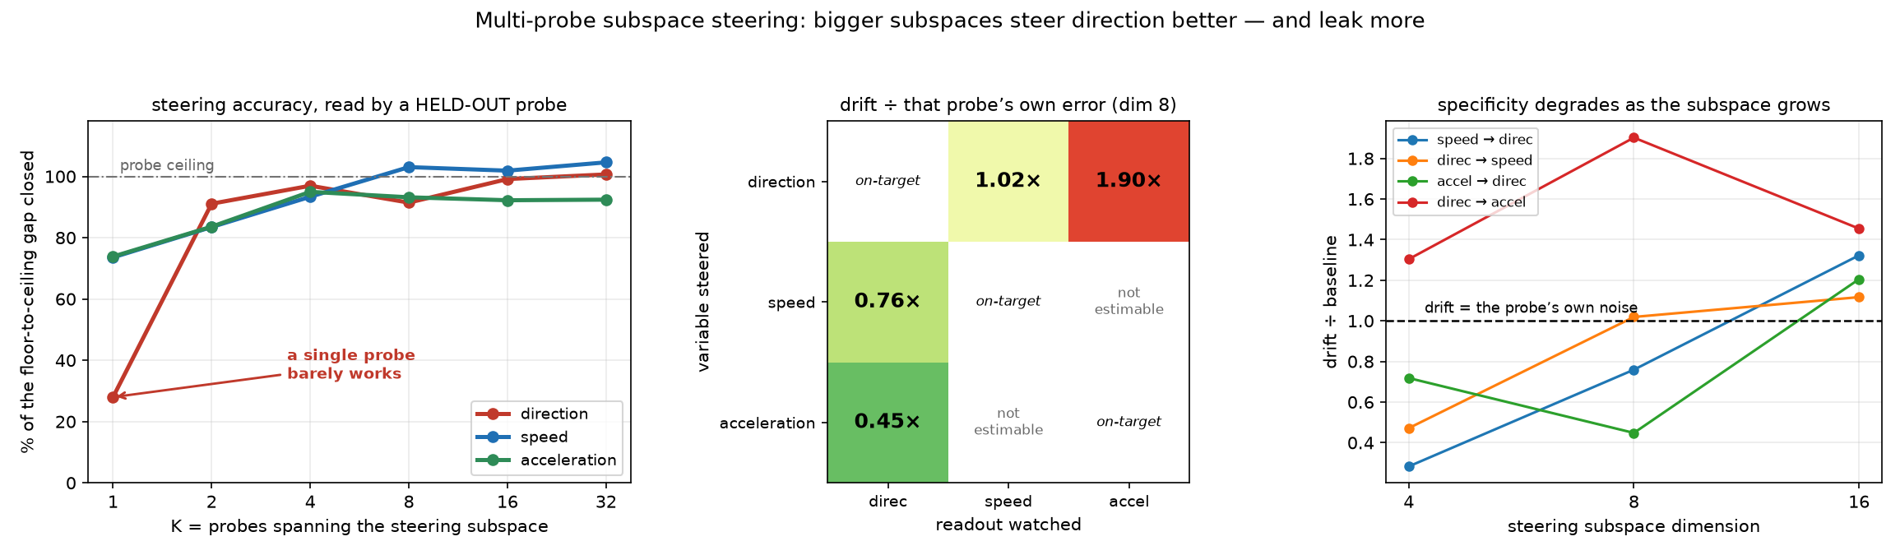
ACT 2 — THE LINEAR TRAP
F8 · F8b
Steering direction needs a coordinated subspace
Stack K probe readouts, solve for the coordinates that make them all read the target. Evaluated with a HELD-OUT probe — never one of the K that built the basis — on held-out label values.
DIRECTION, K = 1
DIRECTION, K = 4
EITHER SCALAR, K = 1
LEAKAGE AT DIM 16
28%
97%
74%
every cell
of the gap closed — barely works
a coordinated subspace works
one probe is enough
specificity is gone
V-JEPA 2 ViT-L/16-256 · frozen encoder · 4,572 clips
05
Notes:
This is the paper's steering experiment, and the evaluation protocol is the part worth spelling out.
THREE INDEPENDENT HELD-OUT AXES. The evaluation probe is never one of the K that built the steering subspace, and it is fitted on clips disjoint from all of them. The clips being steered carry target values never seen during fitting. Without the probe split, 'steering worked' would only mean the intervention satisfied the very equations it solved.
LEFT PANEL, the result. A single probe closes 28 percent of the floor-to-ceiling gap for direction but 74 percent for either scalar. Direction needs K of at least two and is essentially solved by K around four. That is the causal counterpart of slide 3: a 2-dimensional readout cannot be driven along a single direction.
MIDDLE AND RIGHT, the cost. To build a subspace big enough to steer the ring you capture other kinematics with it. By dimension 16 every cell in the matrix leaks. Dimension 4 to 8 is the usable operating point.
TWO CELLS ARE BLANK, and that is a finding about the data. Speed and acceleration are mutually exclusive in every supplied dataset — no clip has both non-zero — so the coupling v = v0 + a t that would make that leakage interesting has been designed out of the stimulus set.
If asked what the intervention actually solves: minimise the L2 norm of delta-x subject to the probes reading the target. That is the Moore-Penrose minimum-norm edit, verified against a direct pseudo-inverse to three times ten to the minus fourteen. Smallest EUCLIDEAN step — which is exactly the setup for Act 2.

Slide 6
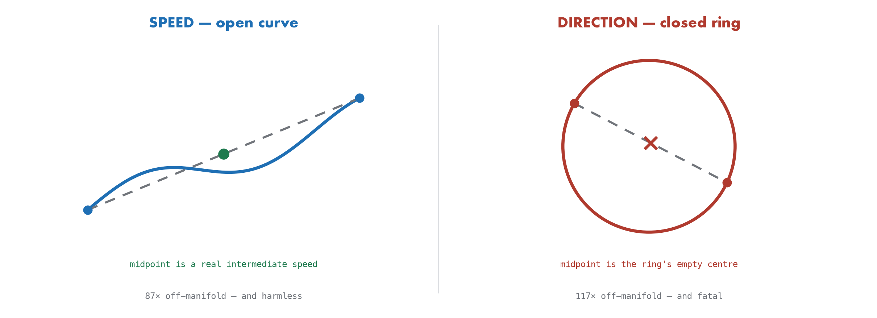
ACT 2 — THE LINEAR TRAP
F11 · F12
It is topology, not curvature
Endpoints are identical by construction, so the only difference between the two routes is the path taken. Both chords leave the data manifold by a similar margin. Only one of them breaks the model.
SPEED · ARCLENGTH ÷ CHORD
DIRECTION · ARCLENGTH ÷ CHORD
OFF-MANIFOLD, BOTH
BEHAVIOURAL PENALTY
4.68
6.59
80–120×
direction only
strongly curved too
similar curvature
in 100% of value pairs
speed is untouched
V-JEPA 2 ViT-L/16-256 · frozen encoder · 4,572 clips
06
Notes:
Wurgaft et al. warn that Euclidean steering goes off-manifold. Our data says that is NECESSARY BUT NOT SUFFICIENT.
The tempting explanation — direction is more curved — does not survive measurement. Speed's manifold is curved too, 4.68 against 6.59, and both chords sit 80 to 120 times off manifold in every pair we tested. Yet the behavioural penalty appears only for direction.
What separates them is TOPOLOGY. Speed's curve is open: the chord leaves it geometrically, but every point along it still decodes to a sensible intermediate speed. Direction's ring is closed, so a chord must cross the interior — a region that corresponds to no direction at all. Off-manifold only matters when the region you land in is semantically empty.

Slide 7
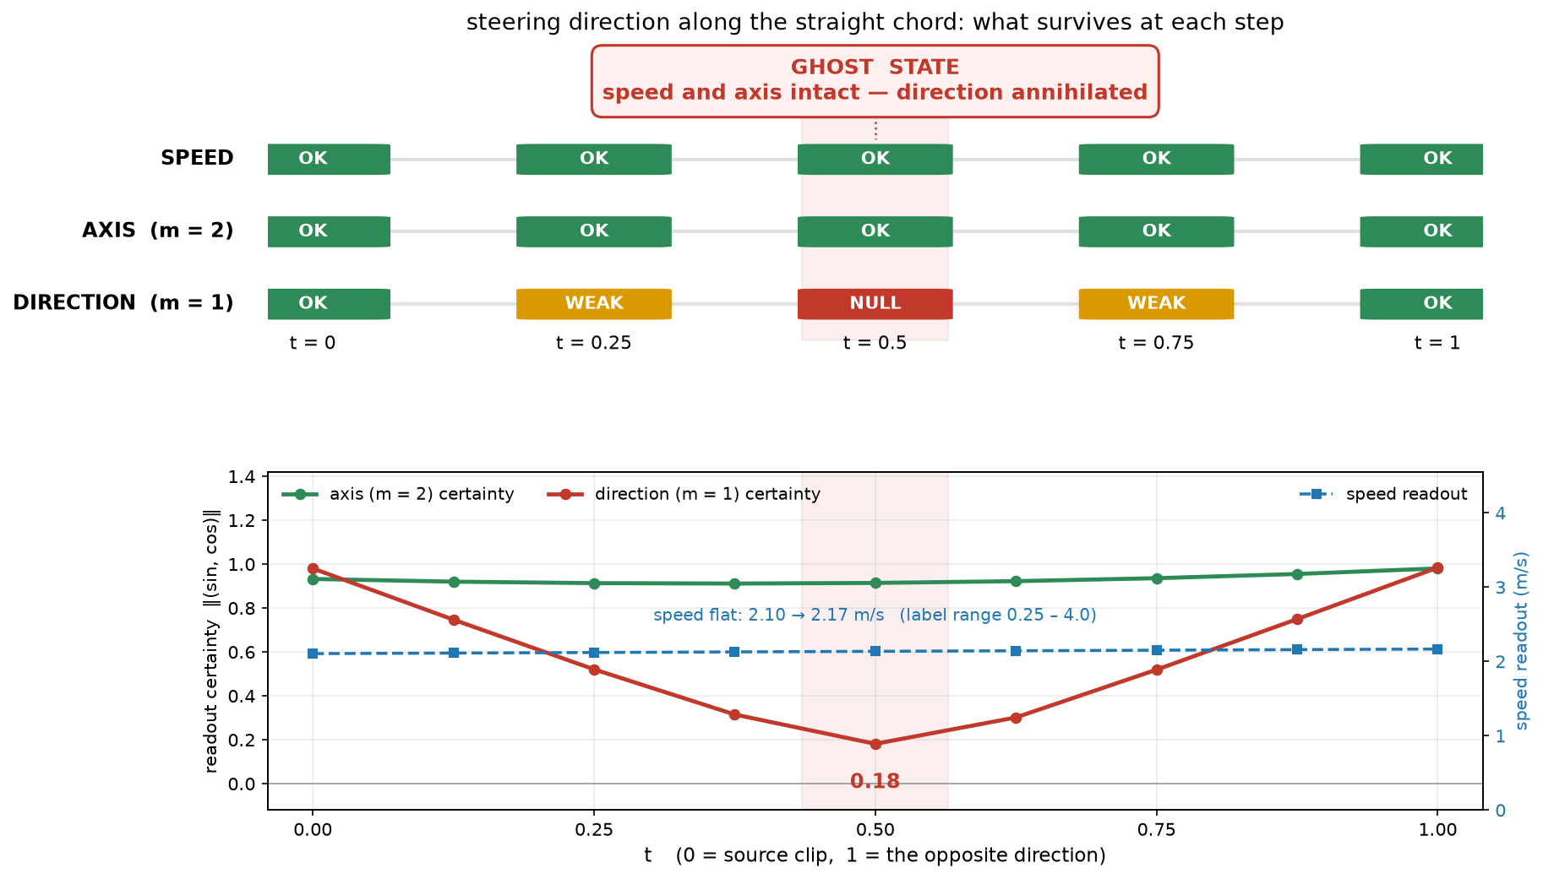
ACT 2 — THE LINEAR TRAP
F12b
A physically impossible state
Reading three probes at the midpoint of the linear direction chord. Run on the clips where theta and speed are decorrelated, so the speed probe is clean.
SPEED
AXIS, M = 2
DIRECTION, M = 1
2.10 → 2.17 m/s
5.9° error
certainty 0.18
untouched across the path
intact — chance is 45°
annihilated — chance is 0
V-JEPA 2 ViT-L/16-256 · frozen encoder · 4,572 clips
07
Notes:
You might expect the centre of the ring to be the stationary state: left plus right equals nothing. IT IS NOT. Speed survives completely, and so does the axis of motion. Only the direction bit is removed.
So the model is holding: an object moving along this specific line, at 2.1 metres per second, with no fact about which of the two ways it is going. No clip in the dataset can be in that state.
And it falls straight out of slide 4. m=1 is anti-symmetric under a 180-degree flip, so the two endpoints cancel exactly at the midpoint. m=2 is invariant, so the axis rides through untouched. That is also why the collapse bottoms out precisely at t = 0.5.
This is the concrete version of 'unnatural output': not noise, but a structured, physically impossible state.

Slide 8
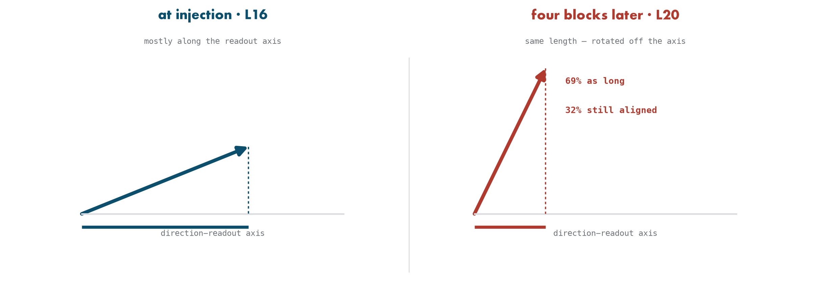
ACT 3 — MECHANISM AND FIX
F14
Attention rotates the edit out
Reading the residual stream at half-block resolution, with probes fitted per position on unmodified activations. The question is why the network undoes a Euclidean edit.
LAYERNORM RESCALING
PERTURBATION MAGNITUDE
READOUT-ALIGNED PART
ATTENTION SHARE
ruled out
69% kept
32% kept
77%
norm ratio 1.00 ± 0.005
it is not erased
decays 2.2× faster
of the total decay
V-JEPA 2 ViT-L/16-256 · frozen encoder · 4,572 clips
08
Notes:
Three candidates. LAYERNORM IS NOT THE ANSWER — token norms and channel standard deviations sit within half a percent of the control, and only 0.6% of the edit lies along the all-ones direction that LayerNorm deletes.
The substantive result is that THE EDIT IS NOT REMOVED, IT IS ROTATED. 69% of the perturbation survives four blocks, while the component that points along the direction readout keeps only 32%. The network turns the intervention into something that no longer means direction.
Splitting by half-block: ATTENTION ACCOUNTS FOR 77% of the decay, concentrated in blocks 17 and 18. So the MLP is NOT acting as an error-correcting projection back onto the data distribution — that hypothesis predicts the opposite split. A uniform edit is invisible to the token-relative computation attention actually does.

Slide 9
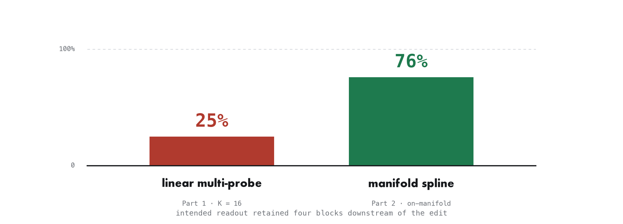
ACT 3 — MECHANISM AND FIX
F15 · F10
The on-manifold edit survives 3× better
Both methods steered to the same held-out targets, injected at layer 16, propagated through the same blocks, scored by alignment with the intended readout.
MULTI-PROBE
MANIFOLD SPLINE
IN FEATURE SPACE
FOUR BLOCKS LATER
25% retained
76% retained
multi-probe wins
manifold wins
alignment +1.33 → +0.33
alignment +1.03 → +0.78
5.32° vs 7.02°
the ordering flips
V-JEPA 2 ViT-L/16-256 · frozen encoder · 4,572 clips
09
Notes:
Fit a periodic cubic spline through the per-value centroids and steer ALONG the curve. At the layer of the intervention this method is WORSE — 7.02 degrees against 5.32. Four blocks later the ordering flips hard.
The reason is visible in the numbers. Multi-probe steering solves for probe readouts and OVERSHOOTS to do it — alignment 1.33, well past the unit norm of a natural representation. That excess is exactly what attention discards. The spline edit lands at 1.03 and is kept.
Most telling: the spline puts LESS of itself in the readout subspace at injection, 0.09 against 0.32, yet survives far better. It is not pushing harder along the probe direction — it is moving the representation the way the network's own geometry moves it.
CONTROL, IF CHALLENGED ON EDIT SIZE. The two edits differ in magnitude — 8.5 for multi-probe, 22.1 for the spline — so someone will ask whether the bigger edit simply survives better. Rescaling the multi-probe edit settles it, and the confound runs the OTHER way: retention FALLS as the Euclidean edit grows. Half size retains 31 percent, normal size 25, double 22, and at 2.6 times — matching the spline's norm exactly — 21 percent against the spline's 76. At matched magnitude the gap widens from three times to three point six.
The sharpest way to say it: give the Euclidean edit THREE TIMES the initial alignment, plus the same perturbation budget, and it still ends up BELOW the spline four blocks later — 0.686 against 0.783. What survives is not how hard you push. It is whether you push somewhere the network maintains.

Slide 10
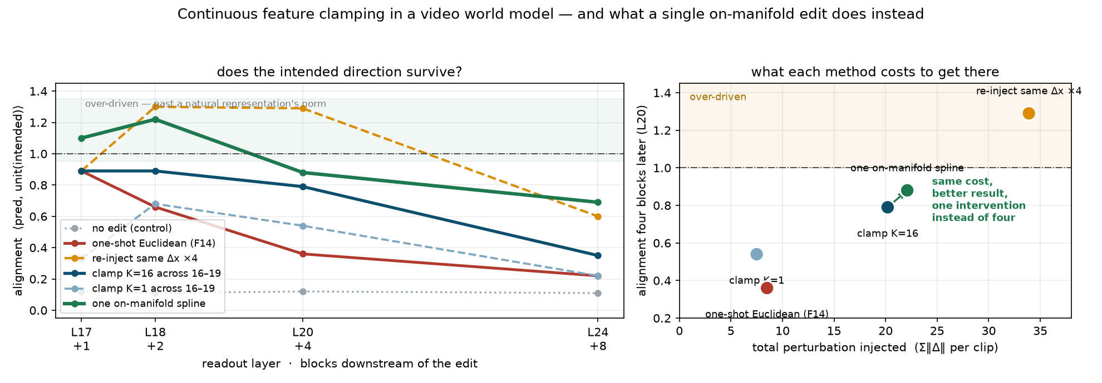
ACT 3 — MECHANISM AND FIX
F17
Or fight the rotation at every layer
The move from LLM interpretability: rather than asking one edit to survive, assert the feature again at every block. Anthropic clamp an SAE feature's activation during the forward pass to steer Claude 3 Sonnet (Templeton et al., Scaling Monosemanticity, 2024). Same idea, applied across blocks 16–19.
CLAMPING WORKS
RE-INJECTING IS NOT CLAMPING
CLAMP K=16
ONE SPLINE EDIT
+0.36 → +0.79
+1.30
4 interventions
1 intervention
at four blocks — more than doubles
over-driven, at 4× the cost
Σ‖Δ‖ = 20.2
Σ‖Δ‖ = 22.1, and +0.88
V-JEPA 2 ViT-L/16-256 · frozen encoder · 4,572 clips
10
Notes:
This is the direct parallel to LLM interpretability, and it is worth saying where it comes from. Anthropic's Scaling Monosemanticity work — Templeton and colleagues, 2024 — steers Claude 3 Sonnet by CLAMPING a sparse-autoencoder feature's activation during the forward pass, typically to something like ten times its maximum observed value. Golden Gate Claude is that technique.
BE PRECISE ABOUT THE ADAPTATION. They clamp at one layer across token positions through a generation. A video encoder has no generation to run along, so the natural analogue of 'keep asserting it as computation proceeds' is across BLOCKS. Same idea, different axis of repetition. It is an adaptation, not a replication.
THE RESULT: IT WORKS. At four blocks downstream, clamping more than doubles the retained effect over a one-shot edit — 0.79 against 0.36. Continuous feature clamping transfers from language models to a video world model without modification.
TWO CAVEATS First, re-injecting the same delta four times is NOT clamping — it accumulates, drives alignment to 1.30, past the norm of any natural representation, at four times the perturbation cost. True clamping applies the minimum-norm correction each block and is self-limiting. Second, the comparison has to match subspace size: clamping with a single probe reaches only 0.54, so a K=1 clamp against a K=16 one-shot edit would have made clamping look worse than it is.
AND THE PUNCHLINE. Clamping costs four interventions and a total perturbation of 20.2 to reach 0.79. The single on-manifold spline edit costs 22.1 — essentially the same — and reaches 0.88, and by eight blocks it leads two to one. So: you can fight the attention mechanism at every layer, or you can make one edit it does not want to undo.
One thing that cuts against intuition: the spline is the LARGER one-shot perturbation, 22.1 against 8.5. It is not about moving less. It is about moving along a direction the network maintains.

Slide 11
VERDICT
F8 · F12 · F15
Geometry is not descriptive. It is the control surface.
Both methods work. Which one you want depends on the shape of the variable — and on whether anything downstream has to read the result.
 | MULTI-PROBE SUBSPACE | SPLINE / MANIFOLD
endpoint accuracy | better — 5.32° | 7.02°
survives propagation | 25% at four blocks | 76%
intermediate states | collapse on closed geometry | stay valid
what it needs | K fitted probes | per-value centroids only
best for | monotone scalars | cyclic variables
main failure | minimises the wrong norm | undershoots the target
THE OBJECTIVE SOLVED
WHICH GIVES
AND THAT IS THE BUG
min ‖Δx‖₂
Δx = W⁺r
wrong norm
s.t. W(x+Δx) + b = y
verified to 3e−14
Euclidean, not geodesic
V-JEPA 2 ViT-L/16-256 · frozen encoder · 4,572 clips
11
Notes:
The multi-probe intervention solves: minimise the L2 norm of delta-x subject to W times (x plus delta-x) plus b equals y. That is the Moore-Penrose solution, which I verified against a direct pseudo-inverse to three times ten to the minus fourteen. It is the SMALLEST EUCLIDEAN STEP satisfying K linear constraints.
And Euclidean smallness is measured in the ambient activation space, which knows nothing about where the data lives. So the solution is free to cut across the manifold, and on a closed geometry the shortest chord runs through the empty centre. The failure is not a bug in the solver — it is what minimising the wrong norm buys you.
Where I would take this next: whether the 3x retention gap widens by the final layer, and whether any of it holds on real video, where the manifolds are not this clean. Happy to go wherever is most useful.

Slide 12
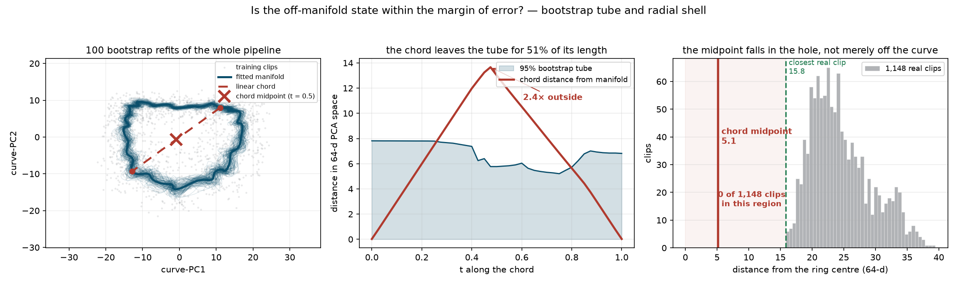
BACKUP — ONLY IF ASKED
BACKUP — NOT PRESENTED
F16
Is that state just within the margin of error?
100 bootstrap resamples of the training clips, each refitting PCA, centroids and spline. Every curve is mapped back to activation space and re-projected into one reference basis before comparison — otherwise you measure PCA basis churn, not fit uncertainty.
BOOTSTRAP TUBE
DISTANCE FROM CURVE
CLIPS NEARER THE CENTRE
Z-SCORE OF THAT RADIUS
2.4× outside
13.0 vs 17.2
0 of 1,148
−4.1
51% of the chord is out
THIS TEST FAILS — see notes
the decisive result
0.32× the closest clip
V-JEPA 2 ViT-L/16-256 · frozen encoder · 4,572 clips
12
Notes:
Whether the off-manifold state is a noisy variant of a real one.
THREE TESTS, AND THE INTUITIVE ONE FAILS.
Test 1, the bootstrap tube: the chord sits 2.4 times outside the 95% tube at its worst point, and 51% of its length is outside. Real, but weaker than it sounds — the tube is about 38% of the ring radius, so 1,148 clips do not pin the manifold that tightly.
Test 2, distance from the curve: THIS ONE FAILS. A real clip sits 17.2 from the centroid curve on average. The chord midpoint sits 13.0 — closer than 77% of real clips. If someone argues 'it is only 13 out and real data is 17 out', they are CORRECT. Do not claim distance-from-curve proves anything.
Test 3, the radial shell, is decisive. In 64 dimensions the data occupies a shell, not a ball. Real clips sit at radius 15.8 minimum, 23.7 median. The midpoint sits at 5.1. ZERO of 1,148 clips are that close to the centre — z-score minus 4.1, and 0.32 times the radius of the closest real clip.
So: the midpoint occupies a region no training clip occupies. Lead with 0-of-1148, not the tube.
General lesson worth one sentence: in high dimensions an off-distribution point is often CLOSER to the mean than real data is, not farther. Distance-to-the-fit is the wrong diagnostic; occupancy of the region is the right one.

