Slide 1
Adversarial Search and Game Playing
Russell and Norvig: Chapter 6
CS-801 (Artificial Intelligence)

Slide 2
Topics
Game playing
Game trees
  Minimax
  Alpha-beta pruning
Examples

Slide 3
Why study games
Clear criteria for success
Offer an opportunity to study problems involving {hostile, adversarial, competing} agents.
Historical reasons
Fun
Interesting, hard problems

Slide 4
Types of games
deterministic
chance
perfect information
imperfect information

Slide 5
Types of games
deterministic
chance
chess, checkers, go, othello | backgammon, monopoly
Battleship | bridge, poker, scrabble
perfect information
imperfect information

Slide 6
Typical case
2-person game
Players alternate moves
Zero-sum: one player’s loss is the other’s gain
Perfect information: both players have access to complete information about the state of the game. No information is hidden from either player.
No chance (e.g., using dice) involved
Examples: Tic-Tac-Toe, Checkers, Chess, Go, Nim, Othello
Not: Bridge, Solitaire, Backgammon, ...

Slide 7
Nim
Game: start with a punch of piles of tokens
At each turn, a player may pick up one or two tokens
The player who picks up the last token LOSES

Slide 8
NIM(2,2)
Try the following case:
pile 1
pile 2

Slide 9
Perfect Two-Player Game
Two players MAX and MIN take turn (with
MAX playing first)
State space
Initial state
Successor function
Terminal test
Score function, that tells whether a terminal
state is a win (for MAX), a loss, or a draw
Perfect knowledge of states, no uncertainty
in successor function
~Utility

Slide 10
How to play a game
A way to play such a game is to:
  Consider all the legal moves you can make
  Compute the new position resulting from each move
  Evaluate each resulting position and determine which is best
  Make that move
  Wait for your opponent to move and repeat
Key problems are:
  Representing the “board”
  Generating all legal next boards
  Evaluating a position

Slide 11
Optimal Play
2
2
1
2
1
2
7
1
8
2
7
1
8
2
7
1
8
This is the optimal play
2
2
1
MAX
MIN
2
7
1
8

Slide 12
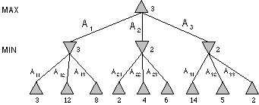
Minimax Tree
MAX node
MIN node
value computed
by minimax
f value

Slide 13
Minimax procedure
Apply the evaluation function at each of the leaf nodes
“Back up” values for each of the non-leaf nodes until a value is computed for the root node
  At MIN nodes, the backed-up value is the minimum of the values associated with its children.
  At MAX nodes, the backed up value is the maximum of the values associated with its children.
Pick the operator associated with the child node whose backed-up value determined the value at the root

Slide 14
Minimax Example
0
5
-3
3
3
-3
0
2
-2
3
5
2
5
-5
0
1
5
1
-3
0
-5
5
-3
3
2

Slide 15
But in general the search tree is
too big to make it possible to reach
the terminal states!
Examples:
Checkers: ~10⁴⁰ nodes
Chess: ~10¹²⁰ nodes

Slide 16
Evaluation function
Evaluation function or static evaluator is used to evaluate the “goodness” of a game position.
  Contrast with heuristic search where the evaluation function was a non-negative estimate of the cost from the start node to a goal and passing through the given node
The zero-sum assumption allows us to use a single evaluation function to describe the goodness of a board with respect to both players.
  f(n) >> 0: position n good for me and bad for you
  f(n) << 0: position n bad for me and good for you
  f(n) near 0: position n is a neutral position
  f(n) = +infinity: win for me
  f(n) = -infinity: win for you

Slide 17
Evaluation function examples
Example of an evaluation function for Tic-Tac-Toe:
  f(n) = [# of 3-lengths open for me] - [# of 3-lengths open for you]
  where a 3-length is a complete row, column, or diagonal
Alan Turing’s function for chess
  f(n) = w(n)/b(n) where w(n) = sum of the point value of white’s pieces and b(n) = sum of black’s
Most evaluation functions are specified as a weighted sum of position features:
  f(n) = w₁*feat₁(n) + w₂*feat₂(n) + ... + w_{n}*feat_{k}(n)
Example features for chess are piece count, piece placement, squares controlled, etc.
Deep Blue has about 6000 features in its evaluation function

Slide 18
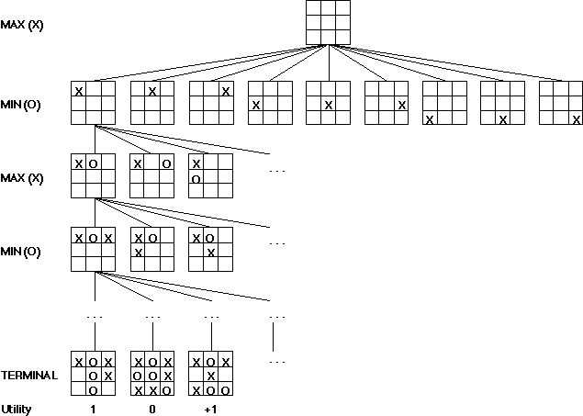
Game trees
Problem spaces for typical games are represented as trees
Root node represents the current
board configuration; player must decide the best single move to make next
Static evaluator function rates a board position. f(board) = real number with
f>0 “white” (me), f<0 for black (you)
Arcs represent the possible legal moves for a player
If it is my turn to move, then the root is labeled a "MAX" node; otherwise it is labeled a "MIN" node, indicating my opponent's turn.
Each level of the tree has nodes that are all MAX or all MIN; nodes at level i are of the opposite kind from those at level i+1

Slide 19
Minimax procedure
Create start node as a MAX node with current board configuration
Expand nodes down to some depth (a.k.a. ply) of lookahead in the game
Apply the evaluation function at each of the leaf nodes
“Back up” values for each of the non-leaf nodes until a value is computed for the root node
  At MIN nodes, the backed-up value is the minimum of the values associated with its children.
  At MAX nodes, the backed up value is the maximum of the values associated with its children.
Pick the operator associated with the child node whose backed-up value determined the value at the root

Slide 20
Partial Game Tree for Tic-Tac-Toe
f(n) = +1 if the position is a win for X.
f(n) = -1 if the position is a win for O.
f(n) = 0 if the position is a draw.

Slide 21
Issues
Choice of the horizon
Size of memory needed
Number of nodes examined

Slide 22
Adaptive Search
Wait for quiescence - hot spots
Horizon effect
Extend singular nodes /Secondary search
Note that the horizon may not then be the same on every path of the tree

Slide 23
Issues
Choice of the horizon
Size of memory needed
Number of nodes examined

Slide 24
Alpha-Beta Procedure
Generate the game tree to depth h in depth-first manner
Back-up estimates (alpha and beta values) of the evaluation functions whenever possible
Prune branches that cannot lead to changing the final decision

Slide 25
Alpha-beta pruning
We can improve on the performance of the minimax algorithm through alpha-beta pruning
Basic idea: “If you have an idea that is surely bad, don't take the time to see how truly awful it is.” -- Pat Winston
MAX
>=2
We don’t need to compute the value at this node.
No matter what it is, it can’t affect the value of the root node.
MIN
=2
<=1
MAX
2
7
1
?

Slide 26
Alpha-beta pruning
Traverse the search tree in depth-first order
At each MAX node n, alpha(n) = maximum value found so far
At each MIN node n, beta(n) = minimum value found so far
  Note: The alpha values start at -infinity and only increase, while beta values start at +infinity and only decrease.
Beta cutoff: Given a MAX node n, cut off the search below n (i.e., don’t generate or examine any more of n’s children) if alpha(n) >= beta(i) for some MIN node ancestor i of n.
Alpha cutoff: stop searching below MIN node n if beta(n) <= alpha(i) for some MAX node ancestor i of n.

Slide 27
Alpha-beta example
MAX
3
MIN
3
2 - PRUNE
14
5
2
3
12
8
2
14
5
2

Slide 28
Alpha-Beta Procedure
The alpha of a MAX node is a lower bound on the backed-up value
The beta of a MIN node is an upper bound on the backed-up value
Update the alpha/beta of the parent of a node N when all search below N has been completed or discontinued

Slide 29
Alpha-Beta Procedure
The alpha of a MAX node is a lower bound on the backed-up value
The beta of a MIN node is a higher bound on the backed-up value
Update the alpha/beta of the parent of a node N when all search below N has been completed or discontinued
Discontinue the search below a MAX node N if its alpha is ≥ beta of a MIN ancestor of N
Discontinue the search below a MIN node N if its beta is ≤ alpha of a MAX ancestor of N

Slide 30
Alpha-Beta Example
0
5
-3
3
3
-3
0
2
-2
3
5
2
5
-5
0
1
5
1
-3
0
-5
5
-3
3
2

Slide 31
Alpha-Beta Example
1
0
1
0
2
1
2
0
2
1
-5
2
0
3
2
1
-5
2
0
-3
3
2
1
-3
-5
2
0
5
-3
3
3
-3
0
2
-2
3
5
2
5
-5
0
1
5
1
-3
0
-5
5
-3
3
2

Slide 32
Effectiveness of alpha-beta
Alpha-beta is guaranteed to compute the same value for the root node as computed by minimax, with less or equal computation
Worst case: no pruning, examining b^d leaf nodes, where each node has b children and a d-ply search is performed
Best case: examine only (b)^(d/2) leaf nodes.
  Result is you can search twice as deep as minimax!
Best case is when each player’s best move is the first alternative generated
In Deep Blue, they found empirically that alpha-beta pruning meant that the average branching factor at each node was about 6 instead of about 35!

Slide 33
Some examples….

Slide 34
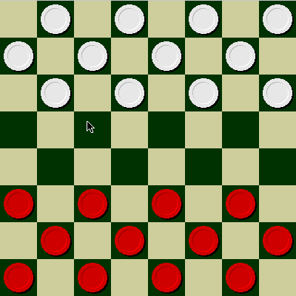
Checkers
© Jonathan Schaeffer

Slide 35
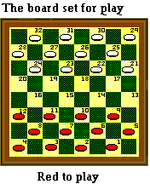
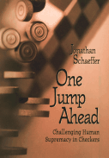
Chinook
Chinook is the World Man-Machine Checkers Champion, developed by researchers at the University of Alberta.
It earned this title by competing in human tournaments, winning the right to play for the (human) world championship, and eventually defeating the best players in the world.

Slide 36
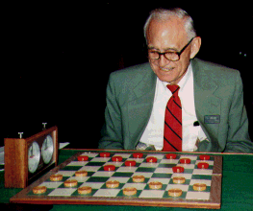
Chinook vs. Tinsley
Name: Marion Tinsley
Profession: Teach
mathematics
Hobby: Checkers
Record: Over 42 years
loses only 3 (!)
games of checkers
© Jonathan Schaeffer

Slide 37
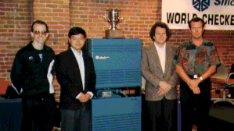
Chinook
First computer to win human world championship!
Visit http://www.cs.ualberta.ca/~chinook/ to play a
version of Chinook over the Internet.

Slide 38
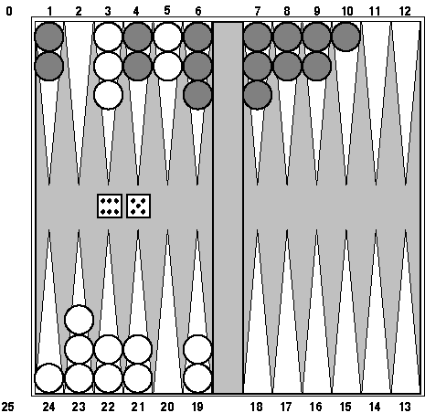
Backgammon
branching factor
several hundred
TD-Gammon v1 –
1-step lookahead, learns to play games
against itself
TD-Gammon v2.1 –
2-ply search, does
well against world champions
TD-Gammon has changed the way experts play backgammon.

Slide 39
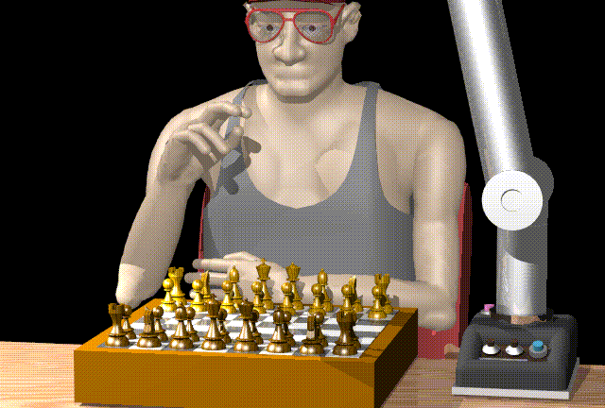
Chess

Slide 40
Man vs. Machine
Kasparov
5’10”
176 lbs
34 years
50 billion neurons
2 pos/sec
Extensive
Electrical/chemical
Enormous
Name
Height
Weight
Age
Computers
Speed
Knowledge
Power Source
Ego
Deep Blue
6’ 5”
2,400 lbs
4 years
512 processors
200,000,000 pos/sec
Primitive
Electrical
None
© Jonathan Schaeffer

Slide 41
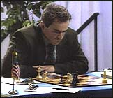
Chess
Name: Garry Kasparov
Title: World Chess
Champion
Crime: Valued greed
over common sense
© Jonathan Schaeffer

Slide 42
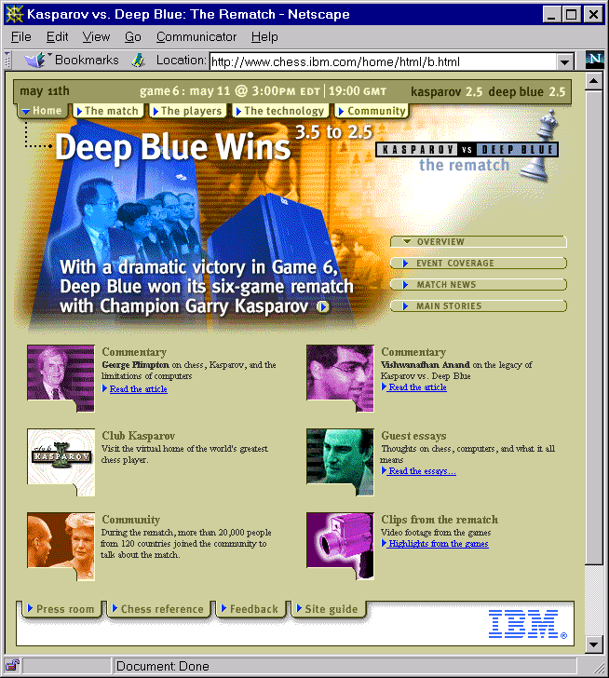

Slide 43
Several versions of the story…
http://www.research.ibm.com/deepblue/home/may11/story_1.html
http://www.columbia.edu/cu/moment/041796/deepblue.html
http://www.wired.com/wired/archive/9.10/chess.html?pg=2&topic=&topic_set=
http://www.byte.com/art/9707/sec6/art6.htm

Slide 44
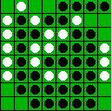
Reversi/Othello
© Jonathan Schaeffer

Slide 45
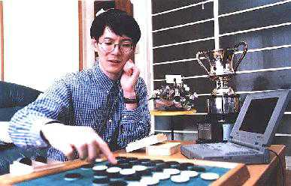
Othello
Name: Takeshi
Murakami
Title: World
Othello Champion
Crime: Man crushed
by machine
© Jonathan Schaeffer

Slide 46
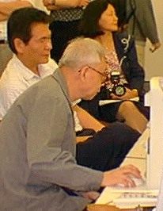
Go: On the One Side
Name: Chen Zhixing
Author: Handtalk (Goemate)
Profession: Retired
Computer skills: self-
taught assembly
language programmer
Accomplishments:
dominated computer go
for 4 years.
© Jonathan Schaeffer

Slide 47
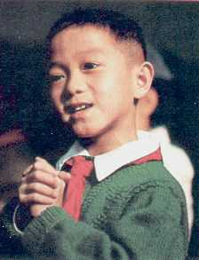
Go: And on the Other
Gave Handtalk a 9 stone
handicap and still easily
beat the program,
thereby winning $15,000
© Jonathan Schaeffer

Slide 48
Perspective on Games: Pro
“Saying Deep Blue doesn’t really think about chess is like saying an airplane doesn't really fly because it doesn't flap its wings”
Drew McDermott
© Jonathan Schaeffer

Slide 49
Perspective on Games: Con
“Chess is the Drosophila of artificial intelligence. However, computer chess has developed much as genetics might have if the geneticists had concentrated their efforts starting in 1910 on breeding racing Drosophila. We would have some science, but mainly we would have very fast fruit flies.”
John McCarthy
© Jonathan Schaeffer

Slide 50
Other Games
Multi-player games, with alliances or
not
Games with randomness in successor
function (e.g., rolling a dice)
Incompletely known states (e.g., card
games)

Slide 51
Summary
Two-players game as a domain where action models are uncertain
Optimal decision in the worst case
Game tree
Evaluation function / backed-up value
Minimax procedure
Alpha-beta procedure

Slide 52
Additional Resources
Game AI Page

Slide 53
Alpha-Beta Example
0
5
-3
3
3
-3
0
2
-2
3
5
2
5
-5
0
1
5
1
-3
0
-5
5
-3
3
2

Slide 54
Alpha-Beta Example
0
0
5
-3
3
3
-3
0
2
-2
3
5
2
5
-5
0
1
5
1
-3
0
-5
5
-3
3
2

Slide 55
Alpha-Beta Example
0
0
0
5
-3
3
3
-3
0
2
-2
3
5
2
5
-5
0
1
5
1
-3
0
-5
5
-3
3
2

Slide 56
Alpha-Beta Example
0
0
-3
0
5
-3
3
3
-3
0
2
-2
3
5
2
5
-5
0
1
5
1
-3
0
-5
5
-3
3
2

Slide 57
Alpha-Beta Example
0
0
-3
0
5
-3
3
3
-3
0
2
-2
3
5
2
5
-5
0
1
5
1
-3
0
-5
5
-3
3
2

Slide 58
Alpha-Beta Example
0
0
0
-3
0
5
-3
3
3
-3
0
2
-2
3
5
2
5
-5
0
1
5
1
-3
0
-5
5
-3
3
2

Slide 59
Alpha-Beta Example
0
0
3
0
-3
3
0
5
-3
3
3
-3
0
2
-2
3
5
2
5
-5
0
1
5
1
-3
0
-5
5
-3
3
2

Slide 60
Alpha-Beta Example
0
0
3
0
-3
3
0
5
-3
3
3
-3
0
2
-2
3
5
2
5
-5
0
1
5
1
-3
0
-5
5
-3
3
2

Slide 61
Alpha-Beta Example
0
0
0
0
3
0
-3
3
0
5
-3
3
3
-3
0
2
-2
3
5
2
5
-5
0
1
5
1
-3
0
-5
5
-3
3
2

Slide 62
Alpha-Beta Example
0
0
0
0
3
0
-3
3
5
0
5
-3
3
3
-3
0
2
-2
3
5
2
5
-5
0
1
5
1
-3
0
-5
5
-3
3
2

Slide 63
Alpha-Beta Example
0
0
0
0
3
2
0
-3
3
2
0
5
-3
3
3
-3
0
2
-2
3
5
2
5
-5
0
1
5
1
-3
0
-5
5
-3
3
2

Slide 64
Alpha-Beta Example
0
0
0
0
3
2
0
-3
3
2
0
5
-3
3
3
-3
0
2
-2
3
5
2
5
-5
0
1
5
1
-3
0
-5
5
-3
3
2

Slide 65
Alpha-Beta Example
0
0
2
0
2
0
3
2
0
-3
3
2
0
5
-3
3
3
-3
0
2
-2
3
5
2
5
-5
0
1
5
1
-3
0
-5
5
-3
3
2

Slide 66
Alpha-Beta Example
0
0
2
0
2
0
3
2
0
-3
3
2
0
5
-3
3
3
-3
0
2
-2
3
5
2
5
-5
0
1
5
1
-3
0
-5
5
-3
3
2

Slide 67
Alpha-Beta Example
0
0
0
2
0
2
0
3
2
0
-3
3
2
0
5
-3
3
3
-3
0
2
-2
3
5
2
5
-5
0
1
5
1
-3
0
-5
5
-3
3
2

Slide 68
Alpha-Beta Example
0
0
0
2
0
2
0
3
2
0
-3
3
2
5
0
5
-3
3
3
-3
0
2
-2
3
5
2
5
-5
0
1
5
1
-3
0
-5
5
-3
3
2

Slide 69
Alpha-Beta Example
0
0
0
2
0
2
0
3
2
1
0
-3
3
2
1
0
5
-3
3
3
-3
0
2
-2
3
5
2
5
-5
0
1
5
1
-3
0
-5
5
-3
3
2

Slide 70
Alpha-Beta Example
0
0
0
2
0
2
0
3
2
1
0
-3
3
2
1
-3
0
5
-3
3
3
-3
0
2
-2
3
5
2
5
-5
0
1
5
1
-3
0
-5
5
-3
3
2

Slide 71
Alpha-Beta Example
0
0
0
2
0
2
0
3
2
1
0
-3
3
2
1
-3
0
5
-3
3
3
-3
0
2
-2
3
5
2
5
-5
0
1
5
1
-3
0
-5
5
-3
3
2

Slide 72
Alpha-Beta Example
0
0
0
2
1
0
2
1
0
3
2
1
0
-3
3
2
1
-3
0
5
-3
3
3
-3
0
2
-2
3
5
2
5
-5
0
1
5
1
-3
0
-5
5
-3
3
2

Slide 73
Alpha-Beta Example
0
0
0
2
1
0
2
1
0
3
2
1
0
-3
3
2
1
-3
-5
0
5
-3
3
3
-3
0
2
-2
3
5
2
5
-5
0
1
5
1
-3
0
-5
5
-3
3
2

Slide 74
Alpha-Beta Example
0
0
0
2
1
0
2
1
0
3
2
1
0
-3
3
2
1
-3
-5
0
5
-3
3
3
-3
0
2
-2
3
5
2
5
-5
0
1
5
1
-3
0
-5
5
-3
3
2

Slide 75
Alpha-Beta Example
0
0
0
2
1
0
2
1
-5
0
3
2
1
-5
0
-3
3
2
1
-3
-5
0
5
-3
3
3
-3
0
2
-2
3
5
2
5
-5
0
1
5
1
-3
0
-5
5
-3
3
2

Slide 76
Alpha-Beta Example
1
0
0
2
1
0
2
1
-5
0
3
2
1
-5
0
-3
3
2
1
-3
-5
0
5
-3
3
3
-3
0
2
-2
3
5
2
5
-5
0
1
5
1
-3
0
-5
5
-3
3
2

Slide 77
Alpha-Beta Example
1
0
1
0
2
1
0
2
1
-5
0
3
2
1
-5
0
-3
3
2
1
-3
-5
0
5
-3
3
3
-3
0
2
-2
3
5
2
5
-5
0
1
5
1
-3
0
-5
5
-3
3
2

Slide 78
Alpha-Beta Example
1
0
1
0
2
1
2
0
2
1
-5
2
0
3
2
1
-5
2
0
-3
3
2
1
-3
-5
2
0
5
-3
3
3
-3
0
2
-2
3
5
2
5
-5
0
1
5
1
-3
0
-5
5
-3
3
2

Slide 79
Alpha-Beta Example
1
0
1
0
2
1
2
0
2
1
-5
2
0
3
2
1
-5
2
0
-3
3
2
1
-3
-5
2
0
5
-3
3
3
-3
0
2
-2
3
5
2
5
-5
0
1
5
1
-3
0
-5
5
-3
3
2

Slide 80
How Much Do We Gain?
1
Size of tree = O(b^{h})
In the worst case all
nodes must be examined
In the best case, only
O(b^{h/2}) nodes need to
be examined
0
1
0
2
1
2
0
2
1
-5
2
0
3
2
1
-5
2
Exercise: In which order should the
node be examined in order to achieve
the best gain?
0
-3
3
2
1
-3
-5
2
0
5
-3
3
3
-3
0
2
-2
3
5
2
5
-5
0
1
5
1
-3
0
-5
5
-3
3
2

Slide 81
The Game
Rules:
Red goes first
On their turn, a player must move their piece
They must move to a neighboring square, or if their opponent is adjacent to them, with a blank on the far side, they can hop over them
The player that makes it to the far side first wins.

Slide 82
Draw the game tree
Rules:
Red goes first
On their turn, a player must move their piece
They must move to a neighboring square, or if their opponent is adjacent to them, with a blank on the far side, they can hop over them
The player that makes it to the far side first wins.

Slide 83
Try this for your Game Tree
Rules:
Red goes first
On their turn, a player must move their piece
They must move to a neighboring square, or if their opponent is adjacent to them, with a blank on the far side, they can hop over them
The player that makes it to the far side first wins.

