Slide 1


Smart Analytics –AI for IT Ops
Applying AI for effective IT Operations
Oct 2023

Slide 2
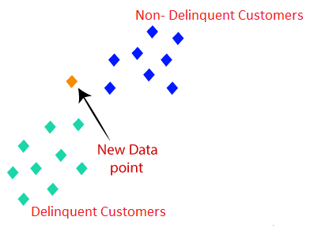


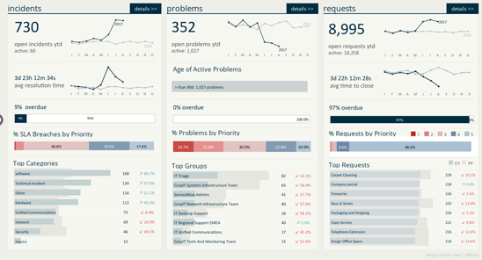

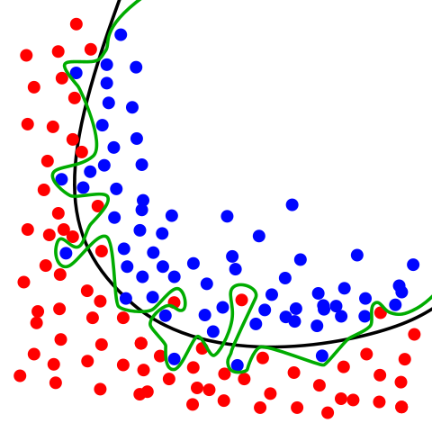

JIRA AUTOMATION ARCHITECTURE DIAGRAM
AI Ops GENAI /AGENTIC
DEVELOPMENT
Feature Engineering
Feature Extraction
EDA
Shared Folder
Data ingestion
NLP,
Similarity Classification
DB
Serialized Python Model
MONITORING AND REMODELING
JIRA
Landing Area
Development and Deployment
Model Serving
Automated Case handling
Reassignment tracking
Issue Theme Detection
Sentiment Analysis
Issue Resolution
Ticket Management
Voice of End-User
Ticket Classification
Ticket Resolution Prediction
Content Recommendation

Slide 3
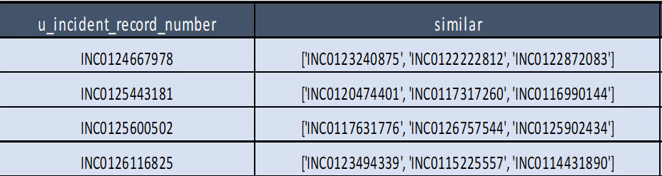
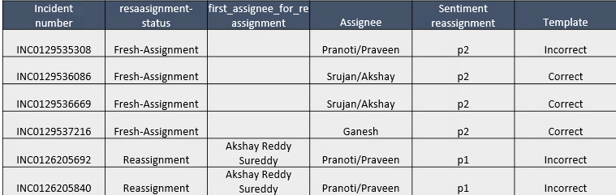
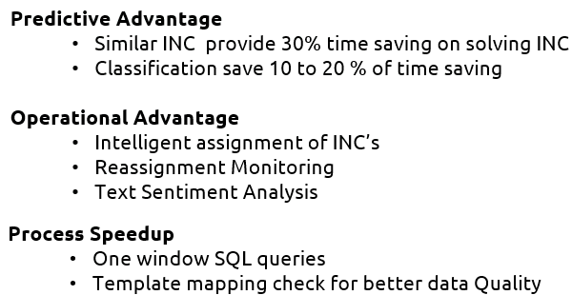
Smart Analytics Output

