Slide 1

GLA UNIVERSITY, MATHURA
DEPARTMENT OF COMPUTER SCIENCE AND ENGINEERING
SESSION 2023-2024
Major Project Presentation
“The Impact of Sentiment Analysis on Social Media to assess Customer Satisfaction”
Submitted by:
Kshitij Varshney (201500356)
Vishal Dixit (201500792)
Raman Gupta (201500558 )
Submitted To:
Dr. Zubair Ashraf

Slide 2
TABLE OF CONTENTS
S.No. | Title
1 | Introduction: What Is Sentiment Analysis?
2 | Motivation
3 | Aim and Objective
4 | Flow Chart
5 | Algorithms and Methods: Feature Extraction, Machine Learning Models
6 | Conclusion
7 | References

Slide 3
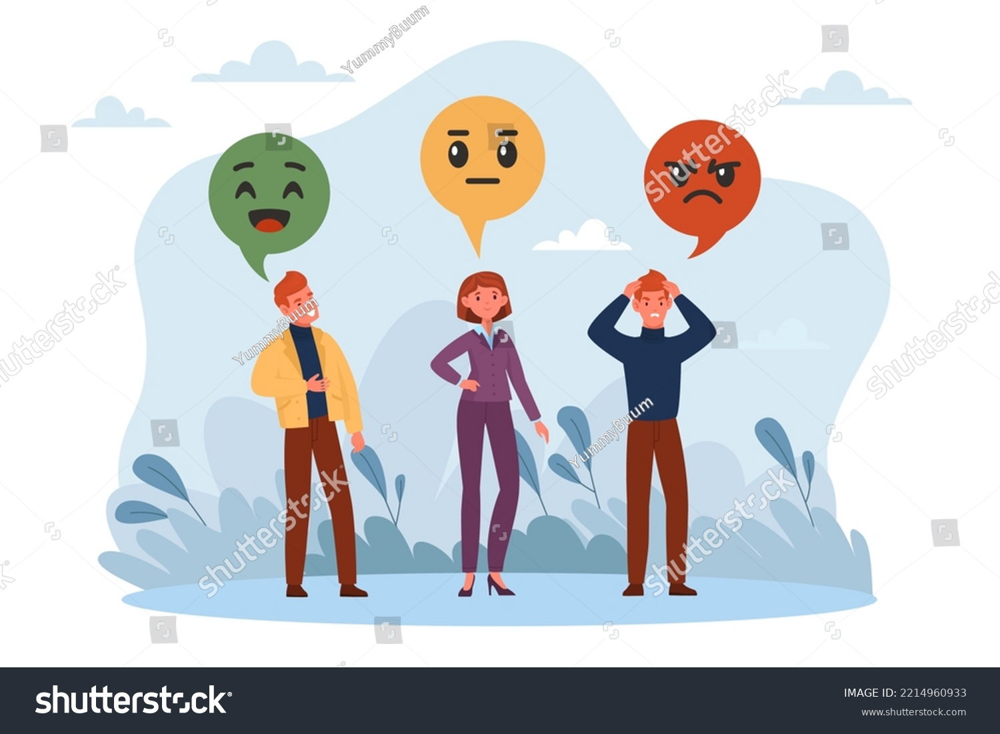
Introduction: What Is Sentiment Analysis?
Sentiment analysis or opinion mining is useful for review of movies, products, customer services, opinion about any event etc. This helps us to decide whether specific item or service is good/bad or preferred or not preferred. It is also useful to identify opinions of people about any event or persons and also finds polarity of text whether positive, negative or neutral. Sentiment analysis is a type of text classification which can classify text into different sentiments.

Slide 4
MOTIVATION
It helps you understand your audience
You can gather actionable data
You can meet customers where they are
You can get meaningful insights about your brand messaging
AIM AND OBJECTIVE:-
Aim: To analyze sentiments of customers or general public about a product and provide valuable feedback to companies for maximizing profit and increasing customer satisfaction.
Objective: The objective of sentiment analysis is to accurately extract people's opinions from a large number of unstructured review texts and classifying them into sentiment classes, i.e., positive, negative, or neutral. Sometimes “highly positive” and “highly negative” are also considered.

Slide 5
Flow Chart
Sentiment Analysis has pulled in significantly more consideration from analysts in late years. As web-based shopping is getting to be typical, more item data and item audits are posted on the Internet. Since clients can't see and feel the items straightforwardly, item surveys are turning into a basic wellspring of subjective data.
Text To be Processed
Data preprocessing
Data Visualization
Evaluation metrics used
Machine Learning Models
Feature Extraction

Slide 6
Text To be Processed
Formally, given a training sample of tweets and labels, where label ‘1’ denotes the tweet is racist/sexist and label ‘0’ denotes the tweet is not racist/sexist, our objective is to predict the labels on the given test dataset.
id : The id associated with the tweets in the given dataset.
tweets : The tweets collected from various sources and having either positive or negative sentiments associated with it.
label : A tweet with label ‘0’ is of positive sentiment while a tweet with label ‘1’ is of negative sentiment.

Slide 7
Data Pre-processing
Removing Twitter Handles( @user )
Removing punctuation, numbers, special characters
Removing short words
Tokenization
Stemming

Slide 8
Data Visualization
One of the popular visualization techniques is Word Cloud and other is Bar Plots
Word Cloud:-
A word cloud (or tag cloud ) is a word visualization that displays the most used words in a text from small to large, according to how often each appears.
They give a glance into the most important keywords in news articles, social media posts, and customer reviews, among other text.
Bar Plots:-
- For Positive Tweets in the dataset
- Counting the frequency of the words having Positive Sentiment
- For Negative Tweets in the dataset
- Counting the frequency of the words having Negative Sentiment

Slide 9

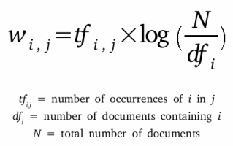

Feature Extraction
Bag-of-Words Features:- Bag of Words is a method to extract features from text documents. These features can be used for training machine learning algorithms. It creates a vocabulary of all the unique words occurring in all the documents in the training set.
TF-IDF:- TF-IDF stands for Term Frequency-Inverse Document Frequency, and the TF-IDF weight is a weight often used in information retrieval and text mining. This weight is a statistical measure used to evaluate how important a word is to a document in a collection or corpus. The importance increases proportionally to the number of times a word appears in the document but is offset by the frequency of the word in the corpus.

Slide 10
Machine Learning Models
There are a number of techniques and complex algorithms used to command and train machines to perform sentiment analysis. There are pros and cons to each. But, used together, they can provide exceptional results. Below are some of the most used algorithms.
Logistic Regression : Logistic regression estimates the probability of an event occurring, such as voted or didn’t vote, based on a given dataset of independent variables.
XGBoost : When it comes to a superfast machine learning algorithm that works on tree-based models and tries to reach the best in class accuracy by optimally using computational resources.
Decision Trees : It is a tree-structured classifier, where internal nodes represent the features of a dataset, branches represent the decision rules and each leaf node represents the outcome. It is a graphical representation for getting all the possible solutions to a problem/decision based on given conditions.

Slide 11
Evaluation Metrics Used
Whenever we build Machine Learning models, we need some form of metric to measure the goodness of the model. Bear in mind that the “goodness” of the model could have multiple interpretations, but generally when we speak of it in a Machine Learning context we are talking of the measure of a model's performance on new instances that weren’t a part of the training data.
Different Types of Evaluation Metrics
Accuracy
Precision
Recall
F1 Score

Slide 12
Conclusion
Effective Feedback
Sentiment analysis provides businesses with valuable feedback that can be used to improve product development and customer satisfaction.
Improved Communication
Competitive Advantage
Using sentiment analysis, businesses can respond more effectively to customer feedback, leading to improved communication and a better customer experience.
Sentiment analysis provides businesses with a significant competitive advantage by helping them identify key issues affecting customer satisfaction and respond more effectively to feedback.

Slide 13
References
- https://ieeexplore.ieee.org/document/6691379
- M. Govindarajan, Sentiment Analysis of Movie Reviews Using Hybrid Method of Naive Bayes and Genetic Algorithm,
- Journal of Advanced Computer Research (ISSN (print): 2249-7277 ISSN (online): 2277- 7970), Volume-3 Number-4 Issue-13
- https://ieeexplore.ieee.org/document/6691379
- Sangeeta, Twitter Data Analysis Using FLUME & HIVE on Hadoop Framework, Special Issue on International Journal of Recent
- Advances in Engineering & Technology (IJRAET) V-4 I-2 For National Conference on Recent Innovations in Science,Technology & http://www.rstudio.com accessed 10-Feb-2016
- https://cran.r-project.org/web/packages/ accessed 15-Feb-2016

Slide 14


