Slide 1
Case Study : Loan Default Prediction
Presented By
Mr. Vishal Gaikwad
Dr. Somvir Singh Nain

Slide 2
Introduction
A consumer finance company which specializes in lending various types of loans to urban customers. When the company receives a loan application, the company has to make a decision for loan approval based on the applicant’s profile. Two types of risks are associated with the bank’s decision:
- If the applicant is likely to repay the loan, then not approving the loan results in a loss of business to the company
- If the applicant is not likely to repay the loan, i.e. he/she is likely to default, then approving the loan may lead to a financial loss for the company

Slide 3
Problem Statement
The company wants to understand the driving factors (or driver variables) behind loan default, i.e. the variables which are strong indicators of default. The company can utilize this knowledge for its portfolio and risk assessment.

Slide 4
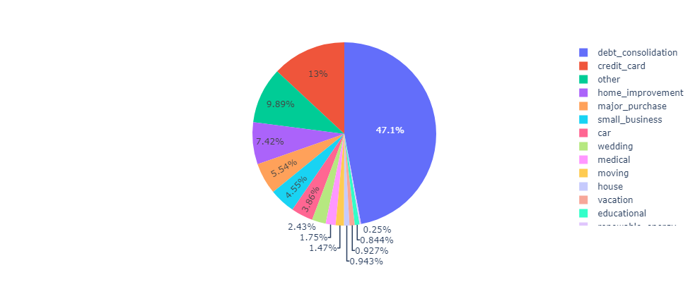
Univariate Analysis
1. Distribution of the loans across categories
Analysis: Almost half of the loans (47%) are given for the debt consolidation purpose
Debt consolidation is when a borrower takes out a new loan and then uses the loan proceeds to pay off their other debts

Slide 5
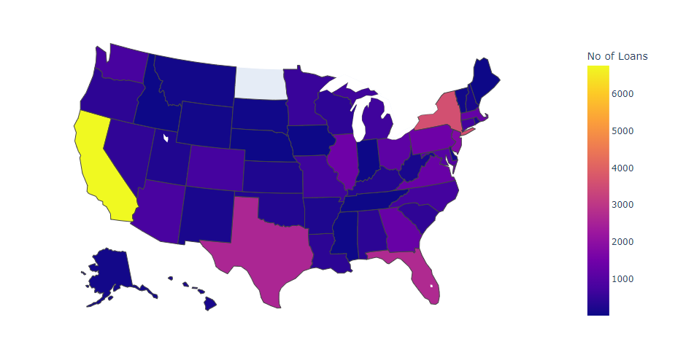
2. Distribution of the loans across the States
Analysis: Maximum number of loans are taken from coastal states like California, New York, Florida, and Texas.

Slide 6
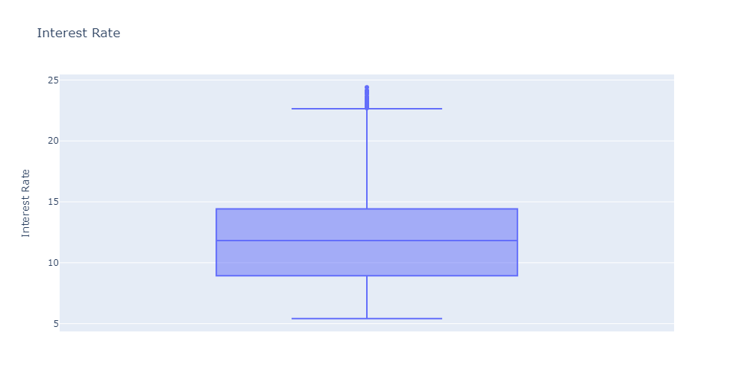
3. Interest Rate
Analysis : Most of the loans Interest rate is distributed between 8.94 and 14.42. There is small portion of the risky loan which are given at higher interest rate

Slide 7
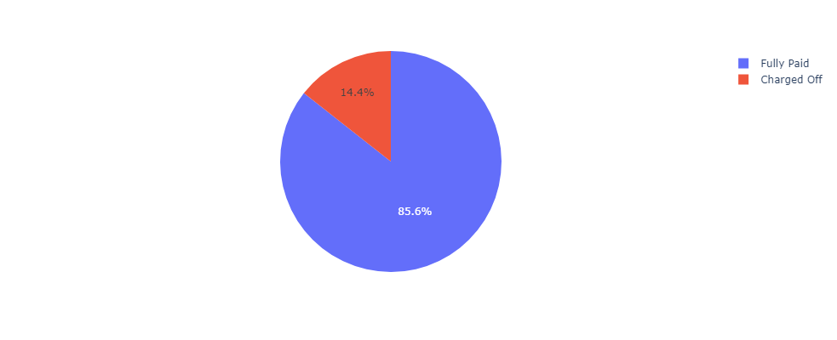
4. Default Rate
Analysis : The current default Rate of the Loans is almost 15 Percent

Slide 8
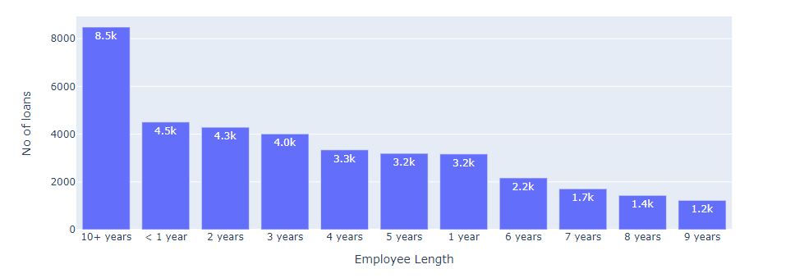
5. Distribution across the Employee Length
Analysis : There is inverse relation between Employee length and number of loans.
** 10+ years contain all the loans given to the employee length higher than 10 years

Slide 9
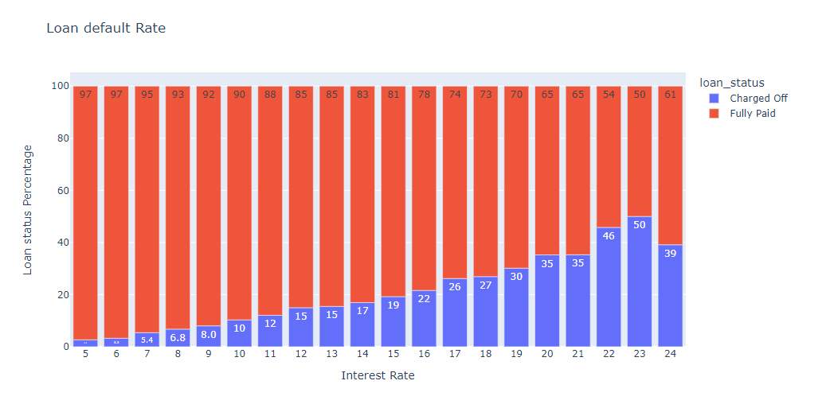
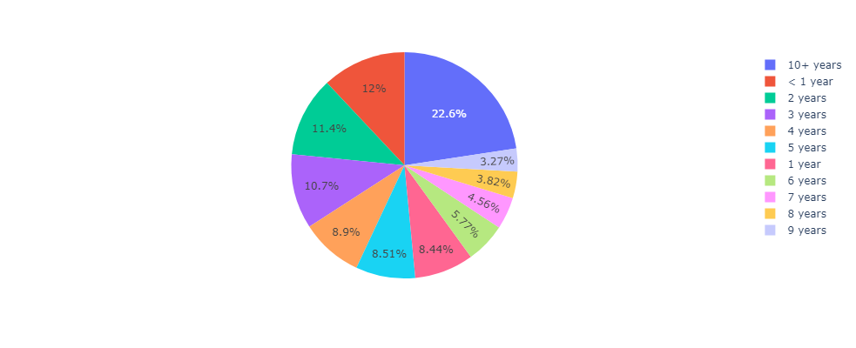
Bivariate/Multivariate Analysis
1. Distribution of the Default Loans against Interest rate.
Analysis : As Rate of Interest increase default Rate is also going up. Risky loans are given at higher interest have higher default rate.

Slide 10
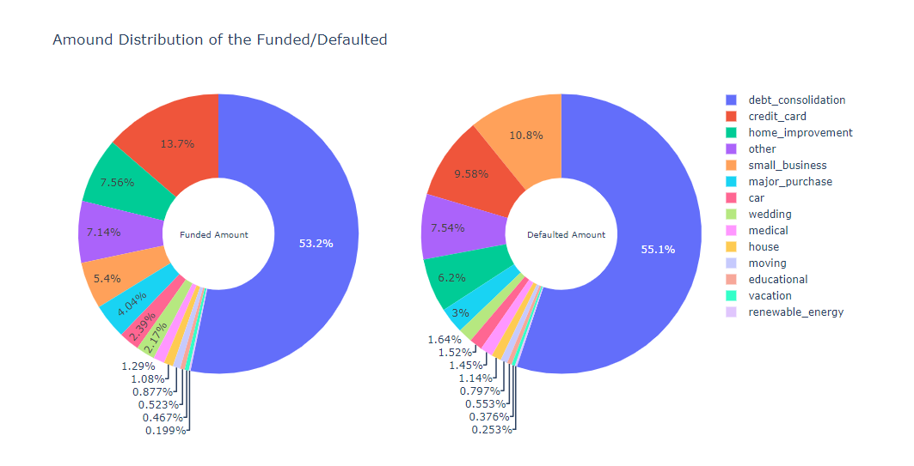
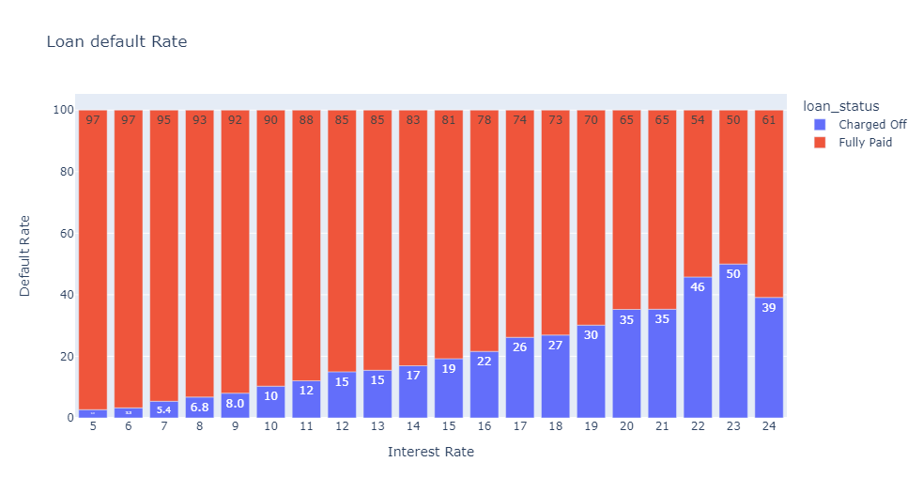
2. Distribution of the Funded and Defaulted amounts across the Purpose

Slide 11
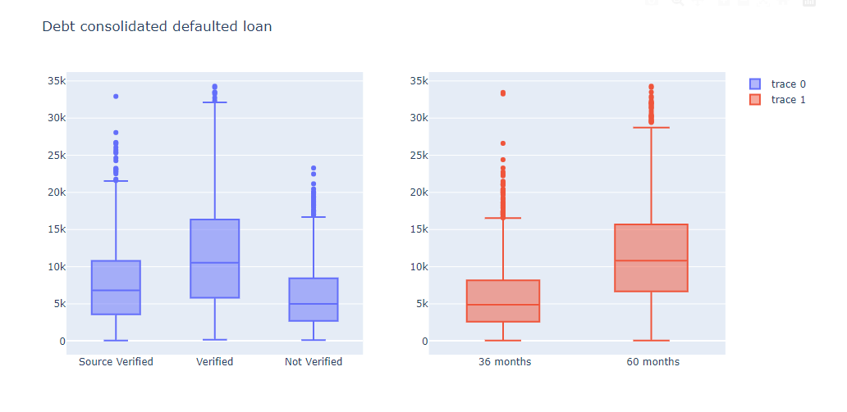
2. Distribution of the Funded and Defaulted amounts across the Purpose

Slide 12
Analysis :
There are debt consolidated loans above 10,500 that are defaulting after bank verification compared to the Source verified. There higher scope for improvement for bank verification so that credit loss can be minimized.
Loans taken for longer duration are more likely to default so credit loss can be minimized by giving more short-term loans compared to long term
Only debt-consolidated loans are taken with verification status for analysis as considering other loans with debt consolidation may hamper the analysis.

Slide 13
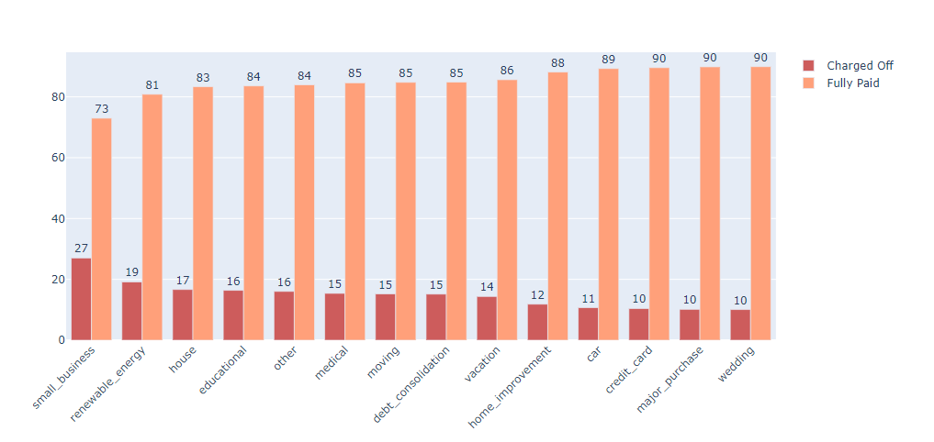
3. Default Percentage across the Purpose of the loan
Analysis : There higher rate(27%) of default for small business compared to the other purpose of the loan.

Slide 14
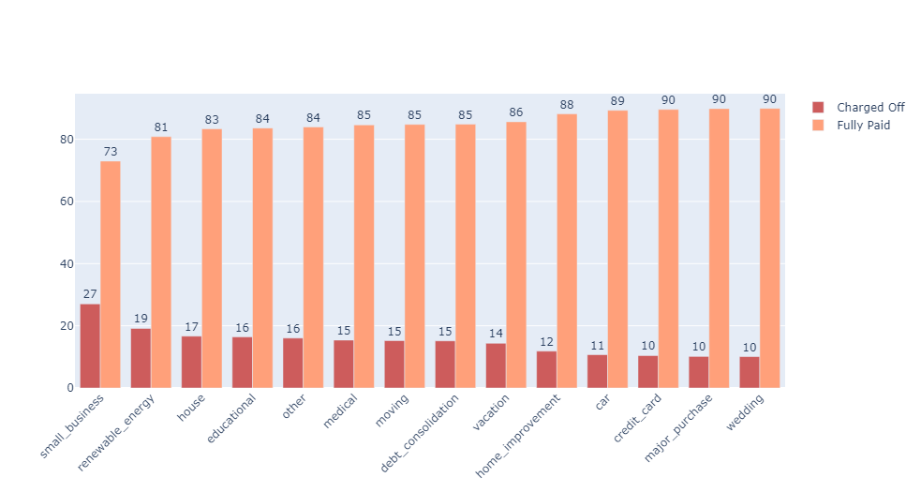
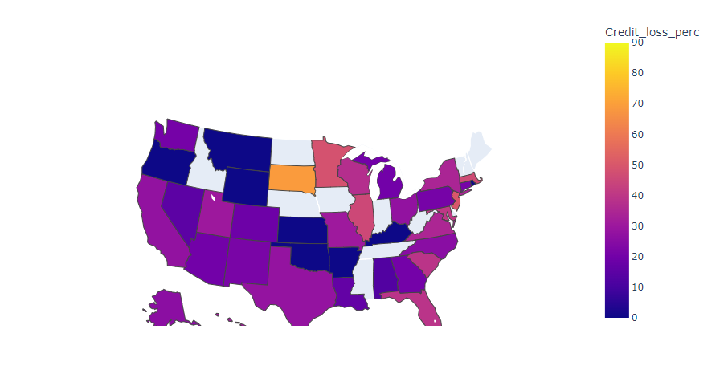
4. Credit loss of the Risky loans(Loans with higher Interest Rate)
Analysis: Major credit loss is happening in eastern states compared to the western states for risky loans. It can be minimized by changing the proportion towards eastern states like California.

Slide 15
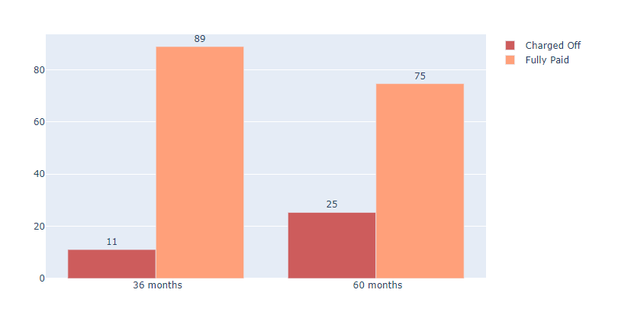
5. Default rate across the loan term
Analysis: The default rate of the long-term(5 years) is 25 Percent which is much higher than the short-term(3 years) loans. Credit loss/Loan default rate can be reduced by increasing the portion of the short-term loan.

Slide 16
Conclusion :
Important features which are affecting the default rate :
Term: Loans with a longer term are more likely to default.
Interest Rate: Loans with a higher interest rate have a higher default rate.
Region: Eastern part of the USA has a higher percentage of credit loss for risky loans.
Purpose: Small business loans have a higher rate of default.

Slide 17


