Slide 1


Task 2: Corona Virus Analysis with SQL
Name: Vishwanath Goud Kallem
Profile: Data Analyst Intern
Batch: MIP-DA-07

Slide 2

Project Overview
The COVID19’ impact on public health underscores the need for data-driven insights to understand its spread.
As a data analyst, the task at hand is to analyze a COVID-19 dataset to extract valuable insights.
Through data exploration and statistical analysis, the aim is to
uncover patterns, trends, and correlations within the dataset.
By presenting these findings, the agenda is to contribute to the collective effort in combating the COVID-19 crisis.

Slide 3
Dataset Overview
Description of each column in the dataset (Corona Virus Dataset)
Province: Geographic subdivision within a country/region.
Country_Region: Geographic entity where data is recorded.
Latitude: North-south position on Earth's surface.
Longitude: East-west position on Earth's surface.
Date: Recorded date of CORONA VIRUS data.
Confirmed: Number of diagnosed CORONA VIRUS cases.
Deaths: Number of CORONA VIRUS-related deaths.
Recovered: Number of recovered CORONA VIRUS cases

Slide 4


DBMS and Tool Used
Database Used:
Management Tool: pgAdmin 4

Slide 5
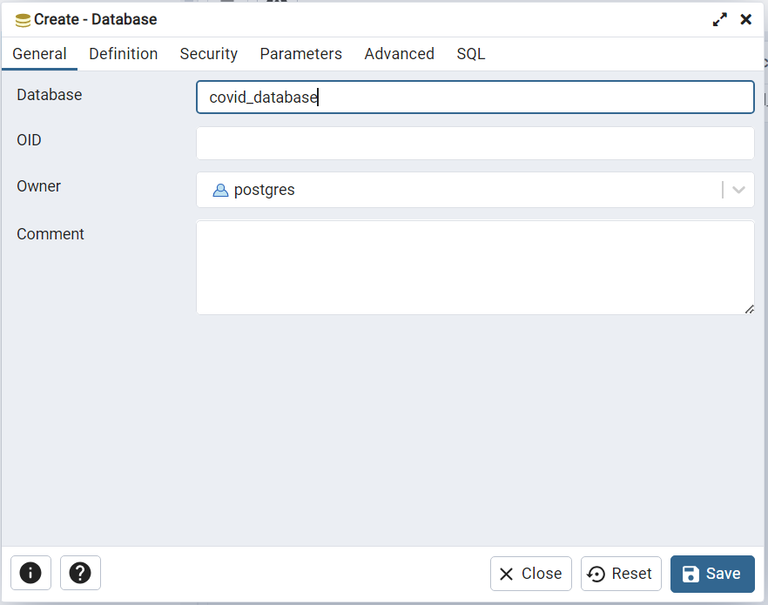
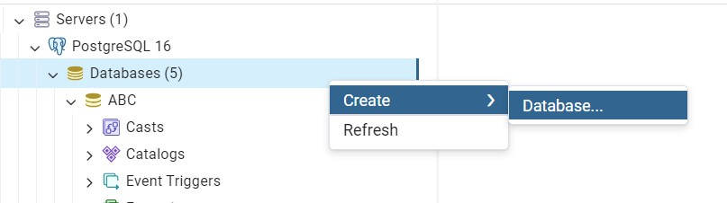
Creating Database
“Covid_database”

Slide 6
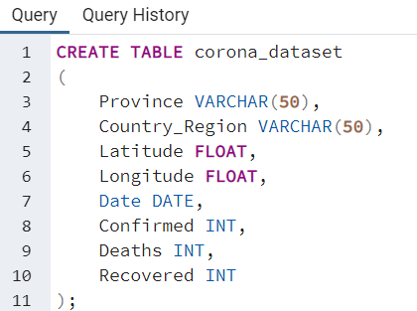
Creating Table
Query to Create the table

Slide 7
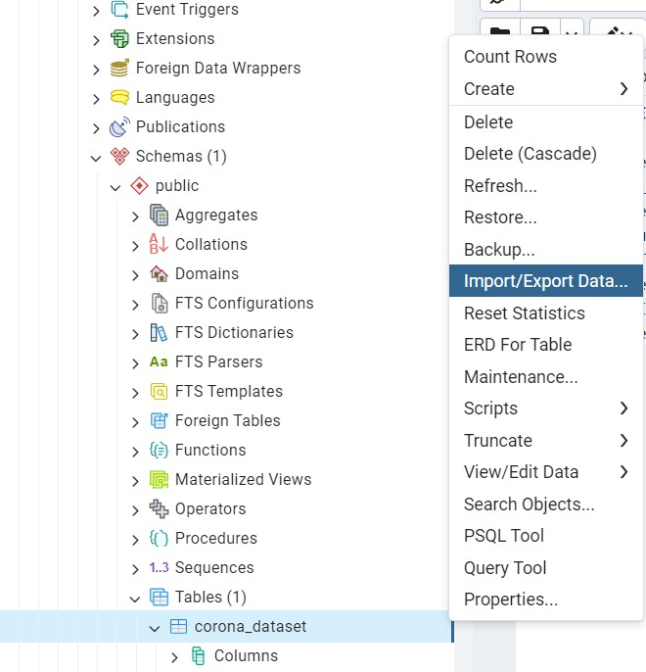
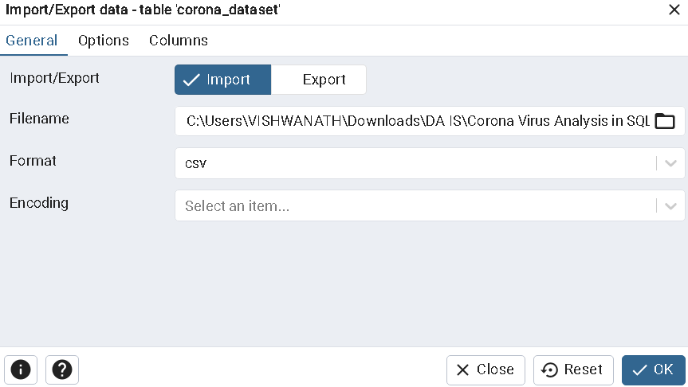
How to Import Data into the Table
Right Click the table we just created and choose
“Import/Export Data ”
Select the Path which leads to “Corona Dataset.csv” file

Slide 8
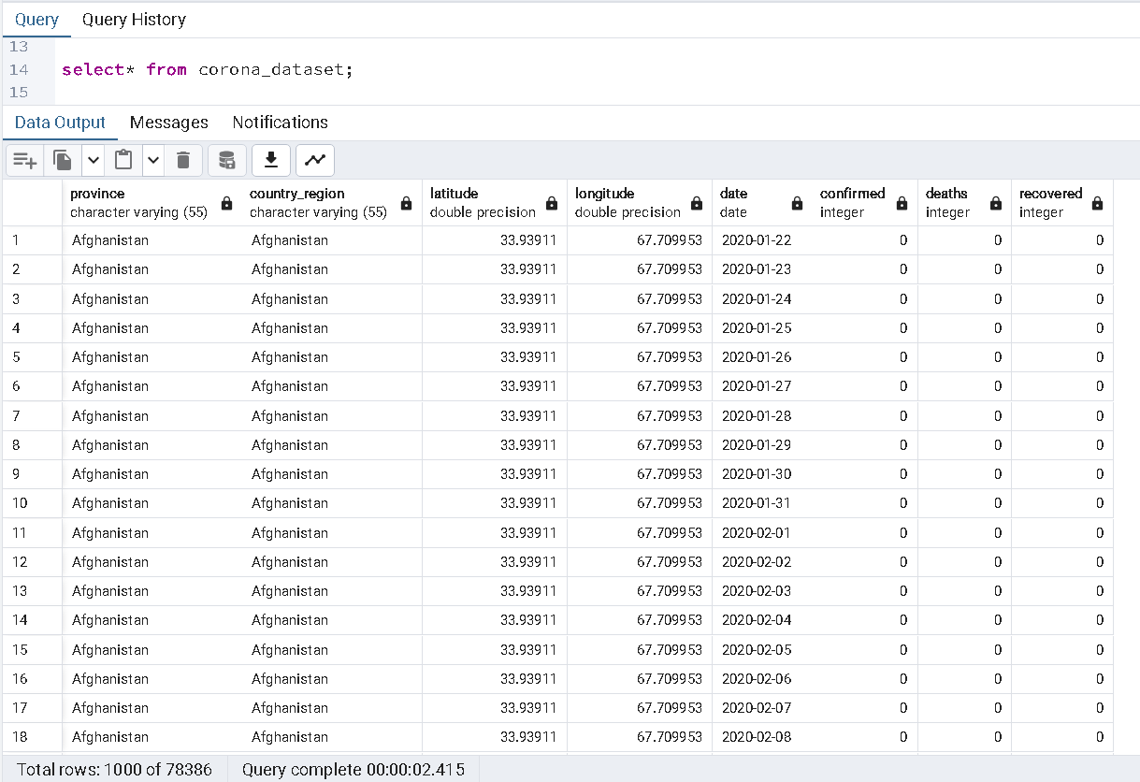
Imported Data into Table

Slide 9
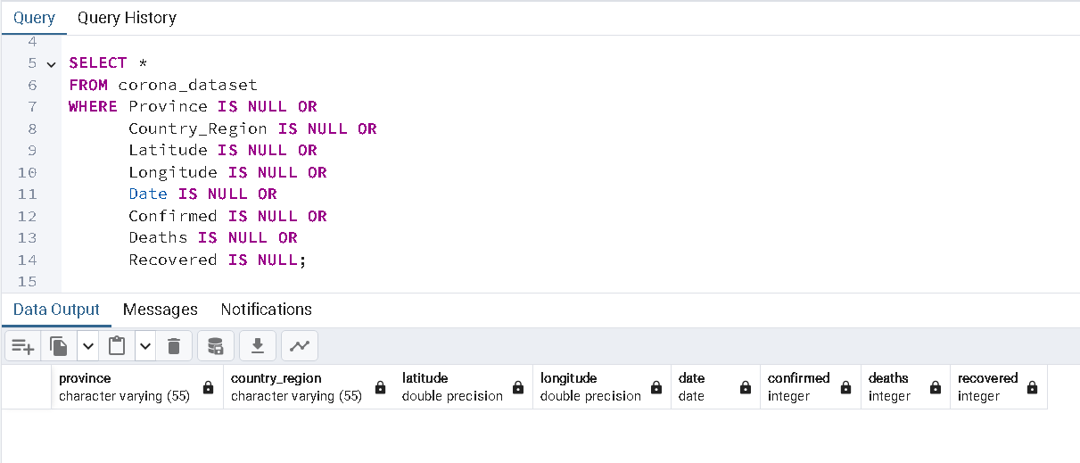
Data Cleaning
To avoid any errors, we check for missing value / null value
1. Write a code to check NULL values
SQL Query
Output
Inference: Based on the output, it could be rest assured that there are no null values present in any columns within the dataset.

Slide 10
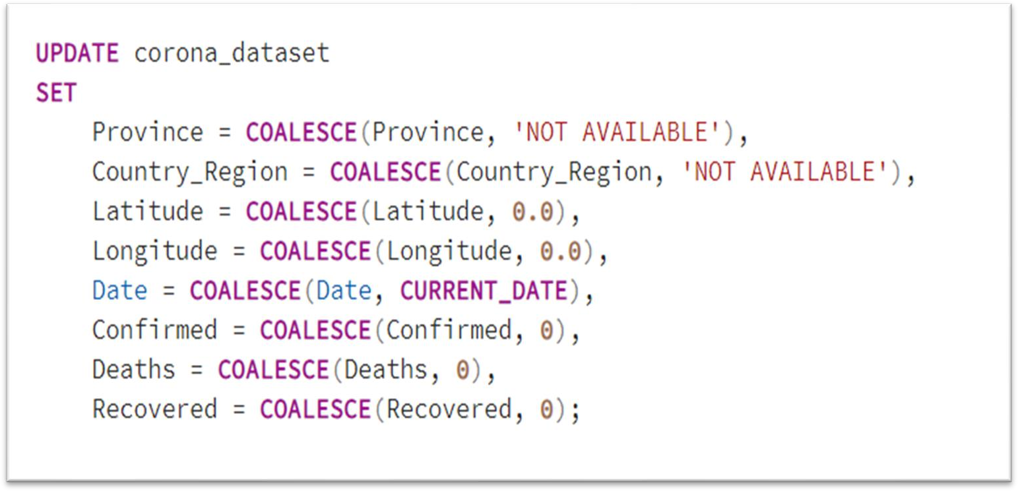
2. If NULL values are present, update them with zeros for all columns
As we have seen already, there were no null values present in the dataset, but if the values were null, we could have addressed them using the above query.

Slide 11
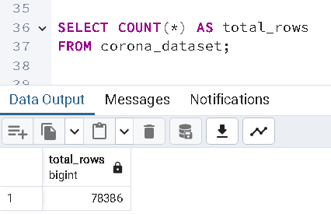
3. Check the total number of rows
Inference: The total number of records stored in the dataset is 78,386.

Slide 12
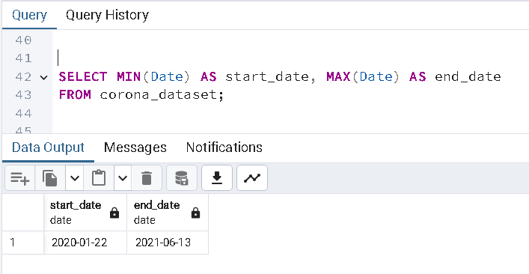
4. Check what is the start date and end date
Inference: According to the dataset, the start date of the COVID-19 pandemic is recorded as January 22, 2020 (22-01-2020) with the end date noted as June 13, 2021 (13-06-2021)

Slide 13
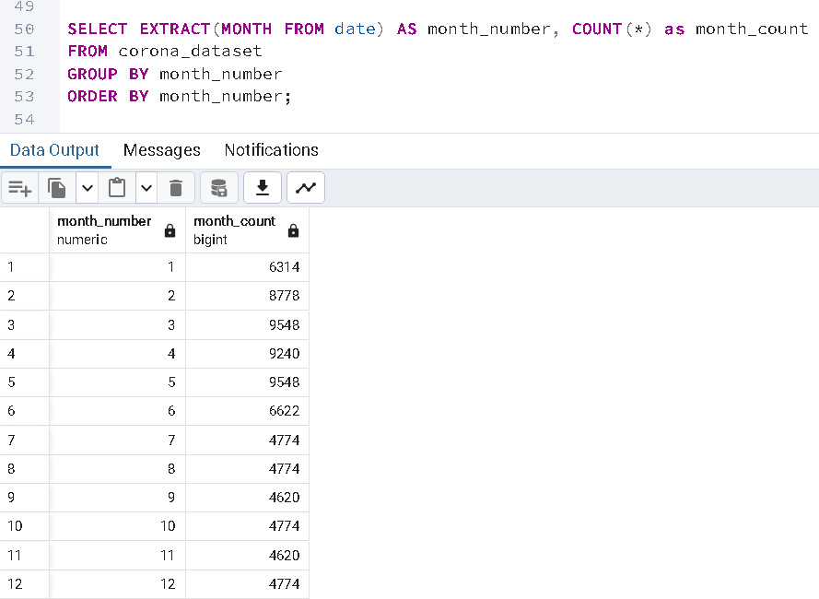
5. Number of months present in the dataset
In the output, "month_number" represents distinct months, while "month_count" denotes the frequency of COVID cases associated with each respective month_number.
For instance, if we consider January (month_number = 1), with a month_count of 6314, it indicates that there were 6314 occurrences of COVID-19 reported across various countries/regions during the month of January in both 2020 and 2021, as per the dataset.
Inference: The dataset includes 12 distinct months

Slide 14
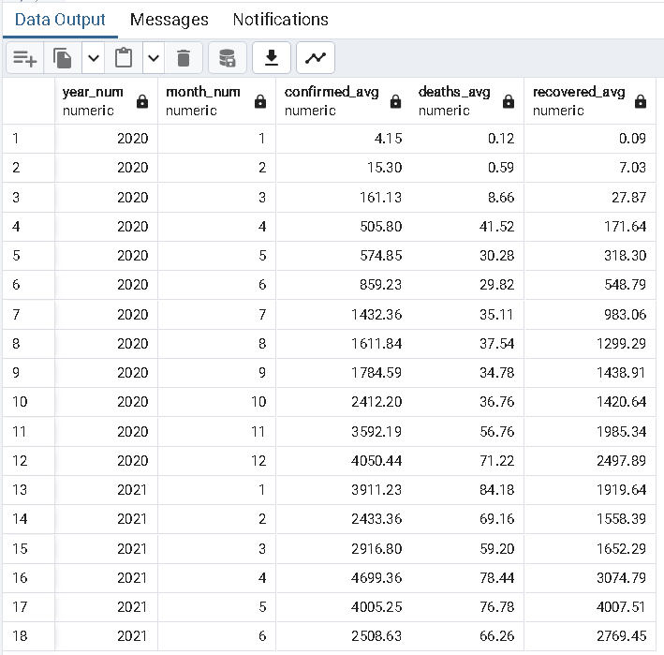
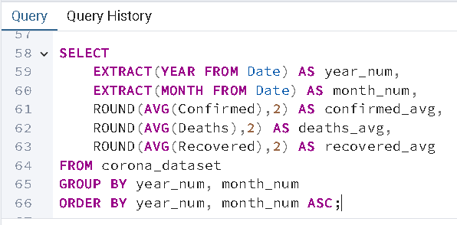
6. Find the monthly average for confirmed, deaths, recovered
Inference: Based on the output provided, it is apparent that the highest average values for confirmed cases, deaths, and recovered cases are as follows:
Confirmed cases: 4699.36 in April 2021
Deaths: 84.18 in January 2021
Recovered cases: 4007.51 in May 2021

Slide 15
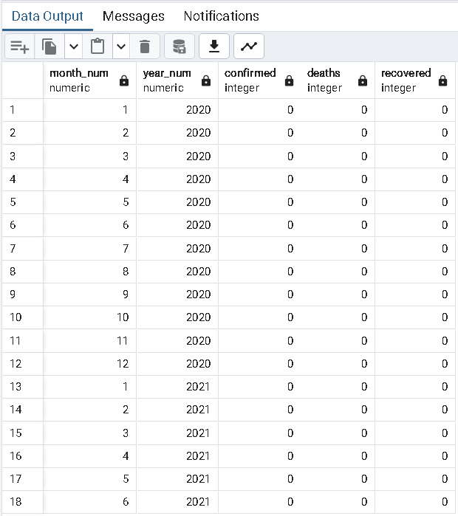
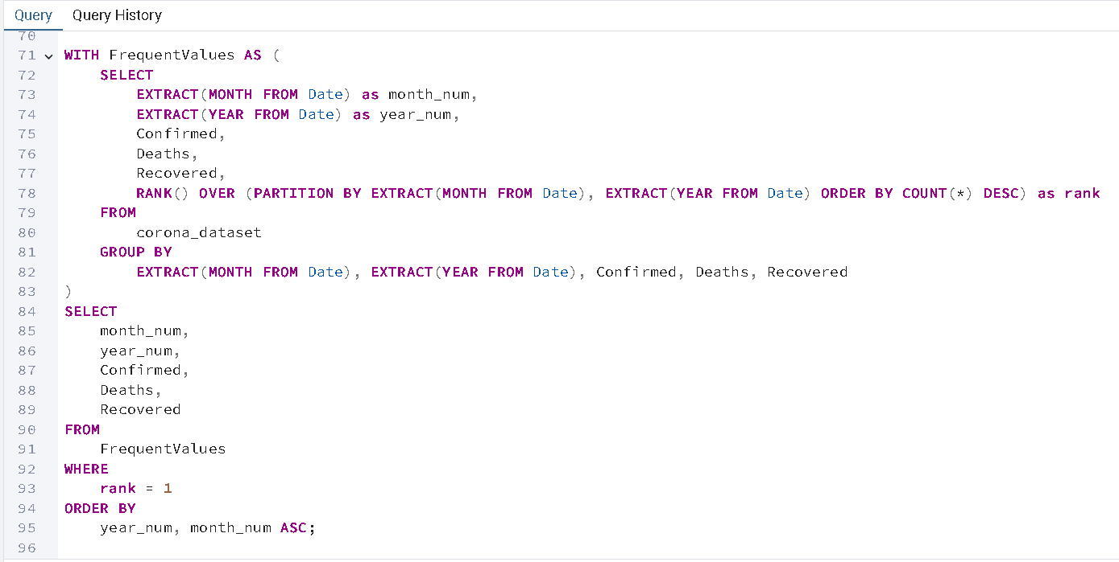
7. Find the most frequent value for confirmed, deaths, recovered each month

Slide 16
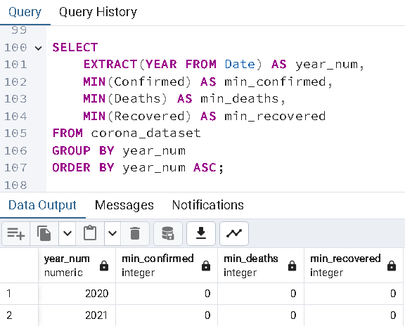
8. Find minimum values for confirmed, deaths, recovered per year

Slide 17
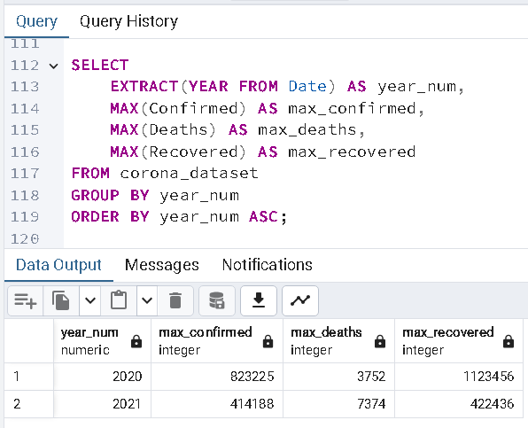
9. Find maximum values for confirmed, deaths, recovered per year
The year 2020 records the highest number of confirmed cases, with a total of 823,225 cases.
In contrast, the year 2021 reports the highest number of deaths was 7,374.
However, the maximum number of recovered cases, amounting to 1,123,456, is reported in the year 2020.

Slide 18
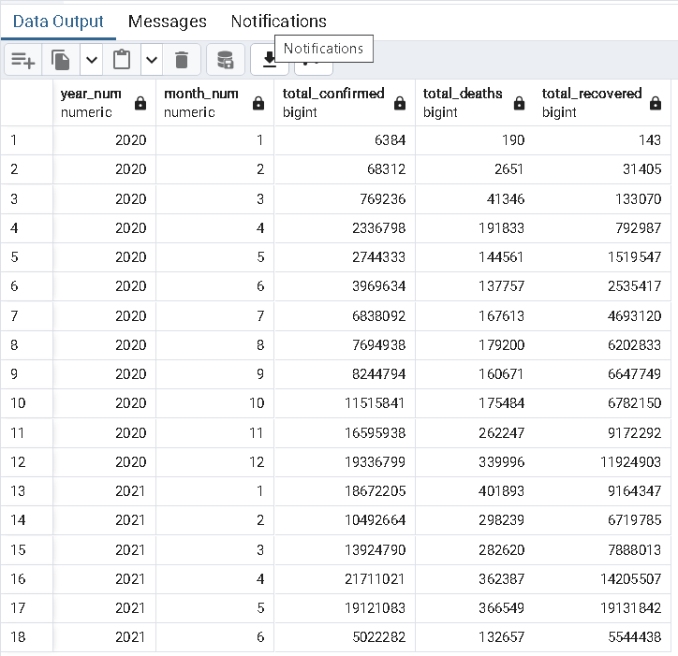
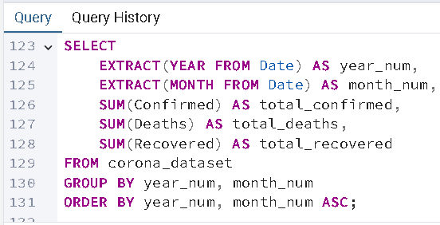
10. The total number of case of confirmed, deaths, recovered each month
Inference:
With a cumulative count of 21,711,021 cases, the number of confirmed cases peaked in April 2021.
In contrast, January 2021 saw the most number of deaths— recorded as 401,893.
Additionally, May 2021 reported the highest number of
recovered cases, which came to 19,131,842.

Slide 19
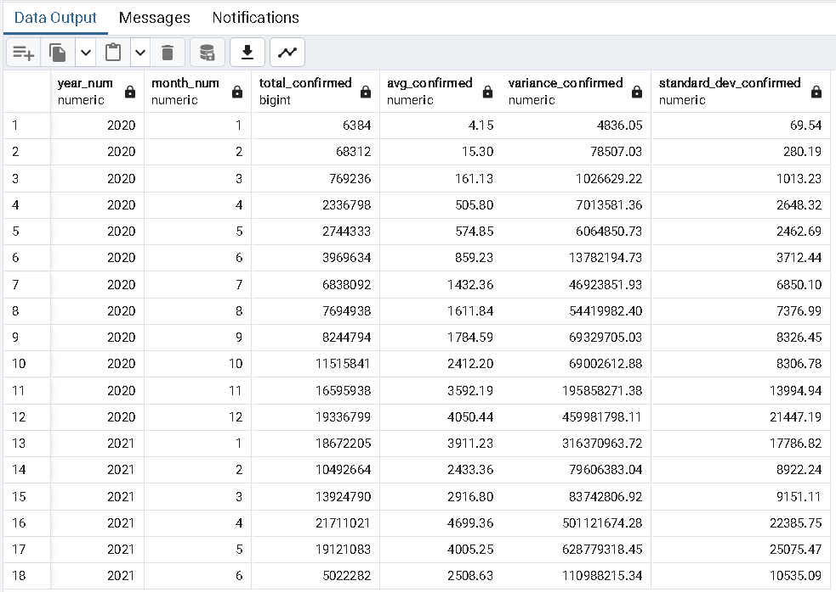
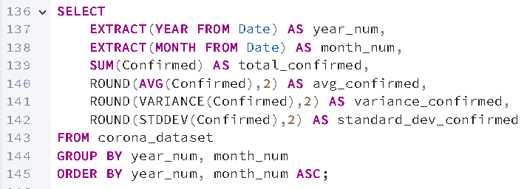
11. Check how coronavirus spread out with respect to confirmed cases per month
(Eg: total confirmed cases, their average, variance & STDEV )

Slide 20
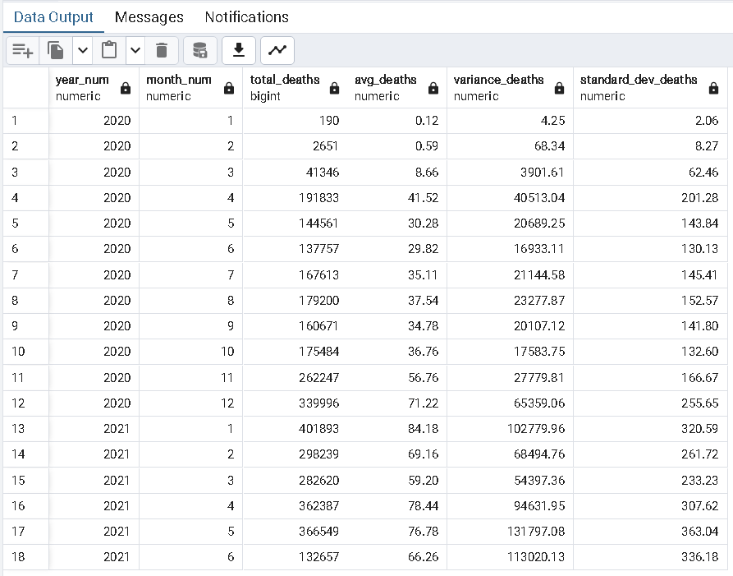
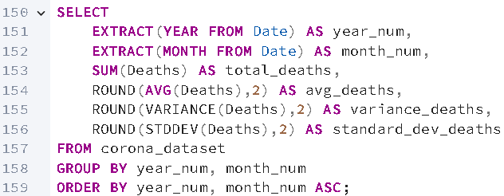
12. Check how coronavirus spread out with respect to death cases per month
(Eg: total death cases, their average, variance & STDEV )

Slide 21
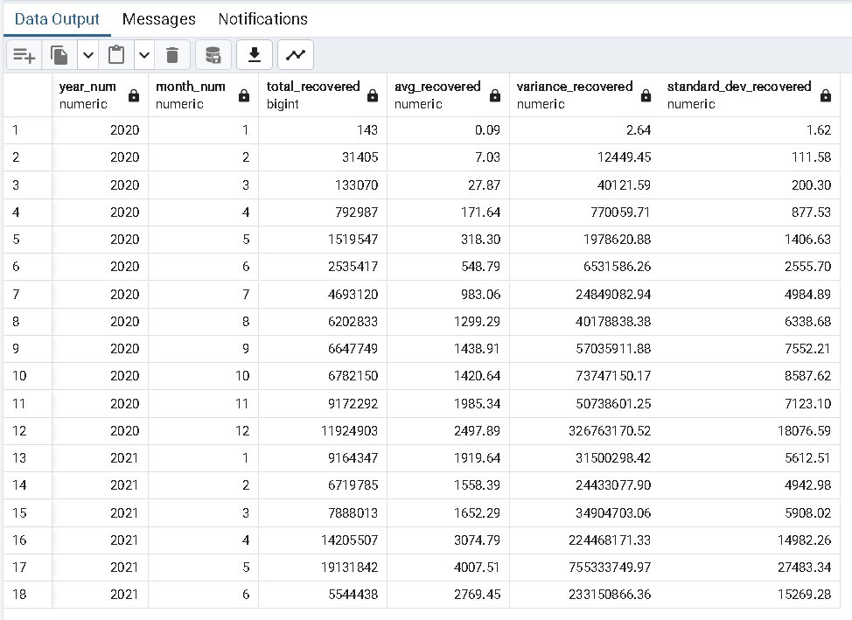
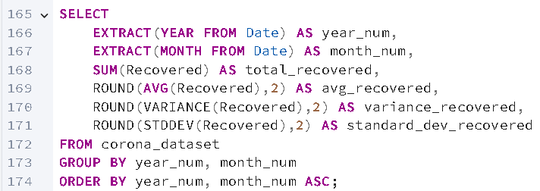
13. Check how coronavirus spread out with respect to recovered cases per month
(Eg: total recovered cases, their average, variance & STDEV )

Slide 22
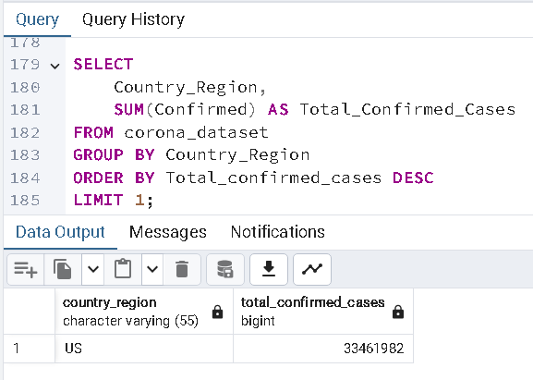
14. Find the Country having the highest number of Confirmed cases
Inference: US had the highest number of confirmed cases recorded which was cumulated to 33,461,982.

Slide 23
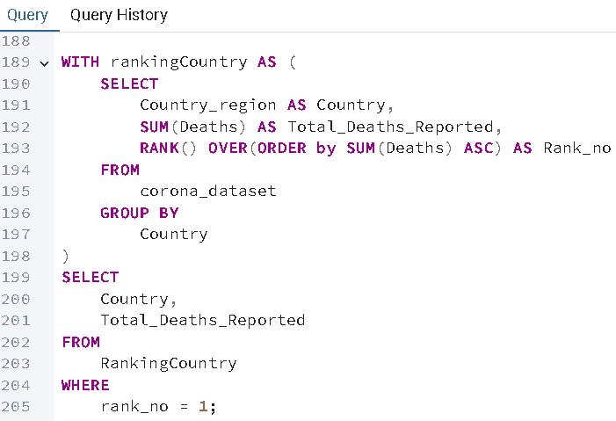
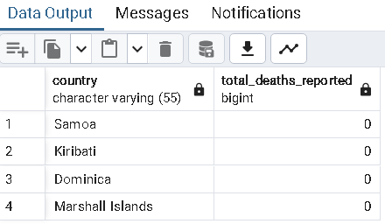
15. Find the Country having the lowest number of death cases
Inference: Samoa, Kiribati, Dominica, and Marshall Islands had reported the lowest number of death cases, which each country had 0 casualties as per the datasets.

Slide 24
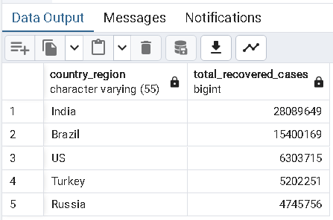
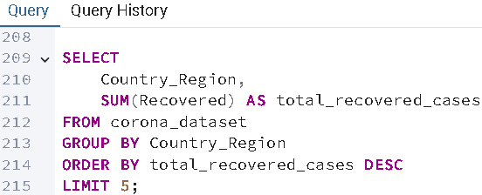
16. Find top 5 countries having highest recovered cases
Inference: India, Brazil, US, Turkey, and Russia are the top five countries with the highest number of recovered COVID-19 cases.

Slide 25
Insights
Several revelations have been discovered after the SQL analysis of the COVID dataset.
According to the dataset COVID-19 Pandemic duration was from January 22, 2020, to June 13, 2021.
Though 2020 had the most number of cases recorded, the amount of casualties recorded was more in 2021.
India had the highest number of recovered cases.
The confirmed cases skyrocketed in April 2021.
Samoa, Kiribati, Dominica, and Marshall Islands had reported the lowest number of death cases.
Though the US was the most recorded country with confirmed cases, it comes 3rd in the case of recovery data which was accumulated in the dataset.
These datasets provide valuable insights for understanding the impact of COVID-19 pandemic based on the dataset.

Slide 26
Thank You !

