Slide 1
Computer Systems An Integrated Approach to Architecture and Operating Systems
Chapter 5
Processor Performance and Rudiments of Pipelined Processor Design
©Copyright 2008 Umakishore Ramachandran and William D. Leahy Jr.

Slide 2
5.1 Space and Time Metrics
Two important metrics for any program
Space: How much memory does the program code and data require? (Memory footprint)
Time: What is the execution time for the program?
Different design methodologies
CISC
RISC
Memory footprint and execution time are not necessarily correlated

Slide 3
What determines execution time?
Execution time = (∑ CPI_{j}) * clock cycle time, where 1 ≤ j ≤ n
Execution time = n * CPI_{Avg} * clock cycle time, where n is the number of instructions (executed not static instruction count)

Slide 4
5.2 Instruction Frequency
Static instruction frequency refers to number of times a particular instruction occurs in compiled code.
Impacts memory footprint
If a particular instruction appears a lot in a program, can try to optimize amount of space it occupies by clever instruction encoding techniques in the instruction format.
Dynamic instruction frequency refers to number of times a particular instruction is executed when program is run.
Impacts execution time of program
If dynamic frequency of an instruction is high then can try to make enhancements to datapath and control to ensure that CPI taken for its execution is minimized.

Slide 5
5.3 Benchmarks
Benchmarks are a set of programs that are representative of the workload for a processor.
The key difficulty is to be sure that the benchmark program selected really are representative.
A radical new design is hard to benchmark because there may not yet be a compiler or much code.

Slide 6
Evaluating a Suite of Benchmark Programs
Total execution time: cumulative total of execution times of individual programs.
Arithmetic mean (AM): Simply an average of all individual program execution times.
It should be noted, however that this metric may bias the summary value towards a time-consuming benchmark program (e.g. execution times of programs: P1 = 100 secs; P2 = 1 secs; AM = 50.5 secs).
Weighted arithmetic mean (WAM) : weighted average of the execution times of all the individual programs taking into account the relative frequency of execution of the programs in the benchmark mix
Geometric mean (GM), p^{th} root of the product of p values. This metric removes the bias present in arithmetic mean

Slide 7
SPECint2006 12 programs for quantifying performance of processors on integer programs
Intel Core 2 Duo E6850 (3 GHz)
Program name | Description | Time in seconds
400.perlbench | Applications in Perl | 510
401.bzip2 | Data compression | 602
403.gcc | C Compiler | 382
429.mcf | Optimization | 328
445.gobmk | Game based on AI | 548
456.hmmer | Gene sequencing | 593
458.sjeng | Chess based on AI | 679
462.libquantum | Quantum computing | 422
464.h264ref | Video compression | 708
471.omnetpp | Discrete event simulation | 362
473.astar | Path-finding algorithm | 466
483.xalancbmk | XML processing | 302

Slide 8
5.4 Increasing the Processor Performance
Execution time = n * CPI_{Avg} * clock cycle time
Reduction in the number of executed instructions
Datapath organization leading to lower CPI
Increasing clock speed

Slide 9
5.5 Speedup
Assume a base case execution time of 10 sec.
Assume an improved case execution time of 5 sec.
Percent improvement = (base-new)/base
Percent improvement = (10-5)/5 = 100%
Speedup = base/new
Speedup = 10/5 = 2
Speedup is preferred by advertising copy writers

Slide 10
Amdahl’s Law
Amdahl’s law:
Time_{after} = Time_{unaffected} + Time_{affected}/x
where x is speedup

Slide 11
5.6 Increasing the Throughput of the Processor
Don’t focus on trying to speedup individual instructions
Instead focus on throughput i.e. number of instructions executed per unit time

Slide 12
5.7 Introduction to Pipelining
Consider a sandwich shop with a five step process
Take order
Bread
Cheese
Meat
Veggies
One employee can do the job
Now imagine 5 employees making sandwiches
Order
Bread
Cheese
Meat
Veggies

Slide 13
Pipeline Math
If it takes one person 5 minutes to make a sandwich
And we pipeline the process using 5 people each taking a minute
And we start making sandwiches constantly (i.e. ignore startup pipeline filling)
How long does it actually take to make a single sandwich (Real elapsed time)
What is the effective time to produce a sandwich? (i.e. a sandwich exits from the pipeline every how many minutes?)

Slide 14
5.8 Towards an instruction processing assembly line
Macro State Functional Units in Use_______________
FETCH IR ALU PC MEM
DECODE IR
EXECUTE (ADD) IR ALU Reg-file
EXECUTE (LW) IR ALU Reg-file MEM Sign extender
instructions
instructions
I₄
F
D
E
I₄
F
D
E
I₃
F
D
E
I₃
F
D
E
I₂
F
D
E
I₂
F
D
E
I₁
F
D
E
I₁
F
D
E
time
time

Slide 15
5.9 Problems with a simple-minded instruction pipeline
The different stages often need the same datapath resources (e.g. ALU, IR).
Structural Hazards
The amount of work done in the different stages is not the same.
T_{Fetch} <> T_{Decode} <> T_{execute}

Slide 16
5.10 Fixing the problems with the instruction pipeline
IF Instruction Fetch
ID/RR Instruction Decode/Read Registers
EX Execute
MEM Memory
WB Write Back

Slide 17
Instruction pipeline with buffers between stages
B
U
F
F
E
R
B
U
F
F
E
R
B
U
F
F
E
R
B
U
F
F
E
R
IF
ID/RR
EX
MEM
WB
Instruction
in
Instruction
out

Slide 18
5.11 Datapath elements for the instruction pipeline
IF
ID/RR
EX
MEM
WB
B
U
F
F
E
R
B
U
F
F
E
R
B
U
F
F
E
R
B
U
F
F
E
R
PC
DPRF
ALU-1
I-MEM
D-MEM
data
A
B
ALU-2
Decode
logic
DPRF
ALU

Slide 19
5.12 Pipeline-conscious architecture and implementation
Need for a symmetric instruction format
Need to ensure equal amount of work in each stage

Slide 20
5.12.1 Anatomy of an instruction passage through the pipeline
FBUF
DB
U
F
EB
U
F
MB
U
F
IF
ID/RR
EX
MEM
WB

Slide 21
Pipeline Buffers
Name | Output of Stage | Contents
FBUF | IF | Primarily contains instruction read from memory
DBUF | ID/RR | Decoded IR and values read from register file
EBUF | EX | Primarily contains result of ALU operation plus other parts of the instruction depending on the instruction specifics
MBUF | MEM | Same as EBUF if instruction is not LW or SW; If instruction is LW, then buffer contains the contents of memory location read

Slide 22
5.12.2 Design of the Pipeline Registers
Design the pipeline registers solely for the LDR instruction
FBUF
DBUF
EBUF
MBUF

Slide 23
5.12.3 Implementation of the stages
Design and implementation of a pipeline processor may be simpler than a non-pipelined processor.
Pipelined implementation modularizes design.
Layout and interpretation of the pipeline registers are analogous to well-defined interfaces between components of a large software system.
Since datapath actions of each stage happen in one clock cycle, the design of each stage is purely combinational. Each stage:
At the beginning of each clock cycle, interprets input pipeline register,
Carries out the datapath actions using the combinational logic for this stage
Writes the result of the datapath action into its output pipeline register.

Slide 24
5.13 Hazards
Structural
Reduce throughput to < 1 instruction/cycle
Pipeline is synchronous
Pipeline is stalled when an instruction cannot proceed to next stage.
A stall introduces bubble into pipeline.
NOP instruction is manifestation of bubble.
Stage executing NOP instruction does nothing for one cycle.
Output buffer remains unchanged from previous cycle.
Stalls, bubbles, and NOPs used interchangeably in the textbook to mean the same thing.
Control
Data

Slide 25
5.13.1 Structural hazard
Caused by limitations in hardware that don’t allow concurrent execution of different instructions
Examples
Bus
Single ALU
Single Memory for instructions and data
Single IR
Remedy is to add additional elements to datapath to eliminate hazard

Slide 26
5.13.2 Data Hazard
Consider these three pairs of instructions. Could they be executed in any sequence and yield correct results?
R1 ← R2 + R3
R4 ← R1 + R5
R4 ← R1 + R5
R1 ← R2 + R3
R1 ← R4 + R5
R1 ← R2 + R3

Slide 27
5.13.2.1 RAW Hazard
M
X
1
ADD
ADD
P
C
Instr
Mem
DPRF
BEQ
A
Data
Mem
M
X
M
X
ALU
SE
D

Slide 28
5.13.2.1 RAW Hazard
M
X
1
ADD
ADD
P
C
Instr
Mem
DPRF
BEQ
A
Data
Mem
M
X
M
X
ALU
SE
D
R1 ← R2+R3

Slide 29
5.13.2.1 RAW Hazard
M
X
1
ADD
ADD
P
C
Instr
Mem
DPRF
BEQ
A
Data
Mem
M
X
M
X
ALU
SE
D
R4 ← R1+R5
R1 ← R2+R3

Slide 30
5.13.2.1 RAW Hazard
M
X
1
ADD
ADD
P
C
Instr
Mem
DPRF
BEQ
A
Data
Mem
M
X
M
X
ALU
SE
D
R4 ← R1+R5
R1 ← R2+R3

Slide 31
5.13.2.1 RAW Hazard
M
X
1
ADD
ADD
P
C
Instr
Mem
DPRF
BEQ
A
Data
Mem
M
X
M
X
ALU
SE
D
R4 ← R1+R5
R1 ← R2+R3

Slide 32
5.13.2.1 RAW Hazard
M
X
1
ADD
ADD
P
C
Instr
Mem
DPRF
BEQ
A
Data
Mem
M
X
M
X
ALU
SE
D
R4 ← R1+R5
R1 ← R2+R3

Slide 33
5.13.2.1 RAW Hazard
M
X
1
ADD
ADD
P
C
Instr
Mem
DPRF
BEQ
A
Data
Mem
M
X
M
X
ALU
SE
D
R4 ← R1+R5

Slide 34
5.13.2.2 Solving the RAW Data Hazard Problem: Data Forwarding
M
X
ADD
=?
1
R1
ADD
P
C
Instr
Mem
DPRF
A
Data
Mem
M
X
M
X
ALU
SE
D
R1
R4 ← R1+R5
R1 ← R2+R3

Slide 35
5.13.2.2 Solving the RAW Data Hazard Problem: Data Forwarding
Forwarding components have to be installed to take care of all possible cases

Slide 36
5.13.2.3 Dealing with RAW Data Hazard introduced by Load instructions
M
X
1
ADD
ADD
P
C
Instr
Mem
DPRF
BEQ
A
Data
Mem
M
X
M
X
ALU
SE
D
LW R1,3(R2)

Slide 37
5.13.2.3 Dealing with RAW Data Hazard introduced by Load instructions
M
X
1
ADD
ADD
P
C
Instr
Mem
DPRF
BEQ
A
Data
Mem
M
X
M
X
ALU
SE
D
R4 ← R1+R5
LW R1,3(R2)

Slide 38
5.13.2.3 Dealing with RAW Data Hazard introduced by Load instructions
M
X
1
ADD
ADD
R=1
R1
P
C
Instr
Mem
DPRF
BEQ
A
Data
Mem
M
X
M
X
ALU
SE
D
R=1
R4 ← R1+R5
LW R1,3(R2)

Slide 39
5.13.2.3 Dealing with RAW Data Hazard introduced by Load instructions
M
X
1
ADD
ADD
P
C
R1
Instr
Mem
DPRF
BEQ
A
Data
Mem
R1
M
X
M
X
ALU
SE
D
R=1
R4 ← R1+R5
LW R1,3(R2)

Slide 40
5.13.2.3 Dealing with RAW Data Hazard introduced by Load instructions
M
X
1
ADD
ADD
P
C
R1
Instr
Mem
DPRF
BEQ
A
Data
Mem
R1
M
X
M
X
ALU
SE
D
R=1
R4 ← R1+R5
NOP
LW R1,3(R2)

Slide 41
5.13.2.4 Other types of Data Hazards
WAR
Not a problem in our pipeline
R4 ← R1 + R5
R1 ← R2 + R3
WAW
Becomes an issue in complex pipelines with many stages
Stop Here

Slide 42
5.13.3 Control Hazard
Typically associated with branch instructions
PC must contain address of next instruction before we know it!!!
Simple solution: Stall pipeline
But what is the impact?

Slide 43
5.13.3 Control Hazard
M
X
1
ADD
ADD
P
C
Instr
Mem
DPRF
BEQ
A
Data
Mem
M
X
M
X
ALU
SE
D
BEQ R1, R2, X

Slide 44
5.13.3 Control Hazard
M
X
1
ADD
ADD
P
C
Instr
Mem
DPRF
BEQ
A
Data
Mem
M
X
M
X
ALU
SE
D
???
BEQ R1, R2, X

Slide 45
5.13.3 Control Hazard
M
X
1
ADD
ADD
P
C
Instr
Mem
DPRF
BEQ
A
Data
Mem
M
X
M
X
ALU
SE
D
NOP
BEQ R1, R2, X

Slide 46
5.13.3 Control Hazard
M
X
1
ADD
ADD
P
C
Instr
Mem
DPRF
BEQ
A
Data
Mem
M
X
M
X
ALU
SE
D
NOP
NOP
BEQ R1, R2, X

Slide 47
5.13.3 Control Hazard
M
X
1
ADD
BEQ
ADD
P
C
Instr
Mem
DPRF
A
Data
Mem
M
X
M
X
ALU
SE
D
NOP
BEQ R1, R2, X

Slide 48
5.13.3.1 Dealing with branches in the pipelined processor
Delayed Branch
Branch Prediction
Branch prediction with target buffer

Slide 49
5.13.3.2 Summary of dealing with branches in a pipelined processor
Name | Pros | Cons | Examples
Stall | Simple | Performance loss | IBM 360
Predict (not taken) | Good performance | Need additional hardware to be able to flush pipeline | Most modern processors use this technique. Some also employ sophisticated branch target buffers
Predict (taken) | Good performance | Requires more elaborate hardware since target not available until EX
Delayed Branch | Needs no hardware just compiler recognition that it exists | Deep pipelines make it difficult to fill all the delay slots | Older RISC architectures e.g. MIPS, PA-RISC, SPARC

Slide 50
5.13.4 Summary of Hazards
Structural
Data
Control

Slide 51
5.14 Dealing with interrupts in a pipelined processor
First Method
Stop sending new instructions into the pipeline
Wait until the instructions that are in partial execution complete their execution (i.e. drain the pipe).
Go to the interrupt state
Second Method
The other possibility is to flush the pipeline.

Slide 52
5.15 Advanced topics in processor design
Pipelined processor designs have their roots in high performance processors and vector processors of the 1960's and 1970's
Many of the concepts used are still relevant today

Slide 53
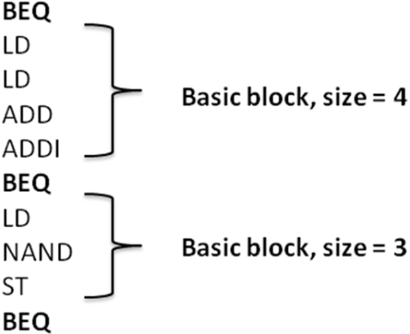
5.15.1 Multiple Issue Processors
Sequential Program Model
Perceived Program Order Execution
Actual instruction overlap
Instruction Level Parallelism (ILP)
Limited by hazards especially control hazards
Basic blocks

Slide 54
5.15.2 Deeper pipelines
Pipelines may have more than 20 stages
Basic blocks are often in the range of 3-7 instructions
Must develop techniques to exploit ILP to make it worthwhile
For example, can issue multiple instructions in one cycle
Assume hardware and/or compiler has selected a group of instruction that can be executed in parallel (no hazards)
Need additional functional units

Slide 55
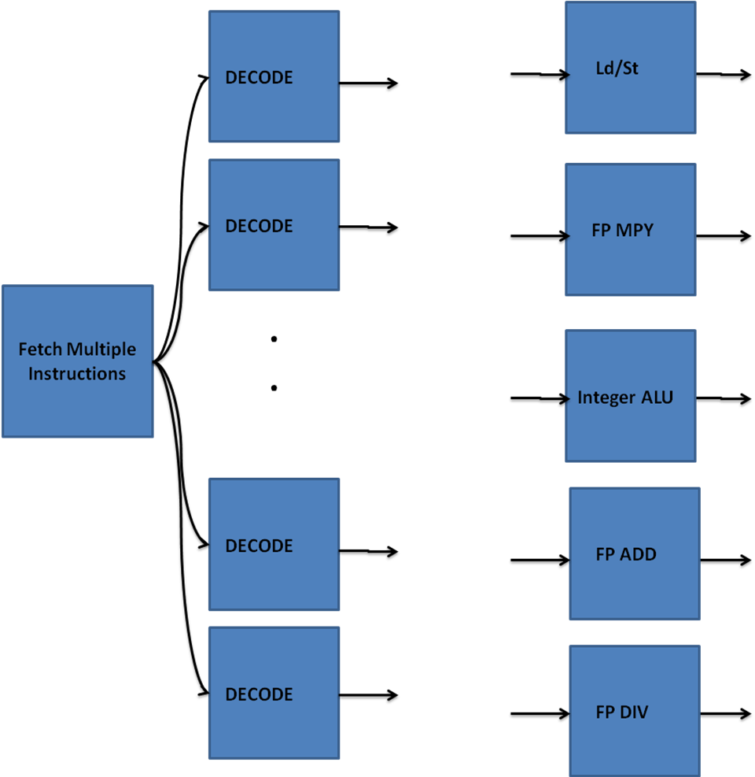
5.15.2 Deeper pipelines

Slide 56
Necessity for Deep Pipelining
Relative increase in storage access time
Microcode ROM access
Multiple functional units
Dedicated floating point pipelines
Out of order execution and reorder buffer
Register renaming
Hardware-based speculation

Slide 57
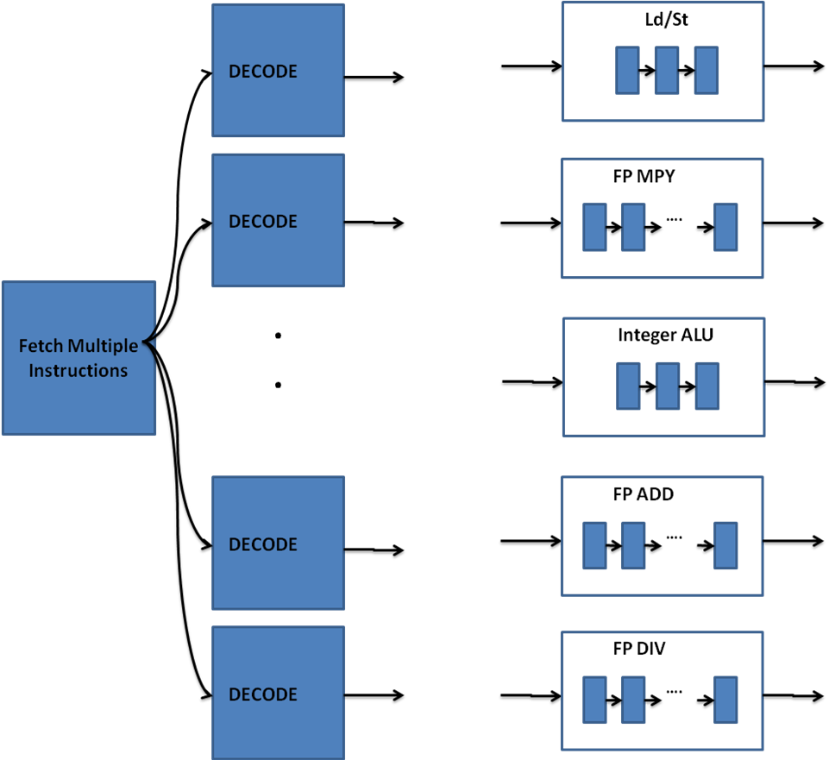
Different Pipeline Depths

Slide 58
5.15.3 Revisiting program discontinuities in the presence of out-of-order processing
External Interrupts can be handled by stopping instruction issue and allowing pipeline to drain
Exceptions and traps were problematic in early pipelined processors
Instructions following instruction causing exception or trap may have already finished and changed processor state
Known as imprecise execution
Modern processors retire instructions in program order
Potential exceptions are buffered in re-order buffer and will manifest in strictly program order.

Slide 59
5.15.4 Managing shared resources
Managing shared resources such as register files becomes more challenging with multiple functional units
Solutions
Scoreboard keeps track of all resources needed by an instruction
Tomasulo algorithm equips functional units with registers which act as surrogates to the architecture-visible registers

Slide 60
5.15.5 Power Consumption
Speeding up processors can drive designers to try and pack more smaller components onto the chip.
This can allow the clock cycle time to decrease
Unfortunately higher operational frequencies will cause power consumption to increase
Higher power consumption can also lead to thermal problems with chip operating temperatures

Slide 61
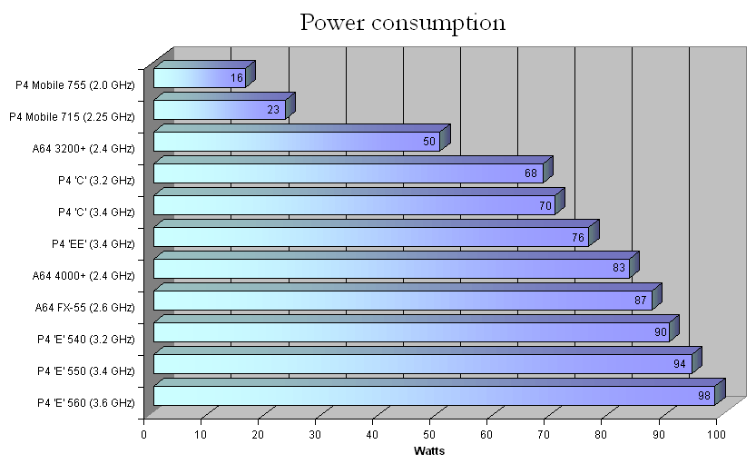
5.15.5 Power Consumption

Slide 62
5.15.6 Multi-core Processor Design
One solution to achieving higher performance without increasing power consumption and temperature beyond acceptable limits is multi-core processors
Essentially the chip has more than one processor.
Such a design is not as transparent to the programmer as instruction level parallelism and as such brings a whole new set of challenges and opportunities to effectively utilize these new chips.

Slide 63
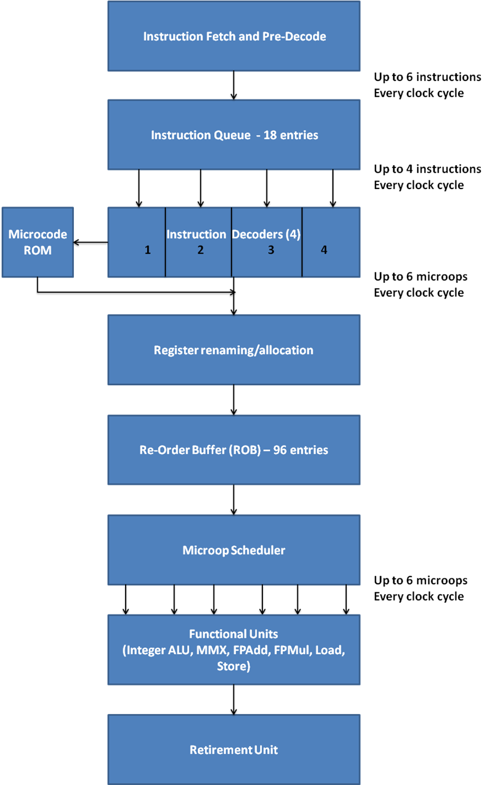
5.15.7 Intel Core Microarchitecture: An example pipeline

Slide 64
5.16 Historical Perspective
Amdahl works out basic pipelining principles for dissertation at UW-Madison in 1952
Amdahl is chief architect of IBM s/360 where pipelining is implemented originally in high end mainframe processors
Early minicomputers did not use pipelining
Killer micros did use pipelining to get needed performance advantages
Today most all processors except for very low end embedded processors use some form of pipelining

Slide 65
Questions?

