Slide 1
Artificial Neural Networks
Haider Banka
Associate Professor, Department of Computer Science & Engineering, Indian School of Mines,
Dhanbad 826004
email: banka.h.cse@ismdhanbad.ac.in

Slide 2
Agenda
AI and Soft computing
From Conventional AI to Computational Intelligence
Neural Networks
Fuzzy Set Theory
Evolutionary Computation

Slide 3
AI and Softcomputing
AI: predicate logic and symbol manipulation techniques
User
Global
Database
Inference
Engine
Question
User Interface
Explanation
Facility
KB:
Fact
rules
Response
Knowledge
Acquisition
Knowledge
Engineer
Human
Expert
Expert Systems

Slide 4
AI and Softcomputing
ANN
Learning and
adaptation
Fuzzy Set Theory
Knowledge representation
Via
Fuzzy if-then RULE
Genetic Algorithms
Systematic
Random Search

Slide 5
AI and Softcomputing
ANN
Learning and
adaptation
Fuzzy Set Theory
Knowledge representation
Via
Fuzzy if-then RULE
Genetic Algorithms
Systematic
Random Search
AI
Symbolic
Manipulation

Slide 6
What is Soft Computing?
The idea behind soft computing is to model cognitive behavior of human mind.
Soft computing is foundation of conceptual intelligence in machines.
Unlike hard computing , Soft computing is tolerant of imprecision, uncertainty, partial truth, and approximation.

Slide 7
Hard Vs Soft Computing Paradigms
Hard computing
Based on the concept of precise modeling and analyzing to yield accurate results.
Works well for simple problems, but is bound by the NP-Complete set.
Soft computing
Aims to surmount NP-complete problems.
Uses inexact methods to give useful but inexact answers to intractable problems.
Represents a significant paradigm shift in the aims of computing - a shift which reflects the human mind.
Tolerant to imprecision, uncertainty, partial truth, and approximation.
Well suited for real world problems where ideal models are not available.

Slide 8
Difference b /w Soft and Hard Computing
Hard Computing | Soft Computing
Conventional computing requires a precisely stated analytical model. | Soft computing is tolerant of imprecision.
Often requires a lot of computation time. | Can solve some real world problems in reasonably less time.
Not suited for real world problems for which ideal model is not present. | Suitable for real world problems.
It requires full truth | Can work with partial truth
It is precise and accurate | Imprecise.
High cost for solution | Low cost for solution

Slide 9
Unique Features of Soft Computing
Soft Computing is an approach for constructing systems which are
computationally intelligent,
possess human like expertise in particular domain,
can adapt to the changing environment and can learn to do better
can explain their decisions

Slide 10
Components of Soft Computing
Components of soft computing include:
Fuzzy Logic (FL)
Evolutionary Computation (EC) - based on the origin of the species
Genetic Algorithm
Swarm Intelligence
Ant Colony Optimizations
Neural Network (NN)
Machine Learning (ML)

Slide 11
Neural Networks
Artificial neural network (ANN) is a machine learning approach that models human brain and consists of a number of artificial neurons.
Neuron in ANNs tend to have fewer connections than biological neurons.
Each neuron in ANN receives a number of inputs.
An activation function is applied to these inputs which results in activation level of neuron (output value of the neuron).
Knowledge about the learning task is given in the form of examples called training examples.

Slide 12
Why Artificial Neural Networks?
(An exemplar based system without any pre-programmed instructions for problem solving)
There are two basic reasons why we are interested in building artificial neural networks (ANNs):
Technical viewpoint: Some problems such as character recognition or the prediction of future states of a system require massively parallel and adaptive processing.
Biological viewpoint: ANNs can be used to replicate and simulate components of the human (or animal) brain, thereby giving us insight into natural information processing.

Slide 13
Contd..
An Artificial Neural Network is specified by:
neuron model: the information processing unit of the NN,
an architecture: a set of neurons and links connecting neurons. Each link has a weight,
a learning algorithm: used for training the NN by modifying the weights in order to model a particular learning task correctly on the training examples.
The aim is to obtain a NN that is trained and generalizes well.
It should behaves correctly on new instances of the learning task.

Slide 14
Neuron
The neuron is the basic information processing unit of a NN. It consists of:
A set of links, describing the neuron inputs, with weights W₁, W₂, …, W_{m}
An adder function (linear combiner) for computing the weighted sum of the inputs:
(real numbers)
Activation function for limiting the amplitude of the neuron output. Here ‘b’ denotes bias.

Slide 15


Digital versus biological computers
5 distinguishing properties
speed
robustness
flexibility
adaptivity
context-sensitivity

Slide 16
BENEFITS AND LIMITATIONS OF NEURAL NETWORKS
Benefits of ANNs
Usefulness for pattern recognition, classification, generalization, abstraction and interpretation of imcomplete and noisy inputs. (e.g. handwriting recognition, image recognition, voice and speech recognition, weather forecasing).
Providing some human characteristics to problem solving that are difficult to simulate using the logical, analytical techniques of expert systems and standard software technologies. (e.g. financial applications).
Ability to solve new kinds of problems. ANNs are particularly effective at solving problems whose solutions are difficult, if not impossible, to define. This opened up a new range of decision support applications formerly either difficult or impossible to computerize.

Slide 17
Robustness. ANNs tend to be more robust than their conventional counterparts. They have the ability to cope with imcomplete or fuzzy data. ANNs can be very tolerant of faults if properly implemented.
Fast processing speed. Because they consist of a large number of massively interconnected processing units, all operating in parallel on the same problem, ANNs can potentially operate at considerable speed (when implemented on parallel processors).
Flexibility and ease of maintenaince. ANNs are very flexible in adapting their behavior to new and changing environments. They are also easier to maintain, with some having the ability to learn from experience to improve their own performance.

Slide 18
Artificial Neural Networks
An ANN can:
compute any computable function, by the appropriate selection of the network topology and weights values.
learn from experience! Specifically, by trial‐and‐error

Slide 19
Computers vs. Neural Networks
“Standard” Computers Neural Networks
one CPU highly parallel processing
fast processing units slow processing units
reliable units unreliable units
static infrastructure dynamic infrastructure

Slide 20
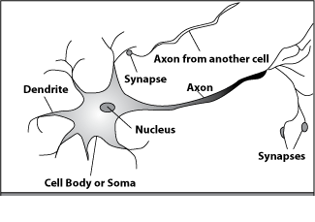
How do our brains work?
A processing element
Dendrites: Input
Cell body: Processor
Synaptic: Link
Axon: Output

Slide 21
How do our brains work?
A processing element
A neuron is connected to other neurons through about 10,000 synapses

Slide 22
How do our brains work?
A processing element
A neuron receives input from other neurons. Inputs are combined.

Slide 23
How do our brains work?
A processing element
Once input exceeds a critical level, the neuron discharges a spike ‐ an electrical pulse that travels from the body, down the axon, to the next neuron(s)

Slide 24
How do our brains work?
A processing element
The axon endings almost touch the dendrites or cell body of the next neuron.

Slide 25
How do our brains work?
A processing element
Transmission of an electrical signal from one neuron to the next is effected by neurotransmitters.

Slide 26
How do our brains work?
A processing element
Neurotransmitters are chemicals which are released from the first neuron and which bind to the
Second.

Slide 27
How do our brains work?
A processing element
This link is called a synapse. The strength of the signal that reaches the next neuron depends on factors such as the amount of neurotransmitter available.

Slide 28
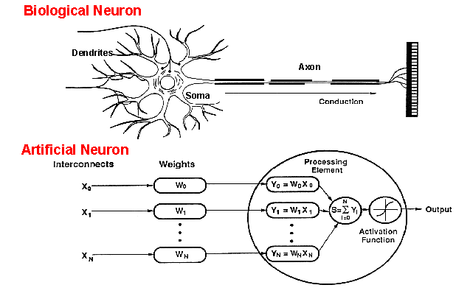
How do ANNs work?
An artificial neuron is an imitation of a human neuron

Slide 29
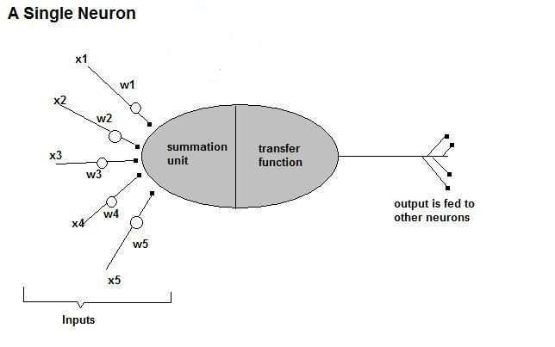
How do ANNs work?
• Now, let us have a look at the model of an artificial neuron.

Slide 30
How do ANNs work?
Input
xm
. . . . . . . . . . . .
x2
x1
Processing
∑
∑= X₁+X₂ + ….+X_{m} =y
Output
y

Slide 31

How do ANNs work?
Not all inputs are equal
xm
. . . . . . . . . . . .
x2
x1
Input
w_{m}
w₂
w₁
weights
. . . . .
Processing
∑
∑= X₁w₁+X₂w₂ + ….+X_{m}w_{m} =y
Output
y

Slide 32

How do ANNs work?
The signal is not passed down to the
next neuron verbatim
xm
. . . . . . . . . . . .
x2
x1
Input
w_{m}
w₂
w₁
weights
. . . . .
Processing
∑
Transfer Function (Activation Function)
f(v_{k})
Output
y

Slide 33
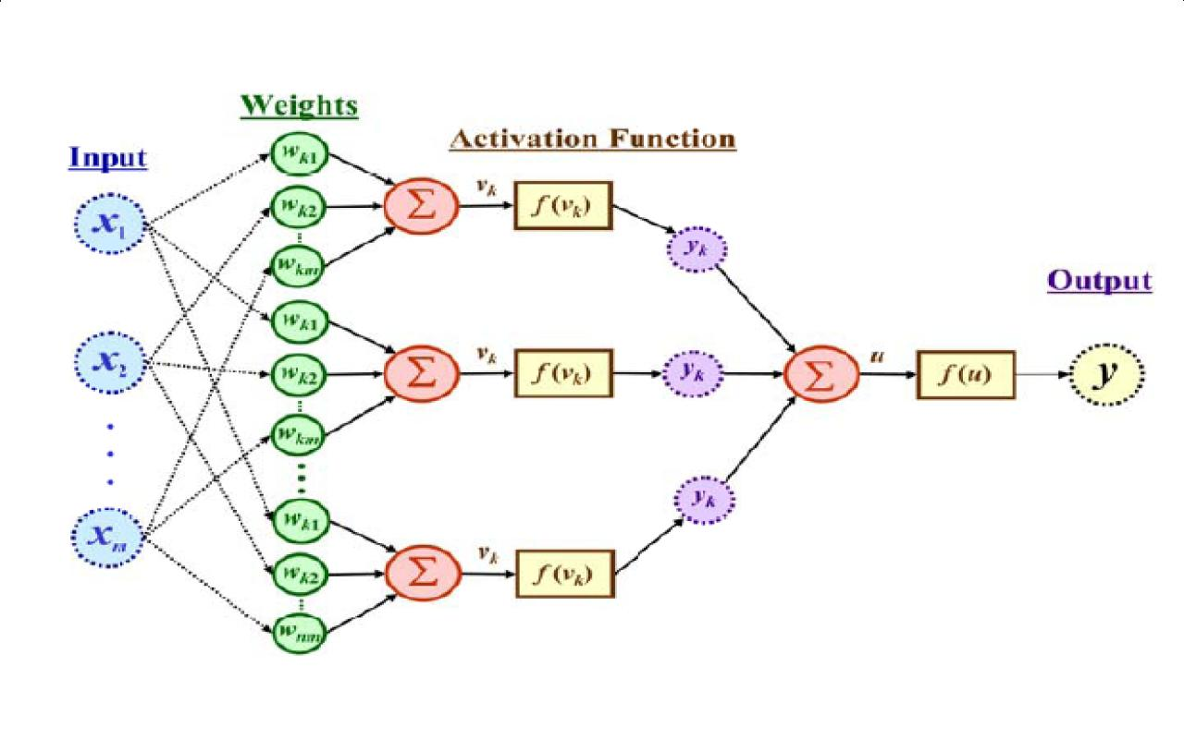
The output is a function of the input, that is affected by the weights, and the transfer functions

Slide 34
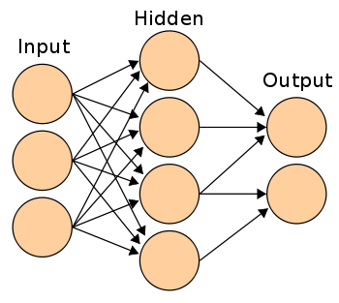
Three types of layers: Input, Hidden, and Output

Slide 35
The Neuron Diagram
Bias
b
x₁
w₁
Activation
function
Induced
Field
v
Output
y
Input
values
x₂
w₂
Summing
function
x_{m}
w_{m}
weights

Slide 36
Neuron Models
The choice of activation function determines the neuron model.
Examples:
step function:
ramp function:
sigmoid function with z,x,y parameters
Gaussian function:

Slide 37
Step Function
b
a
c

Slide 38
Ramp Function
b
a
c d

Slide 39
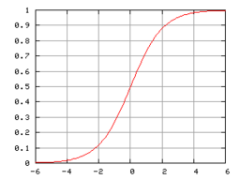
Sigmoid function

Slide 40

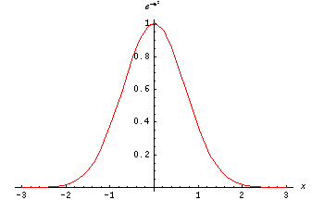
The Gaussian function is the probability function of the normal distribution. Sometimes also called the frequency curve.

Slide 41
Learning by trial‐and‐error
Continuous process of:
Trial:
Processing an input to produce an output (In terms of ANN: Compute the output function of a given input)
Evaluate:
Evaluating this output by comparing the actual output with the expected output.
Adjust:
Adjust the weights.

Slide 42
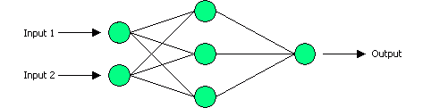
Example: XOR
Output Layer, with one neuron
Input Layer, with two neurons
Hidden Layer, with three neurons

Slide 43
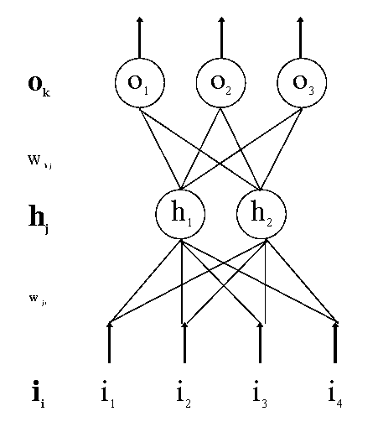
Forward and Backward Propagation

Slide 44
Decision boundaries of Perceptrons
Straight lines (surfaces), linear separable

Slide 45
Decision boundaries of MLPs
Convex areas (open or closed)

Slide 46
Decision boundaries of MLPs
Combinations of convex areas

Slide 47
Linearly Separable
-
+
+
+
+
_
+
+
+
+
+
+
+
+

Slide 48
NOT linearly Separable
+
+
_
+
+
+
OR
+
+
+

Slide 49
Problems with simple networks
y
x₂
x₁
x₁
x₂
Some kinds of data are not linearly separable
AND
OR
XOR
x₂
x₂
x₂
x₁
x₁
x₁

Slide 50
A solution: multiple layers
output layer
y
y
z₂
hidden layer
z₁
z₂
z₁
x₂
input layer
x₁
x₂
x₁

Slide 51
How it works?
Output Layer, with one neuron
Input Layer, with two neurons
Hidden Layer, with three neurons

Slide 53
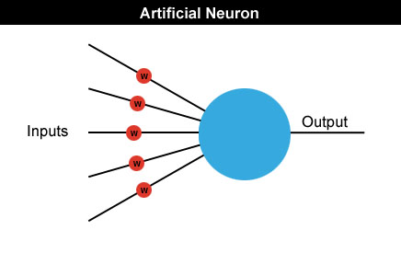
Neural networks
Neural networks are made up of many artificial neurons.
Each input into the neuron has its own weight associated with it illustrated by the red circle.
A weight is simply a floating point number and it's these we adjust when we eventually come to train the network.

Slide 54
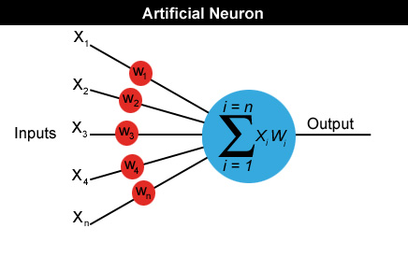
Neural networks
A neuron can have any number of inputs from one to n, where n is the total number of inputs.
The inputs may be represented therefore as x1, x2, x3… xn.
And the corresponding weights for the inputs as w1, w2, w3… wn.
Output a = x1w1+x2w2+x3w3... +xnwn

Slide 55
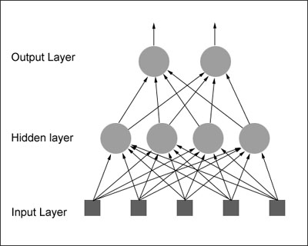
How do we actually use an artificial neuron?
feedforward network: The neurons in each layer feed their output forward to the next layer until we get the final output from the neural network.
There can be any number of hidden layers within a feedforward network.
The number of neurons can be completely arbitrary.

Slide 56

Neural Networks by an Example
let's design a neural network that will detect the number '4'.
Given a panel made up of a grid of lights which can be either on or off, we want our neural net to let us know whenever it thinks it sees the character '4'.
The panel is eight cells square and looks like this:
the neural net will have 64 inputs, each one representing a particular cell in the panel and a hidden layer consisting of a number of neurons (more on this later) all feeding their output into just one neuron in the output layer

Slide 57
Properties of architecture
No connections within a layer
No direct connections between input and output layers
Fully connected between layers
Often more than 3 layers
Number of output units need not equal number of input units
Number of hidden units per layer can be more or less than
input or output units
Each unit is a perceptron
Often include bias as an extra weight

Slide 58
What do each of the layers do?
3rd layer can generate arbitrarily complex boundaries
1st layer draws linear boundaries
2nd layer combines the boundaries

Slide 59
Limitations of ANNs
ANNs do not produce an explicit model even though new cases can be fed into it and new results obtained.
ANNs lack explanation capabilities. Justifications for results is difficults to obtain because the connection weights usually do not have obvious interpretaions.

Slide 60
7. SOME ANN APPLICATIONS
ANN application areas:
Tax form processing to identify tax fraud
Enhancing auditing by finding irregularites
Bankruptcy prediction
Customer credit scoring
Loan approvals
Credit card approval and fraud detection
Financial prediction
Energy forecasting
Computer access security (intrusion detection and classification of attacks)
Fraud detection in mobile telecommunication networks

Slide 61
Other Applications
Practical
OCR
financial time series
fraud detection
process control
marketing
speech recognition
Theoretical
cognitive modeling
biological modeling

Slide 62
Two types of learning
Supervised learning
curve fitting, surface fitting, ...
Unsupervised learning
clustering, visualisation...

Slide 63

Learning in the Perceptron
Delta learning rule
the difference between the desired output t and the actual output o, given input x
Global error E
is a function of the differences between the desired and actual outputs

Slide 64
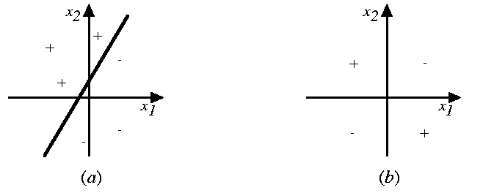
Linear decision boundaries

Slide 65
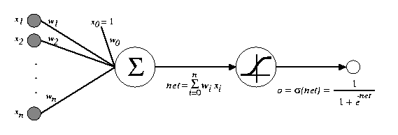
The multilayer perceptron
input
hidden
output

Slide 66
Network Architectures
Three different classes of network architectures
single-layer feed-forward
multi-layer feed-forward
recurrent
The architecture of a neural network is linked with the learning algorithm used to train

Slide 67
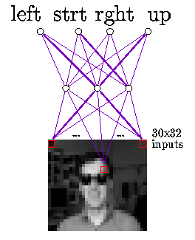
Image Recognition with the MLP

Slide 68
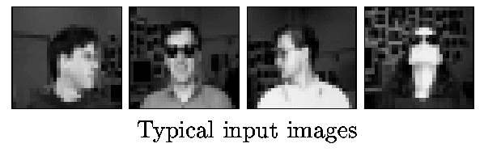

Slide 69
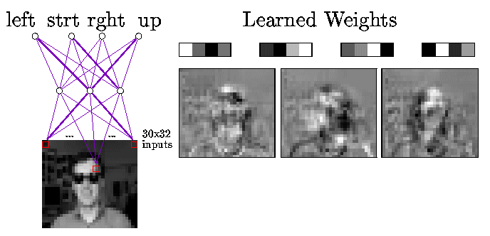
Hidden Representations

Slide 70
Design Conciderations
What transfer function should be used?
How many inputs does the network need?
How many hidden layers does the network need?
How many hidden neurons per hidden layer?
How many outputs should the network have?
There is no standard methodology to determinate these values. Even there is some heuristic points, final values are determinate by a trial and error procedure.

Slide 71
NEURAL NETWORK APPLICATION DEVELOPMENT
The development process for an ANN application has eight steps.
Step 1: (Data collection) The data to be used for the training and testing of the network are collected. Important considerations
are that the particular problem is amenable to neural network solution and that adequate data exist and can be obtained.
Step 2: (Training and testing data separation) The available data are divided into training and testing data sets.
Step 3: (Network architecture) A network architecture and a learning method are selected. Important considerations are the exact number of perceptrons and the number of layers.

Slide 72
Step 4: (Parameter tuning and weight initialization) Part of this step is initialization of the network weights and parameters, followed by modification of the parameters as training performance feedback is received.
Often, the initial values are important in determining the effectiveness and length of training.
Step 5: (Data transformation) Transforms the application data into the type and format required by the ANN.
Step 6: (Training) Training is conducted iteratively by presenting input and desired or known output data to the ANN. The ANN computes the outputs and adjusts the weights until the computed outputs are within an acceptable.

Slide 73
Step 7: (Testing) Once the training has been completed, it is necessary to test the network.
The testing examines the performance of the network using the derived weights by measuring the ability of the network to classify the testing data correctly.
Black-box testing (comparing test results to historical results) is the primary approach for verifying that inputs produce the appropriate outputs.
Step 8: (Implementation) Now a stable set of weights are obtained.
Now the network can reproduce the desired output given inputs like those in the training set.
The network is ready to use as a stand-alone system or as part of another software system where new input data will be presented to it and its output will be a recommended decision.

Slide 74
Some mathematics…

Slide 75
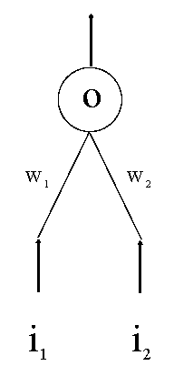
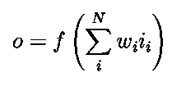
Perceptron

Slide 76

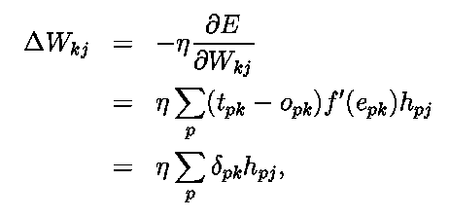
Derivation of the delta learning rule
Target output
Actual output
h = i

Slide 77


MLP

Slide 78
Sigmoid function
May also be the tanh function
(<-1,+1> instead of <0,1>)
Derivative f’(x) = f(x) [1 – f(x)]

Slide 79
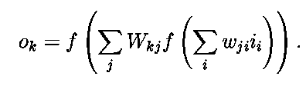


Derivation generalized delta rule

Slide 80
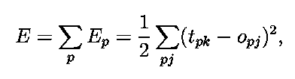
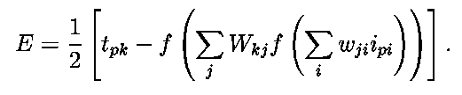
Error function (LMS)

Slide 81

Adaptation hidden-output weights

Slide 82
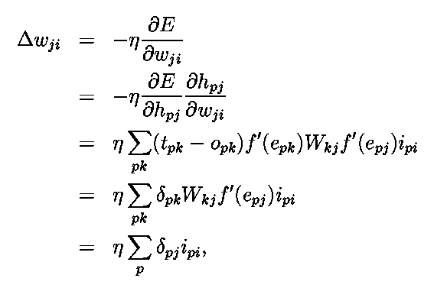

Adaptation input-hidden weights

Slide 83
The Perceptron Learning Algorithm
Example of current-best-hypothesis (CBH) search (so incremental, etc.):
Begin with a hypothesis (a perceptron)
Repeat over all examples several times
Adjust weights as examples are seen
Until all examples correctly classified or a stopping criterion reached

Slide 84
Method for Adjusting Weights
One weight update possibility:
If classification correct, don’t change
Otherwise:
If false negative, add input:
If false positive, subtract input:
Intuition: For instance, if example is positive, strengthen/increase the weights corresponding to the positive attributes of the example

Slide 85
Properties of the Algorithm
In general, also apply a learning rate
The adjustment is in the direction of minimizing error on the example
If learning rate is appropriate and the examples are linear separable, after a finite number of iterations, the algorithm converges to a linear separator

Slide 86
Training and testing data
How many examples ?
The more the merrier !
Disjoint training and testing data sets
learn from training data but evaluate performance (generalization ability) on unseen test data
Aim: minimize error on test data

Slide 87
Network parameters
How are the weights initialized?
How is the learning rate chosen?
How many hidden layers and how many neurons?
How many examples in the training set?

Slide 88
Part III: Classification Lab
Botanical Application Example: Iris Flower Classification

Slide 89
Botanical Application Example: Iris Flower Classification
3 species of Iris – SETOSA, VERSICOLOR, VIRGINICA
Each flower has parts called PETALS & SEPALS
Length and Width of sepal & petal can be used to determine iris type
Data collected on large number of iris flowers
For example, in one flower petal length=6.7mm and width=4.3mm also sepal length=22.4mm & sepal width =62.4mm. Iris type was SETOSA
Neural net will be trained to determine specie of iris for given set of petal and sepal width and length

Slide 90
Iris training and testing data:
Sepal Length | Sepal Width | Petal Length | Petal Width | Iris Class
0.224 | 0.624 | 0.067 | 0.043 | Setosa
0.749 | 0.502 | 0.627 | 0.541 | Veracolor
0.557 | 0.541 | 0.847 | 1.000 | Virginica
0.110 | 0.502 | 0.051 | 0.043 | Setosa
0.722 | 0.459 | 0.663 | 0.584 | Veracolor
0.776 | 0.416 | 0.831 | 0.831 | Virginica
0.196 | 0.667 | 0.067 | 0.043 | Setosa
0.612 | 0.333 | 0.612 | 0.584 | Veracolor
0.612 | 0.416 | 0.812 | 0.875 | Virginica
0.055 | 0.584 | 0.067 | 0.082 | Setosa
0.557 | 0.541 | 0.627 | 0.624 | Veracolor
0.165 | 0.208 | 0.592 | 0.667 | Virginica
0.027 | 0.376 | 0.067 | 0.043 | Setosa
0.639 | 0.376 | 0.612 | 0.498 | Veracolor
0.667 | 0.208 | 0.812 | 0.710 | Virginica
0.306 | 0.710 | 0.086 | 0.043 | Setosa
0.196 | 0.000 | 0.424 | 0.376 | Veracolor
0.612 | 0.502 | 0.694 | 0.792 | Virginica
0.137 | 0.416 | 0.067 | 0.000 | Setosa

Slide 91
Iris Flower Classification
Since output is non-numeric, will use a 3bit binary code to specify output
1 0 0 represents SETOSA
0 1 0 represents VERSICOLOR
0 0 1 represents VIRGINICA
Columns 1-4 rep sepal L, W and petal L, W in mmX0.01
Sample data below
0.224 0.624 0.067 0.043 1 0 0
0.749 0.502 0.627 0.541 0 1 0
0.557 0.541 0.847 1 0 0 1
0.11 0.502 0.051 0.043 1 0 0
0.722 0.459 0.663 0.584 0 1 0
0.776 0.416 0.831 0.831 0 0 1
0.196 0.667 0.067 0.043 1 0 0

Slide 92
Let's Train & test
Neural net !

Slide 93
Conceptually: Forward Activity - Backward Error

Slide 94
Forward Propagation of Activity
Step 1: Initialise weights at random, choose a learning rate η
Until network is trained:
For each training example i.e. input pattern and target output(s):
Step 2: Do forward pass through net (with fixed weights) to produce output(s)
i.e., in Forward Direction, layer by layer:
Inputs applied
Multiplied by weights
Summed
‘Squashed’ by sigmoid activation function
Output passed to each neuron in next layer
Repeat above until network output(s) produced

Slide 95
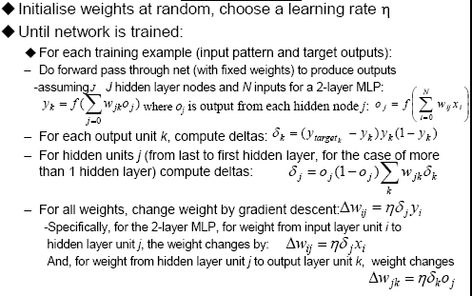
‘Back-prop’ algorithm summary (with Maths!) (Not Examinable)

Slide 96
‘Back-prop’ algorithm summary (with NO Maths!)

Slide 97
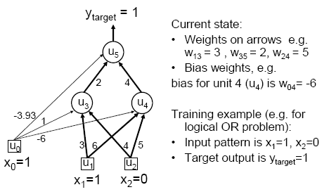
MLP/BP: A worked example

Slide 98
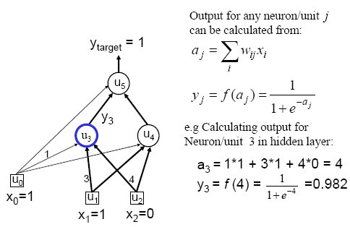
Worked example: Forward Pass

Slide 99
Worked example: Forward Pass

Slide 100
Worked example: Backward Pass

Slide 101
Worked example: Update Weights Using Generalized Delta Rule (BP)

Slide 102
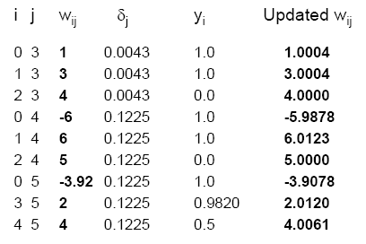
Similarly for the all weights wij:

Slide 103
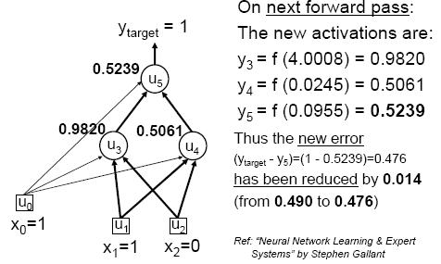
Verification that it works

Slide 104
Training
This was a single iteration of back-prop
Training requires many iterations with many training examples or epochs (one epoch is entire presentation of complete training set)
It can be slow !
Note that computation in MLP is local (with respect to each neuron)
Parallel computation implementation is also possible

Slide 105
AI and Softcomputing
cat
Animal?
cat
cut
Neural character
recognition
knowledge

Slide 106
Fuzzy Sets Theory
What is fuzzy thinking
Experts rely on common sense when they solve the problems
How can we represent expert knowledge that uses vague and ambiguous terms in a computer
Fuzzy logic is not logic that is fuzzy but logic that is used to describe the fuzziness. Fuzzy logic is the theory of fuzzy sets, set that calibrate the vagueness.
Fuzzy logic is based on the idea that all things admit of degrees. Temperature, height, speed, distance, beauty – all come on a sliding scale.
Jim is tall guy
It is really very hot today

Slide 107
Fuzzy Set Theory
Communication of “fuzzy “ idea
This box is too heavy..
Therefore, we need a lighter one…

Slide 108
Fuzzy Sets Theory
Boolean logic
Uses sharp distinctions. It forces us to draw a line between a members of class and non members.
Fuzzy logic
Reflects how people think. It attempt to model our senses of words, our decision making and our common sense -> more human and intelligent systems

Slide 109

Fuzzy Sets Theory
Prof. Lotfi Zadeh

Slide 110
Fuzzy Sets Theory
Classical Set vs Fuzzy set
No | Name | Height (cm) | Degree of Membership of “tall men”
 |  |  | Crisp | Fuzzy
1 | Boy | 206 | 1 | 1
2 | Martin | 190 | 1 | 1
3 | Dewanto | 175 | 0 | 0.8
4 | Joko | 160 | 0 | 0.7
5 | Kom | 155 | 0 | 0.4

Slide 111
Fuzzy Sets Theory
Classical Set vs Fuzzy set
Membership value
Membership value
1
1
0
0
175
Height(cm)
175
Height(cm)
Universe of discourse

Slide 112
Fuzzy Sets Theory
Classical Set vs Fuzzy set
Let X be the universe of discourse and its elements be denoted as x.
In the classical set theory, crisp set A of X is defined as function f_{A}(x) called the
the characteristic function of A
In the fuzzy theory, fuzzy set A of universe of discourse X is defined by function
called the membership function of set A

Slide 113
Fuzzy Sets Theory
Membership function

Slide 114
Fuzzy Sets Theory
Fuzzy Expert Systems
Kecepatan (KM)
Jarak (JM)
Posisi Pedal Rem (PPR)

Slide 115
Evolutionary Computation -EC
General term for several computational techniques inspired by biological evolution
Mostly involve meta-heuristic optimization algorithms such as:
Evolutionary algorithms
comprising genetic algorithms, evolutionary programming, etc)
Swarm intelligence
comprising ant colony optimization and particle swarm optimization)

Slide 116
Advantages of EC
Conceptual Simplicity
Broad Applicability
Hybridization with Other Methods
Parallelism
Robust to Dynamic Changes
Solves Problems that have no Solutions

Slide 117
Genetic Algorithms
Genetic algorithms are inspired by Darwin's theory of natural evolution.
In the natural world, organisms that are poorly suited for an environment die off, while those well-suited, prosper.
Genetic algorithms search the space of individuals for good candidates.
The chance of an individual's being selected is proportional to the amount by which its fitness is greater or less than its competitors' fitness.

Slide 118
Contd..
Algorithm begins with a set of initial solutions (represented by set of chromosomes) called population.
A chromosome is a string of elements called genes.
Solutions from one population are taken and are used to form a new population by generating offsprings.
New population is formed using old population and offspring based on their fitness value.
Promising candidates are kept and allowed to reproduce
This is motivated by a hope, that the new population will be better than the old one.
Genetic algorithms are broadly applicable and have the advantage that they require little knowledge encoded in the system.

Slide 119
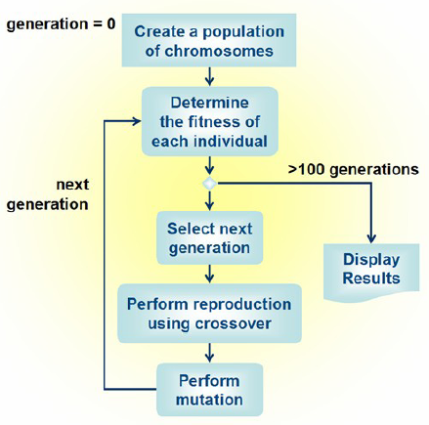

Slide 120
Outline of the Basic Genetic Algorithm
[Start] Generate random population of n chromosomes (suitable solutions for the problem).
[Fitness] Evaluate the fitness f(x) of each chromosome x in the population.
Repeat until terminating condition is satisfied
[Selection] Select two parent chromosomes from a population according to their fitness (the better fitness, the bigger chance to be selected).
[Crossover] Crossover the parents to form new offsprings (children). If no crossover was performed, offspring is the exact copy of parents.
[Mutation] Mutate new offspring at selected position(s) in chromosome).
[Accepting] Generate new population by placing new offsprings.
Return the best solution in current population

Slide 121
Issues involved
How to create chromosomes and what type of encoding to choose?
How to perform Crossover and Mutation, the two basic operators of GA?
How to select parents for crossover?

Slide 122
Termination of Loop
Reaching some (known/hoped for) fitness.
Reaching some maximum allowed number of generations.
Reaching some minimum level of diversity.
Reaching some specified number of generations without fitness improvement.

Slide 123
Advantages and Disadvantages of GA
Applicable when little knowledge is encoded in the system.
Effective way of finding a reasonable solution to a complex problem quickly.
NP-complete problems can be solved in efficient way.
Parallelism and easy implementation is an advantage.
However, they give very poor performance on some problems as might be expected from knowledge-poor approaches.

Slide 124
Criteria for GA Approaches
Completeness: Any solution should have its encoding
Non redundancy: Codes and solutions should correspond one to one
Soundness: Any code (produced by genetic operators) should have its corresponding solution
Characteristic perseverance: Offspring should inherit useful characteristics from parents.

Slide 125
Contd…
The following questions need to be answered:
How to create chromosomes and what type of encoding to choose?
How to perform Crossover and Mutation, the two basic operators of GA?
How to select parents for crossover?
Representation of GA : Binary strings
Recombination operator : N-point or uniform
Mutation operator :Bitwise bit-flipping with fixed probability
Parent selection: Fitness-Proportionate
Survivor selection: All children replace parents
Emphasis on crossover
Speciality:

Slide 126
Evaluation (Fitness) Function
Represents the requirements that the population should adapt to
quality function or objective function
The fitness is calculated by first decoding the chromosome and then the evaluating the objective function.
Fitness function is and indicator of how close the chromosome is to the optimal solution
Typically we talk about fitness being maximised
Some problems may be best posed as minimisation problems, but conversion is trivial

Slide 127
Parent Selection Mechanism
Depending on their finesses -Assigns variable probabilities of individuals acting as parents
Usually probabilistic
high quality solutions more likely to become parents than low quality
but not guaranteed
even the worst in current population usually has non-zero probability of becoming a parent
This stochastic nature can aid escape from local optima

Slide 128
Survivor Selection-Replacement
Most EAs use fixed population size so need a way of going from (parents + offspring) to next generation
Often deterministic
Fitness based : e.g., rank parents + offspring and take best
Age based: make as many offspring as parents and delete all parents
Sometimes do combination of above two

Slide 129
Advantages and Disadvantages of GA
Applicable when little knowledge is encoded in the system.
Effective way of finding a reasonable solution to a complex problem quickly.
NP-complete problems can be solved in efficient way.
Parallelism and easy implementation is an advantage.
However, they give very poor performance on some problems as might be expected from knowledge-poor approaches.

Slide 130
Contd..
There are NP-complete problems that can not be solved algorithmically in efficient way.
NP stands for nondeterministic polynomial and it means that it is possible to guess the solution and then check it in polynomial time.
If we have some mechanism to guess a solution, then we would be able to find a solution in some reasonable or polynomial time .
The characteristic for NP-problems is that algorithm is usually O(2^{n}) and it is not usable when n is large.
For such problems, GA works well.
But the disadvantage of GAs is in their computational time.

Slide 131
They can be slower than some other methods.
Some of the problems are listed below
Choosing encoding and fitness function can be difficult.
GAs may have a tendency to converge towards local optima or even arbitrary points rather than the global optimum in many problems..
GAs cannot effectively solve problems in which the only fitness measure is right/wrong, as there is no way to converge on the solution.
In these cases, a random search may find a solution as quickly as a GA.

Slide 132
GA Applications
Control
Design
Scheduling
Robotics
Machine Learning
Signal Processing
Game Playing
Combinatorial Optimization

Slide 133
More Specific Applications of GA
TSP and sequence scheduling
Finding shape of protein molecules
Strategy planning
Nonlinear dynamical systems - predicting, data analysis
Designing neural networks, both architecture and weights
Evolving LISP programs (genetic programming)

